Slide 1
South Sudan Conflict
How does the intensity of conflict affect population displacement?

Slide 2
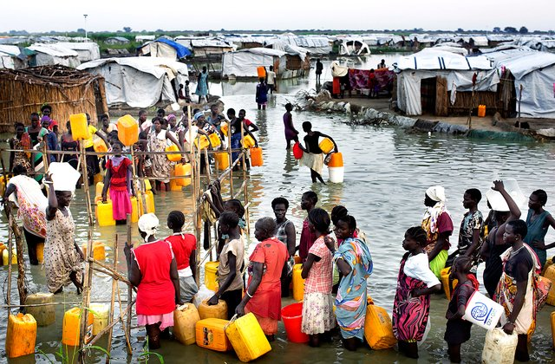
Introduction
War causes great tragedy and upheaval
Numerous conflicts around the world
Sudan has seen continuous conflict since it gained independence in 1956
South Sudan gained independence in 2011
South Sudan had a civil war from 2013 through 2015 that led to the displacement of over 1.5 ml as of Jan 30, 2015

Slide 3
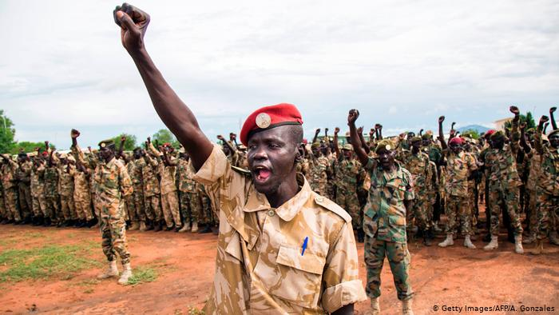
Project Question
How did the intensity of military conflict influence the South Sudanese populations to be displaced from their homes during the December 2013 through December 2015 time period?

Slide 4
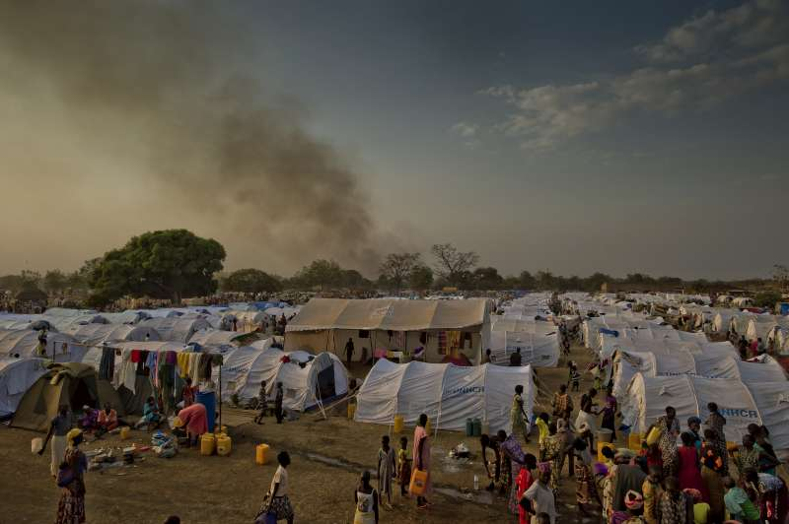
Experimental Design
Outcome Variable - Percent of Population Displaced by Region
Treatment Variable - Intensity of the Conflict (Fatalities per 10,000 per Region)
Potential variation in treatment effect:
Socioeconomic (market, food security)
Access to Health care and other facilities
Tribal ties
Military equipment used/capabilities
Climate, etc.

Slide 5
Ideal Experiment
Ideal Experiment -
Break a country into four equal regions by all metrics
geographic
access to food
water, shelter
tribal/ethnic ties
Military equipment used
Each region has a different intensity of conflict (no conflict, low, medium, and high)
Evaluate how metrics and intensity of conflict affect population movement

Slide 6
Project Design
Collect Demographic, conflict and emigration/IDP Data from numerous sources
Join and aggregate at the Regional/Month Level
Determine a cutoff for high-conflict (experimental) and low-conflict regions (control)
Perform a difference and difference analysis on the experimental/control groups

Slide 7
Project Design (cont.)

Slide 8
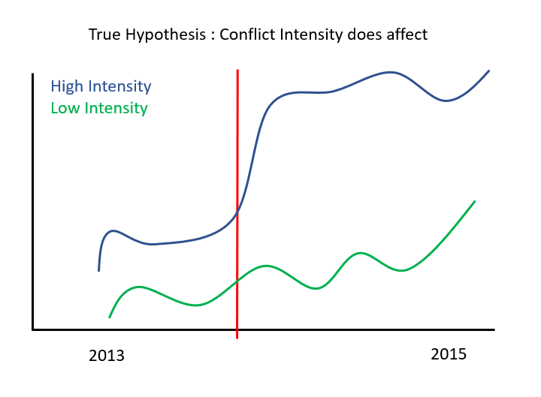
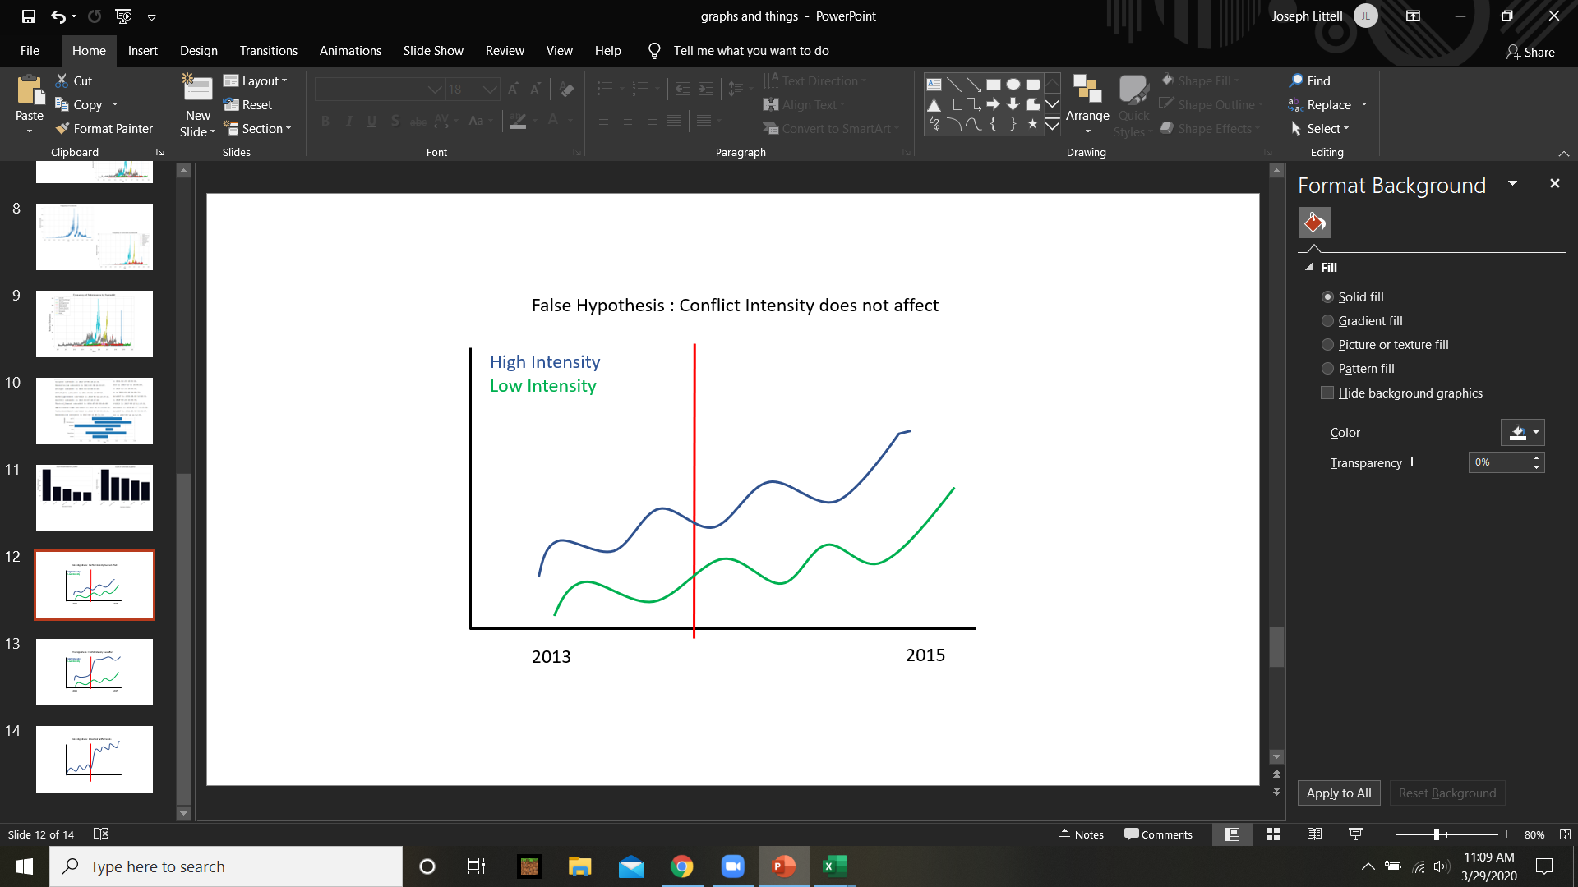
Model Results

