Slide 1
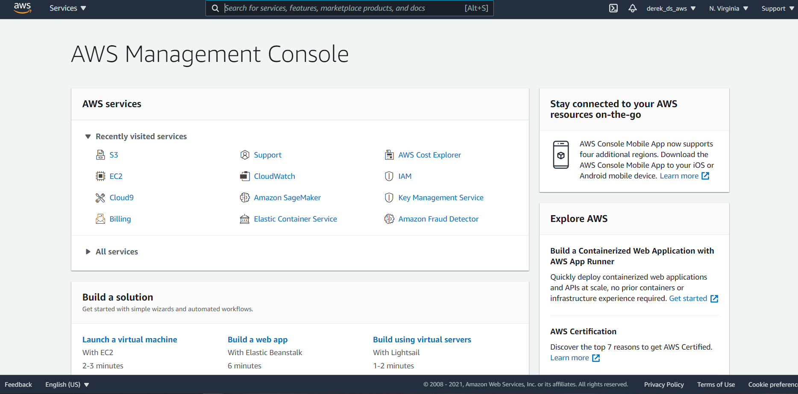
Select Fraud Detector

Slide 2
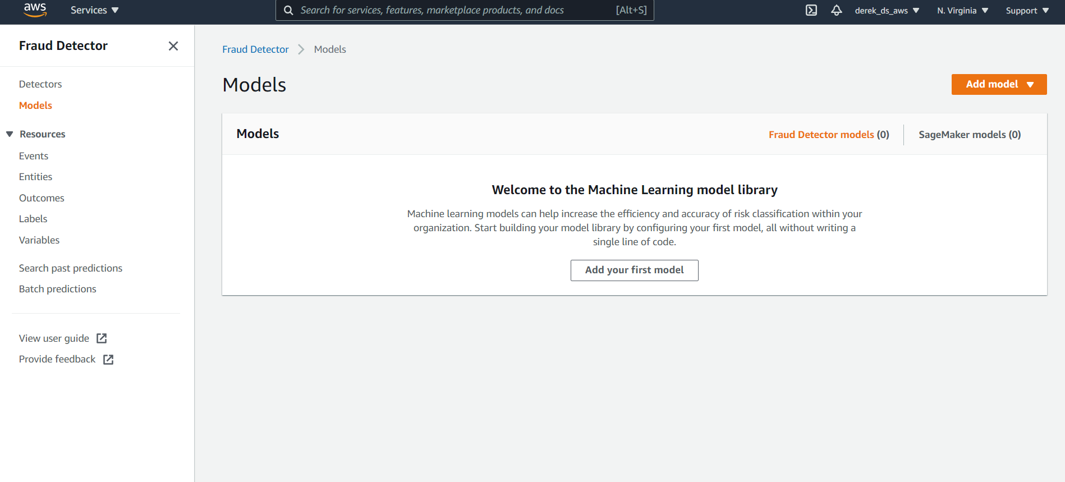
Click Add Model

Slide 3
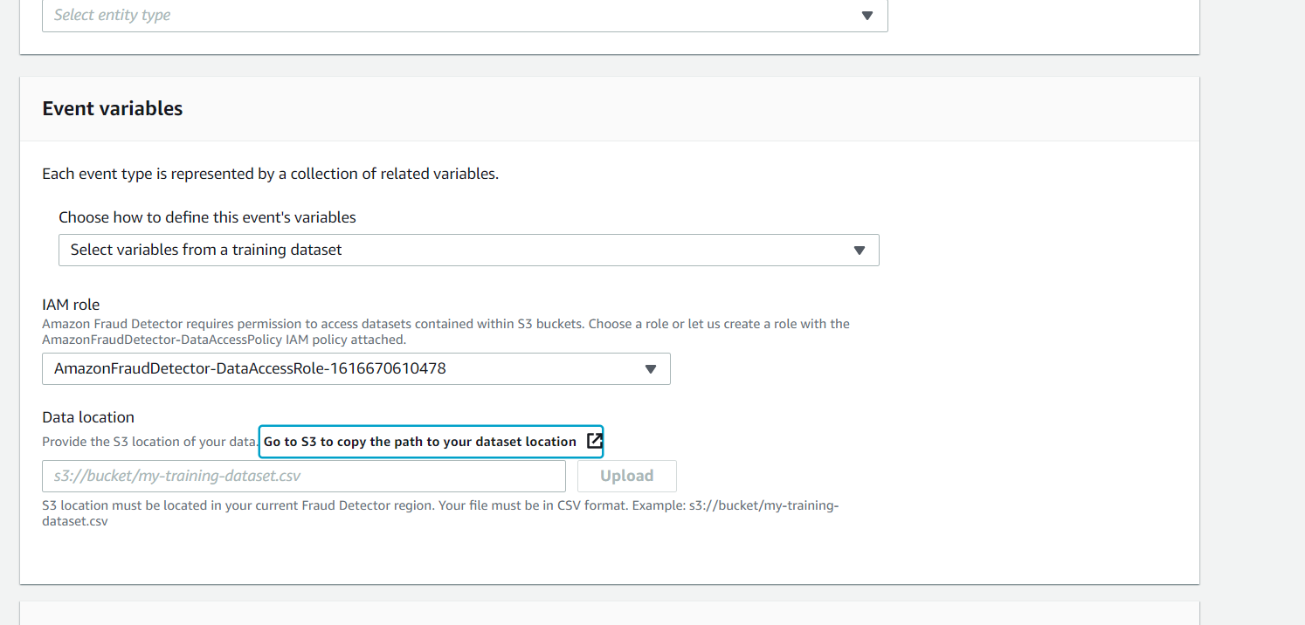
Go to S3 to upload dataset, no spaces or caps

Slide 4
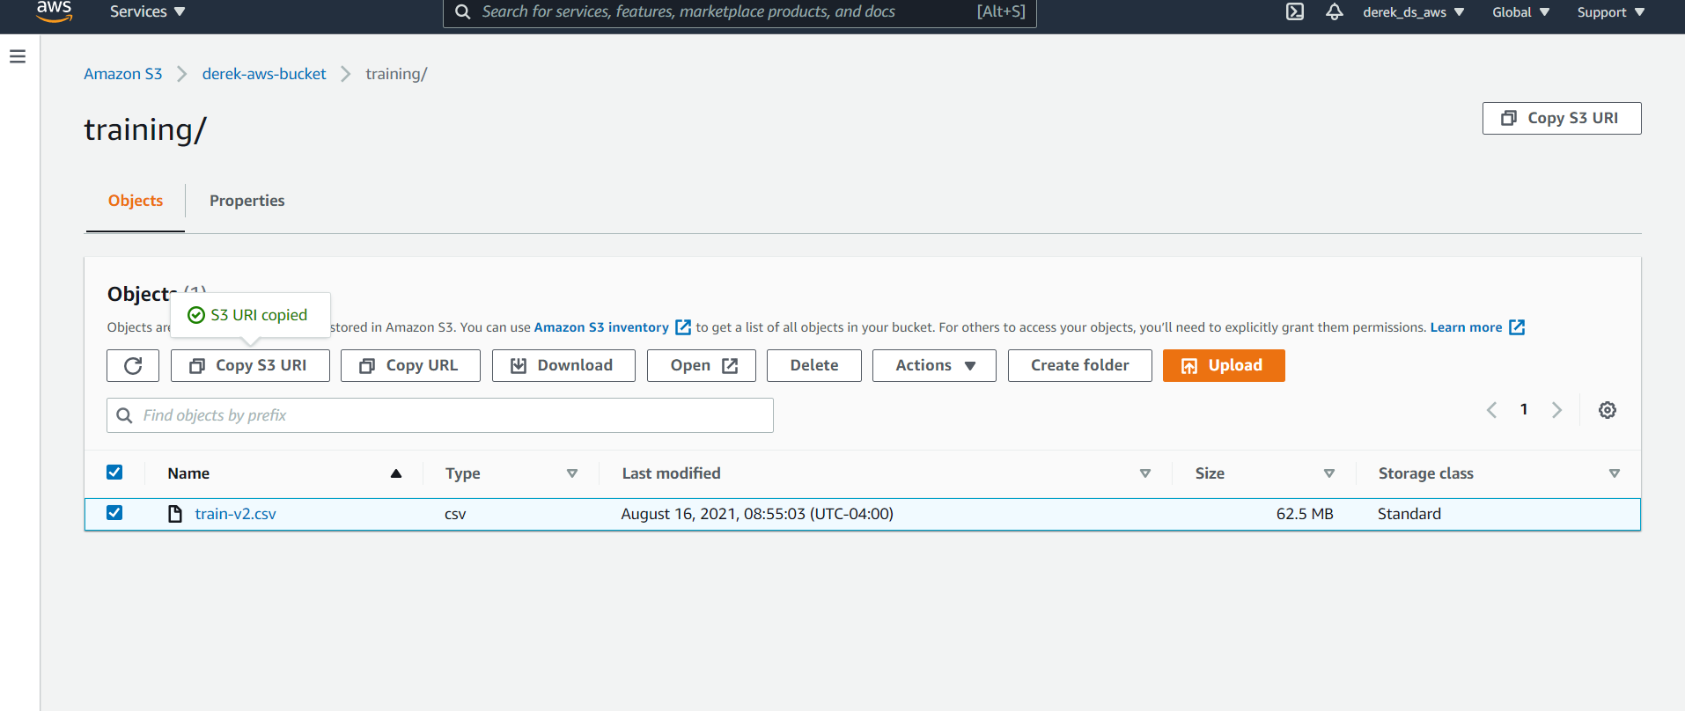
Upload and copy URI

Slide 5
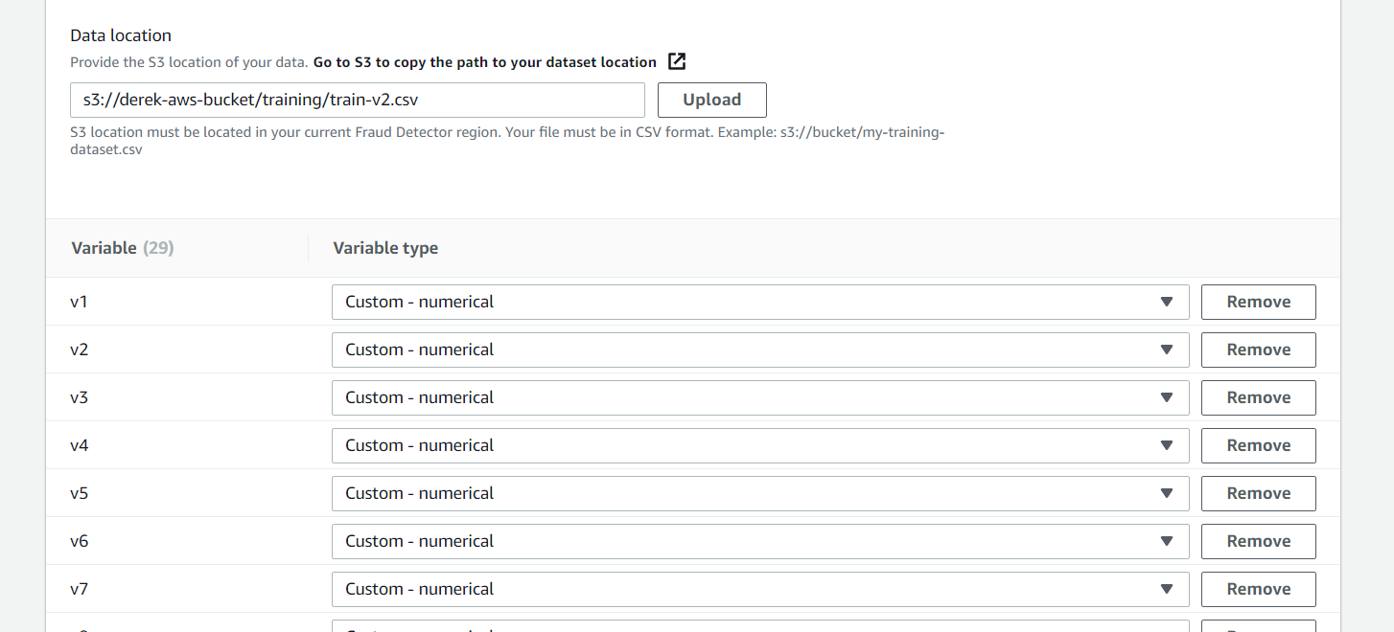
Upload and categorize variable types and you have to create labels (I used fraud and legit

Slide 6
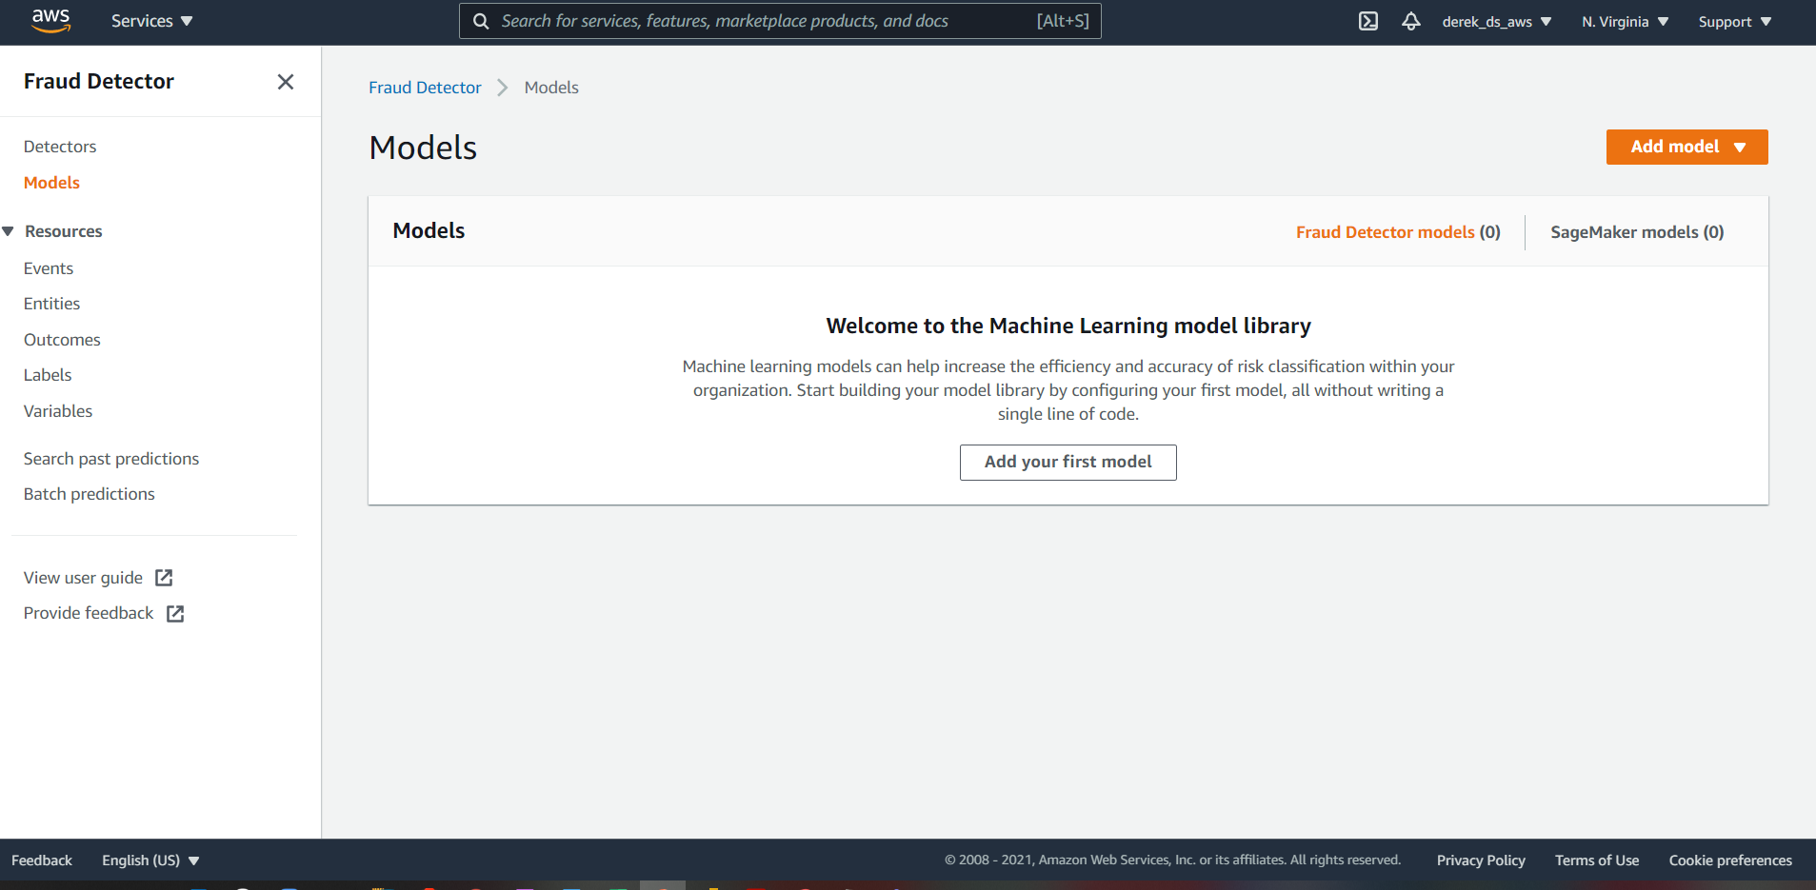
Select models

Slide 7
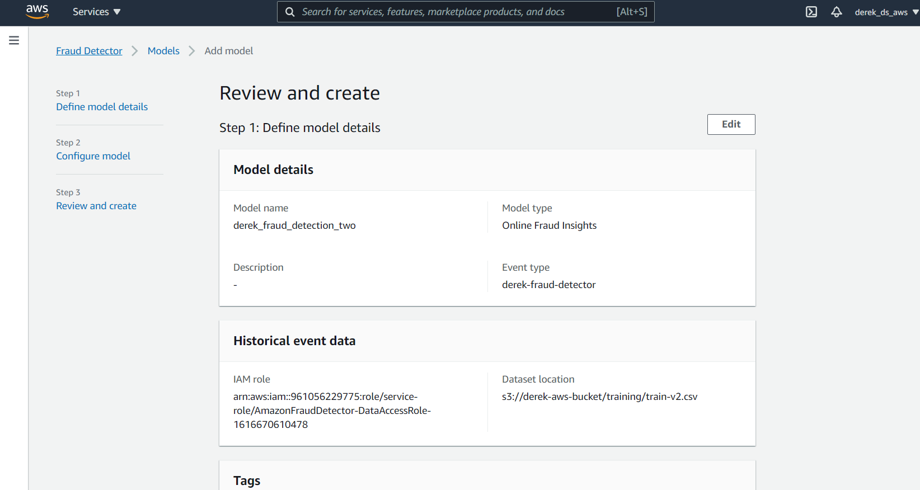
Click through the steps to start training

Slide 8
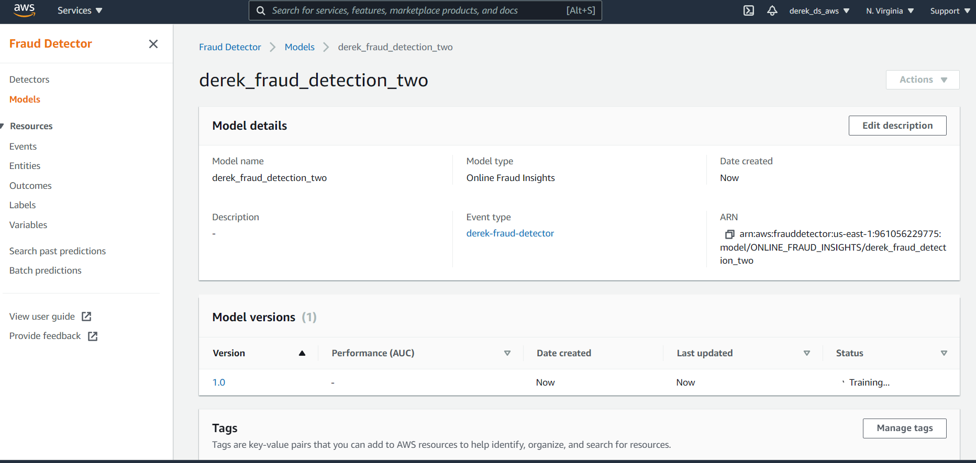
The model will start training

Slide 9
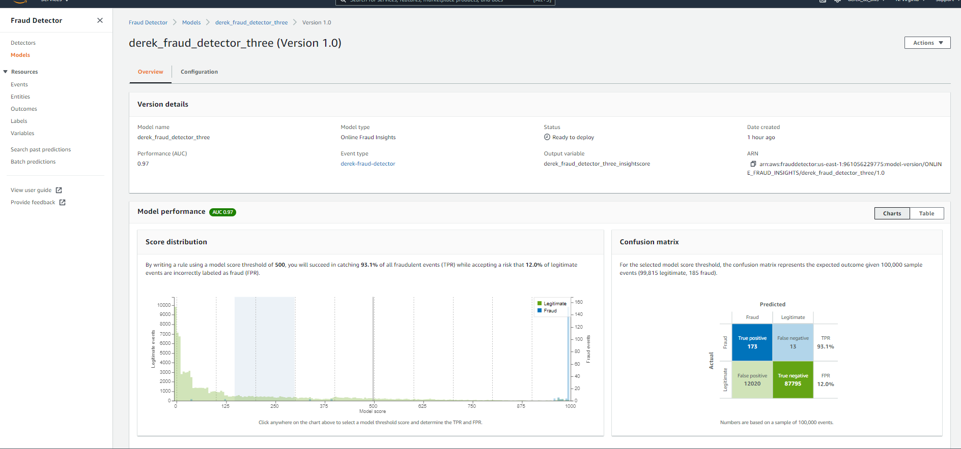
Model Output

