Slide 1
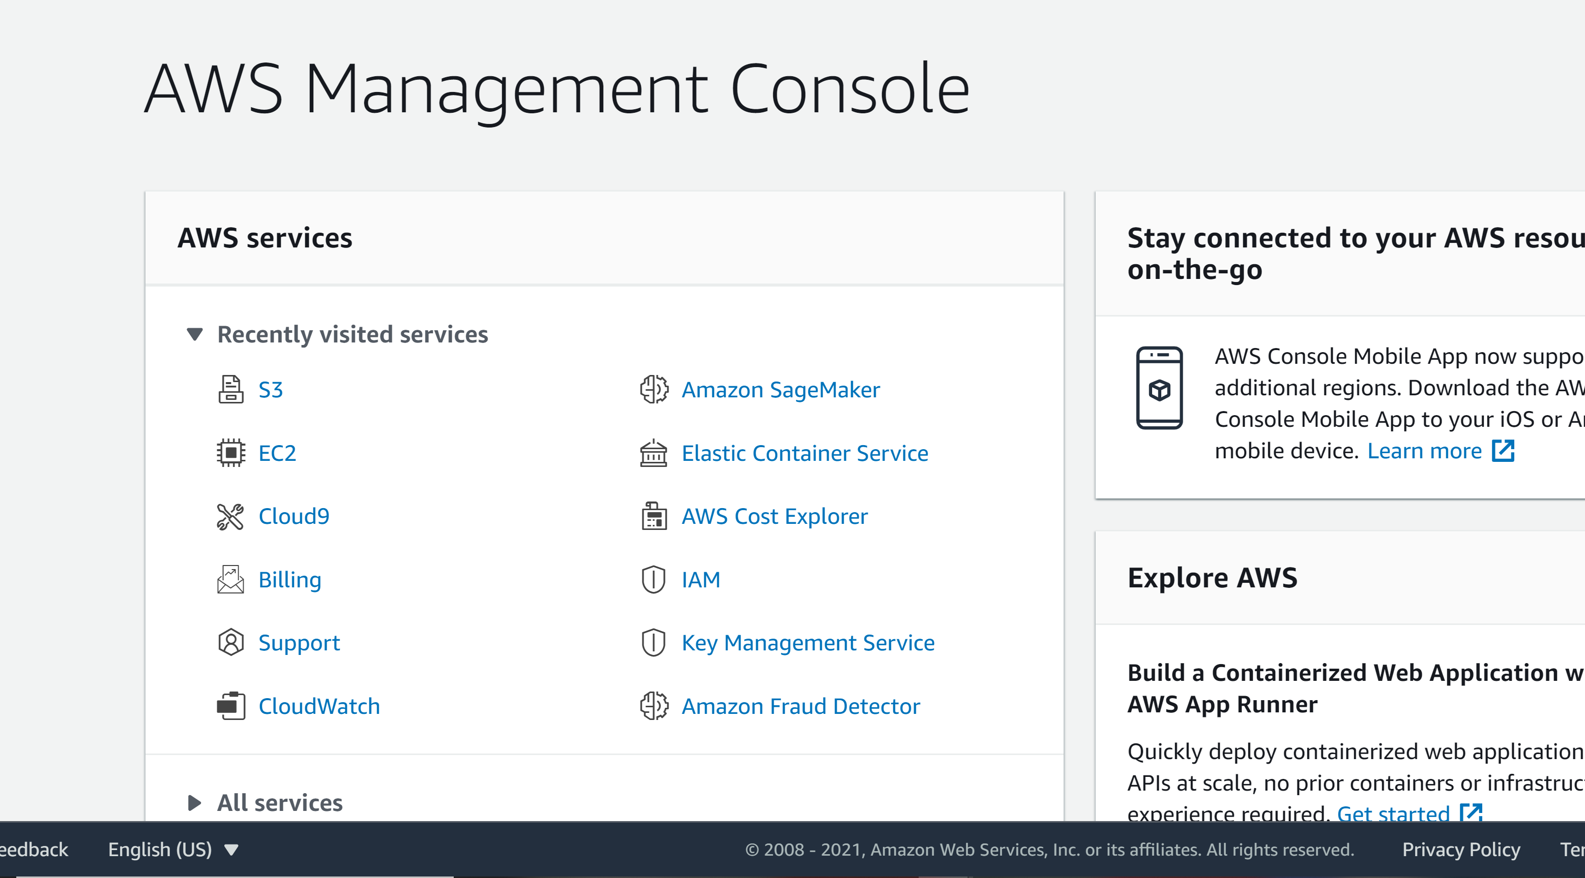
Select S3

Slide 2
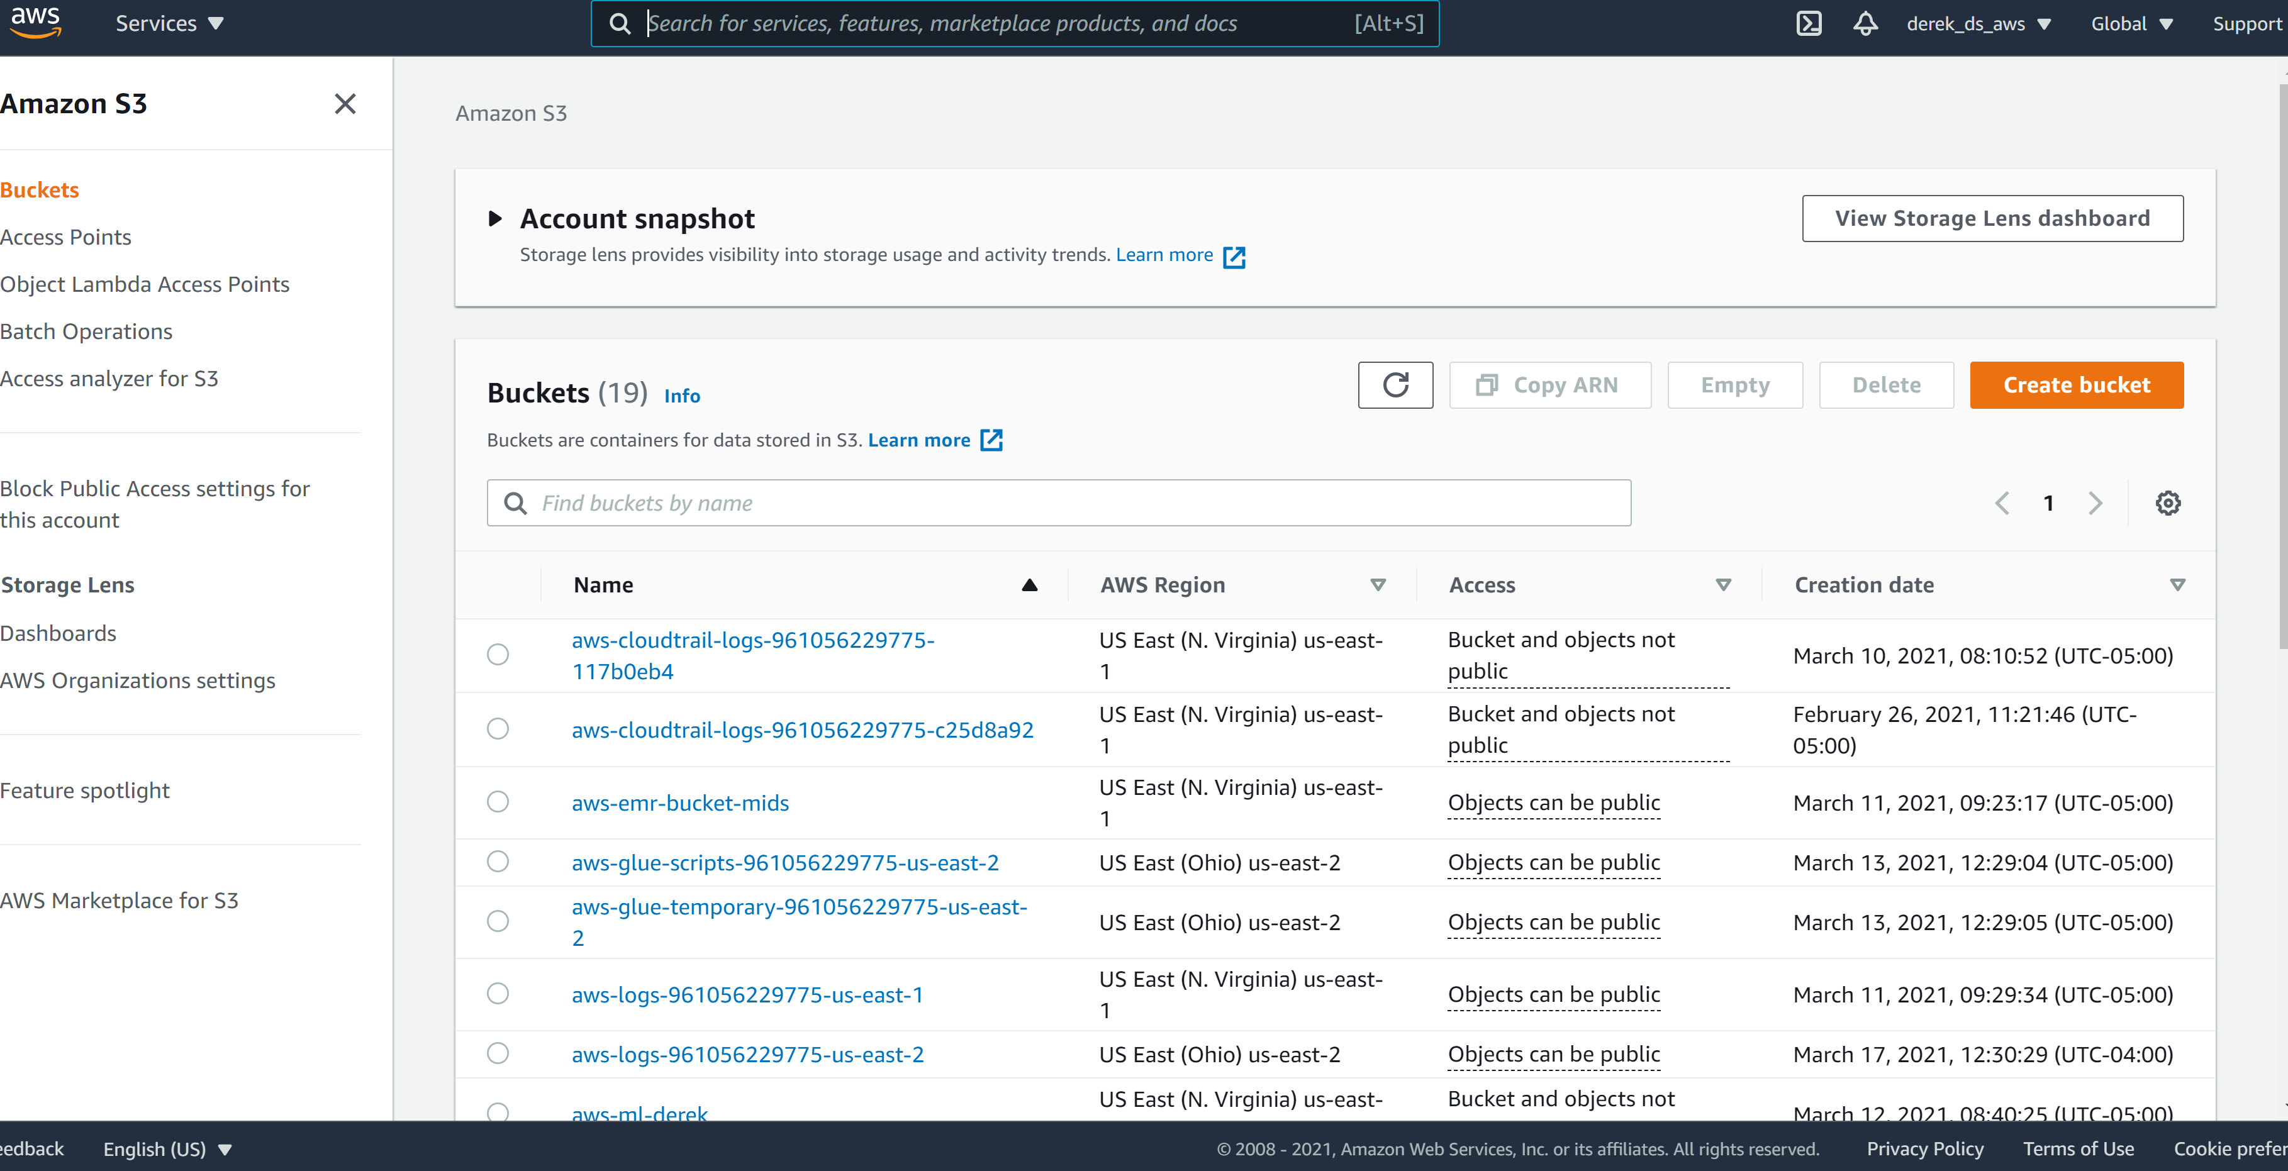
Create Bucket

Slide 3
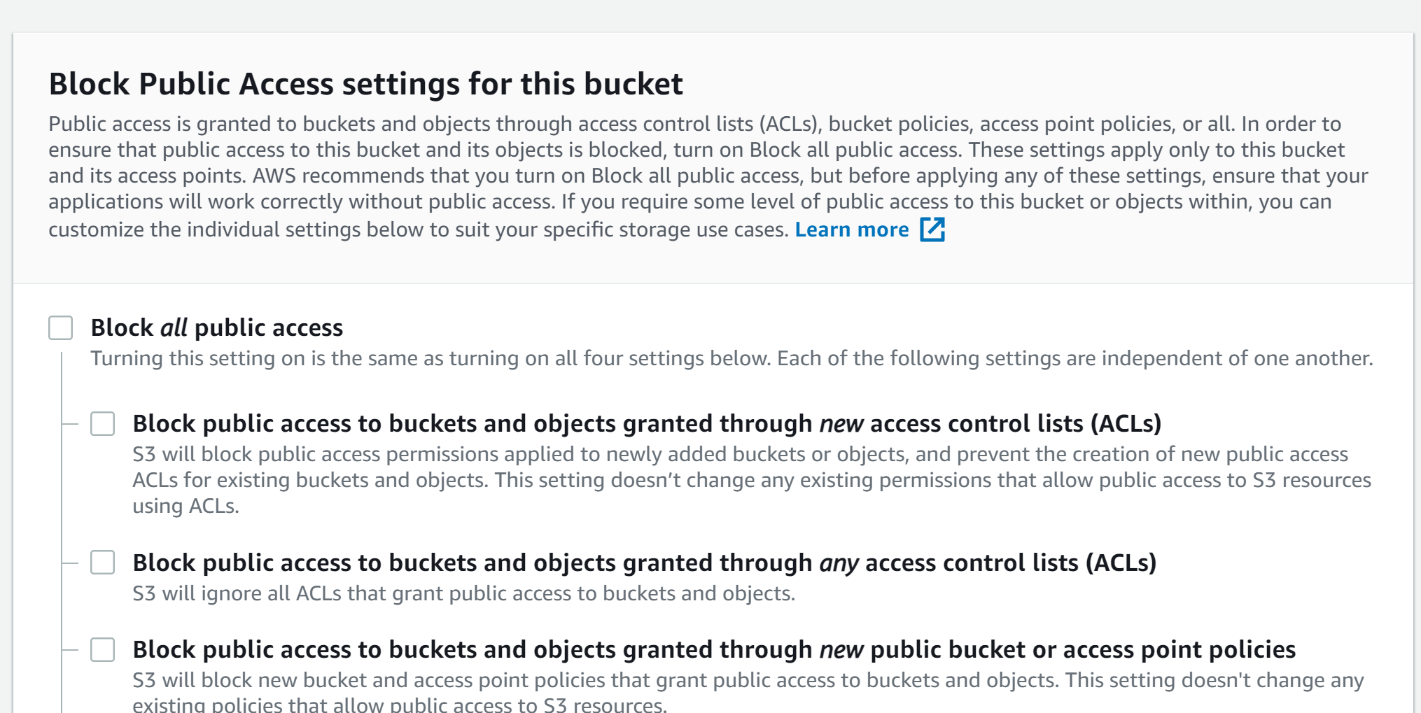
Allow public access

Slide 4
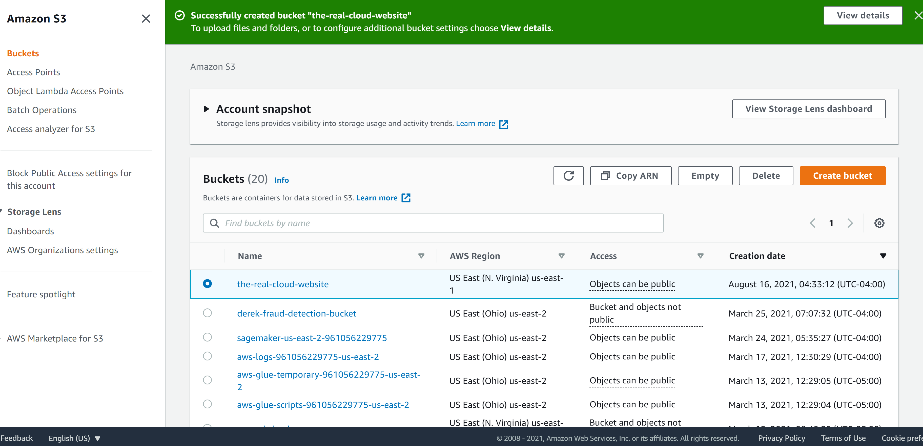
Select the Bucket You Created

Slide 5
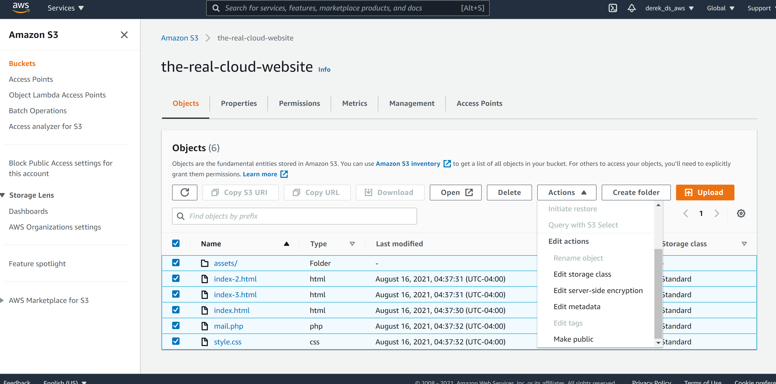
Upload Files
Make the
uploads public

Slide 6
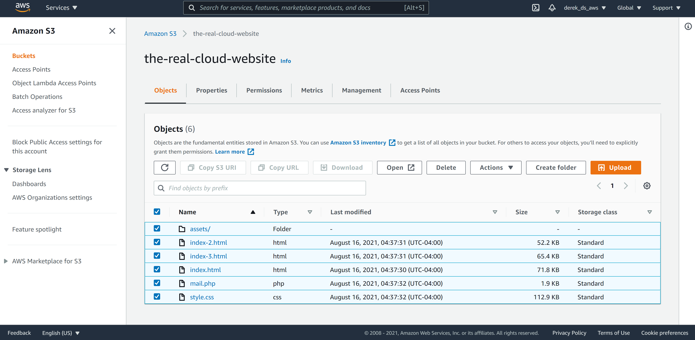
Select
Properties
Notes:
Properties

Slide 7
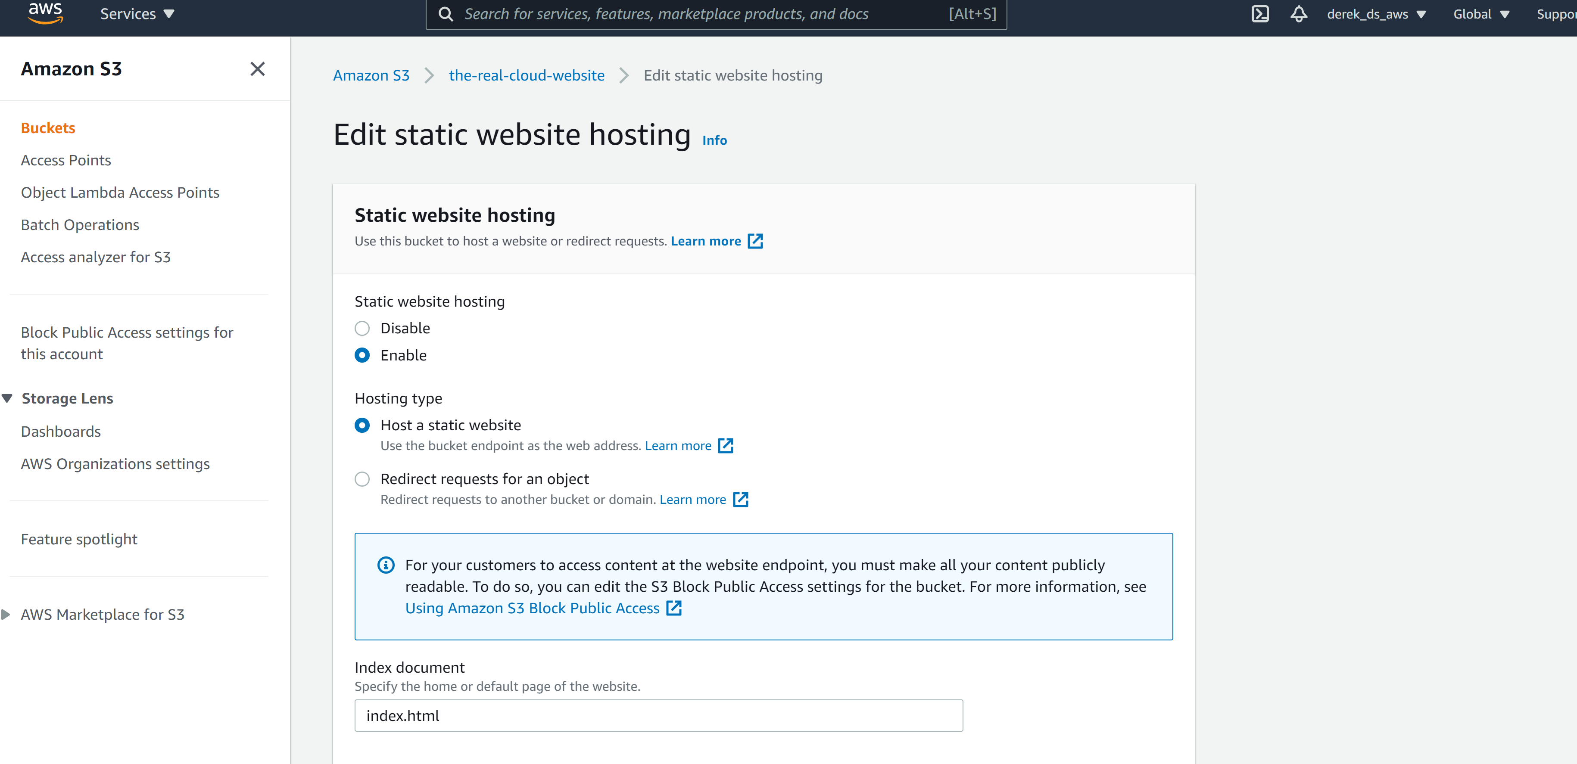
Enable static web hosting

Slide 8
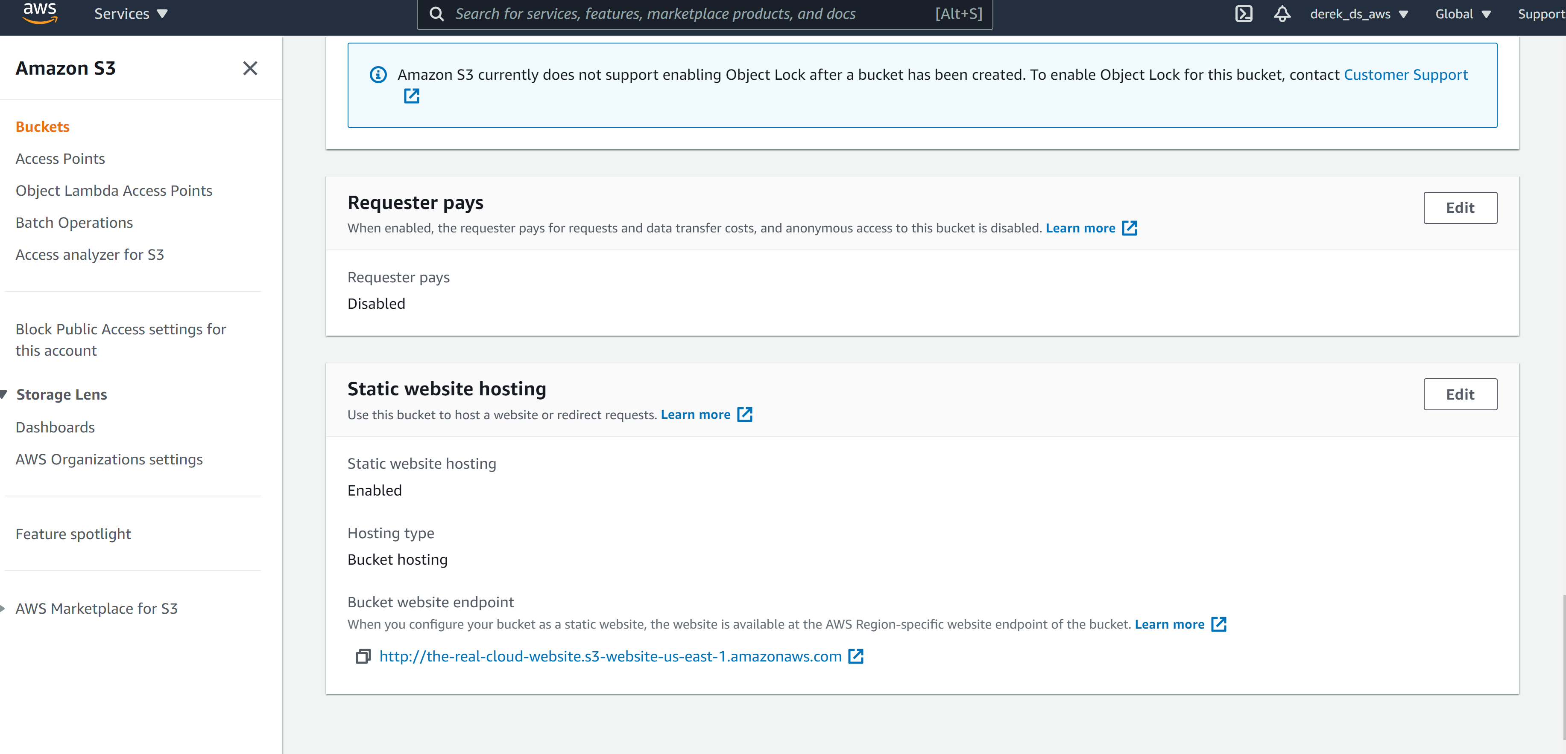
Website URL

