Slide 1
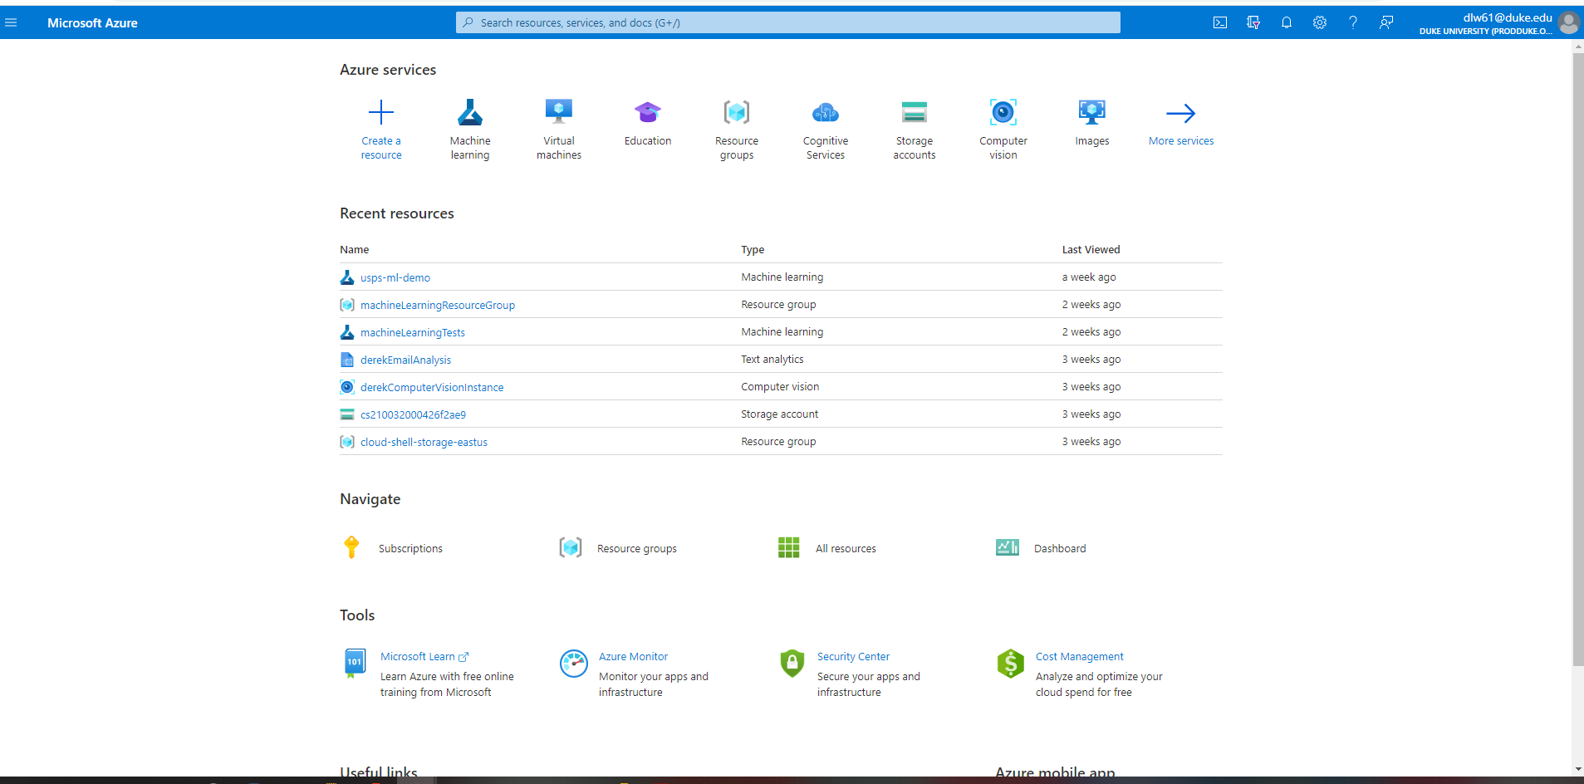
Select or Search Machine Learning

Slide 2
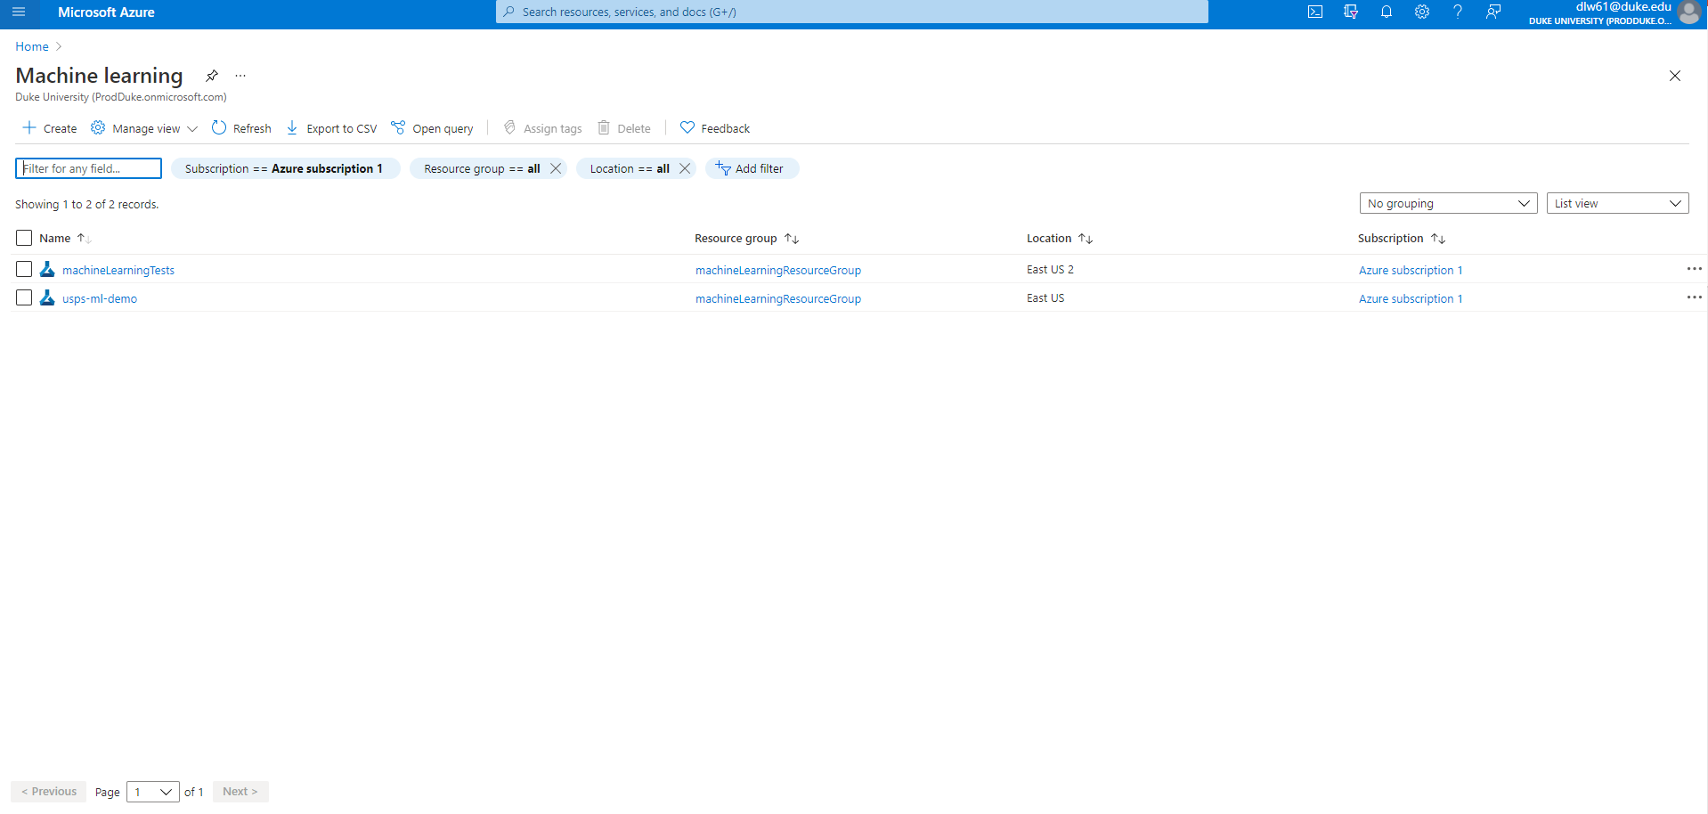
Select Create

Slide 3
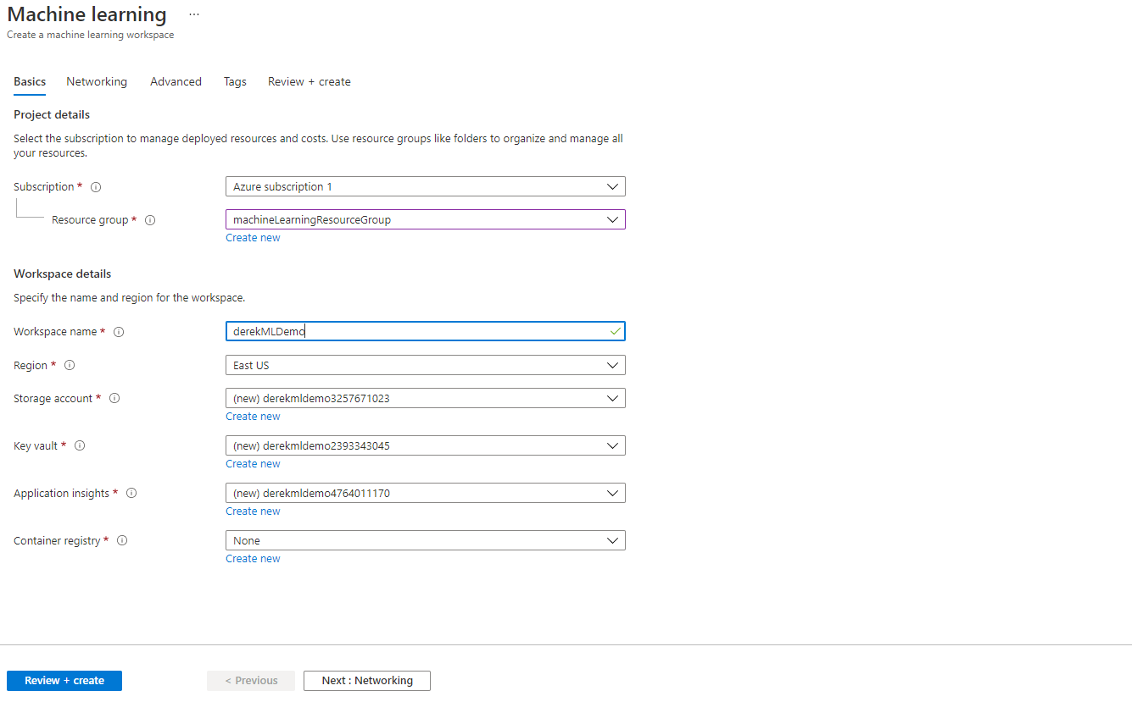
Choose Setting and Create

Slide 4
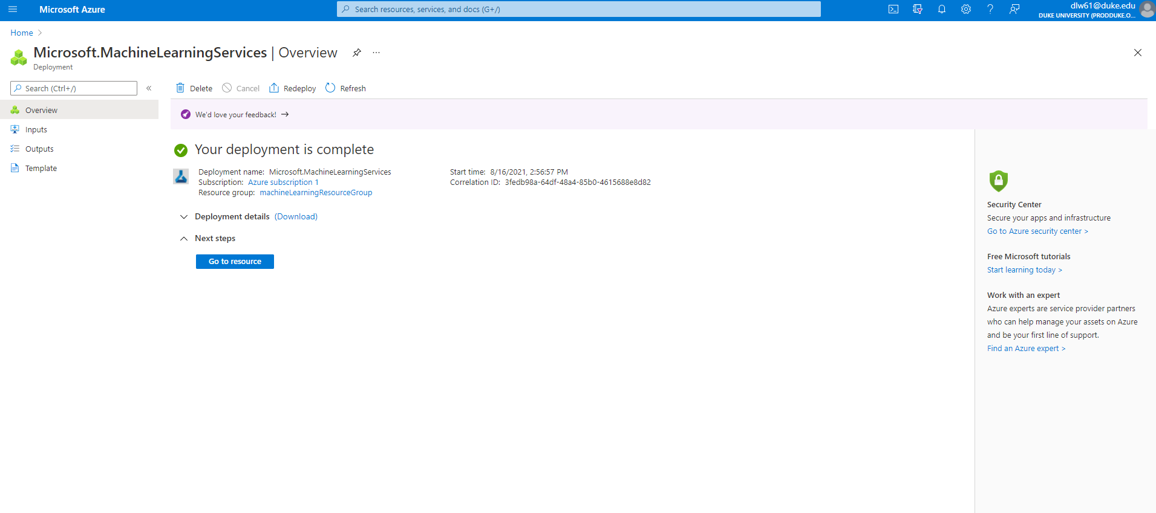
Go to resource and launch studio

Slide 5
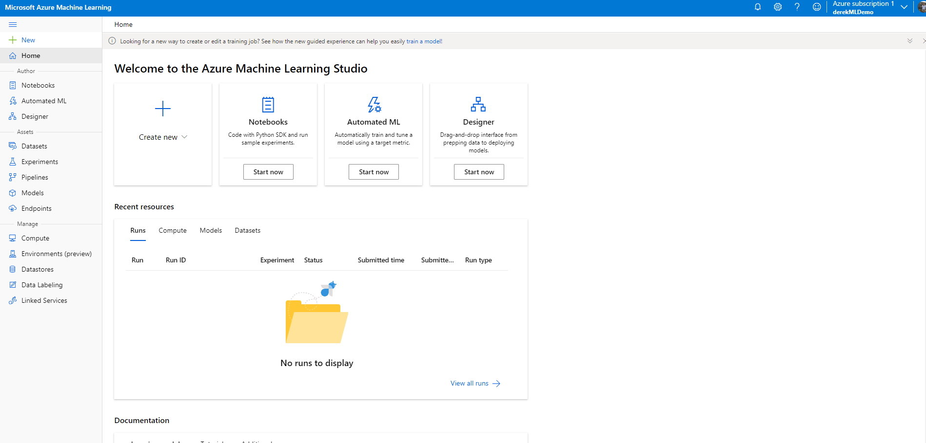
From here you can upload, data, notebooks or use the Auto ML.

Slide 6
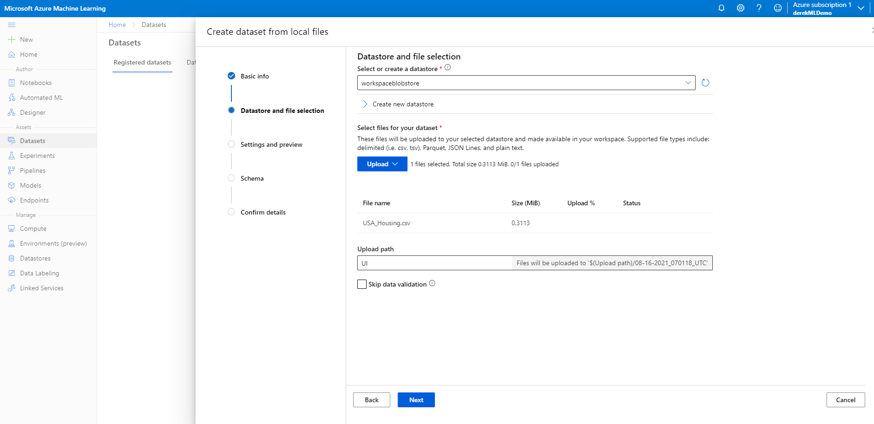
Uploading Data

Slide 7
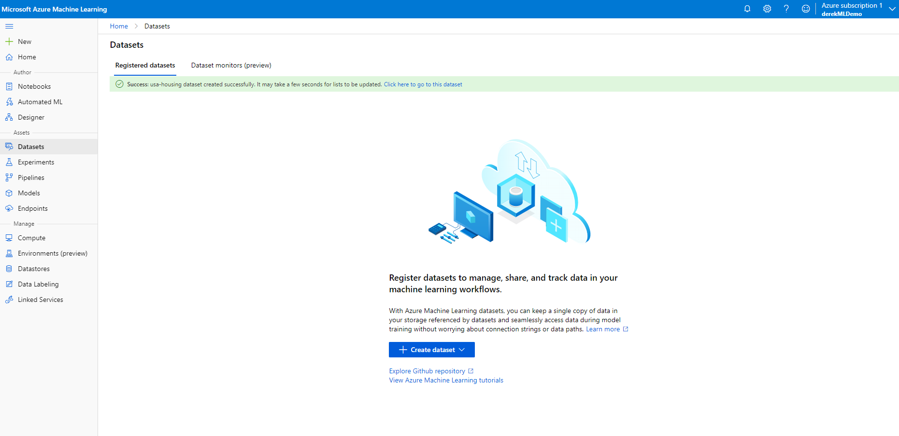
Select Auto ML and follow the steps from the video

Slide 8
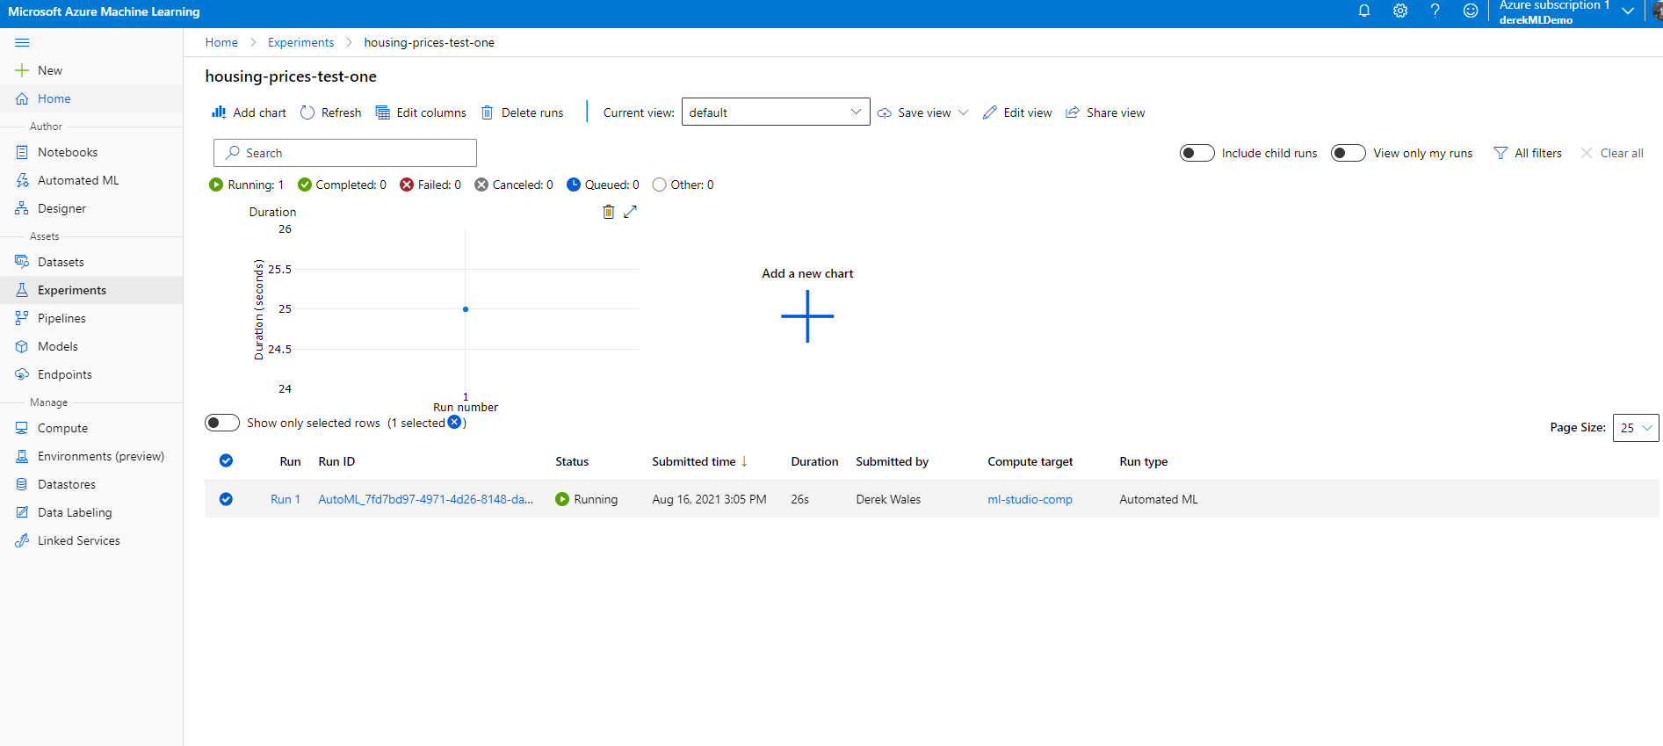
Model Training Screen

Slide 9
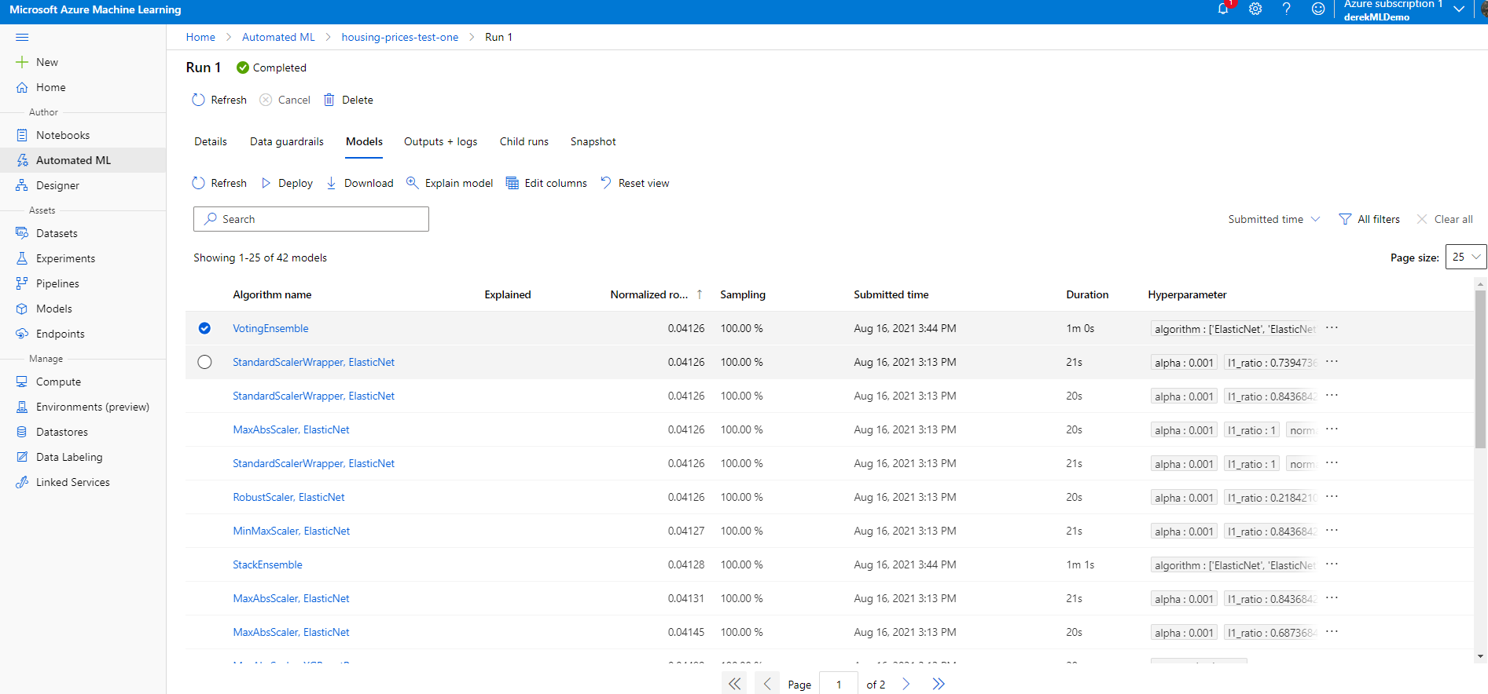
Model Results Screen
Gives you a list of models which can be deployed.

