Slide 1
Twitter and Modern Political Discourse By Andrew Patterson and Derek Wales

Slide 2
Introduction
Social Media is often touted as the new forum where people can discuss and debate about anything, including politics
This often applies to debating political candidates
Do the trends on social media carry over into real world politics?

Slide 3
Background
US Presidential Election Year
Each party elects someone to run for president as their candidate
Focus of this research is on the two highest polling candidates for the democratic ticket over the time period from early to late March
Twitter is often used to debate politics
Research Question: How effectively does twitter mirror the real-life politics and polling of each candidate?

Slide 4

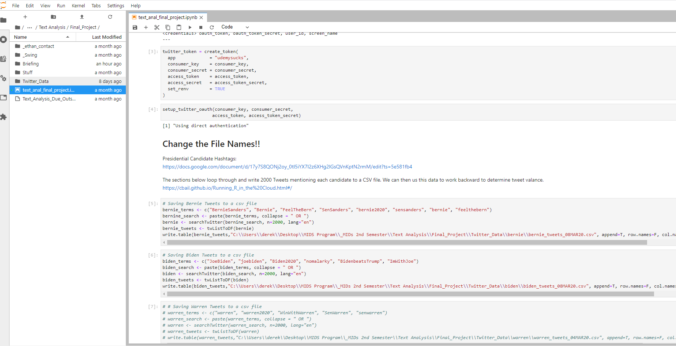
Twitter for Valence Analysis

Slide 5

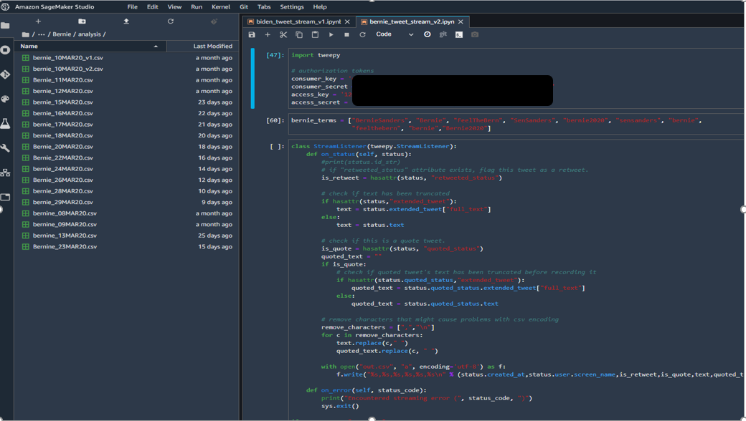
Twitter for Volume Analysis

Slide 6

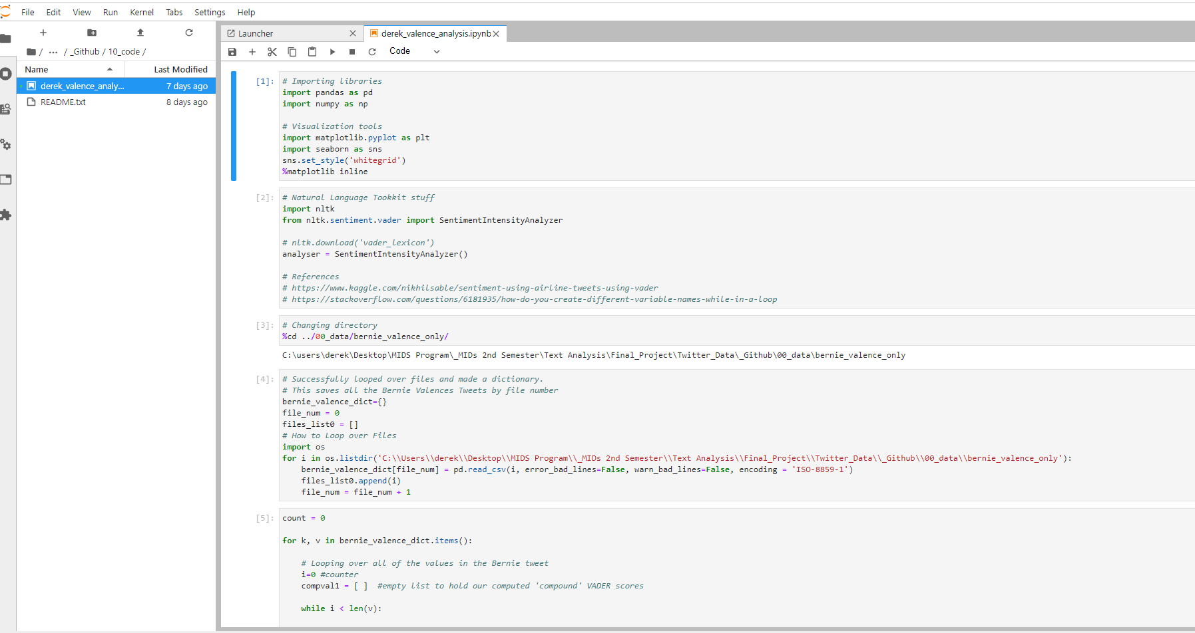
Using Vader to Get Tweet Sentiment

Slide 7
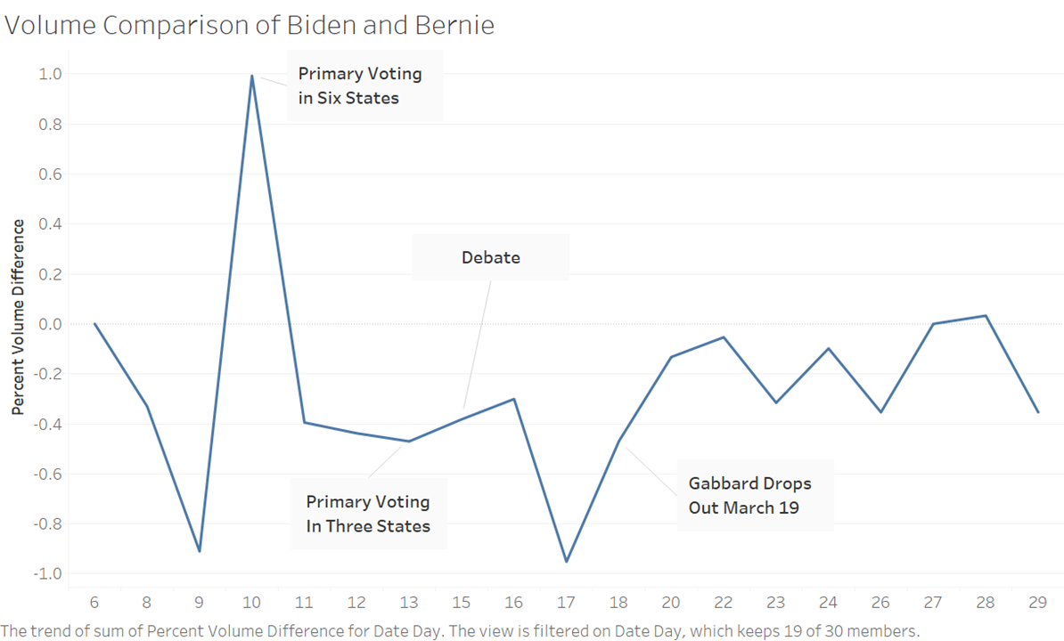
Volume
Does twitter talk about one candidate more than the other?

Slide 8
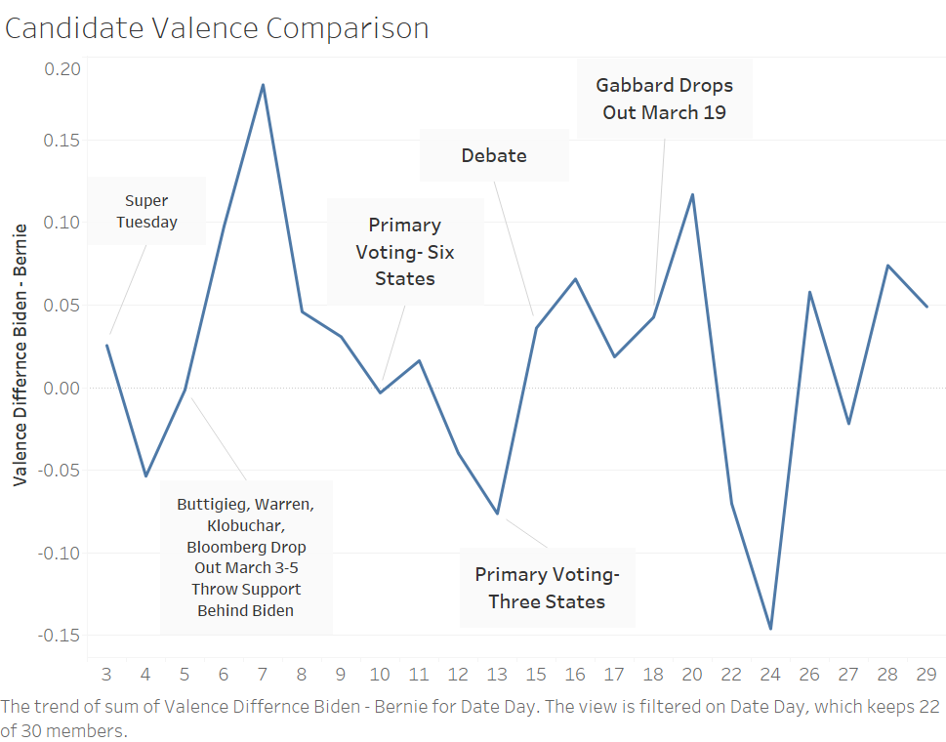
Valence
Does twitter favor one candidate?

Slide 9
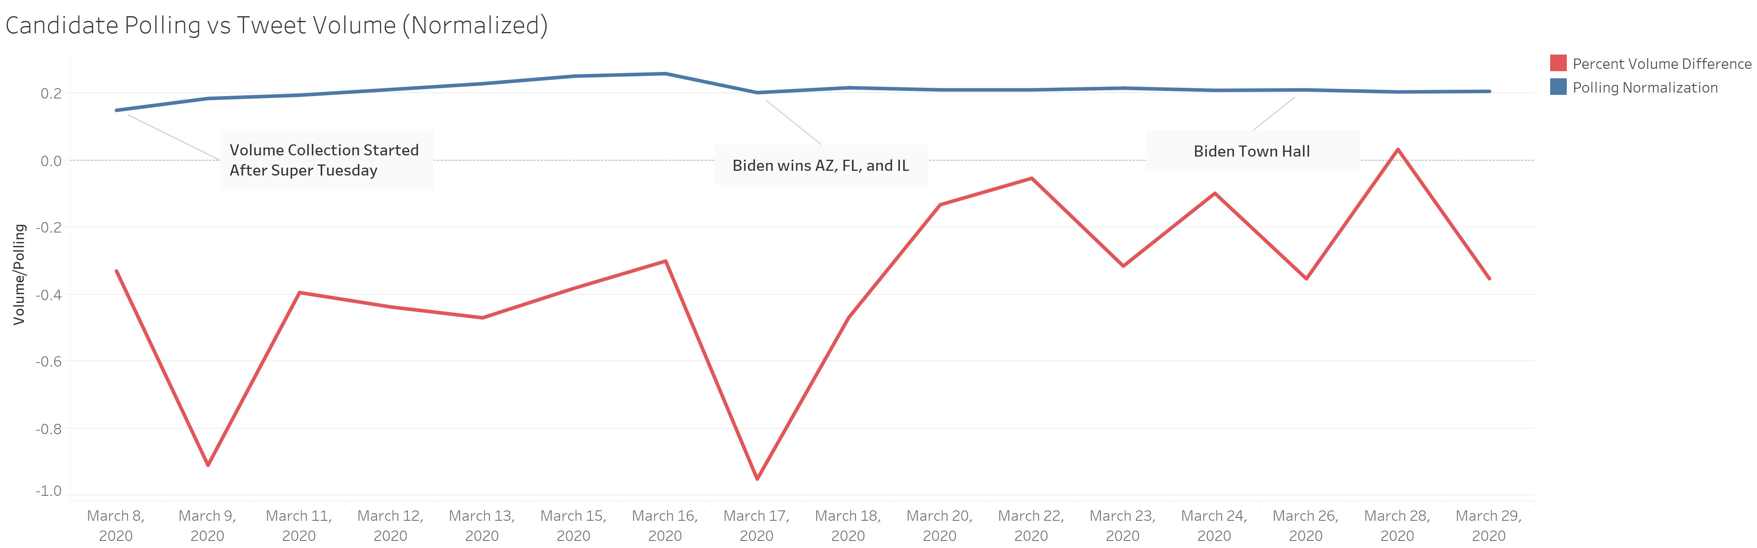
Volume and Polling
Does more twitter traffic mean better polling?

Slide 10
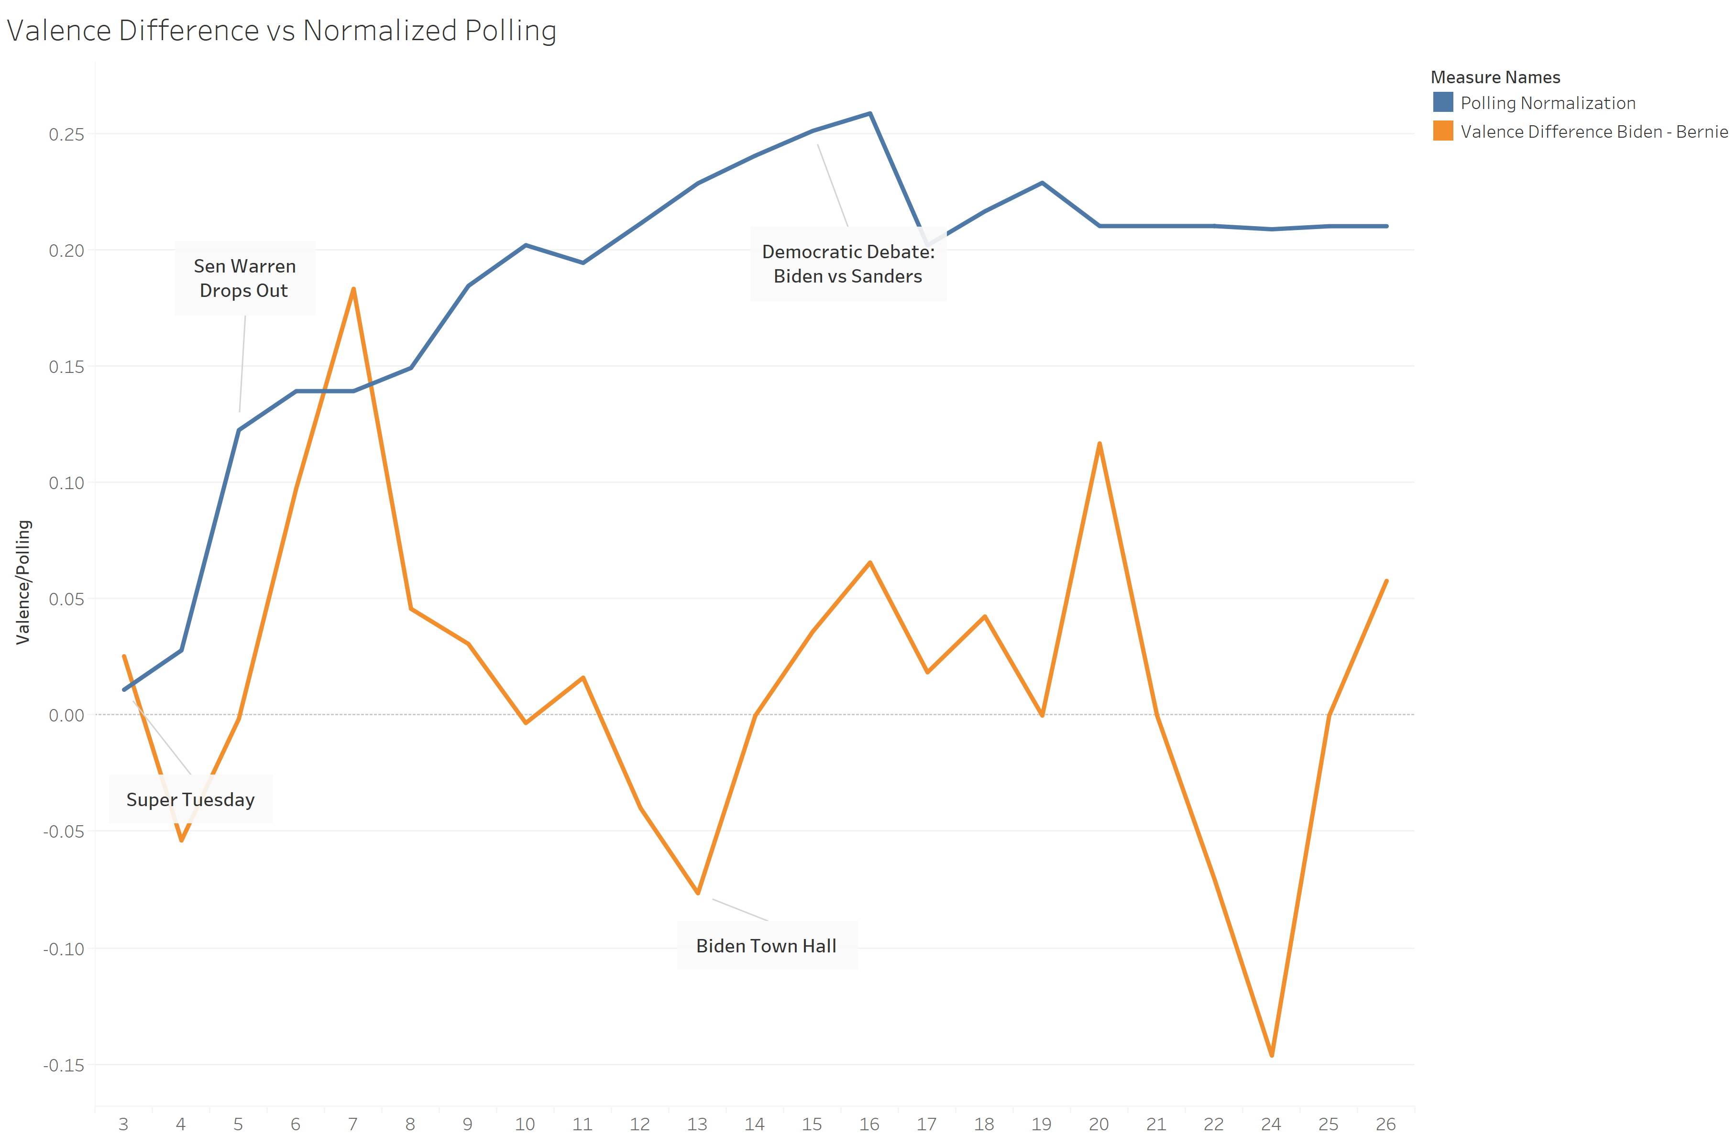
Valence and Polling
Do twitter user’s opinions mirror traditional polling?

Slide 11
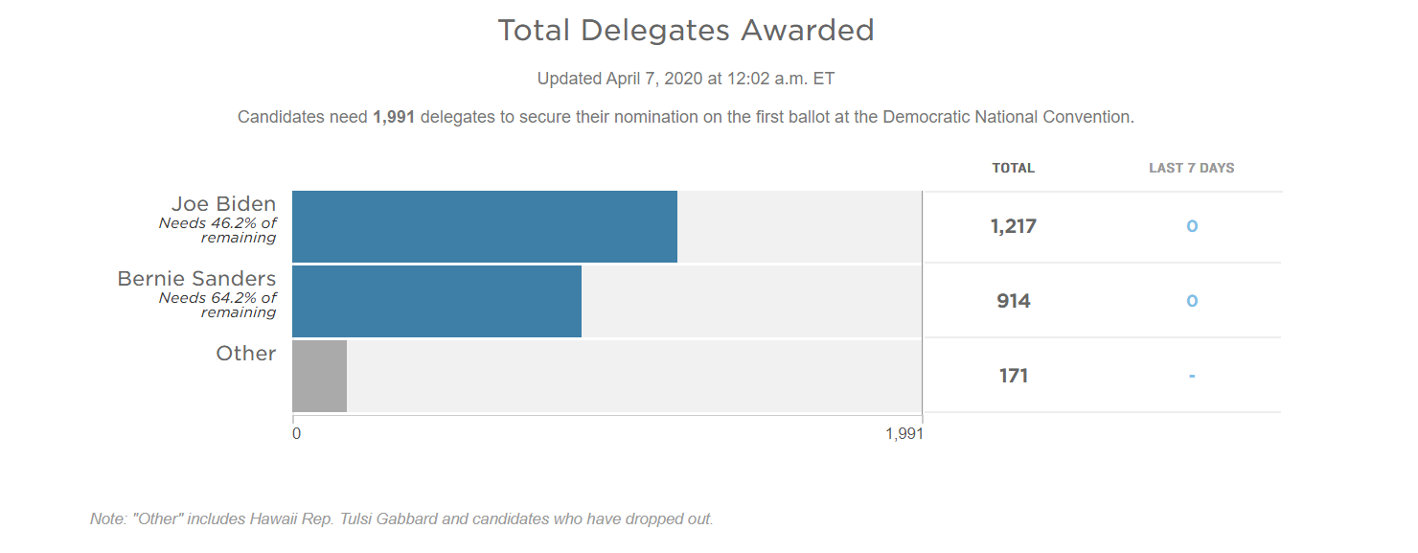
Delegate Counts
The final measure of success of the candidates

Slide 12
Conclusion/Future Research
Twitter alone over a short duration does not translate to primary performance
Expand to other candidates in office, run the twitter feeds for longer
Examine if this holds true for both political parties, or political parties in other countries
Segment by age, and see if twitter more closely follows different generations over others

Slide 13
Sources:
This presentation has been designed using resources from PoweredTemplate.com
NPR.com
Realclearpolitics.com
Twitter

