Slide 1
PGCert InfoTech
Software Development

Slide 2
Software development processes
Generic plan for a software project:
What has to be done?
Why do a task?
When should it be done?
Who does it?
How should it be done?
Notes:
There are many different processes exist
No single process suitable for every project
Using a process can improve the quality of the product

Slide 3
Software development lifecycle
Four common phases:
Requirements
Design
Implementation
Testing
Other phases may include:
Deployment, Operation, Support, Training, and Maintenance

Slide 4
Waterfall model
Old fashioned model of how a process should work
Go through the phases one after another
Linear sequential model
Problems:
Often changes in artefacts of previous phases necessary
In big systems, many requirements become visible only after analysis phase or change over time
Design flaws are often discovered during implementation and testing

Slide 5
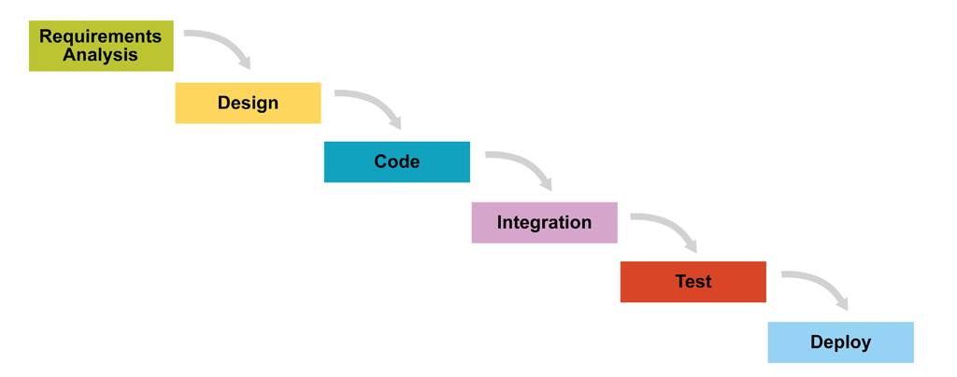

Slide 6
Waterfall model with backflow
Extends the stagewise model with possibility to go back to previous phase (“backflow”)
Defects from the previous phase can still be corrected
Step towards iterative / incremental development
In reality activities of different phases often happen at the same time

Slide 7
Agile software development
Many short iterations, usually in weeks
Control by feedback: re-evaluation & revision of project after each iteration

Slide 8
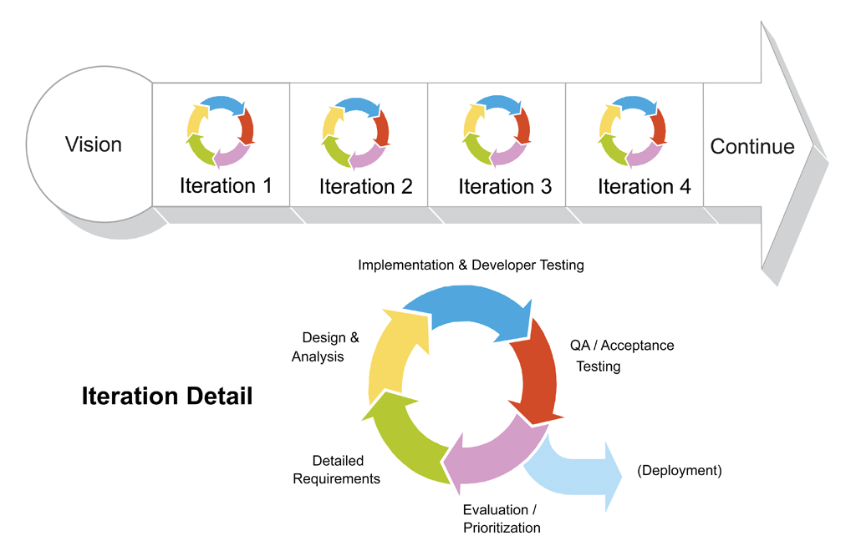

Slide 9
Scrum
A management framework
An alternative to waterfall model
Fixed-length iterations (sprints)
Build potentially shippable product increment every iteration
In each iteration, you generally have the following activities
Detailed Requirements
Design & Analysis
Implementation & Developer Testing
QA / Acceptance Testing
Evaluation / Prioritization
(Deployment)
http://scrumreferencecard.com/scrum-reference-card/

Slide 10
Scrum roles
Product owner
Represents the stakeholders / customers
Ensures the team delivers value to the business
Defines user stories
Development team
Responsible for delivering potentially shippable increments of product at the end of each sprint
A team is usually 3 – 9 people
Do analysis, design, develop, test, technical communication, documentation…
Scrum master
Removes any impediments to the ability of the team to deliver product

Slide 11
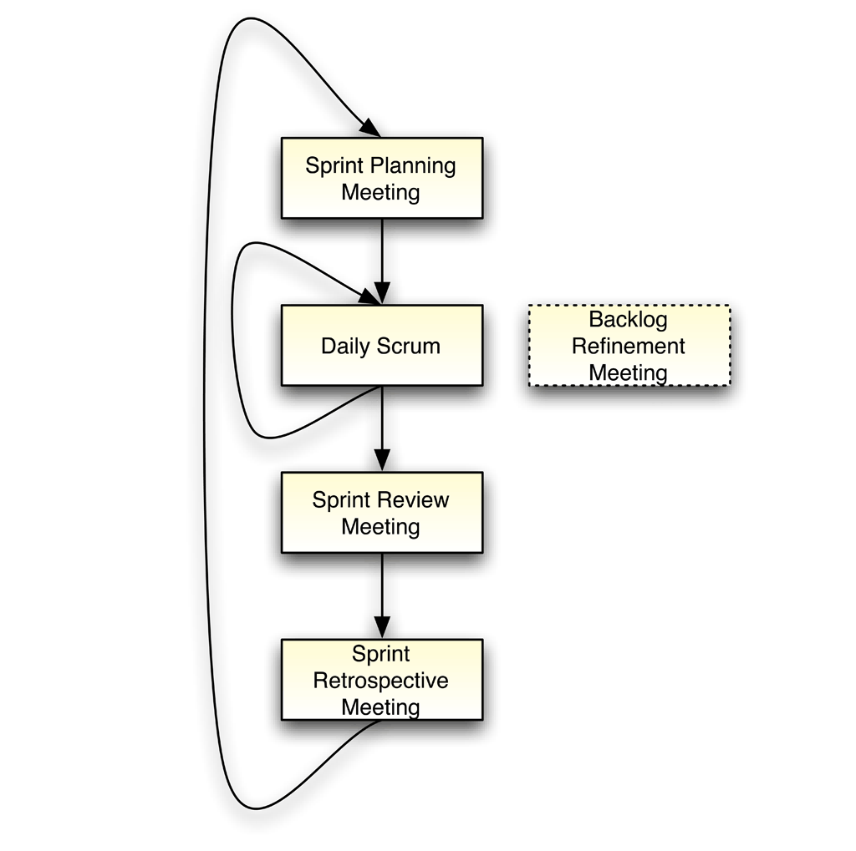
Scrum meetings
Planning
Daily Scrum
Review and retrospective

Slide 12
Scrum artefacts
Product backlog
Ordered list of requirements that a scrum team maintains for a product
E.g. features, bug fixes
MoSCoW labels: M - Must have S - Should have C - Could have W - Won't have
Sprint backlog
List of work the development team must address during the sprint
Basic Scrumban board (Kanban board)
Three columns
To Do
Doing
Done
Velocity chart
Velocity gives you a prediction of how much a development team can successfully complete within a sprint

Slide 13
User stories
Descriptions that capture what a user does or needs
Act as the basis for defining the functions a software system must provide
Capture the who, what, and why of a requirement
General format
As a <role>, I want <goal/desire> so that <benefit>
The “so that” clause may be optional
As a <role>, I can <action with system> so that <external benefit>
Example
Search for customers
As a user, I want to search for my customers by their first and last names

Slide 14
Planning poker
Technique for estimating the effort or size of development goals
Estimating size
Story point
Related to how difficult a story is or how much work needs to be done
Take into account the complexity, effort, and doubt of each story
Not related to the amount of time you may spend on
Free Online tool: https://planningpokeronline.com/

Slide 15
Scrum/Kanban planning tools
More sophisticated planning tool: Jira Software
Website: https://www.atlassian.com/software/jira
Tutorial: https://www.atlassian.com/software/jira/guides/getting-started/basics#step-1-create-a-project
Simpler Kanban tool
Website: https://trello.com/

Slide 16
Wireframe
A wireframe is a schematic or blueprint that is useful for helping you, your programmers and designers think and communicate about the structure of the software or website you're building.
More detail: https://balsamiq.com/learn/articles/what-are-wireframes/
Useful tools: https://www.figma.com/

Slide 17
Architecture/data schema design
Visualise and document design using UML diagram, Sequence diagram
Visualise data schema using ER diagram.
Document and visualisation tool:
Draw.io: draw.io
Lucid chat: https://www.lucidchart.com/pages/examples/database-design-tool

Slide 18
Free graphic material resources
Avatars and icons:
https://www.freepik.com/free-photos-vectors/avatar-icon
https://www.vecteezy.com/free-vector/avatar-icon
Image material:
https://www.freepik.com/free-photos-vectors/graphic-design-material
https://unsplash.com/

