Slide 1
Bluetooth Low Energy
Derek Roberts

Slide 2
Bluetooth LE - Project
Learn how Bluetooth LE protocol works
Designing a simple Bluetooth LE profile
Build a project to implement the Bluetooth LE profile
Test and experiment with the design

Slide 3
Bluetooth LE - Protocol
GATT – Generic Attribute Profile
GATT Server – Host a set of services, characteristics, and descriptors
Read, Write, WriteWithoutResponse, Notify, Indicate
GATT Client – accesses a host services, characteristics, and descriptors.
Apps use APIs to correctly prepare and transmit, receive, and decode ATT protocol data.
GAP – Generic Access Profile (4 roles)
Peripheral – Bluetooth LE device, sensor, etc.
Central – Smart phone
Broadcaster – beacon
Observer – device that listens for beacons

Slide 4
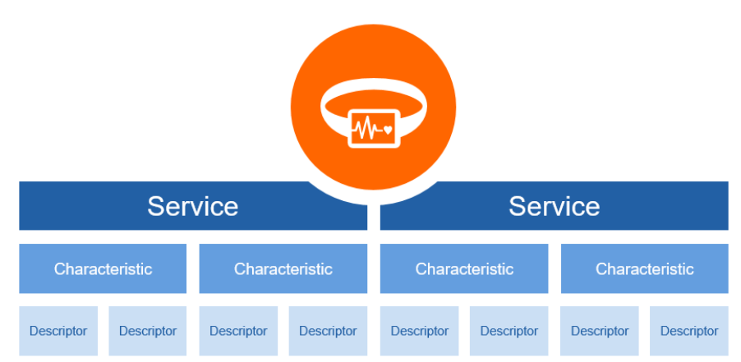
Bluetooth LE protocol - Gatt Server

Slide 5
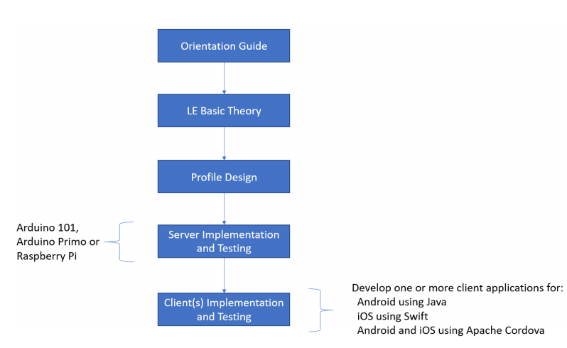
Bluetooth LE - Developer Study Guide
Martin Woolley – Is part of the Bluetooth Special Interest Group (SIG) and he created a in depth tutorial on Bluetooth LE.
This tutorial can be found on the official Bluetooth Website.

Slide 6
Bluetooth LE - Profile Design
# | Feature | Behavior
1 | Set an alert level 0, 1, 2 to indicate the Bluetooth connection is lost | Acknowledge the alert settings (0=green, 1=yellow, 2=red) by flashing an LED 4 times.
2 | Locate a lost device | If device receives a 0 – flash all LEDs 3 times, no buzzer 1 – flash all LEDS 4 times, buzzer 4 times 2 – flash all LEDs 5 times, buzzer 5 times
3 | Proximity Monitoring | Based on the clients received signal strength (RSSI) indicate the following with the LEDs: Green is close, Yellow is mid range, Red is far away.
4 | Disconnected or lost link | The device will flash all LEDs and make a noise 0 – no alert or flashing lights 1 – flash/beep for 15 seconds 2 – flash/beep for 30 seconds
5 | Temperature Monitor | Enable or disable a subscription to temperature updates

Slide 7
Bluetooth LE – Go from Profile design to GATT
# | Feature | Service (uuid) | Service Name | Behavior
1 | Set an Alert level |  |  | No alert, mild alert, high alert
2 | Find device (alarm) |  |  | Flash, flash & beep, flash & beep longer
3 | Tx Power lvl |  |  | Transmitter power dBm
4 | Proximity Monitor Service |  |  | Client reports RSSI value and server displays green, yellow, red
5 | Temperature sensor |  |  | Read a temperature value

Slide 8
Bluetooth LE – Go from Profile design to GATT
# | Feature | Service (uuid) | Service Name | Behavior
1 | Set an Alert level | 0x1803 | Link Loss | No alert, mild alert, high alert
2 | Find device (alarm) | 0x1802 | Immediate Alert | Flash, flash & beep, flash & beep longer
3 | Tx Power lvl | 0x1804 | Immediate Alert | Transmitter power dBm
4 | Proximity Monitor Service | 3E099910-293F-11E4-93BD-AFD0FE6D1DFD | Unknown service | Client reports RSSI value and server displays green, yellow, red
5 | Temperature sensor | 0x1809 | Health Thermometer | Read a temperature value

Slide 9
Bluetooth LE – Go from Profile design to GATT
# | Feature | Service (uuid) | Service Name | Behavior | Characteristic (uuid) | Characteristic Name
1 | Set Alert | 0x1803 | Link Loss | No alert, alert, high alert
2 | Find device (alarm) | 0x1802 | Immediate Alert | Flash, flash & beep, flash & beep longer
3 | Tx Power lvl | 0x1804 | Immediate Alert | Transmitter power dBm
4 | Proximity Monitor Service | 3E099910-293F-11E4-93BD-AFD0FE6D1DFD | Unknown service | Client reports RSSI value and server displays green, yellow, red
5 | Temperature sensor | 0x1809 | Health Thermometer | Read a temperature value

Slide 10
Bluetooth LE – Go from Profile design to GATT
# | Feature | Service (uuid) | Service Name | Behavior | Characteristic (uuid) | Characteristic Name
1 | Set Alert | 0x1803 | Link Loss | No alert, alert, high alert | 0x2A06 | Alert Level
2 | Find device (alarm) | 0x1802 | Immediate Alert | Flash, flash & beep, flash & beep longer | 0x2A06 | Alert Level
3 | Tx Power lvl | 0x1804 | Immediate Alert | Transmitter power dBm | 0x2A07 | Tx Power Level
4 | Proximity Monitor Service | 3E099910-293F-11E4-93BD-AFD0FE6D1DFD | Unknown service | Client reports RSSI value and server displays green, yellow, red | 3E099911-293F-11E4-93BD-AFD0FE6D1DFD | Unknown characteristic
5 | Temperature sensor | 0x1809 | Health Thermometer | Read a temperature value | 0x2A1C | Temperature Measurement

Slide 11
# | Feature | Service (uuid) | Service Name | Behavior | Characteristic (uuid) | Characteristic Name | Value | Properties
1 | Set Alert | 0x1803 | Link Loss | No alert, alert, high alert | 0x2A06 | Alert Level
2 | Find device (alarm) | 0x1802 | Immediate Alert | Flash, flash & beep, flash & beep longer | 0x2A06 | Alert Level
3 | Tx Power lvl | 0x1804 | Immediate Alert | Transmitter power dBm | 0x2A07 | Tx Power Level
4 | Proximity Monitor Service | 3E099910-293F-11E4-93BD-AFD0FE6D1DFD | Unknown service | Client reports RSSI value and server displays green, yellow, red | 3E099911-293F-11E4-93BD-AFD0FE6D1DFD | Unknown characteristic
5 | Temperature sensor | 0x1809 | Health Thermometer | Read a temperature value | 0x2A1C | Temperature Measurement

Slide 12
# | Feature | Service (uuid) | Service Name | Behavior | Characteristic (uuid) | Characteristic Name | Value | Properties
1 | Set Alert | 0x1803 | Link Loss | No alert, alert, high alert | 0x2A06 | Alert Level | 0x00, 0x01, 0x02 | Read, Write
2 | Find device (alarm) | 0x1802 | Immediate Alert | Flash, flash & beep, flash & beep longer | 0x2A06 | Alert Level | 0x00, 0x01, 0x02 | Write Without Response
3 | Tx Power lvl | 0x1804 | Immediate Alert | Transmitter power dBm | 0x2A07 | Tx Power Level | 10 dBm | Read
4 | Proximity Monitor Service | 3E099910-293F-11E4-93BD-AFD0FE6D1DFD | Unknown service | Client reports RSSI value and server displays green, yellow, red | 3E099911-293F-11E4-93BD-AFD0FE6D1DFD | Unknown characteristic | 0x0000 unsubscribe 0x01C0 (Client RSSI: -64) 0xFFFF (very close -1) | Write Without Response
5 | Temperature sensor | 0x1809 | Health Thermometer | Read a temperature value | 0x2A1C | Temperature Measurement | 15.80 degree Celsius | Indicate

Slide 13
Bluetooth LE - Setup
Raspberry Pi 3 B+ is the peripheral device “Server”
Temperature Service
Alarm Service (lost device)
Set Alarm/Link loss Service
Proximity Service
Smart Phone is the central device “Client”
Reads, writes, indicates, writes without response to the server

Slide 14
Bluetooth LE - Setup
Raspberry Pi will be using APIs to use the Bluetooth LE chip, GPIO pins, and MCP3008 ADC
Programming on the Pi will be done in node.js
install node.js then create the Bluetooth project in a text editor bdsk.js
install bleno (node.js module provides APIs Bluetooth GAP peripherals)
Install mcp-spi-adc (node.js module for serial peripheral interface with ADC)
Install onoff (node.js onoff package for GPIO API)
Run the code in the shell using
sudo node bdsk.js

Slide 15
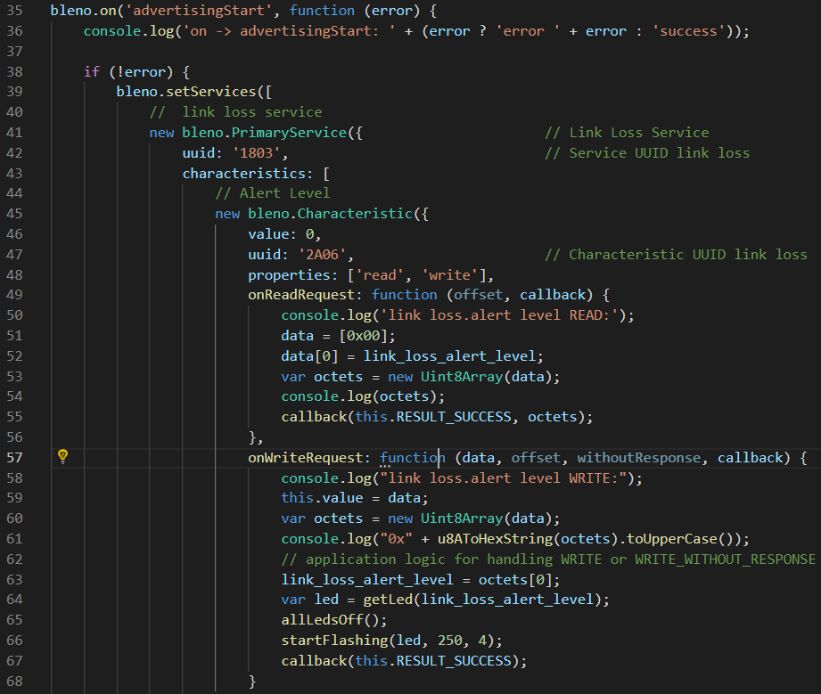
Bluetooth LE - Setup
About 300 lines of node.js

Slide 16
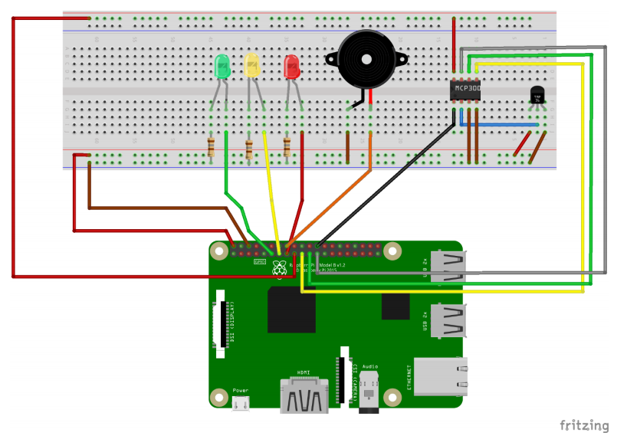
Bluetooth LE - Setup

Slide 17
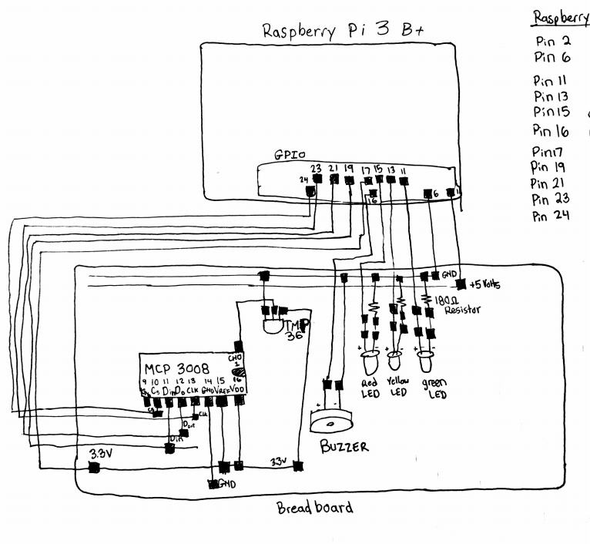
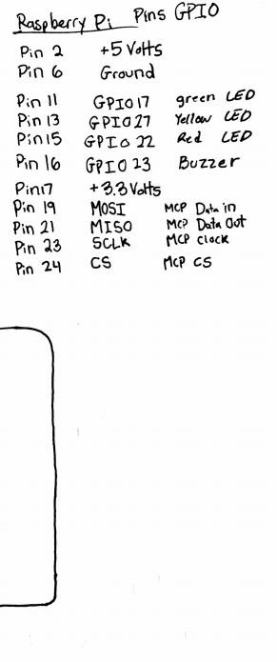

Slide 18
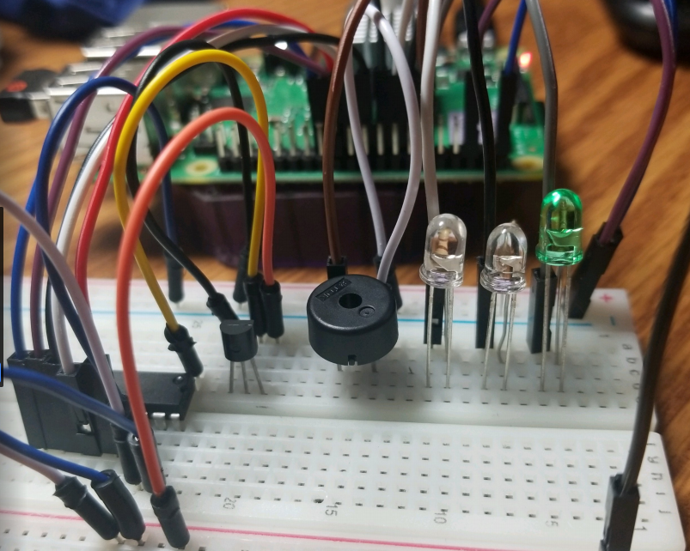
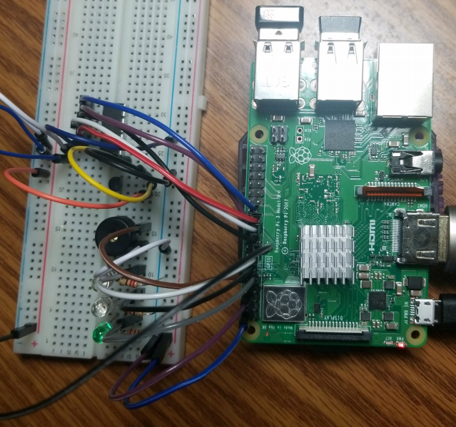
Bluetooth LE - Experimentation

Slide 19
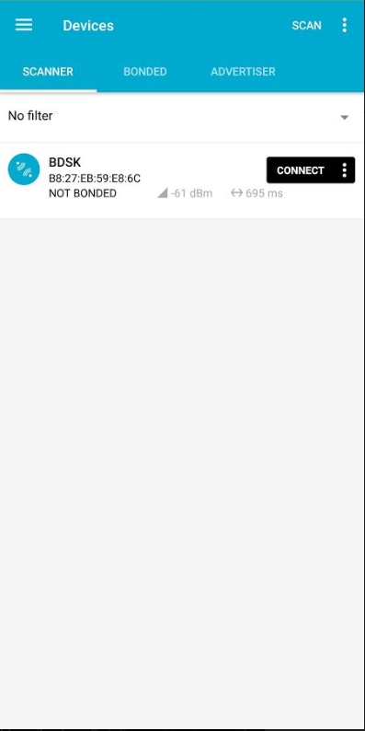
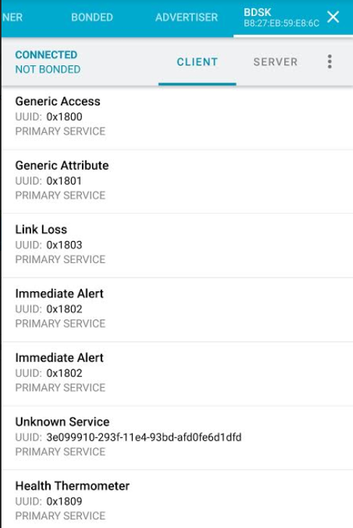
Bluetooth LE - Experimentation
nRF Connect – Nordic Semiconductor App

Slide 20
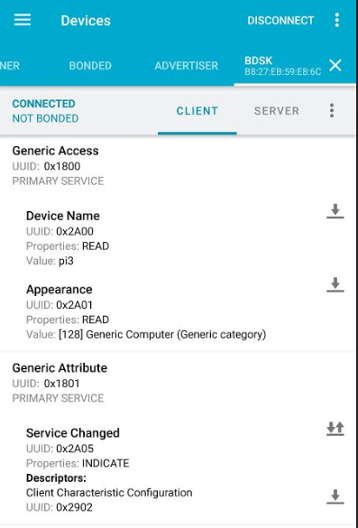
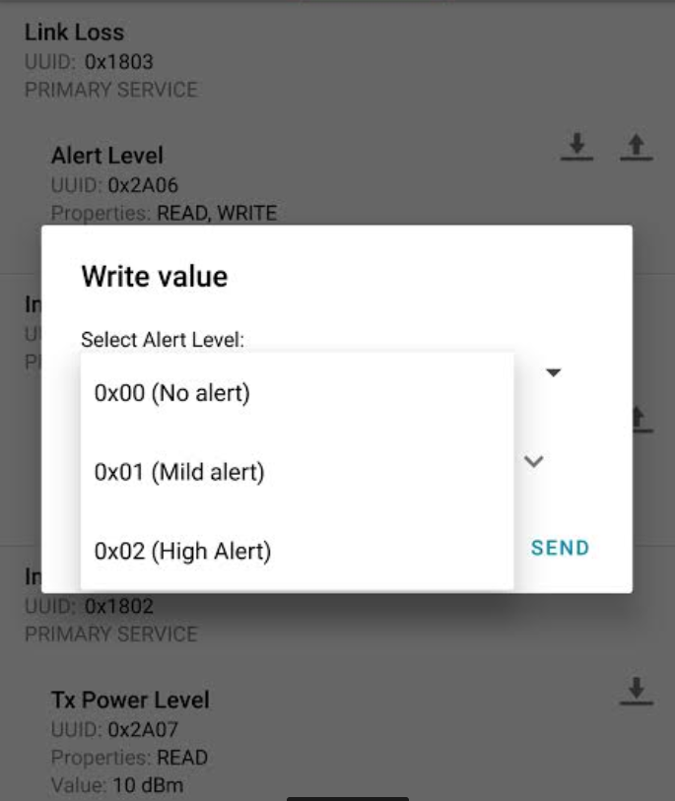
Bluetooth LE - Experimentation

Slide 21
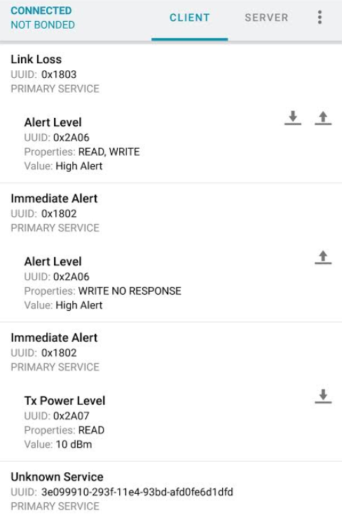
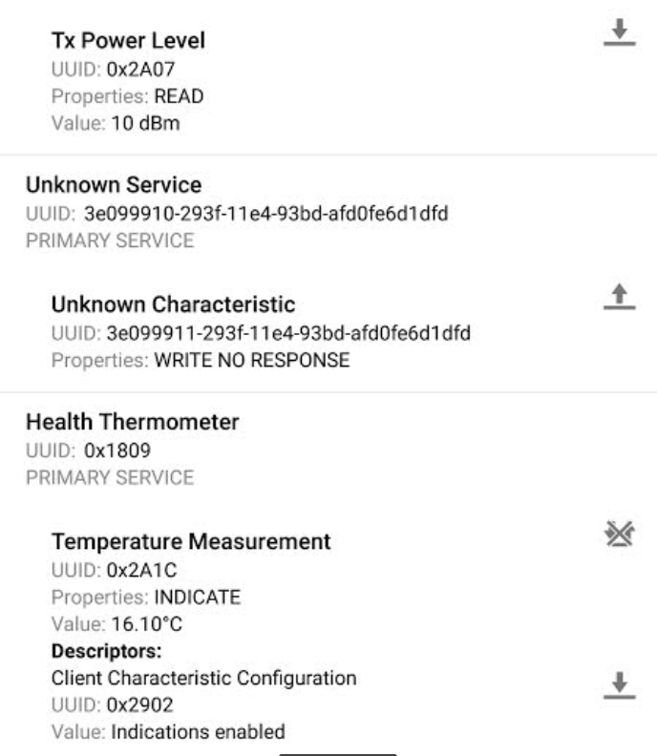
Bluetooth LE - Experimentation

Slide 22
Conclusion
I learned a lot about Bluetooth LE
Learned How to design a simple server/client profile
How to implement that profile into services, characteristics, values, and properties.
First time programming node.js
First time using a Raspberry Pi
Mistakes were made
I killed the Raspberry Pi by shorting the GPIO pins. (don’t use alligator clips)
I bought the wrong components (3 V to 30 V Piezo Buzzer, too quite)
I tried to make an app with MIT App Inventor/android studio (fail)

Slide 23
Future Work
Add more Bluetooth LE services and characteristics
Build the circuit out on a PCB
Build a smartphone app
Implement sound files instead of just a simple buzzer

