Slide 1
Hadoop MapReduce

Slide 2



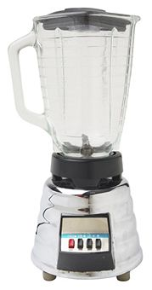


Sam’s Problem
Sam thought of “drinking” the apple
He used a to cut the and a to make juice.

Slide 3
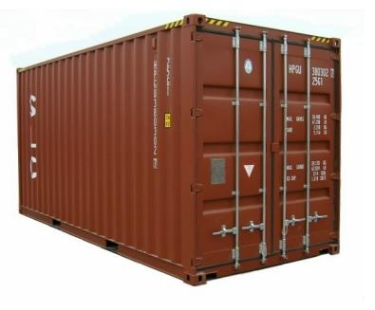





Creative Sam
Implemented a parallel version of his innovation
Fruits
Each input to a map is a list of <key, value> pairs
A list of <key, value> pairs mapped into another list of <key, value> pairs which gets grouped by the key and reduced into a list of values
(<a, > , <o, > , <p, > , …)
Each output of slice is a list of <key, value> pairs
(<a’, > , <o’, > , <p’, > )
Grouped by key
The idea of Map Reduce in Data Intensive Computing
Each input to a reduce is a <key, value-list> (possibly a list of these, depending on the grouping/hashing mechanism)
e.g. <ao, ( …)>
Reduced into a list of values
Notes:
To create his favorite mix fruit juice he can use a combiner after the reducers
If several <key, value-list> fall into the same group (based on the grouping/hashing algorithm) then use the blender (reducer) separately on each of them
The knife (mapper) and blender (reducer) should not contain residue after use – Side Effect Free
In general reducer should be associative and commutative

Slide 4
Overview of MapReduce
“The Google File System” published October 2003
Hadoop DFS
NTFS
“MapReduce: Simplified Data Processing on Large Cluster” published December 2004
Hadoop MapReduce
Microsoft Dryad
“Bigtable: A Dsitributed Storage System for Structured Data” published November 2006
Hbase
Azure SQL server
“Twister: A Runtime for Iterative MapReduce” published June 2010

Slide 5
MapReduce Implementation Overview
Typical cluster:
100s/1000s of 2-CPU x86 machines, 2-4 GB of memory
Limited bisection bandwidth
Storage is on local IDE disks
GFS: distributed file system manages data (SOSP'03)
Job scheduling system: jobs made up of tasks, scheduler assigns tasks to machines
Implementation is a C++ library linked into user programs
Dan Weld’s class at U. Washington

Slide 6
Execution
How is this distributed?
Partition input key/value pairs into chunks, run map() tasks in parallel
After all map()s are complete, consolidate all emitted values for each unique emitted key
Now partition space of output map keys, and run reduce() in parallel
If map() or reduce() fails, reexecute!
Dan Weld’s class at U. Washington

Slide 7
Job Processing
TaskTracker 0
TaskTracker 1
TaskTracker 2
JobTracker
TaskTracker 3
TaskTracker 4
TaskTracker 5
“grep”
Client submits “grep” job, indicating code and input files
JobTracker breaks input file into k chunks, (in this case 6). Assigns work to ttrackers.
After map(), tasktrackers exchange map-output to build reduce() keyspace
JobTracker breaks reduce() keyspace into m chunks (in this case 6). Assigns work.
reduce() output may go to NDFS
Dan Weld’s class at U. Washington

Slide 8
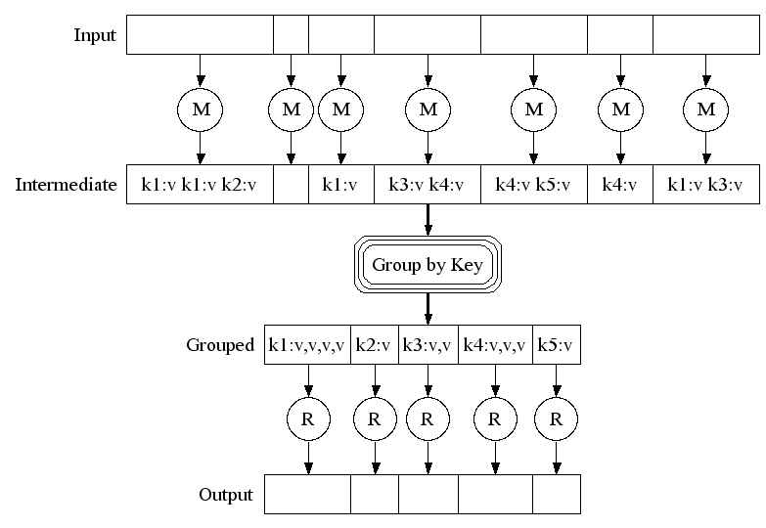
Execution
Dan Weld’s class at U. Washington

Slide 9
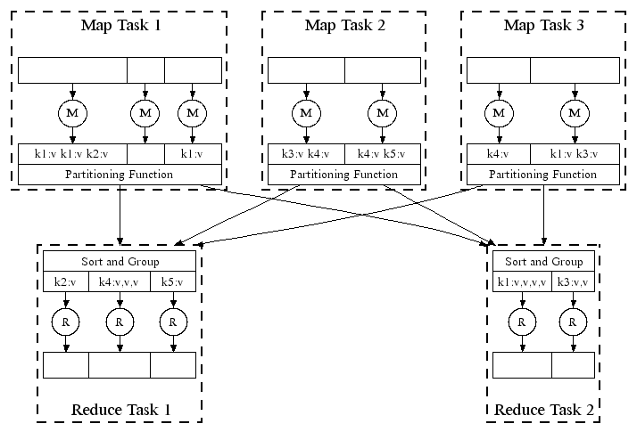
Parallel Execution
Dan Weld’s class at U. Washington

Slide 10
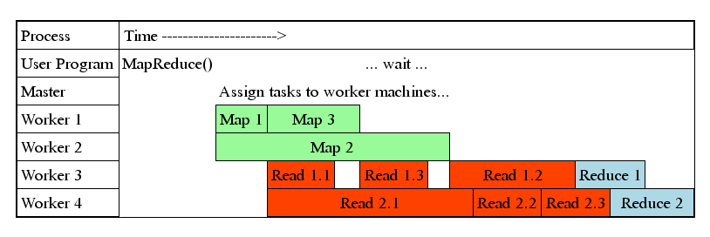
Task Granularity & Pipelining
Fine granularity tasks: map tasks >> machines
Minimizes time for fault recovery
Can pipeline shuffling with map execution
Better dynamic load balancing
Often use 200,000 map & 5000 reduce tasks
Running on 2000 machines
Dan Weld’s class at U. Washington

Slide 11
MapReduce
A parallel Runtime coming from Information Retrieval
Data Partitions
Map(Key, Value)
A hash function maps the results of the map tasks to r reduce tasks
Reduce(Key, List<Value>)
Reduce Outputs
Implementations support:
Splitting of data
Passing the output of map functions to reduce functions
Sorting the inputs to the reduce function based on the intermediate keys
Quality of services

Slide 12
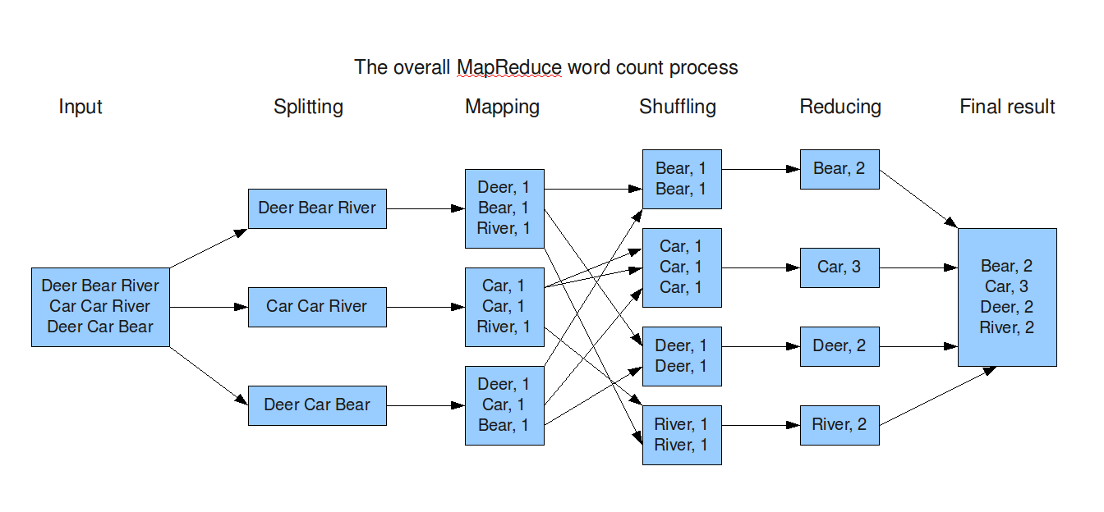
Sort
http://blog.jteam.nl/wp-content/uploads/2009/08/MapReduceWordCountOverview.png

Slide 13
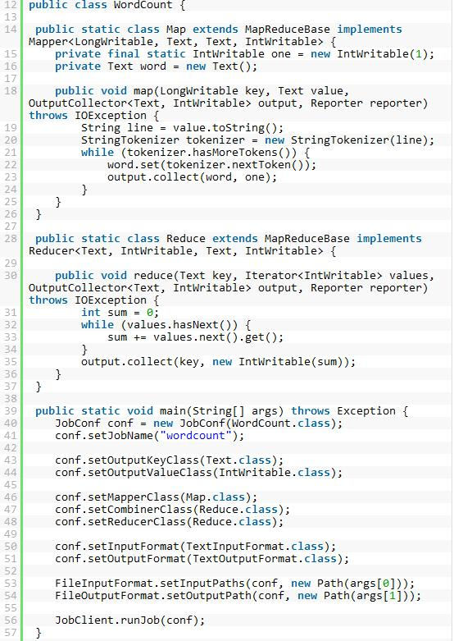
WordCount Example in Hadoop
Combiner Functions
Run on the map output as an optimization
Minimize the data transfer between map and reduce tasks
e.g.
Max(0,20,10,25,15) = max(max(0,20,10), max(25,15)) = max(20,25) = 25

Slide 14
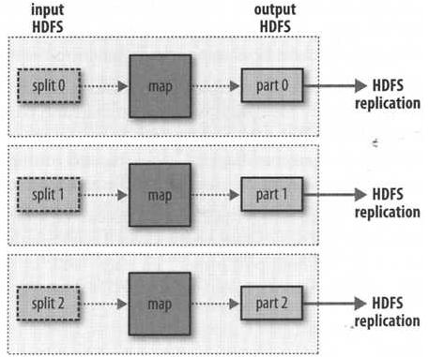
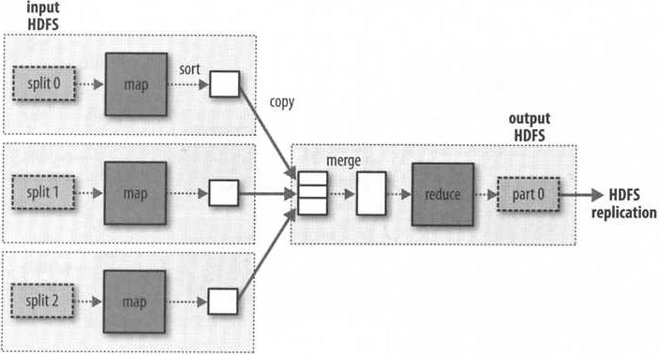
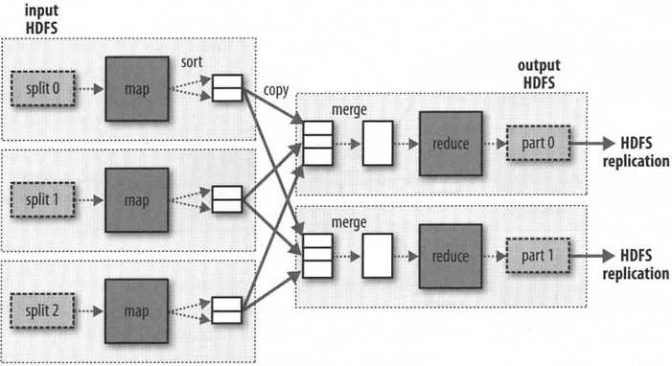
Number of Map tasks and Reduce Tasks
Hadoop: The Definitive Guide

Slide 15
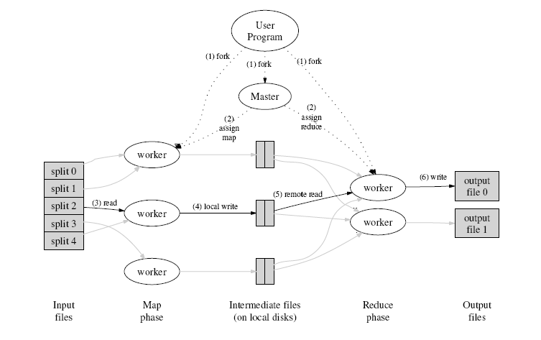
MapReduce Execution Overview
http://code.google.com/edu/parallel/mapreduce-tutorial.html

Slide 16
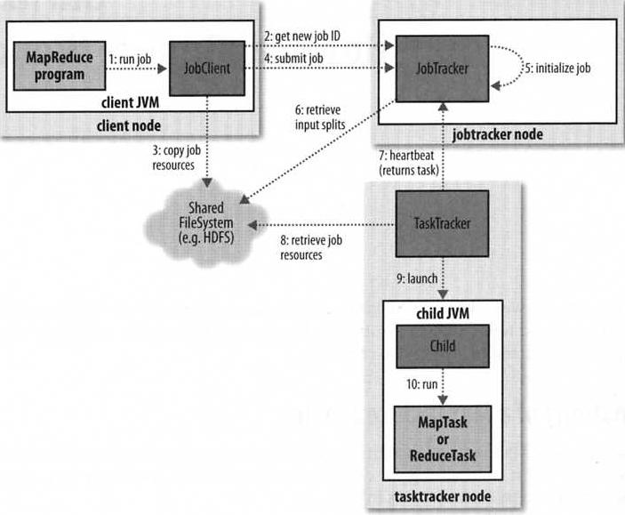
How Hadoop Runs on a MapReduce Job
Output directory
Job JAR (10 copies)
Configuration file
The job scheduler retrieves the input splits and creates one map task for each split
The number of reduce tasks is set by “mapred.reduce.task” property
Tasktrackers runs a simple loop to send heartbeat method calls to the jobtracker
Tasktrackers have a fixed # of slots for map/reduce tasks depending on cores and memory
Hadoop: The Definitive Guide

Slide 17
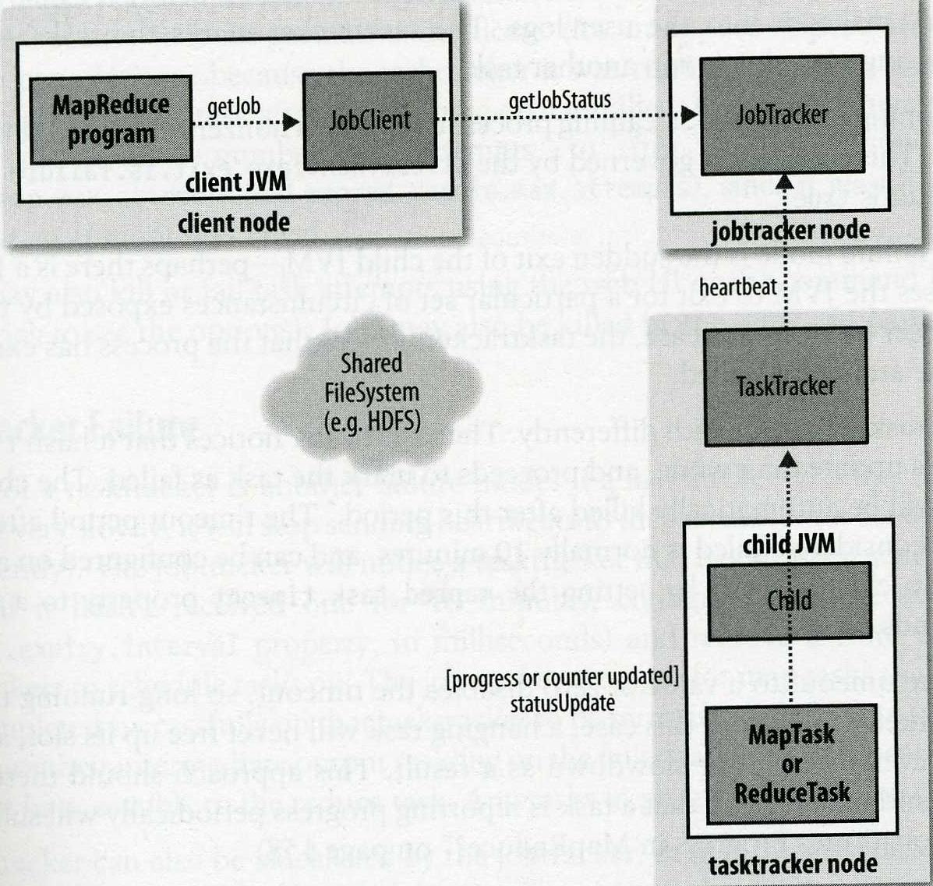
Status updates in MapReduce
MapReduce jobs are long-running batch jobs
A job and each task have a status (e.g. running, successfully completed , failed)
A task report progress by setting a flag, which is checked every 3 seconds.
Tasktrackers sends heartbeat every 5 seconds
JobClient receives the latest status by polling the jobtracker every second
Hadoop: The Definitive Guide

Slide 18
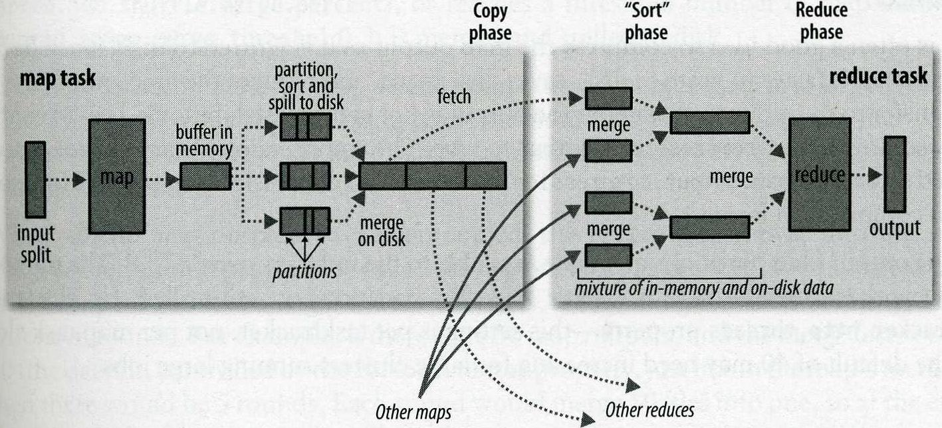
Shuffle and Sort
100 MB
Every reducer is sorted by key in MapReduce
“Shuffle” transfers the map outputs to the reducers as inputs with room for optimization and is heart of MapReduce
When the buffer reachers a certain threshold (80%), a background thread will start to spill the content to disk as a spill file.
“Spill” are written in round-robin to job specific directories
The number of spills is at least 3 if a combiner function has been specified
“Copy phase” is the reduce task starts copying outputs from mappers as soon as each completes. The default is 5 threds.
“Sort phase” starts when all the map outputs have been copied. This is done in rounds e..g merge factor is 10
“Final Merge” can come from a mixture of in-memory and on-disk segments
Hadoop: The Definitive Guide

Slide 19
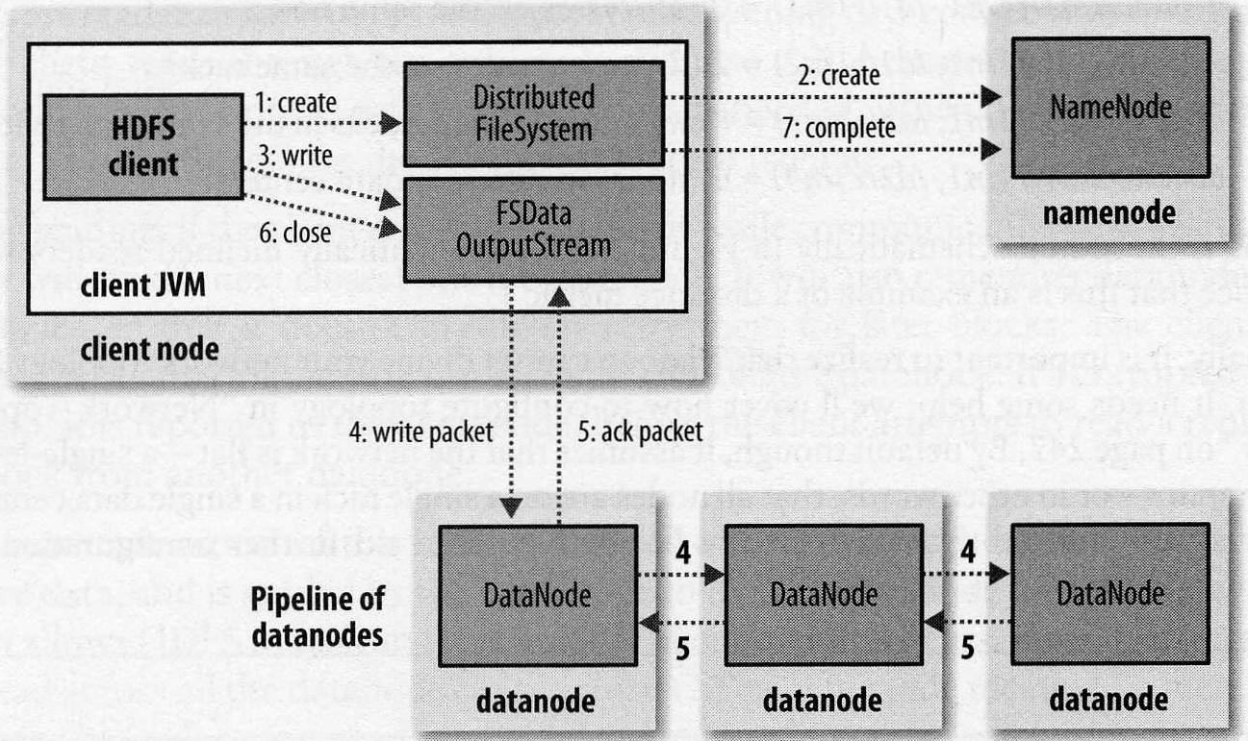
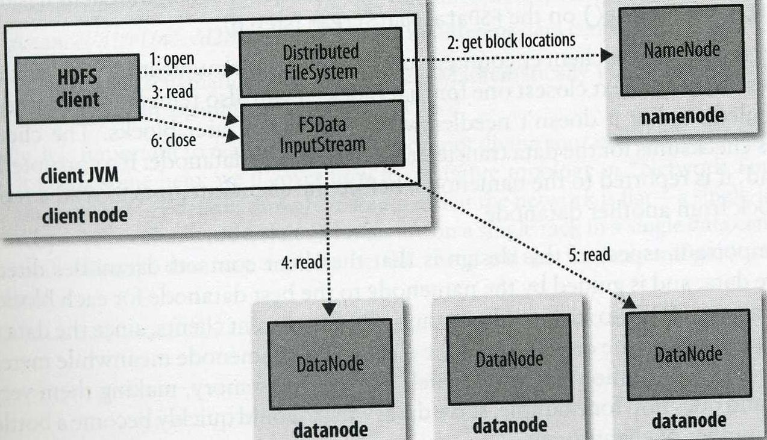
A Client Writing data to HDFS
A Client reading data from HDFS
Hadoop: The Definitive Guide

