Slide 1
Review of Computer Organization
Notes:
Page <number>

Slide 2
Agenda
Computer Organization
CPU
3. Memory
4. I/O
5. Architecture

Slide 3

1. Computer Organization
CPU
Memory
I/O

Slide 4
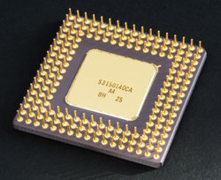
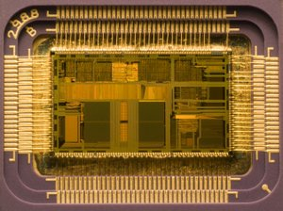
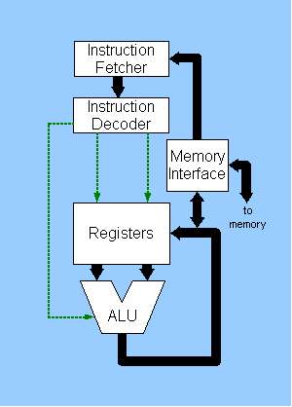
2. CPU (1)
Access
  pins: address, data, control, status
Internals
  program counter (PC)
  registers: address, data, control, flags
  arithmetic logic unit (ALU), FPU, etc
Benchmarks
  clock (GHz), instruction/cycle, MIPS
CSc 360Overview
Notes:
Page <number>

Slide 5
2. CPU (2) operations
Fetch
  retrieve instructions from memory (cache)
Decode
  instruction: operator, operands; microcode
Execute
  arithmetic/logic operation
  move data between register, memory, I/O
  change execution flow
CSc 360Overview
Notes:
Page <number>

Slide 6
3. Memory (1)
Access
  linear address
  segmented address: segment, index
  physical address: cylinder, header, sector (disk)
Benchmarks
  clock (MHz)
  width (bits)
  throughput (Mbps)
CSc 360Overview
Notes:
Page <number>

Slide 7

3. Memory (2): hierarchies
Speed vs. size (vs. cost)
  registers: inside CPU
  cache: transparent to programs
  memory: main storage
    DRAM, SDRAM, SRAM, etc
  disks: secondary storage
    electronic, magnetic, optical, etc
  tapes: backup storage
  networked storage
Caching
CSc 360Overview
Notes:
Page <number>

Slide 8

4. I/O (1)
A large variety of input/output devices
  keyboard/mouse, video, audio, network, etc
Access
  Address
    port numbers
    I/O vs. memory space
  Interrupt
  Direct memory access (DMA)
Synchronous vs asynchronous
CSc 360Overview
Notes:
Page <number>

Slide 9
4. I/O (2): Interrupts
Asynchronous operation
Nonmaskable interrupts
  e.g., hardware fault
Hardware interrupts
  hardware events: e.g., I/O completion
  interrupt controller: priority & arbitration
Software interrupts
  trap, system call
CSc 360Overview
Notes:
Page <number>

Slide 10
4. I/O (3): Interrupt handling
Save current state
  CPU counters, registers, flags at system stack
Update program counter
  interrupt controller; interrupt vectors
Execute interrupt routine
Restore previous state
Multiple interrupts
  priority, masking, reentry
CSc 360Overview
Notes:
Page <number>

Slide 11
4. I/O (4): DMA
High-speed I/O, bulk data transfer
DMA controller
  source/destination address
  counter: the amount of data to be moved
DMA handling
  program DMA controller
  execute DMA concurrently
  issue an interrupt on DMA completion
Q: compare interrupt vs DMA
CSc 360Overview
Notes:
Page <number>

Slide 12
5. Computer architectures
Single-processor systems
Multi-processor systems
  symmetric multiprocessing (SMP)
Cluster systems
  interconnected systems
Distributed systems
  networked systems
Grid systems
CSc 360Overview
Notes:
Page <number>

