Slide 1
File Systems
Notes:
Page <number>

Slide 2
Agenda
Basics of File System
Crash Resilience
Directory and Naming
Multiple Disks
CSc 360
Notes:
Page <number>

Slide 3


1. Basics: File Concept
Memory
Disk
Disk
Notes:
File systems provide a simple abstraction of permanent storage, i.e., storage that doesn’t go away when your program terminates or you shut down the computer. A user accesses information, represented as files, and the operating system is responsible for retrieving and storing this information. We expect files to last a long time and we associate names (as opposed to addresses) with files.

Slide 4
1. Basics: Requirements
Permanent storage
  resides on disk (or alternatives)
  survives software and hardware crashes
    (including loss of disk?)
Quick, easy, and efficient
  satisfies needs of most applications
    how do applications use permanent storage?
Notes:
File systems are responsible for permanent storage. This usually (but not always) means that disks are used as the storage medium.

Slide 5
1. Basics: Needs
Directories
  convenient naming
  fast lookup
File access
  sequential is very common!
  “random access” is relatively rare
Notes:
File systems don’t provide much functionality (unlike, for example, database systems), but what they provide must be provided well.

Slide 6
1. Basics: Example: S5FS
A simple file system
  slow
  not terribly tolerant of crashes
  reasonably efficient in space
  no compression
Concerns
  on-disk data structures
  file representation
  free space
Notes:
The first file system we discuss is known as the S5 File System—it is based on the original Unix file system, developed in the late sixties and early seventies. The name S5 comes from the fact that this was the only file system supported in early versions of what’s known as Unix System V.

Slide 7
1. Basics: Example: S5FS Layout (high-level)
Data Region
I-list
Superblock
Boot block
Notes:
Superblock: contains information on the layout of the rest of the file system + heads to the i-list (inode list) and free list (blocks available in the "data region").

Slide 8
1. Basics: Example: S5FS: an i-node
Device
Inode Number
Mode
Link Count
Owner, Group
Size
Disk Map
Notes:
Inodes (standing for index nodes), used in both S5FS and UFS, are essentially what’s added to the vnode superclass to form the subclasses for the two file systems (they also include some of what’s in the superclass). In addition, they are what’s stored on disk to represent the file.

Slide 9
1. Basics: Example: Disk Map
0
1
2
.
.
.
.
.
3
4
5
6
7
8
9
10
11
12
Notes:
10KB
Single indirect: to block containing up to 256 4-byte pointers. 10KB + 256KB
Double indirect: 10KB + 256KB + 64MB
Triple indirect 10KB + 256KB + 64MB + 16GB

Slide 10
1. Basics: Example: S5FS Free List
99
98
97
99
98
0
97
Super Block
0

Slide 11
1. Basics: Example: S5FS Free Inode List
16
0
15
14
13
0
12
0
11
0
13
10
9
0
8
11
7
6
6
0
12
5
4
4
0
3
Super Block
2
1
I-list
Notes:
Talk a bit about why this is stored in disk rather than kept completely in memory.

Slide 12
1. Basics: Disk Architecture
Sector
Track
Disk heads
(on top and bottom
of each platter)
Cylinder
Notes:
Make note of some things with respect to geometry (i.e., number of sectors on inner tracks vs. outer tracks; number of heads; etc.)

Slide 13
1. Basics: Rhinopias Disk Drive
Rotation speed | 10,000 RPM
Number of surfaces | 8
Sector size | 512 bytes
Sectors/track | 500-1000; 750 average
Tracks/surface | 100,000
Storage capacity | 307.2 billion bytes
Average seek time | 4 milliseconds
One-track seek time | .2 milliseconds
Maximum seek time | 10 milliseconds
Notes:
The slide lists the characteristics of a hypothetical disk drive.
Three concepts alluded to here:
seek time
rotational latency
transfer time

Slide 14
1. Basics: S5FS on Rhinopias
Rhinopias’s average transfer speed?
  63.9 MB/sec
S5FS’s average transfer speed on Rhinopias?
  average seek time:
    < 4 milliseconds (say 2)
  average rotational latency:
    ~3 milliseconds
  per-sector transfer time:
    negligible
  time/sector: 5 milliseconds
  transfer time: 102.4 KB/sec (.16% of maximum)

Slide 15
1. Basics: What to Do About It?
Hardware
  employ pre-fetch buffer
    filled by hardware with what’s underneath head
    helps reads a bit; doesn’t help writes
Software
  better on-disk data structures
    increase block size
    minimize seek time
    reduce rotational latency

Slide 16
1. Basics: Example: FFS
Better on-disk organization
Longer component names in directories
Retains disk map of S5FS

Slide 17
1. Basics: Larger Block Size
Not just this
But all this
Notes:
Increasing the block size is a rather obvious improvement to a file system. The major cost of a disk operation is the initial setup: positioning the disk head. The time it takes to transfer data is small in comparison. Thus the best strategy would seem to be to transfer as much data as possible with each operation.

Slide 18
1. Basics: The Down Side …
Wasted Space
Wasted Space
Notes:
Of course with a larger block size there is a greater wastage of disk space: on average one-half block per file. For large files this is no big deal, but if a system has a large number of small files, this is a big deal. This sort of wasted space is known as internal fragmentation.

Slide 19
1. Basics: Two Block Sizes …
Notes:
One approach to dealing with this fragmentation problem is to use two block sizes: use large blocks for most of the file, then finish off with small blocks. Thus, for most of the file we get the benefits of the large block size, but we deal with the internal fragmentation issue with the use of small blocks in what would have been the last block of the file.
In FFS, these small blocks are known as fragments.

Slide 20
1. Basics: Rules
File-system blocks may be split into fragments that can be independently assigned to files
  fragments assigned to a file must be contiguous and in order
The number of fragments per block (1, 2, 4, or 8) is fixed for each file system
Allocation in fragments may only be done on what would be the last block of a file, and only for small files

Slide 21
1. Basics: Use of Fragments (1)
File A
File B
Notes:
This example illustrates a difficulty associated with the use of fragments. The file system must preserve the invariant that fragments assigned to a file must be contiguous and in order, and that allocation of fragments may be done only on what would be the last block of the file. In the picture, the direction of growth is downwards. Thus file A may easily grow by up to two fragments, but file B cannot easily grow within this block.
In the picture, file A is 18 fragments in length, file B is 12 fragments in length.

Slide 22
1. Basics: Use of Fragments (2)
File A
File B
Notes:
File A grows by one fragment.

Slide 23
1. Basics: Use of Fragments (3)
File A
File B
Notes:
Make some mention of the two-policy allocation strategy:
When there is lots of space, FFS arranges allocation so that there are always free fragments for partial blocks to expand into (i.e., actually give the file a whole block starting on the block boundary) (aka optimization-for-time policy)
When there is a space crunch, FFS switches to allocating partial blocks containing just the number of fragments needed and pays the price of copying when the file grows (aka optimization-for-space policy)

Slide 24
1. Basics: Minimizing Seek Time
Keep related items close to one another
Separate unrelated items

Slide 25
1. Basics: Cylinder Groups
Cylinder
group

Slide 26
1. Basics: Minimizing Seek Time
The practice:
  attempt to put new inodes in the same cylinder group as their directories
  put inodes for new directories in cylinder groups with “lots” of free space
  put the beginning of a file (direct blocks) in the inode’s cylinder group
  put additional portions of the file (each 2MB) in cylinder groups with “lots” of free space
Notes:
One of the major components (in terms of time) of a disk I/O operation is the positioning of the disk head. In S5FS we didn’t worry about this, but in FFS we would like to lay out files on disk so as to minimize the time required to position the disk head. If we know exactly what the contents of an entire file system will be when we create it, then, in principle, we could lay files out optimally. But we don’t have this sort of knowledge, so, in FFS, a reasonable effort is made to lay files out “pretty well.”

Slide 27
1. Basics: How Are We Doing?
Configure Rhinopias with 20 cylinders per group
  2-MB file fits entirely within one cylinder group
  average seek time within cylinder group is ~.3 milliseconds
  average rotational delay still 3 milliseconds
  .12 milliseconds required for disk head to pass over 8KB block
  3.42 milliseconds for each block
  2.4 million bytes/second average transfer time
    20-fold improvement
    3.7% of maximum possible
Notes:
To make our numbers look as good as possible, we assume the disk heads are already positioned in the correct cylinder group.

Slide 28
1. Basics: Minimizing Latency (1)
7
6
8
5
1
4
2
3

Slide 29
1. Basics: Numbers
Rhinopias spins at 10,000 RPM
  6 milliseconds/revolution
100 microseconds required to field disk-completion interrupt and start next operation
  typical of early 1980s
Each block takes 120 microseconds to traverse disk head
Reading successive blocks is expensive!

Slide 30
1. Basics: Minimizing Latency (2)
4
3
1
2

Slide 31
1. Basics: How’re We Doing Now?
Time to read successive blocks (two-way interleaving):
  after request for second block is issued, must wait 20 microseconds for the beginning of the block to rotate under disk head
  factor of 300 improvement (i.e., rather than reading 1 sector per revolution, we can read half the sectors on the track per revolution)

Slide 32
1. Basics: How’re We Doing Now?
Same setup as before
  2-MB file within one cylinder group
  the file actually fits in one cylinder
  block interleaving employed: every other block is skipped
  .3-millisecond seek to that cylinder
  3-millisecond rotational delay for first block
  average of 50 blocks/track (i.e., multiple sectors per block), but 25 read in each revolution
  10.24 revolutions required to read all of file
  32.4 MB/second (50% of maximum possible)

Slide 33
Further Improvements?
S5FS: 0.16% of capacity
FFS without block interleaving: 3.8% of capacity
FFS with block interleaving: 50% of capacity
What next?

Slide 34
1. Basics: Larger Transfer Units
Allocate in whole tracks or cylinders
  too much wasted space
Allocate in blocks, but group them together
  transfer many at once

Slide 35
1. Basics: Block Clustering
Allocate space in blocks, eight at a time
Linux’s Ext2 (an FFS clone):
  allocate eight blocks at a time
  extra space is available to other files if there is a shortage of space
FFS on Solaris (~1990): delay disk-space allocation until:
  8 blocks are ready to be written
  or the file is closed

Slide 36
Extents
runlist
length
offset
length
offset
length
offset
length
offset
8
11728
10
10624
8
9
10
11
12
13
14
15
16
17
10624
0
1
2
3
4
5
6
7
11728

Slide 37
1. Basics: Problems with Extents
Could result in highly fragmented disk space
  lots of small areas of free space
  solution: use a defragmenter
Random access
  linear search through a long list of extents
  solution: multiple levels

Slide 38
1. Basics: Extents in NTFS
Top-level run list
length
offset
length
offset
length
offset
length
offset
50000
1076
10000
9738
36000
5192
2200
14024
Run list
length
offset
length
offset
length
offset
length
offset
8
11728
10
10624
Many more entries here...
50008
50009
50010
50011
50012
50013
50014
50015
50016
50017
10624
50000
50001
50002
50003
50004
50005
50006
50007
11728
Notes:
A two-level run list in NTFS. To find block 50011, we search the top-level run list for a pointer to the file record containing the run list that refers to this block. In this case it’s pointed to by the second entry, which contains a pointer to the run list that refers to extents containing file blocks starting with 50,000 and continuing for 10,000 blocks. We show the first two references to extents in that run list. The block we’re after is in the second one.

Slide 39
1. Basics: Are We There Yet?
file8
file6
file7
file4
file5
file3
file1
file2
Notes:
The slide shows a number of files, each stored in a single extent. This allows fast, perhaps optimal read access for each file, once the disk is positioned for the beginning of that file. Of course, files requiring multiple extents aren’t read quite so quickly. However, we seem to be optimizing for (sequential) read access. Is this the right strategy?

Slide 40
1. Basics: A Different Approach
We have lots of primary memory
  enough to cache all commonly used files
Read time from disk doesn’t matter
Time for writes does matter

Slide 41
1. Basics: Log-Structured File Systems
file1
file3
file2
Notes:
Portions of files are placed in a log (shown here as occupying most of one cylinder) in the order in which they were written.

Slide 42
1. Basics: Example
We create two single-block files
  dir1/file1
  dir2/file2
FFS
  allocate and initialize inode for file1 and write it to disk
  update dir1 to refer to it (and update dir1 inode)
  write data to file1
    allocate disk block
    fill it with data and write to disk
    update inode
  six writes, plus six more for the other file
    seek and rotational delays

Slide 43
1. Basics: FFS Picture
file2 inode
dir2 inode
file2 data
dir2 data
dir1 inode
dir1 data
file1 data
file1 inode

Slide 44
1. Basics: Example (Continued)
Sprite (a log-structured file system)
  one single, long write does everything

Slide 45
Sprite Picture
file1
data
file1
inode
dir1
data
dir1
inode
file2
data
file2
inode
dir2
data
dir2
inode
inode map

Slide 46
1. Basics: Some Details
Inode map cached in primary memory
  indexed by inode number
  points to inode on disk
  written out to disk in pieces as updated
  checkpoint file contains locations of pieces
    written to disk occasionally
    two copies: current and previous
Commonly/Recently used inodes and other disk blocks cached in primary memory

Slide 47
1. Basics: S5FS Layouts
Data Region
I-list
Superblock
Boot block
Notes:
Note that the size of the I-List is fixed.

Slide 48
1. Basics: FFS Layout
data
cg n-1
inodes
cg block
super block
cg i
data
data
cg 1
cg summary
inodes
cg 0
cg block
super block
boot block

Slide 49
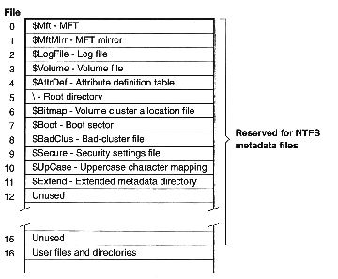
1. Basics: NTFS Master File Table
Notes:
NTFS’s Master File Table (MFT). Each entry is one kilobyte long and refers to a file. Since the MFT is a file, it has an entry in itself (the first entry). There’s a copy of the MFT called the MFT mirror. There are a number of other entries for system files and metadata files, and then the entries for ordinary files.
Each entry of the MFT plays the role of an inode. But, since the MFT is a file that, like any other file, may grow and shrink dynamically, these inode equivalents are not allocated statically but are allocated dynamically.

Slide 50
2. Crash Resiliency: In the Event of a Crash …
Most recent updates did not make it to disk
is this a big problem?
  equivalent to crash happening slightly earlier
  but you may have received (and believed) a message:
    “file successfully updated”
    “homework successfully handed in”
    “stock successfully purchased”
  there’s worse …

Slide 51
2. Crash Resiliency: File-System Consistency (1)
New Node
New Node
1
2
3
Notes:
In the event of a crash, the contents of the file system may well be inconsistent with any view of it the user might have. For example, a programmer may have carefully added a node to the end of the list, so that at all times the list structure is well-formed.

Slide 52

2. Crash Resiliency: File-System Consistency (2)
New Node
New Node
CRASH!!!
Not on disk
Not on disk
1
2
3
4
5
Notes:
But, if the new node and the old node are stored on separate disk blocks, the modifications to the block containing the old node might be written out first; the system might well crash before the second block is written out.

Slide 53
2. Crash Resiliency: How to Cope …
Don’t crash
Perform multi-step disk updates in an order such that disk is always consistent
  the consistency-preserving approach
  implemented via the soft-updates technique
Perform multi-step disk updates as transactions
  implemented so that either all steps take effect or none do
Notes:
The first approach is the most efficient, but tough to implement in practice …

Slide 54
2. Crash Resiliency: Maintaining Consistency
2) Then write this asynchronously
via the cache
New Node
Write this synchronously
to disk

Slide 55

2. Crash Resiliency: Innocuous Inconsistency
After crash:
Old Node
New Node
Notes:
If a crash occurs during the update scenario of the previous slide, it’s possible that the new node will be on disk, but there are no links to it. This is a problem, but a minor one: the new node can be cleaned up at a later time via garbage collection. Thus this (minor) inconsistency is innocuous — it causes no harm.

Slide 56
2. Crash Resiliency: Soft Updates
An implementation of the consistency-preserving approach
  should be simple:
    update cache in an order that maintains consistency
    write cache contents to disk in same order in which cache was updated
  although sometimes it isn’t …
    (assuming speed is important)

Slide 57
2. Crash Resiliency: Which Order?
directory
inode
data
block
containing
directory
entries
file
inode
Notes:
Here we’ve created a file in a directory, necessitating that a new data block be allocated to hold the directory entry. Thus, as shown in the slide, three items must be written to disk: the file’s inode, the directory’s new data block, and the directory’s inode. In what order should the blocks be written to ensure that no crash will leave the disk in an inconsistent state? Clearly first the file’s inode, then the directory’s data block, then the directory’s inode.

Slide 58
2. Crash Resiliency: However …
directory
inode
file
inode
data
block
containing
directory
entries
Notes:
Inodes aren’t large, so a number of them are put into a single disk block. It might happen then that the directory’s inode is in the same disk block as the file’s inode, and thus it’s impossible to write one without writing the other. So if the buffer cache contains the block containing both inodes as well as the block containing the data block, and both blocks have not yet been written to disk, it’s impossible to update the disk in a way that keeps it always consistent. We have a circular dependency that we hadn’t expected.

Slide 59
2. Crash Resiliency: Soft Updates
directory
inode
old
directory
inode
file
inode
data
block
containing
directory
entries
This is written to disk
Notes:
In the soft updates approach, when a cached block must be written out that contains an item that shouldn’t be written yet, that item is replaced with its prior contents, the block is written, and then the item is restored in the cache, to be written later.

Slide 60
2. Crash Resiliency: Soft Updates in Practice
Implemented for FFS in 1994
Used in FreeBSD’s FFS
  improves performance (over FFS with synchronous writes)
  disk updates may be many seconds behind cache updates

Slide 61
2. Crash Resiliency: Transactions
ACID property:
  atomic
    all or nothing
  consistent
    take system from one consistent state to another
  isolated
    have no effect on other transactions until committed
  durable
    persists

Slide 62
2. Crash Resiliency: Implementing this approach...
Journaling
  before updating disk with steps of transaction:
    record previous contents: undo journaling
    record new contents: redo journaling
Shadow paging
  steps of transaction written to disk, but old values remain
  single write switches old state to new

Slide 63
2. Crash Resiliency: Journaling: options
journal everything
  everything on disk made consistent after crash
  last few updates possibly lost
  expensive
journal metadata only
  metadata is made consistent after a crash
  user data is not made consistent after a crash
  last few updates possibly lost
  relatively cheap

Slide 64
2. Crash Resiliency: Ext3
A journaled file system used in Linux
same on-disk format as Ext2 (except for the journal)
  (Ext2 is an FFS clone)
supports both full journaling and metadata only

Slide 65
2. Crash Resiliency: Full Journaling in Ext3
File-oriented system calls divided into subtransactions
  updates go to cache only
  subtransactions grouped together
When sufficient quantity collected or five seconds elapsed, commit processing starts
  updates (new values) written to journal
  once entire batch is journaled, end-of-transaction record is written
  cached updates are then checkpointed — written to file system
  journal cleared after checkpointing completes

Slide 66
2. Crash Resiliency: Journaling in Ext3 (part 1)
Journal
File-system block cache
File system
/
another
cached
block
dir1
inode
dir1
data
another
inode
another
cached
block
dir2
inode
dir2
data
another
inode
dir1
free
vector
block
x
file1
inode
file1
data
dir2
another
inode
free
vector
block
y
file2
inode
file2
data
another
inode
Notes:
Scenario:
One process has created file1 in dir1
Another process has created file2 in dir2
journald thread has yet to commit processing, so operations only affect the cache

Slide 67
2. Crash Resiliency: Journaling in Ext3 (part 2)
Journal
File-system block cache
File system
file1
inode
dir1
data
/
new
file2
data
another
inode
file2
inode
dir2
data
another
cached
block
dir1
inode
dir1
data
another
inode
another
inode
dir1
inode
dir2
inode
another
cached
block
dir2
inode
dir2
data
another
inode
another
inode
another
inode
dir1
file1
data
file2
data
free
vector
block
x
file1
inode
file1
data
dir2
another
inode
free
vector
block
x
free
vector
block
y
free
vector
block
y
file2
inode
file2
data
another
inode
end of transaction
Notes:
Note that in the midst of all this (i.e., modified cache blocks written to journal, but not yet committed) there is new data written to file2.
A copy of the block needs to be created to help with servicing the update.

Slide 68
2. Crash Resiliency: Journaling in Ext3 (part 3)
Journal
File-system block cache
File system
file1
inode
dir1
data
/
new
file2
data
another
inode
file2
inode
dir2
data
another
cached
block
dir1
inode
dir1
data
another
inode
another
inode
dir1
inode
dir2
inode
another
cached
block
dir2
inode
dir2
data
another
inode
another
inode
another
inode
dir1
file1
data
file2
data
free
vector
block
x
file1
inode
file1
data
dir2
another
inode
file1
free
vector
block
x
free
vector
block
y
free
vector
block
y
file2
inode
file2
data
file2
another
inode
end of transaction
Notes:
Checkpointing starts

Slide 69
2. Crash Resiliency: Journaling in Ext3 (part 4)
Journal
File-system block cache
File system
file1
inode
dir1
data
/
new
file2
data
another
inode
file2
inode
dir2
data
another
cached
block
dir1
inode
dir1
data
another
inode
another
inode
dir1
inode
dir2
inode
another
cached
block
dir2
inode
dir2
data
another
inode
another
inode
another
inode
dir1
file1
data
file2
data
free
vector
block
x
file1
inode
file1
data
dir2
another
inode
file1
free
vector
block
x
free
vector
block
y
free
vector
block
y
file2
inode
file2
data
file2
another
inode
end of transaction

Slide 70
2. Crash Resiliency: Metadata-Only Journaling in Ext3
It’s more complicated!
Scenario (one of many):
  you create a new file and write data to it
  transaction is committed
    metadata is in journal
    user data still in cache
  system crashes
  system reboots; journal is recovered
    new file’s metadata are in file system
    user data is not
    metadata refer to disk blocks containing other users’ data

Slide 71
2. Crash Resiliency: Coping
Zero all disk blocks as they are freed
  done in “secure” operating systems
  expensive
Ext3 approach
  write newly allocated data blocks to file system before committing metadata to journal
  fixed?

Slide 72
2. Crash Resiliency: Yes, but …
Spencer deletes file A
  A’s data block x added to free vector
Robert creates file B
Robert writes to file B
  block x allocated from free vector
  new data goes into block x
  system writes newly allocated block x to file system in preparation for committing metadata, but …
System crashes
  metadata did not get journaled
  A still exists; B does not
  B’s data is in A

Slide 73
2. Crash Resiliency: Fixing the Fix
Don’t reuse a block until the transaction freeing it has been committed
  keep track of most recently committed free vector
  allocate from this vector

Slide 74
2. Crash Resiliency: Fixed Now?
Not yet...
Problems can arise involving operations on metadata
Text's example:
  File is created, but then both file and it's directory are deleted
  This is done in the same transaction
  Meanwhile another file is created but it re-used blocks previously holding metadata (for old files) to store data (for new file)

Slide 75
2. Crash Resiliency: The Fix
The problem occurs because metadata is modified, then deleted.
Don’t blindly do both operations as part of crash recovery
  no need to modify the metadata if there isn't a net change
  Ext3 puts a “revoke” record in the journal, which means “never mind …”

Slide 76
2. Crash Resiliency: Fixed Now?
Yes!
  (or, at least, it seems to work …)

Slide 77
2. Crash Resiliency: Shadow Paging
Refreshingly simple
Based on copy-on-write ideas
Examples
  WAFL (Network Appliance)
  ZFS (Sun)

Slide 78
2. Crash Resiliency: Shadow-Page Tree
Root
Inode file indirect blocks
Inode file data blocks
Regular file indirect blocks
Regular file data blocks
Notes:
Involves all in-use blocks in the file system

Slide 79
2. Crash Resiliency: Shadow-Page Tree: Modifying a Node
Root
Inode file indirect blocks
Inode file data blocks
Regular file indirect blocks
Regular file data blocks
Notes:
A leaf node in a shadow-page tree is modified (step 1).

Slide 80
2. Crash Resiliency: Shadow-Page Tree: Propagating Changes
Root
Snapshot root
Inode file indirect blocks
Inode file data blocks
Regular file indirect blocks
Regular file data blocks
Notes:
A leaf node in a shadow-page tree is modified (step 2). Copies are made of the leaf node and its ancestors all the way up to the root. A copy of the old root is maintained, pointing to a snapshot of the old version of the file system.
Scenario to be discussed is what happens if a crash occurs before the Root node (or überblock) is updated....

Slide 81
3. Directories: Desired Properties of Directories
No restrictions on names
Fast
Space-efficient
Notes:
Filesystems are not databases; rather they are design to allow easy browsing and retrieval based on names

Slide 82
3. Directories: S5FS Directories
Component Name
Inode Number
directory entry
.
1
..
1
unix
117
etc
4
home
18
pro
36
dev
93
Notes:
The root directory....
all entries are the same fixed length
directories searched sequentially

Slide 83
3. Directories: FFS Directory Format
117
16
4
u
n
i
x
\0
4
12
3
e
t
c
\0
18
484
3
u
s
r
\0
Free Space
Directory Block
Notes:
inode
entry length component length
component value
directory entries are variable length, added using a "first fit" approach.
directory-implementation performance is important... (caching, structures)
problem: assuming directory is large and consists of many blocks, how to find quickly the block that should contain a new entry?

Slide 84
3. Directories: Extensible Hashing (part 1)
h₂
Ralph
inode index
0
Lily
inode index
Joe
inode index
1
Belinda
inode index
2
Indirect buckets
George
inode index
Harry
inode index
insert(Fritz)
(h₂(Fritz) = 2)
3
Betty
inode index
Buckets

Slide 85
3. Directories: Extensible Hashing (part 2)
Ralph
inode index
0
Lilly
inode index
h₃
Joe
inode index
1
Belinda
inode index
2
George
inode index
Harry
inode index
3
Betty
inode index
Indirect buckets
Buckets

Slide 86
3. Directories: Extensible Hashing (part 3)
Ralph
inode index
0
Lilly
inode index
h₃
Joe
inode index
1
Belinda
inode index
2
Harry
inode index
3
Betty
inode index
Fritz
inode index
4
George
inode index
Indirect buckets
Buckets
Notes:
Note the new bucket is added at the end, and entry 6 of the indirect-buckets is redirected to this new bucket. There is a re-hash of the "Fritz", "Belinda" and "George", with the result that "Fritz" is stored in block 4, "George" is moved to block 4, and "Belinda" stays in 2.

Slide 87
3. Directories: B+ Trees (part 1)
a:
Ivan
Richard
b:
c:
d:
Danielle
Gaston
Lisa
Otto
Virginie
—
Alex
Bonnie
Charlie
Danielle
Earl
Frances
Ivan
Jeanne
Karl
Lisa
Matthew
Nicole
Otto
Paula
—
Richard
Shary
Tomas
Virginie
Walter
Gaston
—
—
Hermine
Notes:
Want to add "Igor"
Want to add "Lucy"

Slide 88
3. Directories: B+ Trees (part 2)
r:
Matthew
—
a:
a′:
Ivan
—
Richard
—
b:
c:
c:
c′:
d:
Danielle
Gaston
Lisa
—
Otto
—
Virginie
—
Alex
Earl
Gaston
Igor
Jeanne
Matthew
Otto
Walter
Danielle
Frances
Ivan
Karl
—
—
—
Lisa
Lucy
Bonnie
Hermine
—
Nicole
Paula
Virginie
Charlie
Richard
Shary
Tomas
Notes:
The result of adding entries for Igor and Lucy to the example of the previous slide.

Slide 89
B+ Trees (part 3)
a:
Ivan
Matthew
b:
c:
c′:
Danielle
Gaston
Lisa
—
Richard
Virginie
Bonnie
Danielle
Earl
Frances
Igor
Ivan
Jeanne
Charlie
Karl
Lucy
Nicole
Shary
Walter
Gaston
—
Alex
Hermine
Lisa
Matthew
—
Richard
Tomas
—
Virginie
Notes:
The directory after removing Paula and Otto.

Slide 90
3. Naming: Name-Space Management
/
File system 1
a
b
c
/
w
x
y
z
File system 2

Slide 91
3. Naming: Mount Points (1)
unix
etc
usr
mnt
dev
tty01
tty02
dsk1
dsk2
tp1
src
lib
bin
Notes:
A special file representing a disk does not provide access to the file system on the disk, but provides access to the disk as a device (the disk appears as if it were a single fixed-length file).

Slide 92
3. Naming: Mount Points (2)
unix
etc
usr
mnt
dev
tty01
tty02
dsk1
dsk2
tp1
src
lib
bin
mount /dev/dsk2 /usr
Notes:
To access a disk as a container for a file system, the directories within the disk must be somehow connected to our system-wide directory hierarchy. I.e., we must be able to follow a path, starting from the root, that leads into the directory hierarchy of the disk’s file system. We need more machinery than what we’ve seen up to now, since directory entries refer only to inodes within the file system containing the directory itself. The new mechanism is the notion of mounting, i.e., superimposing the root of a file-system’s directory hierarchy on top of some other directory that is already accessible from the root of the system-wide hierarchy. Thus paths that lead into the mounted-on directory reach the root of the file-system hierarchy instead. In the example of the slide, the path “/usr”, when followed after the mount command shown is executed, actually leads to the root of the file system contained within /dev/dsk2. Thus we can continue the path to “/usr/lib”. This is accomplished via some magic in the kernel, as we’ll soon see. The directory entry for “usr” (in the root directory), still contains the inode number of the original “/usr” directory (the one which has been mounted upon). This directory still exists; however, while it is mounted upon, its contents (and the files they refer to) are inaccessible (unless linked to via some other, accessible, directory).

Slide 93
4. Multiple Disks: Benefits of Multiple Disks
They hold more data than one disk does
Data can be stored redundantly so that if one disk fails, they can be found on another
Data can be spread across multiple drives, allowing parallel access

Slide 94
4. Multiple Disks: Logical Volume Manager
LVM
Disk
Disk
Spanning
  two real disks appear to file system as one large disk
Mirroring
  file system writes redundantly to both disks
  reads from one

Slide 95
4. Multiple Disks: Striping
 | Disk 1 | Disk 2 | Disk 3 | Disk 4
Stripe 1 | Unit 1 | Unit 2 | Unit 3 | Unit 4
Stripe 2 | Unit 5 | Unit 6 | Unit 7 | Unit 8
Stripe 3 | Unit 9 | Unit 10 | Unit 11 | Unit 12
Stripe 4 | Unit 13 | Unit 14 | Unit 15 | Unit 16
Stripe 5 | Unit 17 | Unit 18 | Unit 19 | Unit 20
Notes:
Disk striping: each stripe is written across all disks at once. The size of a “unit” may be anywhere from a bit to multiple tracks. If it’s less than a sector in size, then multiple stripes are transferred at once so that the amount of data per transfer per disk is an integer multiple of a sector.

Slide 96
4. Multiple Disks: Concurrency Factor
How many requests are available to be executed at once?
  one request in queue at a time
    concurrency factor = 1
    e.g., one single-threaded application placing one request at a time
  many requests in queue
    concurrency factor > 1
    e.g., multiple threads placing file-system requests

Slide 97
4. Multiple Disks: Striping Unit Size
1
2
3
4
Disk 1
Disk 2
Disk 3
Disk 4
1
1
1
1
2
2
2
2
3
3
3
3
4
4
4
4
Disk 1
Disk 2
Disk 3
Disk 4
Notes:
If we have only one waiting disk request at a time (a concurrency factor of 1), then a smaller striping unit is generally better than a larger one, since we can spread one request across lots of disks. But with more than one waiting disk request (a larger concurrency factor), it begins to make sense to have larger striping units, as the slide illustrates.
The top half of the slide shows four disks with a four-sector striping unit. Suppose we have requests for the four data areas shown, each four sectors in length. The four requests can be handled in roughly the time it takes to handle one, since the positioning for each of the requests can be done simultaneously as can the data transfer. The bottom half of the slide shows four disks with a one-sector striping unit. We have the same four requests, but in this case each is spread across all four disks, one sector per disk. Handling the requests requires first positioning the heads on all four disks for the first, then positioning the heads on all four disks for the second, and so forth. Thus the total positioning delays are four times that of the top half of the figure which has a larger striping unit.

Slide 98
4. Multiple Disks: Striping: The Effective Disk
Improved effective transfer speed
  parallelism
No improvement in seek and rotational delays
  sometimes worse
A system depending on N disks is much more likely to fail than one depending on one disk
  if probability of one disk’s failing is f
  probability of N-disk system’s failing is (1-(1-f)^{N})
  (assumes failures are independent, which is probably wrong …)

Slide 99
4. Multiple Disks: RAID to the Rescue
Redundant Array of Inexpensive Disks
  (as opposed to Single Large Expensive Disk: SLED)
  combine striping with mirroring
  5 different variations originally defined
RAID level 1 through RAID level 5
  RAID level 0: pure striping
    numbering extended later
  RAID level 1: pure mirroring

Slide 100
4. Multiple Disks: RAID Level 1
Data
Mirroring
Notes:
RAID level 1: mirroring.
Writes go to both disks
Reads go to either one

Slide 101
4. Multiple Disks: RAID Level 2
Data
Data bits
Bit interleaving;
ECC
Check bits
Notes:
RAID level 2: bit interleaving with an error-correcting code.
Can correct one bit of error, but can detect two bits
Only RAID configuration which you cannot by. Disk drives these days implement hamming code error correction already!

Slide 102
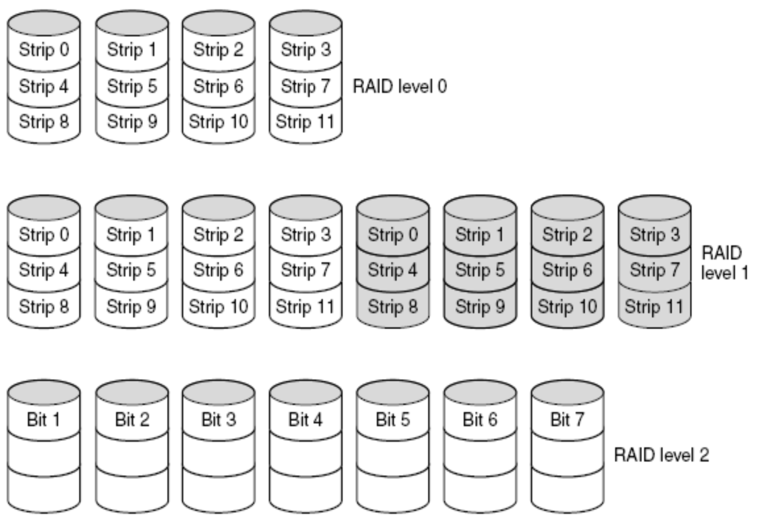
4. Multiple Disks: RAID Levels 0, 1, 2

Slide 103
4. Multiple Disks: RAID Level 3
Data
Data bits
Bit interleaving;
Parity
Parity bits
Notes:
RAID level 3: bit interleaving with parity bits.

Slide 104
4. Multiple Disks: RAID Level 4
Data
Data blocks
Block interleaving;
Parity
Parity blocks
Notes:
RAID level 4: block interleaving with parity blocks.

Slide 105
4. Multiple Disks: RAID Level 5
Data
Block interleaving;
Parity
Data and parity blocks
Notes:
RAID level 5: block interleaving with parity blocks. Rather than dedicating one disk to hold all the parity blocks, the parity blocks are distributed among all the disks. For stripe 1, the parity block might be on disk 1; for stripe 2 it would be on disk 2, and so forth. If we have eleven disks, then for stripe 11 the parity block would be back on disk 1.

Slide 106
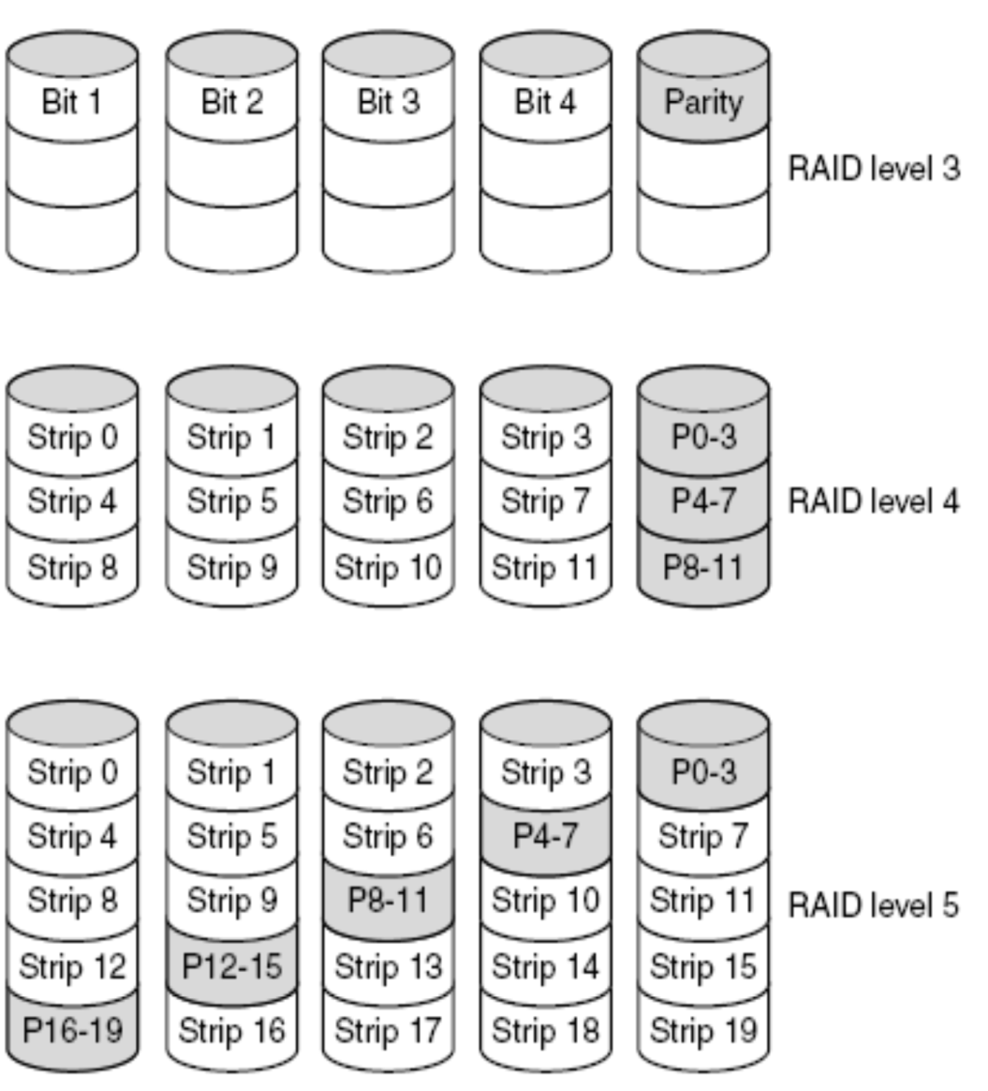
4. Multiple Disks: RAID Levels 3, 4, 5

Slide 107
4. Multiple Disks: RAID 4 vs. RAID 5
Lots of small writes
  RAID 5 is best
Mostly large writes
  multiples of stripes
  either is fine
Expansion
  add an additional disk or two
  RAID 4: add them and recompute parity
  RAID 5: add them, recompute parity, shuffle data blocks among all disks to reestablish check-block pattern

Slide 108
4. Multiple Disks: Beyond RAID 5
RAID 6
  like RAID 5, but additional parity
  handles two failures
Cascaded RAID
  RAID 1+0 (RAID 10)
    striping across mirrored drives
  RAID 0+1
    two striped sets, mirroring each other

