Slide 1
Memory Management
I: Main Memory
Notes:
Page <number>

Slide 2
Agenda
Background
Swapping
Continuous Memory Allocation
Paging
Segmentation

Slide 3

1. Background (1): Storage hierarchy
CPU direct access
  registers
  (main) memory
    cache
CSc 360
Notes:
Page <number>

Slide 4

1. Background (2): Memory access
Access by address
  for both code and data
Address binding
  compiler time: absolute code
    MS-DOS .COM format, 64KB limit
  load time: relocatable code
    MS-DOS .EXE format
  execution time
CSc 360
Notes:
Page <number>

Slide 5
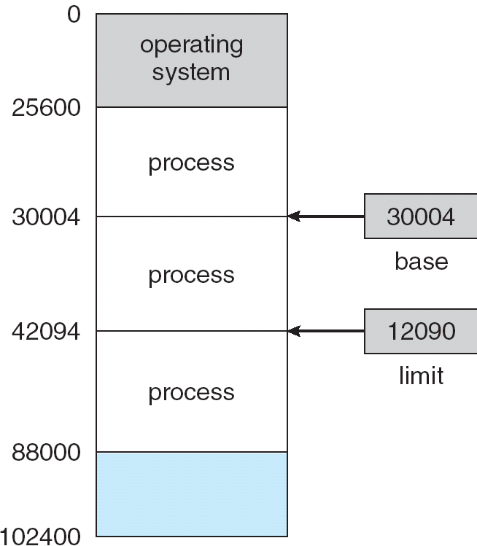
1. Background (3): Memory space
Logical memory
  seen by CPU
  virtual memory
Physical memory
  seen by memory unit
Address binding
  compile/load time: logical/physical addr same
  execution time: logical/physical address differ
CSc 360
Notes:
Page <number>

Slide 6

Background (4):
Memory management
MMU: memory management unit
  logical/physical memory mapping
Relocation register
  physical address =
  logical address +
  relocation base
Dynamic loading
Dynamic linking
CSc 360
Notes:
Page <number>

Slide 7


1. Background (5): Memory protection
With base and limit registers
With limit and relocation registers
physical
CSc 360
Notes:
Page <number>

Slide 8

2. Swapping
Swap out
  e.g., low priority
  reduce the degree of
  multiprogramming
Swap in
  address binding
Swapping overhead
  on-demand
CSc 360
Notes:
Page <number>

Slide 9
3. Contiguous Memory Allocation (1)
Single-partition allocation
  one for OS
  the other one for user process
Multi-partition allocation
OS
OS
OS
OS
process 5
process 5
process 5
process 5
process 9
process 9
process 8
process 10
process 2
process 2
process 2
process 2
CSc 360
Notes:
Page <number>

Slide 10
3. Contiguous Memory Allocation (2): Partition allocation
First-fit
  first “hole” big enough to hold
  faster search
Best-fit
  smallest “hole” big enough to hold
Worst-fit
  largest “hole” big enough to hold
CSc 360
Notes:
Page <number>

Slide 11
3. Contiguous Memory Allocation (3): Fragmentation
External fragmentation
  enough total available size, not individual ones
Compaction
  combine all free partitions together
  possible if dynamic allocation at execution time
  issues with I/O (e.g., DMA)
Internal fragmentation
  difference between allocated and request size
CSc 360
Notes:
Page <number>

Slide 12
4. Paging (1)
Noncontiguous allocation
  in fixed size pages
  page size: normally 512B ~ 8KB
Fragmentation
  no external fragmentation
    unless there is no free page
  still have internal fragmentation
    maximum: page_size - 1
CSc 360
Notes:
Page <number>

Slide 13
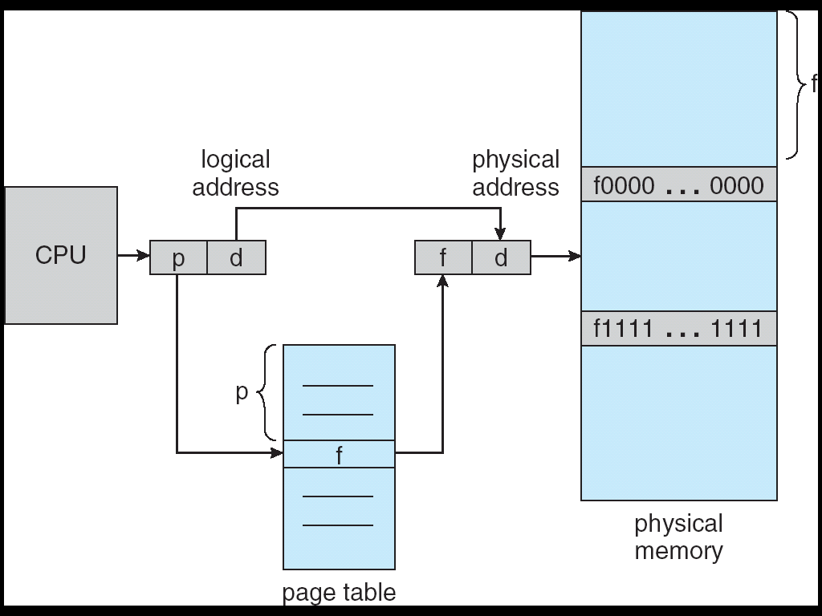
4. Paging (2): Supporting paging
Access by address
  seen by CPU
    logical page number
    page offset
    “frame”
  seen by memory
    physical page number
    page offset
Page-table registers
  one more memory access
CSc 360
Notes:
Page <number>

Slide 14

4. Paging (3): Supporting paging: more
TLB
  translation
  look-aside buffer
  associative
Access by content
  if hit, output frame #
  otherwise, check
  page table
CSc 360
Notes:
Page <number>

Slide 15
4. Paging (4): Page table
CSc 360
Notes:
Page <number>

Slide 16

4. Paging (5): Paging example
CSc 360
Notes:
Page <number>

Slide 17
4. Paging (6): Page table with TLB
Translation Look-aside Buffer (TLB)
  associative memory
CSc 360
Notes:
Page <number>

Slide 18

4. Paging (7): Page table: valid bit
CSc 360
Notes:
Page <number>

Slide 19
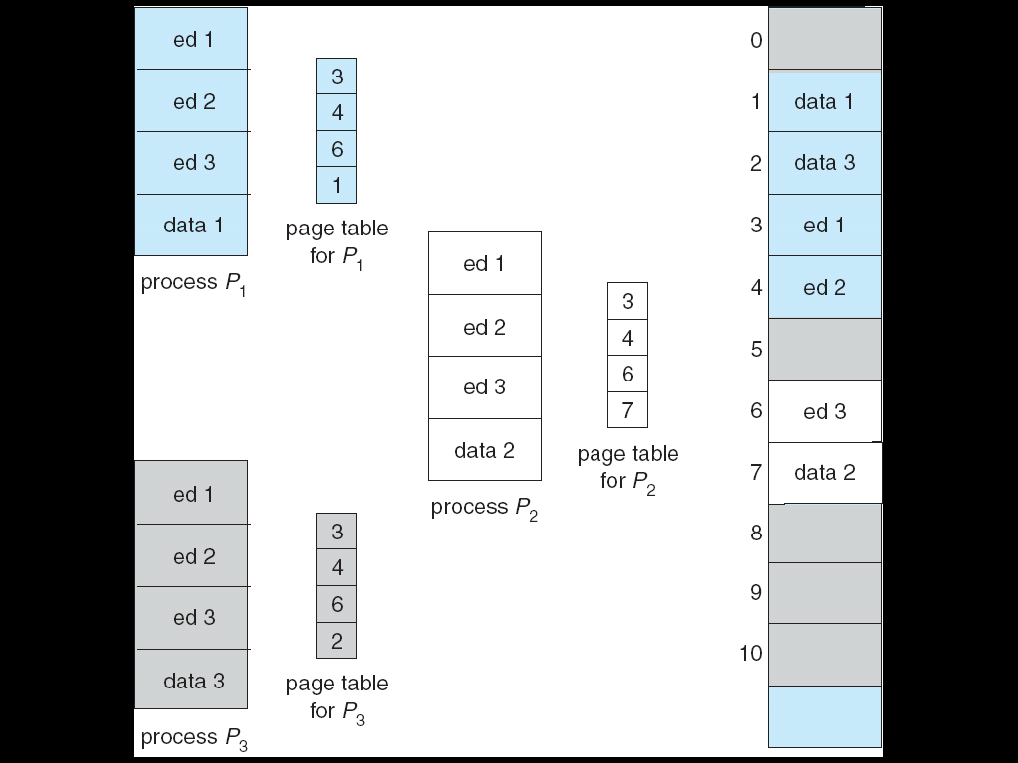
4. Paging (8): Shared pages
Shared code
  one read-only code
  same address in
  logical space
Private code + data
  one copy per
  process
CSc 360
Notes:
Page <number>

Slide 20


4. Paging (9): Hierarchical page table
Difficulty with a table of
too many entries
  where to keep the table
  how to lookup efficiently
Solution
  e.g., 2-level table
CSc 360
Notes:
Page <number>

Slide 21

4. Paging (10): Hash page table
Hash + linked list
CSc 360
Notes:
Page <number>

Slide 22

4. Paging (11): Inverted page table
When
  physical space
  << logical space
Tradeoff
  time
  space
CSc 360
Notes:
Page <number>

Slide 23

5. Segmentation (1): User's view of a program
A collection of segments
  main program
  symbol table
  procedures/functions
  data
  stacks
  heaps
CSc 360
Notes:
Page <number>

Slide 24
5. Segmentation (2): Logical view of segmentation
1
1
4
2
3
4
2
3
user space
physical memory space
CSc 360
Notes:
Page <number>

Slide 25
5. Segmentation (3): Segmentation Architecture
Logical address consists of a two tuple:
<segment-number, offset>,
Segment table – maps two-dimensional physical addresses; each table entry has:
  base – contains the starting physical address where the segments reside in memory
  limit – specifies the length of the segment
Segment-table base register (STBR) points to the segment table’s location in memory
Segment-table length register (STLR) indicates number of segments used by a program;
segment number s is legal if s < STLR
CSc 360
Notes:
Page <number>

Slide 26

5. Segmentation (4): Segment table
CSc 360
Notes:
Page <number>

Slide 27

5. Segmentation (5): Example of segmenting
CSc 360
Notes:
Page <number>

