Slide 1
Memory Management
II: Virtual Memory
Notes:
Page <number>

Slide 2
Agenda
Background
Demand Paging
Copy-on-Write
Page Replacement
Allocation of Frames
Thrashing
Memory-Mapped Files

Slide 3
1. Background (1): Virtual memory
Load an entire process in physical memory?
  not all addresses accessed at the same time
  some even not used before swapped out!
Virtual memory
  logical space >> physical space
    only load the portion being used or to be used
  more (partial) processes in physical memory
  faster swap in/out
CSc 360
Notes:
Page <number>

Slide 4

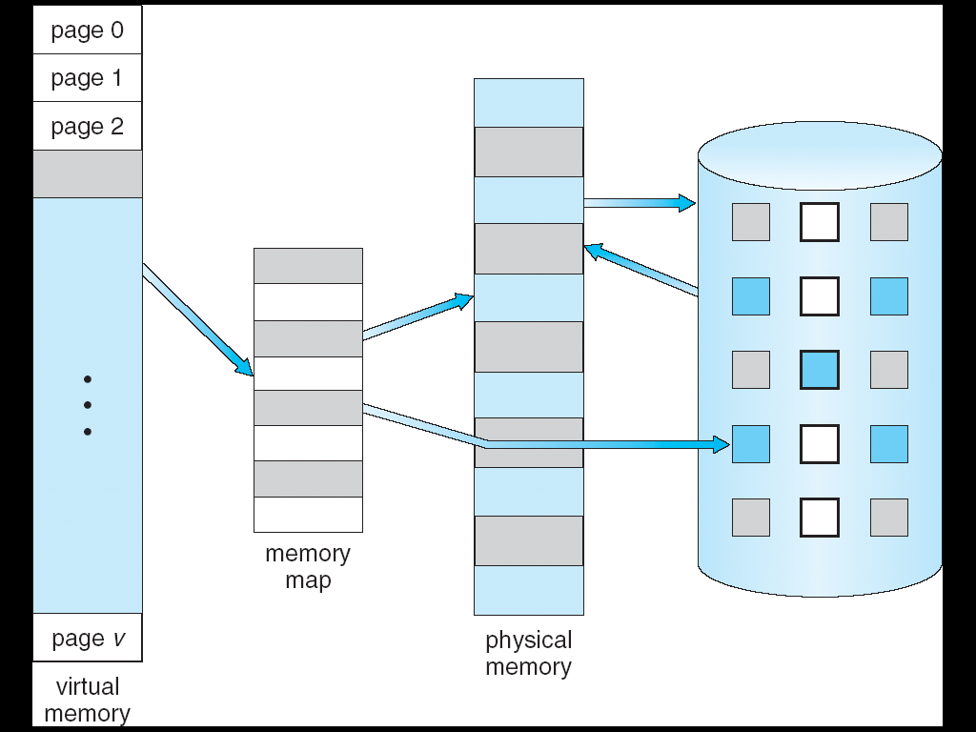
1. Background (2): Virtual vs physical memory
CSc 360
Notes:
Page <number>

Slide 5

2. Demand paging (1)
On demand
  when used
    being referenced
    really invalid reference?
      error!
    valid but not-in-memory
      page in
  lazy pager
  valid-invalid bit
Q: Demand segmenting?
CSc 360
Notes:
Page <number>

Slide 6

2. Demand paging (2): Page fault
Reference
Trap
  to OS
Page in
Update
Restart
  issues
Q: block move instruction
CSc 360
Notes:
Page <number>

Slide 7
2. Demand paging (3): performance
Page Fault Rate 0 <= p <= 1.0
  if p = 0, no page faults
  if p = 1, every reference is a fault
Effective Access Time (EAT)
      EAT = (1 – p) x memory access
        + p (page fault overhead
        + swap page out
        + swap page in
        + restart overhead)
CSc 360
Example
Notes:
Page <number>

Slide 8
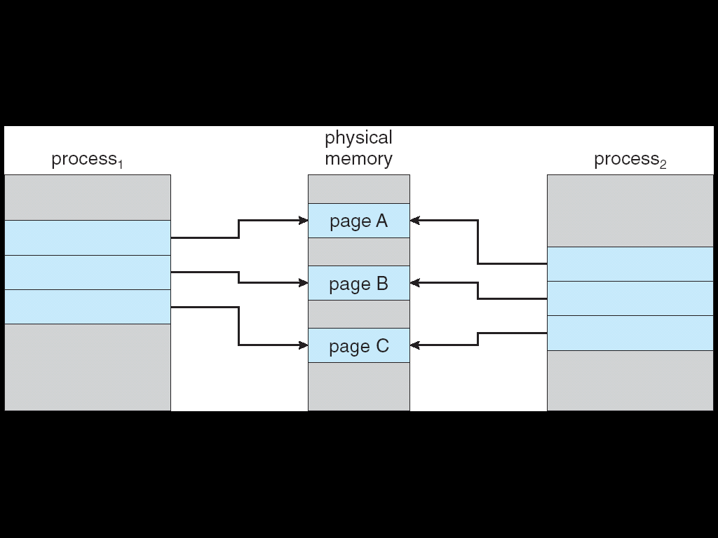
3. Copy-on-write
Share read-only pages
page C’
CSc 360
Notes:
Page <number>

Slide 9

4. Page Replacement (1): The need
CSc 360
Notes:
Page <number>

Slide 10

4. Page Replacement (2): Basic page replacement
Page in
  no free frame?
    choose a victim
    swap out
      dirty bit
Algorithms
  allocation
  replacement
Reduce fault rate
CSc 360
Q: modify bit
Notes:
Page <number>

Slide 11
4. Page Replacement (3): First-in-first-out (FIFO)
Reference string
  1, 2, 3, 4, 1, 2, 5, 1, 2, 3, 4, 5
3 frames
4 frames
Belady’s Anomaly
  more frames: more page faults!
1
1
4
5
2
2
1
3
9 page faults
3
3
2
4
1
1
5
4
2
2
1
5
10 page faults
3
3
2
4
4
3
CSc 360
Notes:
Page <number>

Slide 12
4. Page Replacement (4): Optimal algorithm
Replace the page will not be used for the longest period of time
  how do you know the future?!
    if history is of any indication …
1
4
2
6 page faults
3
4
5
CSc 360
Q: how to achieve optimality?
Notes:
Page <number>

Slide 13
4. Page Replacement (5): Least recently used (LRU)
Replace the least recently used
Counter implementation
  copy timestamp
  search to replace
Stack implementation
  move to top
  replace the bottom
1
1
1
1
5
2
2
2
2
2
3
5
5
4
4
4
4
3
3
3
CSc 360
Notes:
Page <number>

Slide 14
4. Page Replacement (6): LRU approximation algorithms
Additional-reference-bits algorithm
  set reference bit on reference
  shift into a history byte on timer
  least-recently-used one has lowest history byte
Second-chance algorithm
  if 0, replace
  if 1, change to 0 and check the next page
  circular queue
CSc 360
Notes:
Page <number>

Slide 15
4. Page Replacement (7): Counting-based algorithms
Counter
  number of references
Least frequently used (LFU)
  replace the one with the smallest counter
  aging necessary
Most frequently used (MFU)
  new page has small counter
    and might be referenced soon
CSc 360
Notes:
Page <number>

Slide 16
4. Page Replacement (8): Page buffering
Keep a pool of free pages
  speed up swapping in desired pages
  no need to wait a page becomes free
Keep a list of modified pages
  synch with disk when paging is idle
  reduce overhead when swapping out
Reuse “clean” pages from the pool
  on page fault, check free pool first
CSc 360
Notes:
Page <number>

Slide 17
5. Page allocation (1)
A process needs minimum number of pages
  e.g., IBM 370: 6 pages to handle SS MOVE
    instruction is 6 bytes, might span 2 pages
    2 pages to handle from
    2 pages to handle to
Two major allocation schemes
  fixed allocation
  priority allocation
CSc 360
Notes:
Page <number>

Slide 18
5. Page allocation (2): Fixed allocation
Equal allocation
  M free pages
  N requesting processes
  allocation: floor(M/N) each
    some processes may request less than M/N
Proportional allocation
  each process requests s_{i}; all request S=sum s_{i}
  allocation: s_{i}/S*M
CSc 360
Notes:
Page <number>

Slide 19
5. Page allocation (3): Priority allocation
Allocation proportional to priority
  higher priority process gets more pages allocated when necessary
On page fault
  select for replacement one of its frames.
  select for replacement a frame from a process with lower priority number
Global vs local replacement
CSc 360
Notes:
Page <number>

Slide 20

6. Thrashing (1)
Thrashing
  more time on paging than executing
    busy I/O, idle CPU
    more processes admitted, more page faults
    more processes in thrashing!
Why thrashing
  paging: explore locality
  thrashing: locality explored too much!
CSc 360
Notes:
Page <number>

Slide 21

6. Thrashing (2): Paging and thrashing
Why does thrashing occur?
  sum of size of locality > total memory size
CSc 360
Notes:
Page <number>

Slide 22

6. Thrashing (3): Working-set model
Prevent thrashing
  local replacement
  sufficient provisioning
  working-set model
    working-set window
      most recent page references
    working-set size (WSS)
      number of unique page references
  when sum WSS_{i}>M, reduce multiprogramming!
CSc 360
Notes:
Page <number>

Slide 23

7. Memory-mapped files (1): Memory sharing
CSc 360
Notes:
Page <number>

Slide 24
7. Memory-mapped files (2)
Memory-mapped file I/O allows file I/O to be treated as routine memory access by mapping a disk block to a page in memory
A file is initially read using demand paging. A page-sized portion of the file is read from the file system into a physical page. Subsequent reads/writes to/from the file are treated as ordinary memory accesses.
Simplifies file access by treating file I/O through memory rather than read() write() system calls
Also allows several processes to map the same file allowing the pages in memory to be shared
CSc 360
Notes:
Page <number>

Slide 25

7. Memory-mapped files(3):
Memory-mapped file sharing
CSc 360
Notes:
Page <number>

