Slide 1
Interfaces to OS Services
Notes:
Page <number>

Slide 2
Agenda
OS Services
Command Line Interfaces
3. GUI Interfaces
System Calls
API
Unix Manual

Slide 3
1. OS services (1)
User/programmer interfaces
  command line, GUI, API, system calls
Program execution
I/O operation
File manipulation
Process communication
Error handling: software/hardware error
Notes:
Page <number>

Slide 4
1. OS services (2)
Resource allocation and arbitration
  CPU, memory, storage, I/O
Resource sharing and protection
  among processes, users, computers
  authentication, authorization, accounting
Different interfaces to these services
  regular user, application programmer, system programmer, system designer
Notes:
Page <number>

Slide 5
2. Command line interface
E.g.
  Microsoft DOS: \command.com
  Linux: /bin/bash
Interactivity: interpreter
Implementation
  internal: dir (DOS), cd (DOS/Unix)
  external: ls (Unix)
Programmability: shell script
Notes:
Page <number>

Slide 6
3. Graphics user interface
E.g.
  Microsoft Windows
  K Desktop Environment (KDE)
Interactivity: point-and-click, drag-and-drop
Implementation
  integrated with OS
  OS front-end
Programmability: e.g., AutoIt
Notes:
Page <number>

Slide 7
4. System calls (1)
Primitive interfaces to OS services
System call categories
  process control
    fork, exec*, wait, kill, signal, exit, etc
  file/device manipulation
    creat[e], open, read, write, lseek, close, etc
    socket, bind, listen, accept, connect, etc
  information manipulation
    time, getpid, getgid, gethostname, etc
Notes:
Page <number>

Slide 8
4. System call examples (2)
Copy (the content of) file A to file B
  in CLI: cp /path/to/a /path/to/b
  in GUI: Ctrl-C and Ctrl-V, Ctrl-Drag
With system calls
  open(“/path/to/a”, O_RDONLY);
  creat(“/path/to/b”, S_IRWXU);
    open() with O_CREAT|O_WRONLY|O_TRUNC
  read() and write()
  close()
Notes:
Page <number>

Slide 9
4. System call implementation (3)
Software interrupt
  e.g., INT21H in DOS
  command: AH (e.g.,2A/2B: get/set system date)
  parameters
    in registers
    on system stack
    in memory (pointed by registers)
  return status: in specific registers
  return data
Notes:
Page <number>

Slide 10

4. System call flows (4)
Notes:
Page <number>

Slide 11
5. API (1)
E.g.
  Win32 API: Windows
  POSIX API: Unix, Linux, OSX, (Windows)
  Java API: Java JVM
API: another layer of abstraction
  mostly OS-independent
  higher level of functionality
    implemented by a series of system calls and more
Notes:
Page <number>

Slide 12
5. API (2): examples
Copy (the content of) file A to file B
With C library
  fopen(“/path/to/a”, “r”);
  fopen(“/path/to/b”, “w”);
  fread() and fwrite()
    formatted I/O: element size, # of elements
    buffered I/O: streams
  fclose()
Notes:
Page <number>

Slide 13
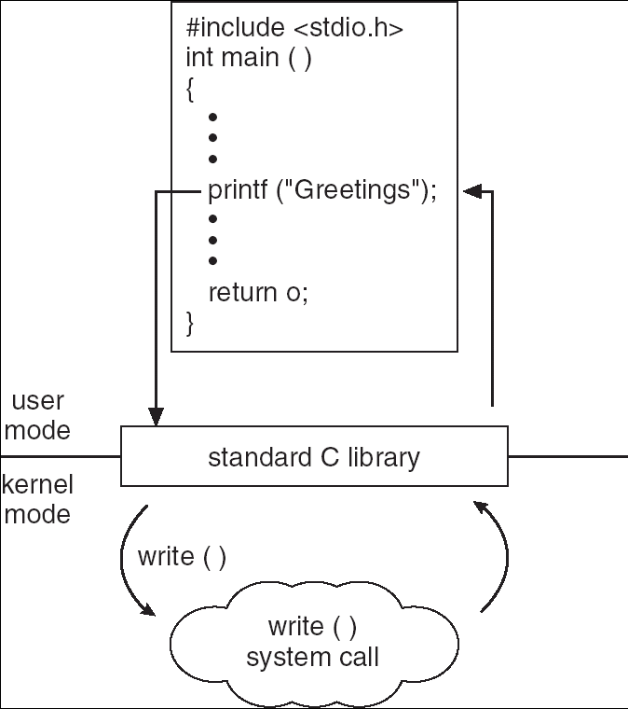
5. API (3): flows
Notes:
Page <number>

Slide 14
6. Unix manual
Manual sections
  1 user commands
  2 system calls
  3 C library functions
  4 device and network interfaces
  …
E.g.
  man 1 open; man 2 open
Notes:
Page <number>

