Slide 1

Notes:
Are you a developer looking to contribute to open source software?
Are you worried that your contributions will become part of a dead code base?
If you answered yes to these questions, then stick around because this presentation is for you!

Slide 2

The Attributes of Healthy Open Source Python Projects
Derek Robinson, Keanelek Enns, Neha Koulecar, and Manish Sihag
Notes:
My name is Keanelek Enns, and today I will be presenting my team’s work on the attributes of healthy open source python projects

Slide 3
How do you define the health of an open source project?
Define health as probability of survival at a given point in time
Many definitions of survival for OSS [1, 5, 9]
We define it as having recorded revisions within an observed time frame
How do we analyze survival you might ask?
Using survival analysis!
Notes:
So, what does it mean for an open source project to be healthy?
---------------
We define health as the probability of a project’s survival at a given point in time.
But what does it mean for a software project to survive?
---------------
There are many working definitions of survival for open source software
---------------
We define survival as having recorded revisions in a repository’s history during an observed time frame. That is, a project is considered alive upon observing its first revision, and dead upon observing its last revision within the time frame, unless there is good reason to believe it will continue to be revised afterwards.
---------------
Alright, with our definitions clear, you might wonder, how do we analyze such survival?
---------------
Using survival analysis of course!

Slide 4
What is survival analysis and how has it been used?
Survival analysis is a set of statistical methods which analyze “time to event” data [2]
In the context of OSS, some examples of events of interest include:
Developer abandonment [3]
Bug-fixes for recently modified files [4]
Project abandonment [1, 5, 9]
Our study is a replication of Ali et al. [9]
Notes:
---------------
Survival analysis is a set of statistical methods which analyze “time to event” data.
Where the event of interest could be the death of a patient undergoing a treatment.
---------------
In the context of open source software, some events of interest include
---------------
Developer abandonment,
---------------
Bug fixes for recently modified files,
---------------
and Project abandonment, which is the event of interest for our study.
---------------
It should be noted that the study we present here is, in part, a replication of Ali et al whom we refer to as the original authors from here on.

Slide 5
Our Research Questions
How do major releases, the type of hosting service, the use of multiple hosting services, and the size of the volunteer team affect the probability of survival for an open source Python project?
How does the revision frequency for an open source Python project affect the probability of its survival?
How do the findings of frequentist survival analysis differ from Bayesian survival analysis?
Notes:
In our study, we aim to explore the effects of certain attributes on the survival probability of open source projects.
-----------
We study the same attributes as the original authors
------------
As well as the effect of revision frequency in the same context.
------------
Finally, we wish to compare the traditional frequentist approach to survival analysis with that of the Bayesian approach.

Slide 6
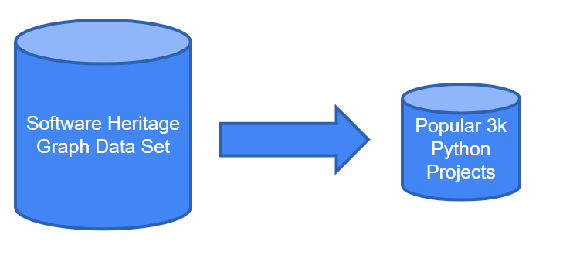
Data
Software Heritage Graph Data Set (popular-3k-python)​ [10]
Snapshots of 3000 popular python projects​
Hosted on GitHub, GitLab, Debian and PyPI​
Between 2005 to 2018
Notes:
We used the same data set as the original authors, which is a subset of the Software Heritage Graph, and contains useful information on approximately 3000 open source python projects.
The time frame for this study was between 2005 and early 2018.

Slide 7
Approach
Kaplan-Meier (K-M) Survival Estimator​
Non-parametric technique​
Visual representation of survival probabilities
Cox Proportional-Hazards Model ​
Regression model ​
Estimate effect of predictor variables on project health as a ratio
Bayesian Survival Analysis​
Parametric technique
Encode domain knowledge in Prior distribution​
Posterior distributions of model parameters [7]​
Visual representations comparable to K-M results
Notes:
---------------
In this study we used the Kaplan Meier estimator to create visual representations of survival probabilities over time (known as KM curves)
---------------
We then used the Cox Proportional-Hazards model to quantify the effect of predictor attributes as a hazard ratio
---------------
Finally, we applied bayesian inference techniques using an exponential prior distribution which produced visual representations comparable to KM curves.

Slide 8
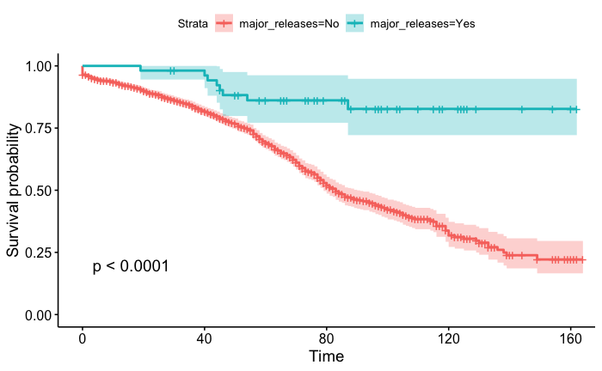
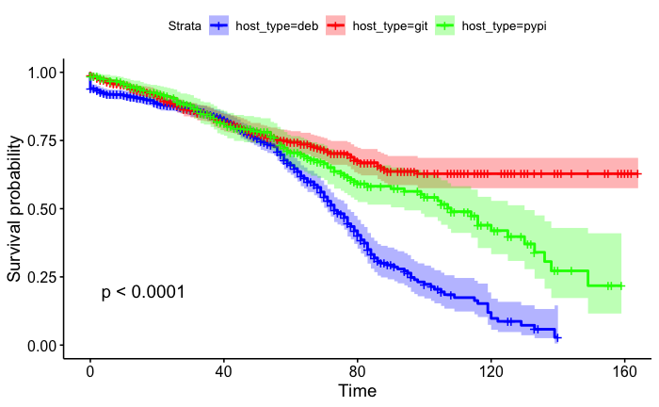
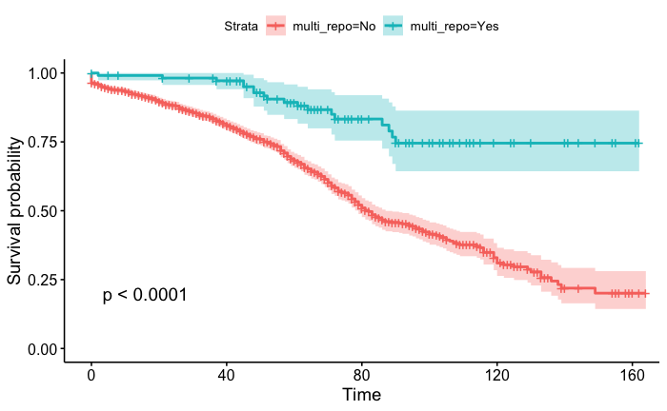
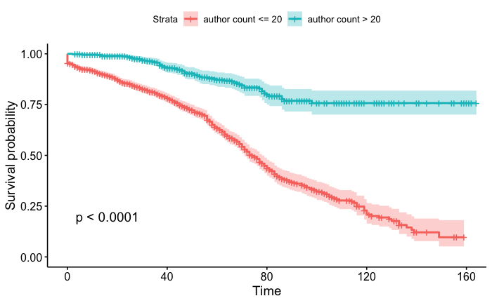
Notes:
Here we see the KM curves generated to answer our first research question.
The results shown here are extremely similar to the results found by the original authors, as would be expected in a replication.
While these results could be discussed in great detail, the most significant difference is found in the curves illustrating the effect of author counts on a project’s survival, which have the smallest confidence interval and indicate that having a larger network of developers significantly increases a project’s probability of surviving an extended period of time.

Slide 9
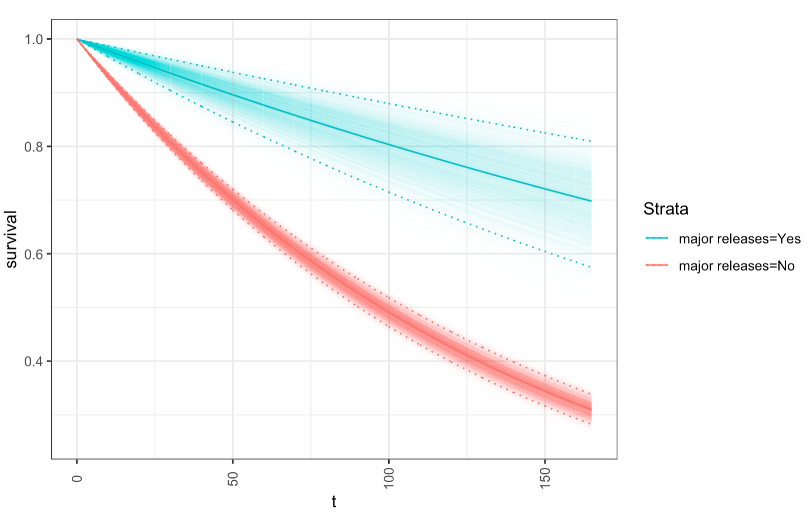
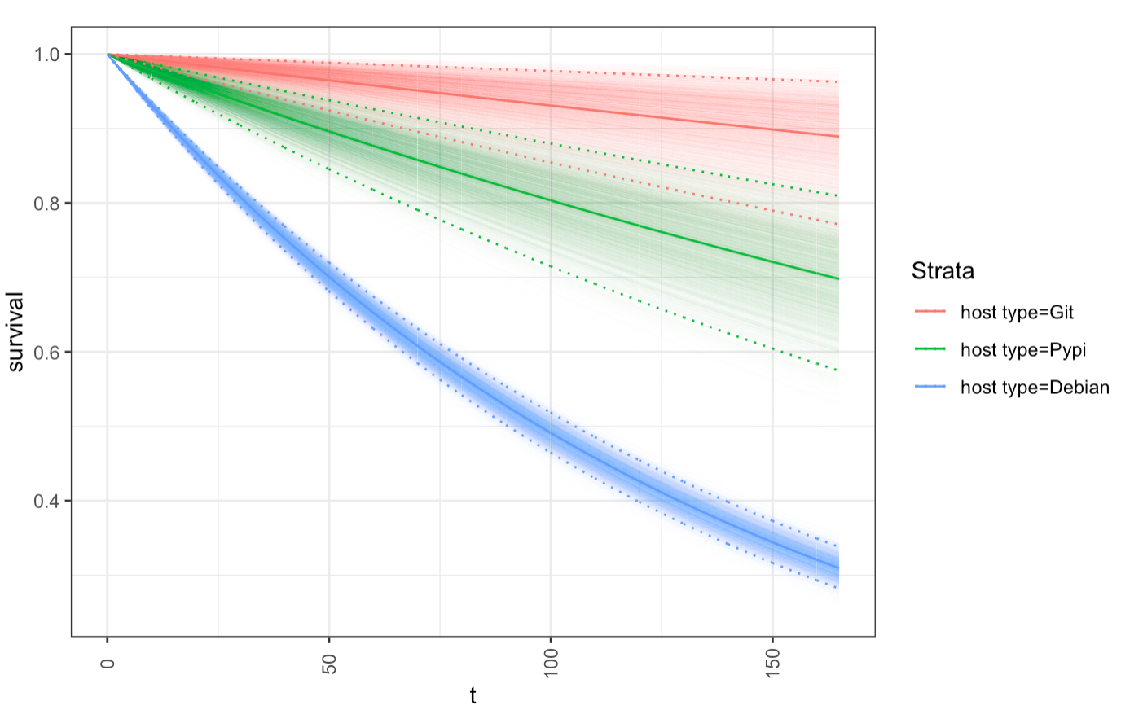
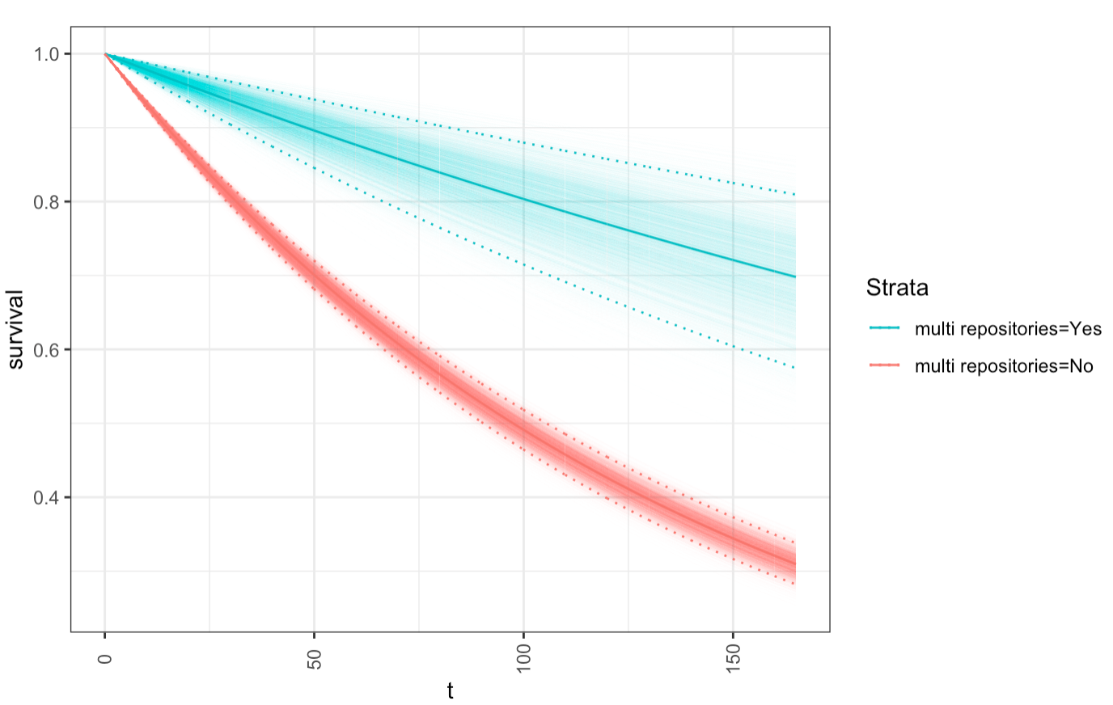
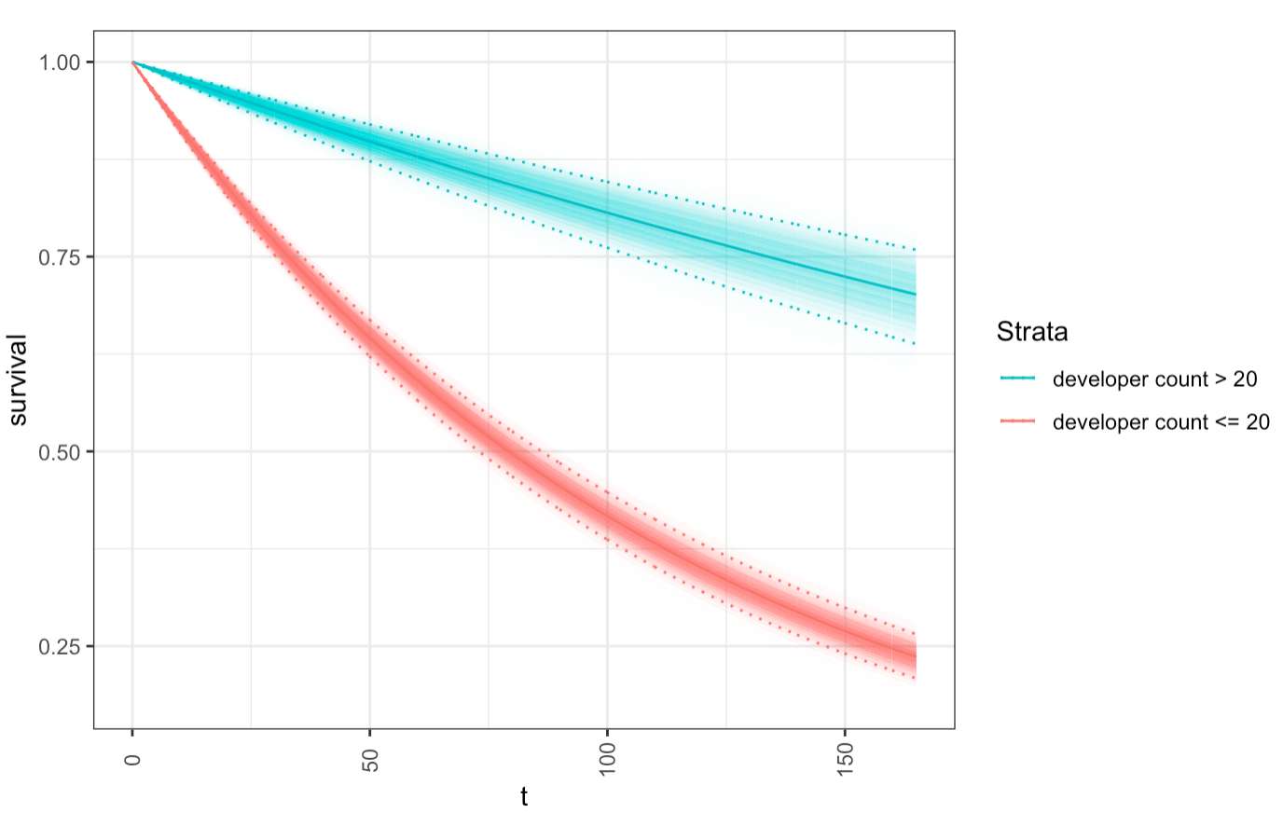
Notes:
Answering our third research question, we see the results of the Bayesian inference performed on the same attributes.
We note that, while the KM curves reflect the data set more accurately, these models use prior knowledge about survival analysis encoded as an exponential distribution. This model is then updated given the data, but without overfitting.
The hope is that these models are able to predict software durations when given new data sets.

Slide 10
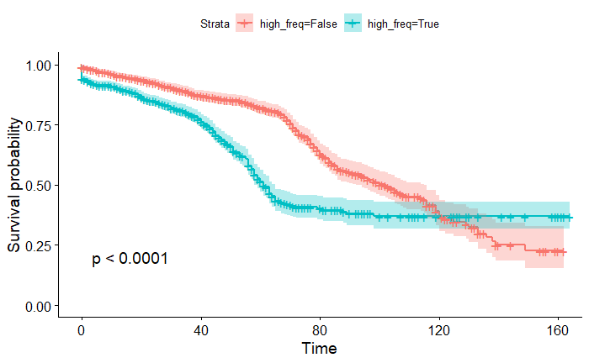
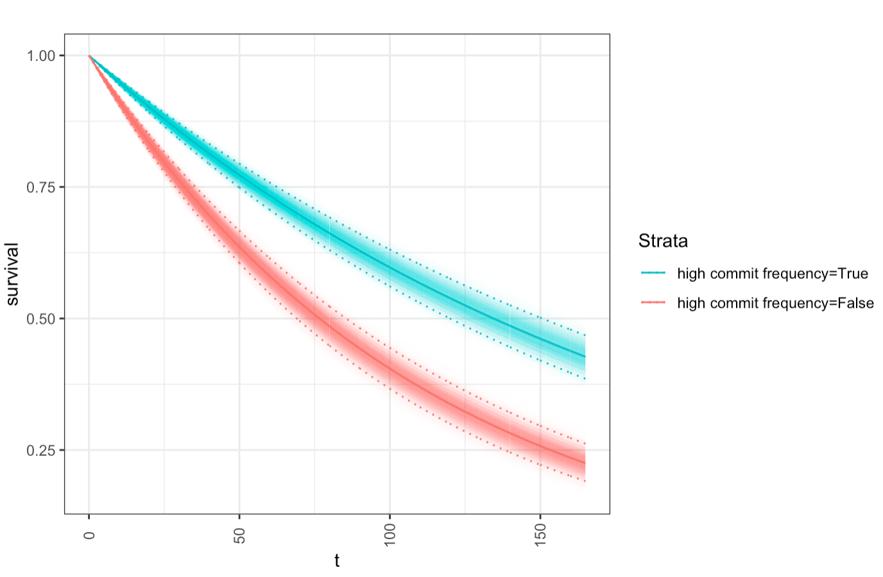
Notes:
To answer our second research question, we performed the same analysis and divided projects into those that had revision frequencies above and below the median frequency.
This attribute has a less significant impact on survival probability when compared to the original set of attributes, though useful inferences can still be drawn from it.

Slide 11
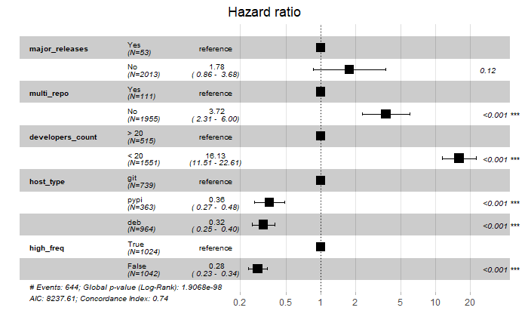
Notes:
This table outlines the results of the Cox-Proportional Hazards Model on all of the studied attributes.
---------------
This column contains the hazard ratio, which indicates the probability of abandonment occurring relative to the reference feature.
The further a feature’s black box is to the right, the higher the hazard ratio or risk of abandonment
This model gives heavier weight to the period of the study containing more projects. That is, the left most portion of the previously shown graphs.

Slide 12
Implications
Demonstrates need for improved reproducibility and artifacts
First known application of Bayesian survival analysis on OSS duration
Priors chosen based on survival analysis performed in other domains [7,8] should be studied further
Gives organizations, coordinators, and developers confidence in the projects they rely on, manage, and contribute to
Notes:
The important implications of this study are now outlined
---------------------------------------
Though our results were qualitatively similar to those of the original authors, it is suspected that a variation in approaches for data retrieval and the analysis tools used caused quantitative discrepancies.
We therefore call for researchers to improve the reproducibility of their studies by providing artifacts.
---------------------------------------
To our knowledge, this is the first application of a Bayesian approach to survival analysis on open source software duration.
---------------
Prior distributions were chosen based on survival analysis done in other domains, but more investigation should be done as to whether these priors are appropriate for this domain and whether the models from this study accurately predict durations of different data sets.
-----------------------
These results keep practitioners informed and give them confidence about which projects they can rely on.

Slide 13
Developer Discretion is Advised
WARNING
Notes:
Warning
Developer discretion is advised
It may be the case that projects supporting good causes do not exhibit the attributes outlined in this study.
Developers should not be deterred from helping such projects simply based on how well the project is already doing.
Remember to use your discretion when choosing where your efforts go, who knows, your active participation and promotion may mean the difference between a project's survival or abandonment.

Slide 14

Notes:
Now that you can recognize the attributes of a long-lasting open source project, get out there and make your efforts count!

Slide 15
References
[1] Nicholas Evangelopoulos, Anna Sidorova, Stergios Fotopoulos, and Indushobha Chengalur-Smith. 2008. Determining process death based on censored activity data. Communications in Statistics—Simulation and Computation®37, 8 (2008), 1647–1662. https://doi.org/10.1080/03610910802140224
[2] F. Emmert-Streib and M. Dehmer, “Introduction to Survival Analysis in Practice,” Machine Learning and Knowledge Extraction, vol. 1, no. 3, pp. 1013–1038, Sep. 2019 [Online].
[3] Courtney Miller, David Gray Widder, Christian Kästner, and Bogdan Vasilescu. 2019. Why do people give up flossing? A study of contributor disengagement in open source. In IFIP International Conference on Open Source Systems. Springer, 116–129.
[4] H. Aman, S. Amasaki, T. Yokogawa, and M. Kawahara, “A survival analysis of source files modified by new developers,” in International Conference on Product-Focused Software Process Improvement. Springer, 2017, pp. 80–88.
[5] I. Samoladas, L. Angelis, and I. Stamelos, “Survival analysis on the duration of open source projects,” Information and Software Technology, vol. 52, no. 9, pp. 902–922, 2010.
[6] Panagiotis Sentas, Lefteris Angelis, and Ioannis Stamelos. A statistical framework for analyzing the duration of software projects. Empirical Software Engineering, 13(2):147–184, 2008.
[7] Riko Kelter. 2020. Bayesian survival analysis in STAN for improved measuring of uncertainty in parameter estimates. Measurement: Interdisciplinary Research and Perspectives 18, 2 (2020), 101–109.
[8] R. McElreath,Statistical rethinking: a Bayesian course with examples in R and Stan, second;1; ed.Boca Raton: Chapman Hall/CRC, 2020;2016;2015;, vol. 122
[9] Rao Hamza Ali, Chelsea Parlett-Pelleriti, and Erik Linstead. 2020. Cheating Death: A Statistical Survival Analysis of Publicly Available Python Projects. In Proceedings of the 17th International Conference on Mining Software Repositories. 6–10.
[10] Antoine Pietri, Diomidis Spinellis, and Stefano Zacchiroli. 2019. The Software Heritage graph dataset: public software development under one roof. In 2019 IEEE/ACM 16th International Conference on Mining Software Repositories (MSR). IEEE, 138–142.

Slide 16
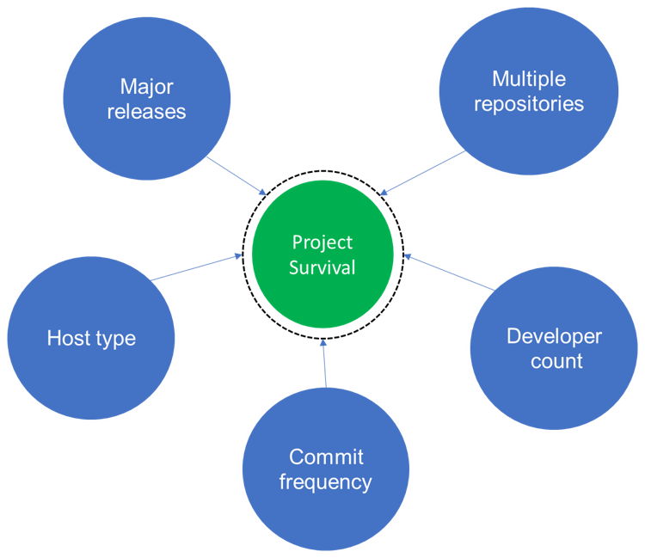
Estimators

Slide 17
Outline from Whiteboard
Skit
Title slide and context
Methods
Visual: KM & Bayesian
Ratio: Cox
Results
KM & Bayesian
Cox
Implications and Conclusion

