Slide 1
Predicting Patient No-Shows with Appointment Data

Slide 2
Introduction – Explain the Problem and why the client cares

Slide 3
Objectives – Explain what the project is trying to accomplish

Slide 4
About the Data
Mention % missed

Slide 5
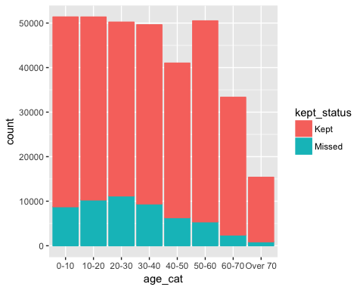
Patient Age
Exploration - age

Slide 6
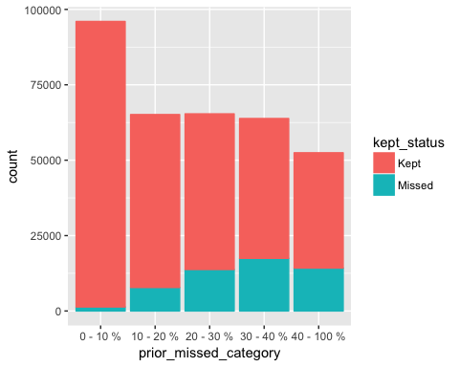
Prior Percent of Appointments Missed
Exploration – Prior Percent Missed

Slide 7
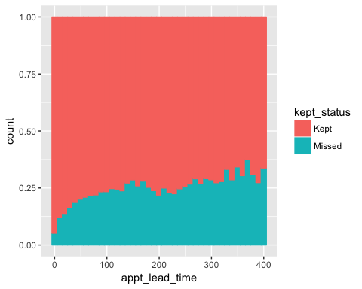
Appointment Lead Time

Slide 8
Modeling

Slide 9
Model Results

Slide 10
Recommendations

Slide 11
Final summary

