Slide 1
Predicting Patient No-Shows with Appointment Data
By Derek Samsom

Slide 2
Introduction
Missed medical appointments are a major problem for medical providers, resulting in lost revenue. The best way to reduce the lost revenue is to over-book the appointments, but there are two major problems associated with over-booking:
Too much over-booking results in overwhelming the staff and resources, and reduced patient satisfaction.
Too little over-booking doesn’t solve the problem of lost revenue.
Predicting which appointments will be kept and missed will help with both of these issues, allowing for more missed appointments to be filled in with over-booking while creating fewer issues associated with having too many patients at a given time.

Slide 3
Objectives
There are two primary objectives:
Predict which appointments will be missed
Predict the probability of an appointment being missed
Errors in the predictions will result in the undesirable effects of too much or too little over-booking. Reducing the prediction errors as much as possible will allow for greater reduction in lost revenue from missed appointments while also minimizing instances of having more patients then expected.

Slide 4
Data
The data contains information on over 340,000 historical appointments.
For each appointment, the data contains information about the patient including age, gender, prior number of appointments kept or missed, distance to the office, and billing type.
The data contains information about the appointment, including the date, time, length, and the specialty provided by the medical staff.
The overall rate of missed appointments in the historical data is 16 %.

Slide 5
Expectations
There are countless reasons a patient might miss an appointment that are not directly captured in the data and can’t be known ahead of time for future appointments.
For example: A random reason to miss an appointment could be getting a flat tire. The actual cause, the flat tire, is not recorded in the historical data, and can’t be known ahead of future appointments.
The predictions are based on indirect factors. A prediction can be based on characteristics of a patient or appointment that is more likely to be impacted by an event such as a flat tire, but it can’t predict the flat tire. There will be a level of prediction error that can’t be eliminated.
Despite the limitations, even an imperfect model has benefits over having no means to predict missed appointments, and will allow providers to reduce the lost revenue due to missed appointments.

Slide 6
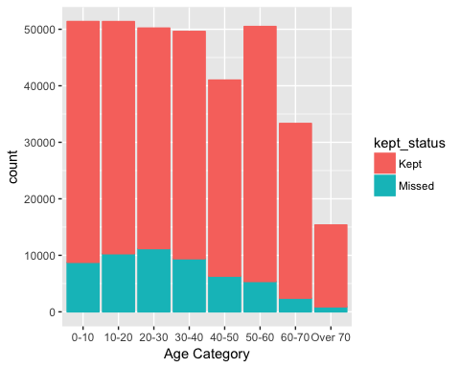
Data Exploration - Patient Age
Patient age is a strong predictor of missed appointments.
Young adults aged 20-30 have the highest rate of missed appointments, This could be due to having less critical medical needs that are easier to skip, or having more frequent occurrences where circumstances with children or work result in missing an appointment.
Older patients have lowest rate of missed appointments. This could be because the appointments for older people may be for more critical needs, or because they may have lower likelihood of children or work causing a missed appointment.

Slide 7
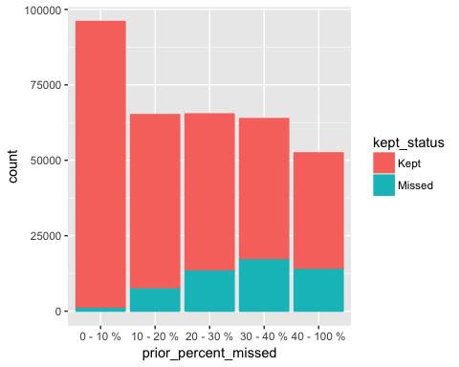
Data Exploration - Percent of Prior Appointments Missed
The percentage of missed prior appointments is a strong predictor. The higher the percent of prior missed appointments, the higher the ratio of missed appointments.
Among those with the lowest rate of missed appointments, 0 – 10%, appointments are overwhelmingly kept.
Even among those with the highest rates of prior percent missed, 40 – 100%, more appointments were kept than missed.
Even without knowing the exact cause of the missed appointments, this picks up on the fact that factors that cause past missed appointments are more likely to cause future missed appointments.

Slide 8
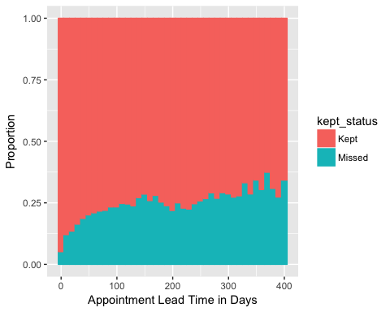
Data Exploration – Appointment Lead TIME
The appointment lead time represents the number of days between an appointment being booked and the appointment occurring.
The ratio of missed appointments increases as the appointment lead time increases.
Shorter lead times could represent more urgent patient needs that are less likely to be missed.
Longer lead times might lead to more misses because they are more likely to be forgotten, or they are more likely to be for preventative care that is deemed less critical.

Slide 9
Modelling
The data was split into a test set (60%), validation set (20%), and a test set (20%).
Random Forest and glm models were initially fit to the training set.
The validation set was used to see how well the models perform on unseen data to choose the best one. The random forest model performed best.
Finally, the random forest model was tested on the test data to estimate the expected future results.

Slide 10
Model Performance
Model Performance Summary:
When the model predicts an appointment will be missed, it is expected to be accurate 39 % of the time.
The overall historical rate of missed appointments is 16%. This means that with no model, predicting an appointment will be missed is only expected to be correct 16% of the time, and will be incorrect the remaining 84% of the time.
The model improves the accuracy of predicting a missed appointment from 16% to 39%.

Slide 11
Recommendations
The model can be improved by adding new information. For example, weather information is not included in the original data but is widely available and can be added in.
Further analysis can be done calculating the expected number of missed appointments when there are multiple appointments available in a time slot. Combining the likelihoods of each patient showing up in a specific time slot would allow the overall likelihood of a desired number of patients to be calculated.
There are some valuable insights in the data exploration. For example, patients who missed 10% or less of their prior appointments are overwhelmingly expected to make their appointments. Making sure not to over-book these patients would be recommended because they are unlikely to miss anyway, and it would keep the best patients happy.

Slide 12
Conclusion
Predicting missed appointments is challenging because there are many reasons an appointment can be missed that can’t be known in advance of future appointments due to their random nature, such as having a flat tire or getting called in to a last-minute work meeting.
Despite the challenges, indirect information about the patient and the appointment can still help predict whether an appointment will be missed. While these predictions have an inherent level of error, they still provide useful information.
With a perfect prediction, a medical provider could completely make up for the lost revenue due to missed appointments by overbooking by just the right amount, without resulting in times the overbooking leads to having more patients than desired. Due to the inherent prediction error, there will still be times that the overbooking is too much or too little, meaning there will still times where there are more or less patients than desired. However, since the model predictions are better than predicting without a model, the model allows a medical provider to over-book more intelligently, which will allow more lost revenue to be made up for with over-booking with fewer negative consequence

