Slide 1
Predicting Return on Investment for Lending Club Investors
By Derek Samsom
Springboard Data Science Career Track Capstone 1
November 2018

Slide 2
ABOUT Lending CLUB
Peer-to-Peer Lender
Lower overhead than traditional financial institutions
Higher returns for investors
Lower interest rates for borrowers
Investors risk loss when loans default

Slide 3
The Problem
Risk of Investing in Loans that Default – Many loans will actually result in a loss
Uncertainty in how much a loan will repay
How to select the most profitable loans

Slide 4
Who WILL BENEFIT
Lending Club investors who want to:
Increase earnings on their investments
Reduce risk of losing money on defaulting Loans

Slide 5
The Data
Downloaded from Lending Club
Loans Originating between 2012 and 2013
More than 150,000 loans
Loan information such as grade, purpose
Borrower information such as debt-to-income ratio, and credit history

Slide 6
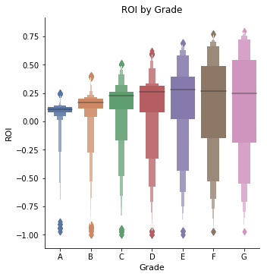
Initial findings – loan grade
Higher Grades = Lower Risk, Lower Returns
Lower Grades = Higher risk, higher potential returns
Grade A loans have the lowest average return on investment
Grade E loans have the highest average return on investment

Slide 7
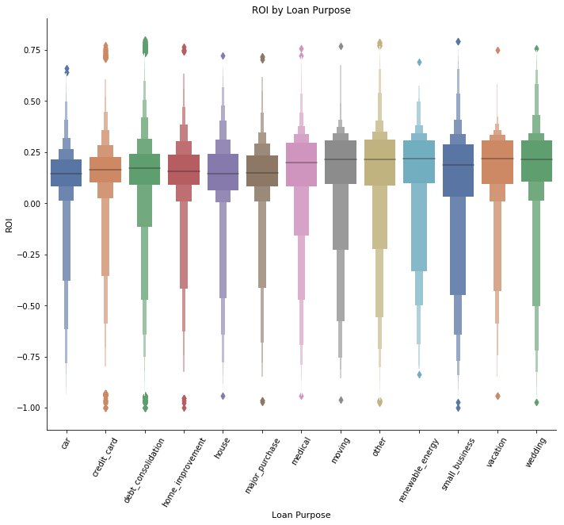
Initial findings – loan Purpose
Two major groups:
Loans for car, credit card, debt consolidation, home improvement, house, and major purchase have lower average returns, and lower risk
Loans for medical, moving, other, renewable energy, vacation, and wedding have higher average returns and higher risk
Additional Findings can be found in notebook at: https://github.com/DerekSamsom/Capstone1/blob/master/Code/Data_Storytelling.ipynb

Slide 8
Modeling
Scoring Metrics:
R-squared score
Root Mean Squared Error
Residual Analysis
Three Models Tested:
Linear Regression
Random Forest
Gradient Boosting

Slide 9
Modeling - Methodology
Split data into Train, Validation, Test Sets
First run the three models with Default Parameters
Tune the models to find best scores on validation Set
Lasso And ridge regularization
OOB error plot for Random Forest
Tuning grid for Gradient Boosting

Slide 10
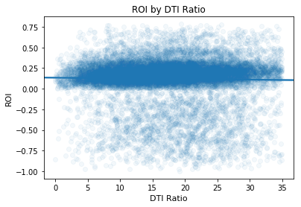
Modeling - Challenges
ROI is more useful than amount repaid, but less variation.
Riskier loans have higher interest rates. This tends to even out the ROI across predictor variables
Many variables have only a slight relationship with ROI

Slide 11
RESULTS – Model Summary
Base Models | R-Squared | Root Mean Squared Error | Residuals, 90th Percentile
Linear Regression | 0.0473 | 0.2556 | -0.7594 to 0.2355
Random Forest | 0.2265 | 0.2303 | -0.6450 to 0.2529
Gradient Boosting | 0.1941 | 0.2351 | -0.6596 to 0.2422
Tuned Models | R-Squared | Root Mean Squared Error | Residuals, 90th Percentile
Linear Regression | 0.0475 | 0.2556 | -0.7592 to 0.2359
Random Forest | 0.2321 | 0.2295 | -0.6437 to 0.2552
Gradient Boosting | 0.2456 | 0.2275 | -0.6221 to 0.2407
Gradient boosting model performs the best in all metrics
Even with best performing model, 5% of scores are over-predicted by 0.6221

Slide 12
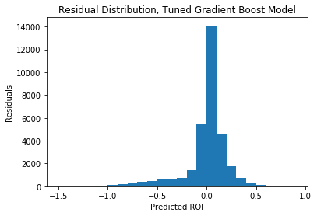
RESULTS – RESIDUALS
Most predictions are between 0.05 below and 0.10 above the actual ROI
There is a tail of negative residuals that represent loans that have a lower ROI than predicted

Slide 13
Results – Use Case Scenario 1
This scenario compares choosing the loans with the highest predicted ROI to choosing loans at random
The top 5th percentile of predicted ROI represent the loans selected by the model
These loans have a predicted ROI of 0.30 or greater.

Slide 14
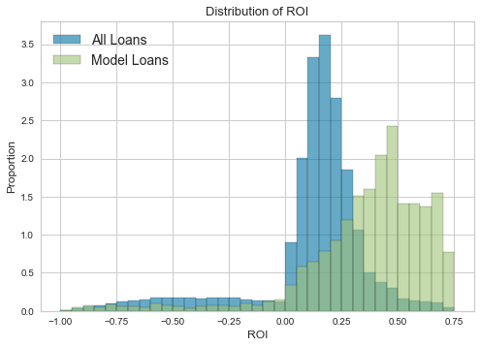
Results – Use Case Scenario 1
Loans from model much more likely to have ROI greater than 0.3
Percent of loans with negative ROI Drops from 13% to 7%
Average ROI Increases from 12% to 37%

Slide 15
RESULTS – Use Case Scenario 2
Most Investors have a strategy and do not just pick loans at random
This is a scenario in which an investor chooses E-Grade Loans since they have the highest average ROI
E-Grade Loans are compared to the same best loans chosen by model

Slide 16
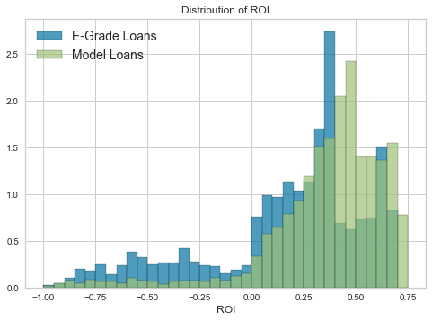
RESULT – Use CaSE SCENARIO 2
Model less beneficial in this scenario
Three important model benefits:
Percent of loans with negative ROI Drops from 22% to 7%
Higher proportion of loans with ROI greater than 0.40
Average ROI Increases from 17% to 37%

Slide 17
Further research
Model Improvements:
Improvements to Linear Regression, such as variable transformation
Research benefits for other investor strategies:
Low-risk investors – how much improvement without increasing risk
Investors who want the highest return possible, least concerned with risk
Loan subsets:
36 vs 60 month loans
Loans for specific purposes

Slide 18
Recommendations
Investors who choose higher risk, higher return E-Grade loans see an increase in average ROI from 17% to 37%, and reduction of negative ROI loans from 22% to 7%
Investors with other investment strategies should compare results their own strategy with choosing loans from the model
Investors should keep in mind, the data used is from 2012-2013, and an unknown amount of erosion of the model’s accuracy on new loans is expected.

