Slide 1
TRAFFIC SIGN IMAGE RECOGNITION USING CONVOLUTIONAL NEURAL NETWORKS IN TENSORFLOW
By Derek Samsom
Springboard Data Science Career Track Capstone 2
MARCH 2019

Slide 2
The Problem
Autonomous driving requires the ability for the software to correctly read traffic signs
Incorrect classification of traffic signs leads to safety problems

Slide 3
Who WILL BENEFIT
Companies Developing autonomous driving software
Classifying traffic signs correctly will allow the software to make better-informed driving decisions
Even human-driven cars could benefit – car could alert driver if it doesn’t sense appropriate reaction to signage

Slide 4
The Data
Data comes from Institute for Neuroinformatic In Germany
43 Classes of traffic signs
35,000 training images
12,000 test images
32 x 32 pixels and 3 color channels

Slide 5
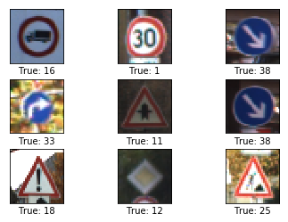
Example Images
Many types of signs including:
Speed Limits
Caution – Various types
Stop and Yield
Image characteristics:
Well Centered
Fairly small
Wide range of brightness

Slide 6
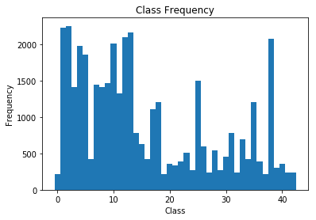
CLASS IMBALANCE
The data does not contain the same number of images per sign class
Some classes have fewer than 200 images
Others have over 2,000 images

Slide 7
Preprocessing – Create Additional Images
Additional training images were generated to even out the class imbalance.
Randomly sampled existing images
Random rotation between -5 and 5 degrees was applied to each sampled image to help the models better gerneralize

Slide 8


Preprocessing – CONVERT TO GRAYSCALE
Images were converted from 3-channel color to 1-channel grayscale
Many different classes have the same color scheme
Much of the color variation is in the background, adding noise

Slide 9
CONVOLUTIONAL NEURAL NETORK ARCHITECTURE 1 of 3
Based on LeNet-5 Architecture developed in the 1990s
Uses 5 x 5 filters and 2 convolutional layers with pooling
Convolutional Layers 1 and 2 use 24 and 64 filtered images, respectively
Uses 3 fully connected layers

Slide 10
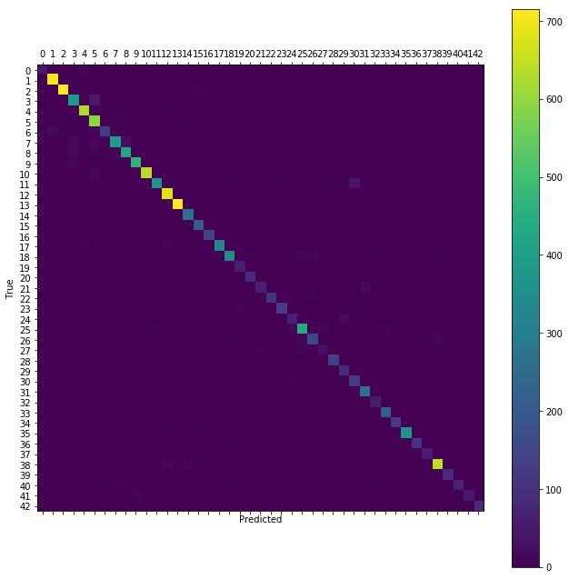
CONVOLUTIONAL NEURAL NETORK ARCHITECTURE 1 - Results
40, 000 training iterations
93.5% overall accuracy
Poor recall results on “Pedestrian” and “Double Curve Signs”

Slide 11
CONVOLUTIONAL NEURAL NETORK ARCHITECTURE 2
Based on VGGNet Architecture developed in 2014
VGGNet is much deeper than LeNet-5, typically having up to 13 convolutional layers
Too much pooling? Output of final pooling layer is only 4 x 4 images
Due to small image size only allowing so many pooling layers, VGGNet was adapted as follows:
6 Convolutional Layers with pooling on layers 2, 4, and 6
3 x 3 filter sizes, with the number of filtered images at 64, 128, and 256
4 Fully Connected Layers

Slide 12

CONVOLUTIONAL NEURAL NETORK ARCHITECTURE 2 - Results
40,000 training iterations
Improvement over the first architecture with overall accuracy of 96.0%
Still has poor recall results on “Pedestrian” and “Double Curve Signs”

Slide 13
CONVOLUTIONAL NEURAL NETORK ARCHITECTURE 3
Again based on VGGNet Architecture
Only 4 Convolutions this time, so that output images are 8 x 8
VGGNet adapted as follows
4 Convolutional Layers with pooling on layers 2, and 4
3 x 3 filter sizes, with the number of filtered images at 64, and 128
4 Fully Connected Layers

Slide 14

CONVOLUTIONAL NEURAL NETORK ARCHITECTURE 3 - REsults
40,000 training iterations
Best overall accuracy of 97.1%
Much improved recall on “Double Curve” signs
Still has low recall score on “Pedestrian” signs

Slide 15
SUMMARY
Results – Test Accuracy
# Iterations | Architecture 1 | Architecture2 | Architecture 3
10,000 | 89.4% | 93.5% | 94.4%
20,000 | 93.2% | 95.9% | 96.5%
30,000 | 93.5% | 95.2% | 96.9%
40,000 | 93.5% | 96.1% | 97.1%
Architecture 3 performed the best with 97.1% overall accuracy
Still a few classes that are not as accurate as needed for safe autonomous driving

Slide 16
Future research
Preprocessing:
Histogram equalization and skew can be added in addition to rotation
Removing background can remove some noise
Hyperparameter Tuning:
Different numbers of filters and filter sizes
Adjustments to Architecture (number of layers, size of fully connected layers, etc.
More Image Collection:
Larger images would allow a deeper VGGNet architecture
More images to train would allow for greater generalization

Slide 17
Recommendations
To achieve the very high level of accuracy needed to safely develop autonomous cars, I recommend the following:
Collect larger training images
Larger Images would allow a deeper VGGNet architecture since it would allow more pooling layers.
Collect a higher number of images, as give the model a greater ability to generalize
Test other preprocessing techniques such as histogram equalization

