Slide 1
· ✦ · ✦ · ✦ ·
Bob is You: You are Bob
An Integrated Guide to the Five Dimensions
· ✦ · ✦ · ✦ ·
WHO 1948 · Engel 1977 · Hettler 1976 · SAMHSA today

Slide 2
OPENING
You meet yourself in pieces.
At the gym you are a body.
At your desk you are an attention span.
With your parents you are a phone call.
After midnight you are a worry.
On Sunday morning you are a question that doesn't have a name.
Each of these is real. None of them, alone, is you.
Call the integrated version Bob.
02 · 21

Slide 3
A SHORT HISTORY OF THE IDEA
The framework is older than it gets credit for.
1948
1976
1977
TODAY
WHO
Bill Hettler
George Engel
SAMHSA
Health is "a state of complete physical, mental and social well-being, not merely the absence of disease."
Co-founds the National Wellness Institute; proposes six dimensions of wellness.
Publishes the biopsychosocial model in Science; challenges biomedicine to treat the whole person.
Federal mental-health agency teaches an eight-dimension wellness model in clinical use.
Different lists. Same idea. Here we'll use five.
03 · 21

Slide 4
THE FIVE DIMENSIONS
Physical · Mental · Emotional · Social · Spiritual
♥
◐
◈
❖
✦
PHYSICAL
MENTAL
EMOTIONAL
SOCIAL
SPIRITUAL
Your body's basic operating capacity. Sleep, movement, nutrition, energy at noon.
Cognitive function. Focus, learning, problem-solving, working memory.
Felt experience. Mood, regulation, the ability to notice and feel without being dragged under.
The network you actually have. Depth, frequency, who answers the phone at 2 a.m.
Sense of meaning and orientation. Why this is for. The thing that gets you back up.
You know most of what each one means. The interesting part is what's between them.
04 · 21

Slide 5
DIMENSION · 1 OF 5
Physical
Your body's basic operating capacity.
♥
INCLUDES
› Sleep — quality, duration, regularity
› Movement — cardio, strength, mobility
› Nutrition — fuel and hydration
› Recovery — illness, injury, energy at noon
05 · 21

Slide 6
DIMENSION · 2 OF 5
Mental
Cognitive function in the day-to-day.
◐
INCLUDES
› Focus — staying with one thing
› Learning — taking in something new
› Problem-solving — thinking a thought to its end
› Working memory — holding the pieces while you assemble them
06 · 21

Slide 7
DIMENSION · 3 OF 5
Emotional
Felt experience and your relationship to it.
◈
INCLUDES
› Mood — the baseline you walk around in
› Regulation — what you do when something hits you
› Awareness — noticing what you feel before it acts
› Integration — feeling it without being it
07 · 21

Slide 8
DIMENSION · 4 OF 5
Social
The network of people you actually have.
❖
INCLUDES
› Depth — who knows the unflattering version
› Frequency — how often you actually talk
› Reciprocity — both directions, not one
› Presence — time spent being, not transacting
08 · 21

Slide 9
DIMENSION · 5 OF 5
Spiritual
Sense of meaning and orientation.
✦
INCLUDES
› Purpose — the answer to "what is this for?"
› Values — what you actually move toward
› Awe — being smaller than something
› Re-up — what gets you back on your feet
09 · 21

Slide 10
✦
THE THESIS
The five dimensions are not five things.
They are five views of the same thing,
and a change in any one of them moves all the others.
What follows: five integration loops, each well-documented.
10 · 21

Slide 11
LOOP · 1 OF 5 · PHYSICAL → EMOTIONAL → SOCIAL
Sleep is not just a physical input.
REM sleep is when the brain reduces the emotional charge on memories: the next-morning "it doesn't feel as bad now" effect.
A bad night is not just physical fatigue. Sleep-deprived brains show heightened amygdala reactivity and weakened prefrontal control: the rational manager is offline while the threat system is on overdrive. By Wednesday, last week's bad night has become an emotional regulation problem, a social withdrawal problem, and a work problem, all from one missing dimension.
Walker, M. (2017). Why We Sleep. Scribner. Walker (2009), Annals NYAS 1156.
11 · 21

Slide 12
LOOP · 2 OF 5 · PHYSICAL → MENTAL → EMOTIONAL
Exercise is not just a body input.
Aerobic exercise releases BDNF (brain-derived neurotrophic factor), which is essentially fertilizer for neurons.
Regular cardio measurably improves focus, learning, and mood. In some trials, with effect sizes that rival the lower doses of antidepressants prescribed for the same indications. The "I went for a run and the whole day got better" effect is not vibes. It is neurochemistry, with paperwork. Physical → Mental → Emotional, in that order, within an hour.
Ratey, J. (2008). Spark: The Revolutionary New Science of Exercise and the Brain. Little, Brown.
12 · 21

Slide 13
LOOP · 3 OF 5 · SOCIAL → PHYSICAL
Loneliness is not just an emotional problem.
Weak social ties carry a mortality risk comparable to smoking up to fifteen cigarettes a day.
Holt-Lunstad's 2010 meta-analysis pooled 148 studies and ~300,000 participants. The effect of social disconnection on mortality is larger than obesity, larger than physical inactivity. The 2023 U.S. Surgeon General's advisory on loneliness was built on that finding. The Social dimension is, in plainly measurable terms, also a Physical risk factor.
Holt-Lunstad, Smith & Layton (2010), PLOS Medicine 7(7). U.S. Surgeon General Advisory (2023).
13 · 21

Slide 14
LOOP · 4 OF 5 · SPIRITUAL → SOCIAL → PHYSICAL
Purpose is not a spiritual nice-to-have.
Adults with a stronger sense of purpose in life were less likely to die during a 14-year follow-up, at every age.
Hill & Turiano (2014) followed ~6,000 adults; the effect held for young, middle-aged, and older participants alike, and persisted after controlling for other well-being measures. Independently, the Harvard Study of Adult Development (now 85+ years, Waldinger PI) found that relationship satisfaction at age 50 predicts physical health at age 80 better than cholesterol does.
Hill & Turiano (2014), Psychological Science 25(7). Waldinger & Schulz (2023), The Good Life.
14 · 21

Slide 15
LOOP · 5 OF 5 · EMOTIONAL ⇄ PHYSICAL
The body keeps the score.
Emotional injuries leave physical traces: in posture, immune function, sleep architecture, chronic pain.
Van der Kolk's three decades of trauma research showed that healing often requires going through the body, not around it. The reverse is also true: chronic physical conditions tax mental and emotional capacity, narrow social bandwidth, and erode the sense of why-this-matters. Every dimension speaks the others' language eventually. The system is honest in the long run.
van der Kolk, B. (2014). The Body Keeps the Score. Viking.
15 · 21

Slide 16
WHY ONE-AXIS SELF-HELP FAILS
The change holds when two dimensions help carry it.
A book about exercise is almost always also a book about mood, focus, and sleep; it just doesn't say so.
A book about Stoicism is almost always also about social regulation, recovery, and sleep; it just doesn't say so either.
When you read the book and try to make a change on the single axis it discusses, you usually fail not because the advice is bad but because the other four axes don't know about the project.
"Willpower" is one dimension trying to do all five jobs.
One dimension can't.
16 · 21

Slide 17
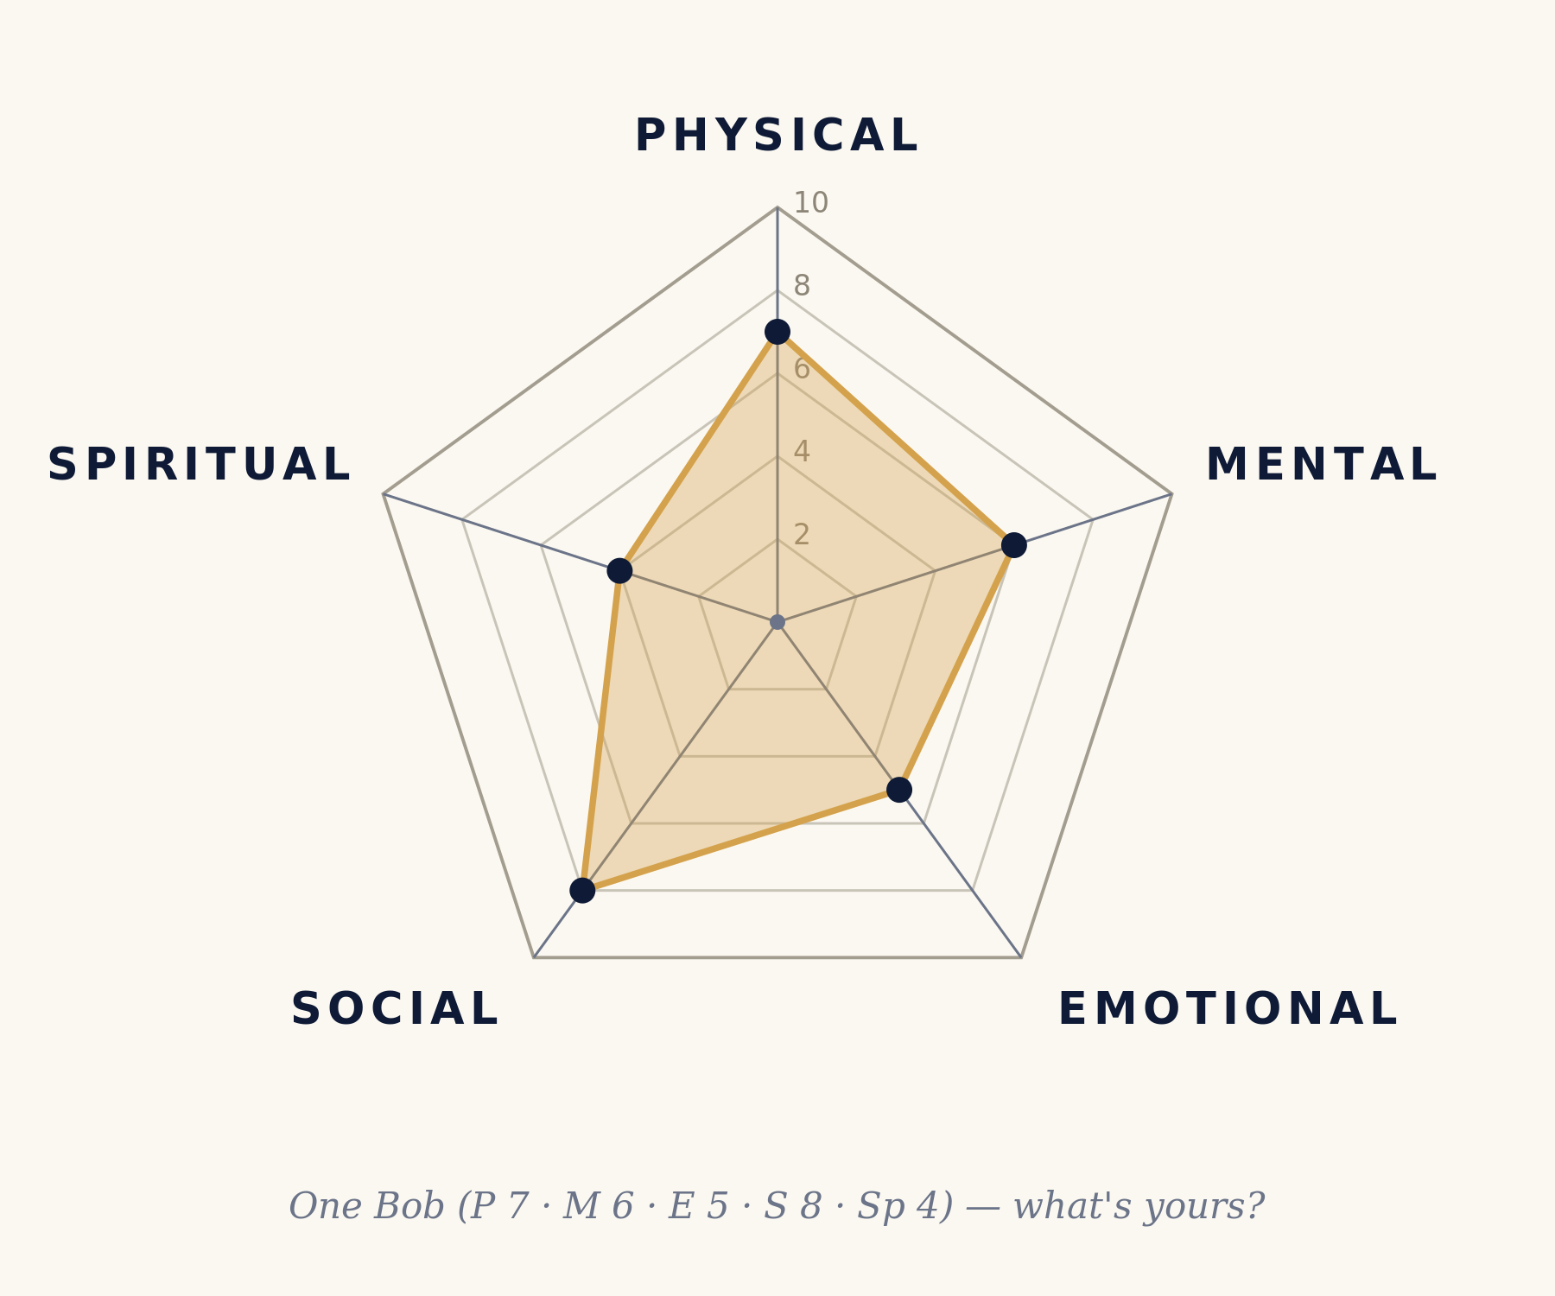
✦
THE REVEAL
Bob is a shape.
Five points: Physical, Mental, Emotional, Social, Spiritual.
Each axis runs from 0 at the center to 10 at the edge. Score yourself today, with the honesty you'd only give to yourself or your doctor. Connect the dots.
That shape is Bob.
Right now. Today.
A perfect Bob is a regular pentagon. Nobody is that.
17 · 21

Slide 18
TWO QUESTIONS WORTH ASKING THE PICTURE
Area, then symmetry.
1
What is the shape's area?
2
How symmetrical is it?
A bigger pentagon is, roughly, a bigger life. This is what "wellness" actually means as a quantity:
total area across all five dimensions,
not max score on one.
A very lopsided shape is fragile. One dimension is carrying the others, and the others are quietly losing capacity.
Spend years at 8 on Mental and 3 on Social, and Social will eventually drag Mental down to its level. The dimensions average; they do not partition.
18 · 21

Slide 19
· ✦ · ✦ ·
CODA
Bob is the whole instrument.
Bob is You.
You are Bob.
The shape is the thing to look at.
· ✦ · ✦ ·
19 · 21

Slide 20
SOURCES & FURTHER READING
What stands behind the claims.
WHO (1948)
Constitution of the World Health Organization: health as physical, mental, and social well-being, in force 1948.
Engel (1977)
"The Need for a New Medical Model: A Challenge for Biomedicine." Science 196(4286): 129-136.
Hettler (1976)
The Six Dimensions of Wellness. National Wellness Institute.
SAMHSA
Creating a Healthier Life: A Step-by-Step Guide to Wellness (eight dimensions).
Walker (2017)
Why We Sleep: Unlocking the Power of Sleep and Dreams. Scribner.
Ratey (2008)
Spark: The Revolutionary New Science of Exercise and the Brain. Little, Brown.
Holt-Lunstad, Smith & Layton (2010)
"Social Relationships and Mortality Risk: A Meta-Analytic Review." PLOS Medicine 7(7): e1000316.
Hill & Turiano (2014)
"Purpose in Life as a Predictor of Mortality Across Adulthood." Psychological Science 25(7): 1482-1486.
Waldinger & Schulz (2023)
The Good Life. Simon & Schuster. Harvard Study of Adult Development.
van der Kolk (2014)
The Body Keeps the Score: Brain, Mind, and Body in the Healing of Trauma. Viking.
20 · 21

Slide 21
· ✦ · ✦ · ✦ ·
Bob is You.
You are Bob.
Look at the shape.
· ✦ · ✦ · ✦ ·
an integrated guide · for the Bobs · part of the Bobology series

