Slide 1
Turing Machines

Slide 2
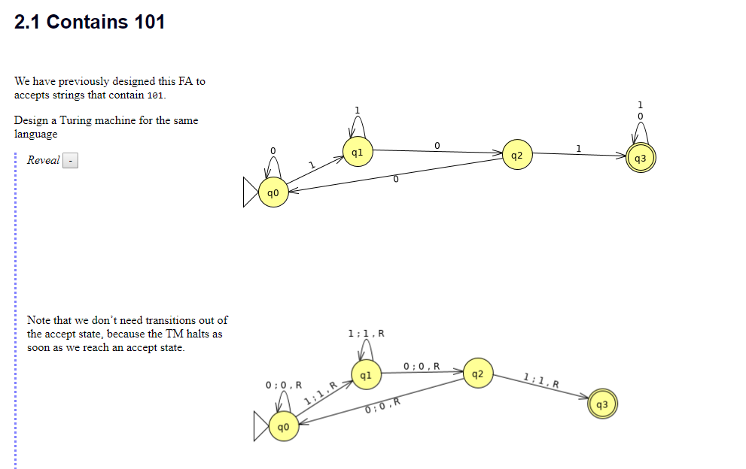

Slide 3
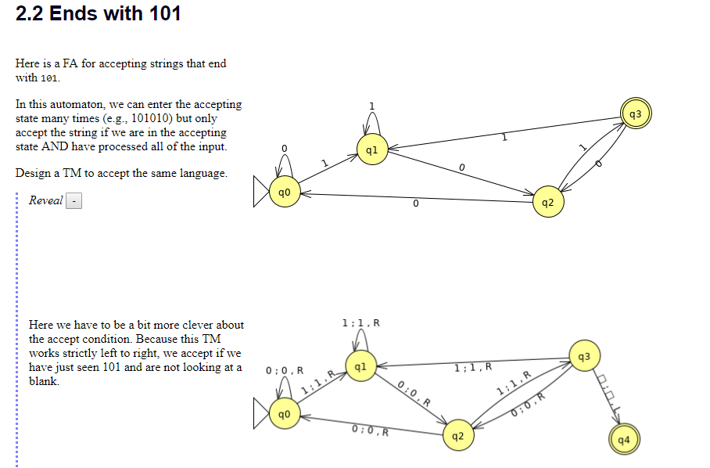

Slide 4
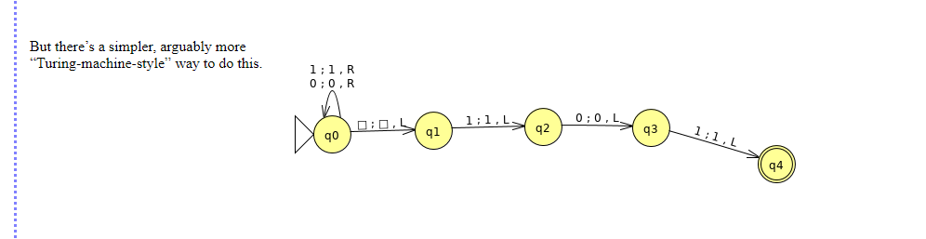
Ends with 101

Slide 5
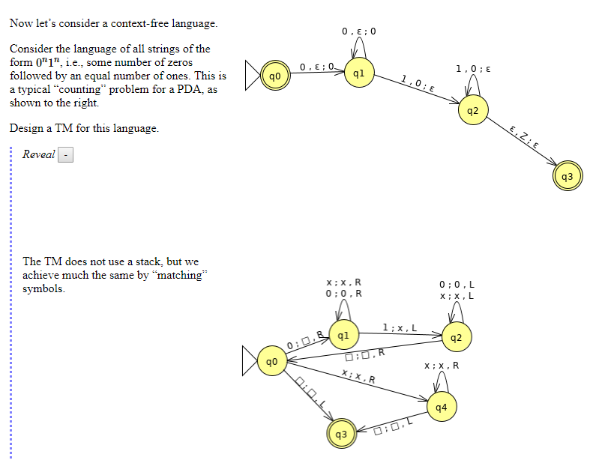

Slide 6
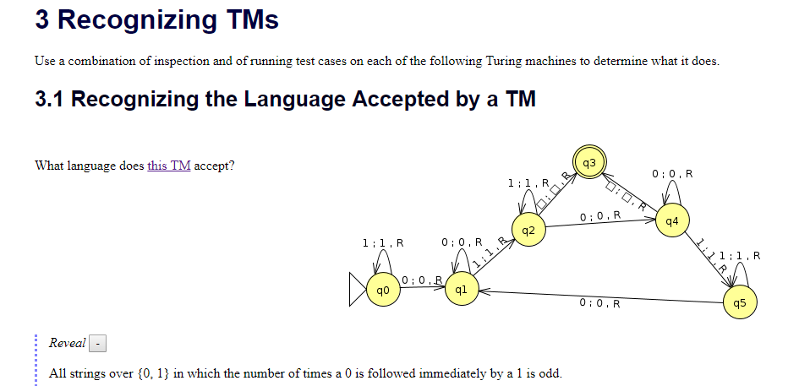

Slide 7
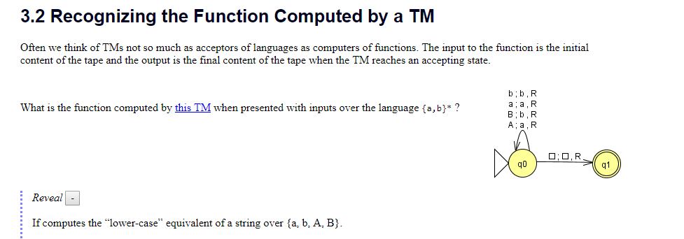

Slide 8
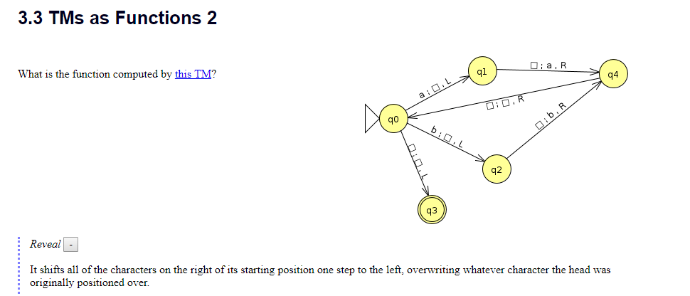

Slide 9
https://www.cs.odu.edu/~zeil/cs390/latest/Public/turing-jflap/index.html

