Slide 1
CARMEN STUDY GUIDE / PROJECT DEMO
Connect course evidence
to the next useful
learning action.
THE PROJECT
Carmen links learning
resources, student work,
instructor insight, and
protected study support.
Course materials, assessment results, and feedback often live apart. A score alone does not tell a learner what to revisit.
2:50 TOTAL | INCLUDES A 30-SECOND LIVE DEMO
Notes:
0:00-0:20. Course content, assessment results, and feedback are often separate. A score alone does not show a learner what to revisit, and generic AI help can ignore assessment rules. Carmen Study Guide connects course evidence to the next useful learning action.

Slide 2
WHAT THE PROJECT DOES
Carmen turns course sources into connected support
COURSE SOURCES
CARMEN EVIDENCE LAYER
LEARNING SUPPORT
Syllabus and outcomes
Modules and assignments
Slides, readings, and files
Submissions and feedback
Versioned normalized records
Source references and hashes
Pseudonymous learner IDs
Course resource chunks
Student-level feedback
Instructor progress views
Course-grounded tutor
Analytics-ready exports
The data layer preserves source links and missing values; it does not infer mastery from incomplete evidence.
CARMEN STUDY GUIDE
02
Notes:
0:20-0:50. Carmen accepts course sources and assessment evidence, normalizes them into a versioned bundle, and keeps source references with the records. That gives the learning views, analytics path, and tutor a shared course context. The pipeline preserves missing data and distinguishes evidence from interpretation. Source: carmen-study-guide/mock-canvas/INGEST_CONTRACT.md.

Slide 3
PRODUCT EXPERIENCE
Learners and instructors get different useful views
LEARNER
INSTRUCTOR
See what to do next
See the evidence behind progress
Review completed work item by item
Review class roster and grade summaries
See which answer was selected and which was correct
Trace quiz, rubric, and feedback records to sources
Ask for hints grounded in course material
Export normalized evidence for downstream analysis
The tutor uses a student session, retrieved course sources, assessment modes, and output checks before showing a reply.
CARMEN STUDY GUIDE
03
Notes:
0:50-1:20. The learner can inspect a completed attempt and use course-grounded hints. The tutor mode is set by code from assessment state, then verifies allowed moves and citations. Instructors have roster and grade views, and evidence references make assessment details traceable. The student and instructor views have different access boundaries. Source: carmen-study-guide/mock-canvas/ui.py, tutor/policy.py, tutor/verifier.py, and INGEST_CONTRACT.md.

Slide 4
TECHNOLOGY AND TRUST
The stack separates the demo from shared data services
BROWSER
APP SERVICES
DATA
HTML / CSS / JS
Python + FastAPI
SQLite + Supabase
Canvas-style pages
Student and instructor UI
Mock Canvas API
Ingestion and tutor routes
SQLite for the local demo
Supabase for shared services
ACCESS AND INTEGRITY
Pseudonymous learner IDs and source references
Browser reads follow the signed-in session
Answer keys are instructor-only
Service credentials stay on the server
The local demo uses synthetic records and demo tokens. Shared Supabase and tutor flows require course and provider configuration.
CARMEN STUDY GUIDE
04
Notes:
1:20-1:50. The local walkthrough runs on the Python FastAPI app with SQLite-backed synthetic data. The project also has server-side Supabase integration for shared analytics data. Browser reads use the logged-in session, service credentials stay on the server, and the tutor calls retrieval as the student. Answer keys are instructor-only. The local demo tokens are fixtures, not production authentication. Source: carmen-study-guide/README.md and INGEST_CONTRACT.md.

Slide 5
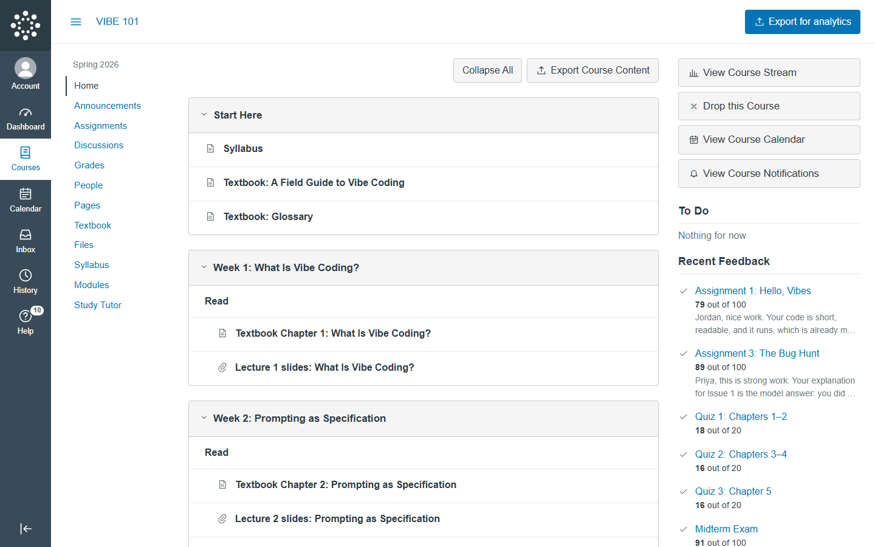
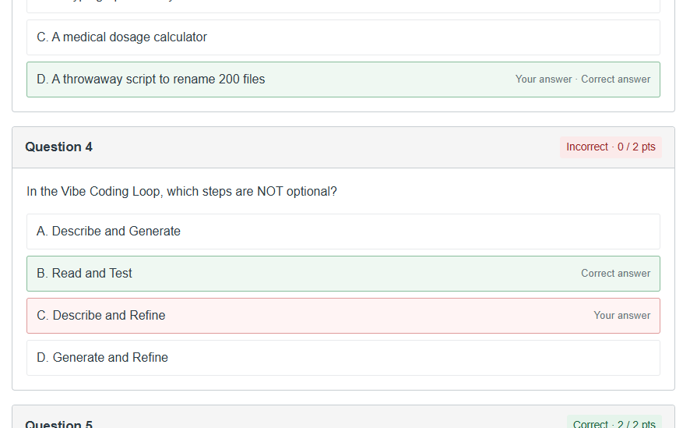
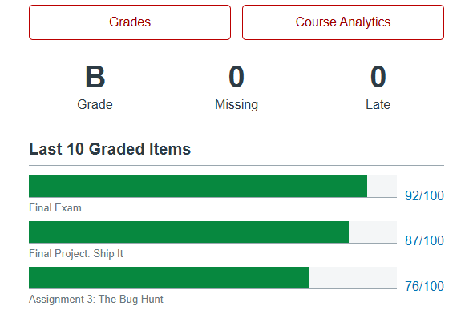
LIVE WALKTHROUGH
30-second demo on the sample course
VIBE 101 is sample course content; Carmen Study Guide is the project.
COURSE HOME
QUIZ REVIEW
INSTRUCTOR VIEW
0-8 SEC
Open completed Quiz 1
8-18 SEC
Show the missed item and correction
18-30 SEC
Open a learner grade drawer
Start at http://localhost:8001/courses/1001
30 SECONDS TOTAL
CARMEN STUDY GUIDE
05
Notes:
1:50-2:20. This is the complete 30-second demo. Start on the sample VIBE 101 course home. Seconds 0-8: open Assignments and the completed Quiz 1 attempt. Seconds 8-18: point to the incorrect response and its correct answer. Seconds 18-30: open People, select Avery Chen, and show the instructor grade drawer. All roster and score records shown here are fictional demo fixtures.

Slide 6
PROJECT STATUS
The integration foundation is built; impact still needs a pilot
IMPLEMENTED
NEXT VALIDATION
Canvas-style local course interface and API
Connect an authorized real course, verify its data mapping with the course owner, and measure whether source-linked feedback helps learners correct mistakes.
Versioned, source-linked analytics export
Role-scoped student and instructor views
Integrity-aware, course-grounded tutor module
No learning-gain result is claimed. The demo roster and assessments are synthetic.
CARMEN STUDY GUIDE | COURSE DATA IN | TRUSTED LEARNING SUPPORT OUT
CARMEN STUDY GUIDE
06
Notes:
2:20-2:50. The project has a local Canvas-style interface, an evidence-linked export, role-scoped views, and an integrity-aware tutor module. The local roster and quizzes are synthetic, and we are not claiming measured learning gains. Next we would connect an authorized real course, verify the mapping with its owner, then measure whether source-linked feedback helps learners correct mistakes.

