Slide 1
BUAN 6340 Data Analysis Project
Section 5U1
Presentation by Derek Tallent

Slide 2
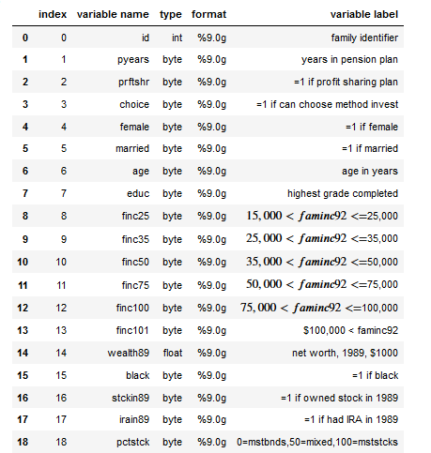
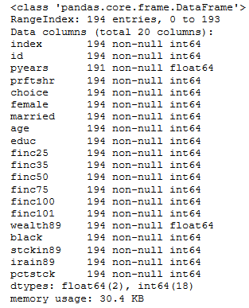
DataSet
The data used in this project was taken from the “Pension” dataset from the Wooldridge database. The data is from a study by L.E. Papke titled “Individual Financial Decisions in Retirement Saving: The Role of Participant-Direction,” Journal of Public Economics 88, 39-61(2004). Data collected from the National Longitudinal Survey of Mature Women,1991.
Variables
Data Types

Slide 3
Data Manipulation
Missing Data
3 records were removed from the dataset due to having missing values in the pyears variable
Outliers
There were a significant amount of outliers in the wealth89 and pyears variables (as shown by boxplots on next slide). A log transformation was done which got rid of a few outliers in each variable. The other outliers were left alone because they seemed to be plausible based on the rest of the data and removing them would likely introduce biases into the models.
Log Transformation
In order to do the log transformation all of the data in pyears and wealth89 needed to be nonnegative. Values of 6.30001 and .00001 were added to all cases in wealth89 and pyears, respectively. This ensured all values are positive without changing the ranges between each of the cases.

Slide 4
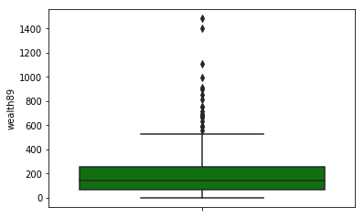
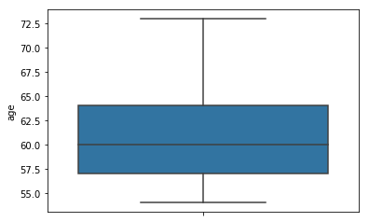
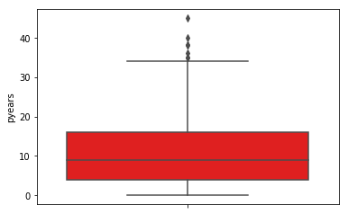
Exploratory Analysis
Outliers (Pre-Transformation)
There are approximately 17 outliers in wealth 89 (cases where the net worth in 89 was greater than $600,000) and 5 outliers in pyears (cases where the years in the pension plan is greater than about 33 years).
Wealth89
Age
Pyears

Slide 5
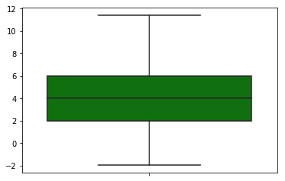
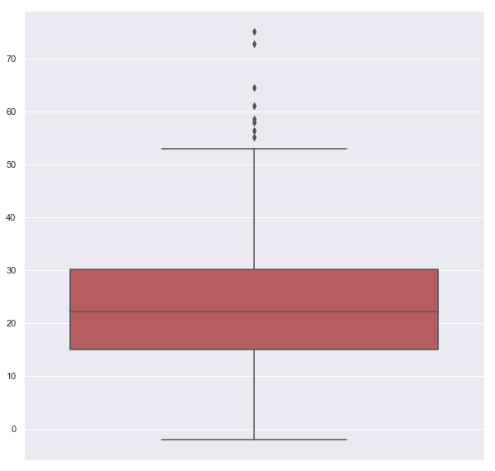
Outliers (Post-Transformation)
After the log transformations, wealth89 only has 8 outliers, while pyears has none.
Log of Wealth89
Log of Pyears

Slide 6
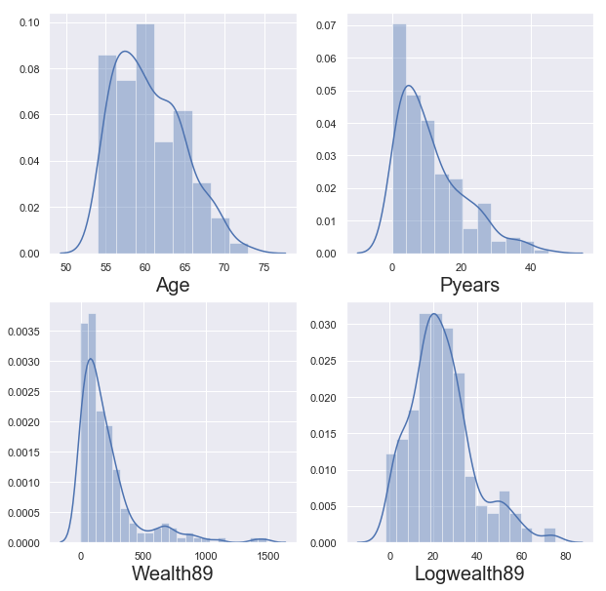
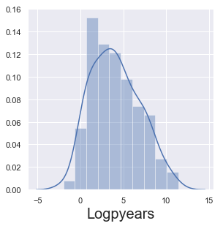
Variable Distributions
The following show the distributions of each of the variables. Age is approximately normally distributed, while pyears and wealth89 are skewed to the right. Logpyears becomes approximately normally distributed, while logwealth89 is still slightly skewed to the right.

Slide 7
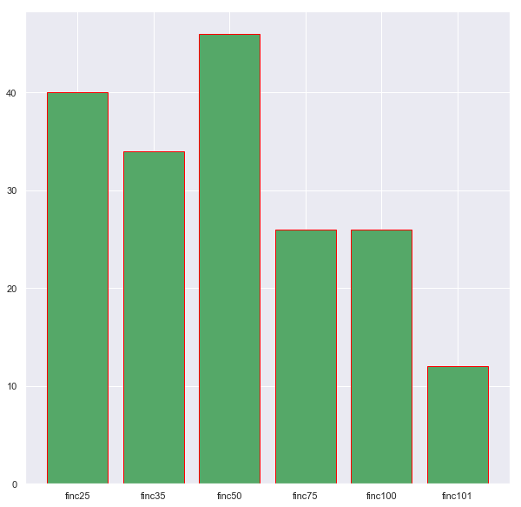
Family Income Distribution
The distribution of family income in the dataset. A majority of the respondents listed their family income as $15,000 to $50,000, while very few respondents had a family income of over $100,000. The respondents seem to be mostly lower to middle class instead of upper class.

Slide 8
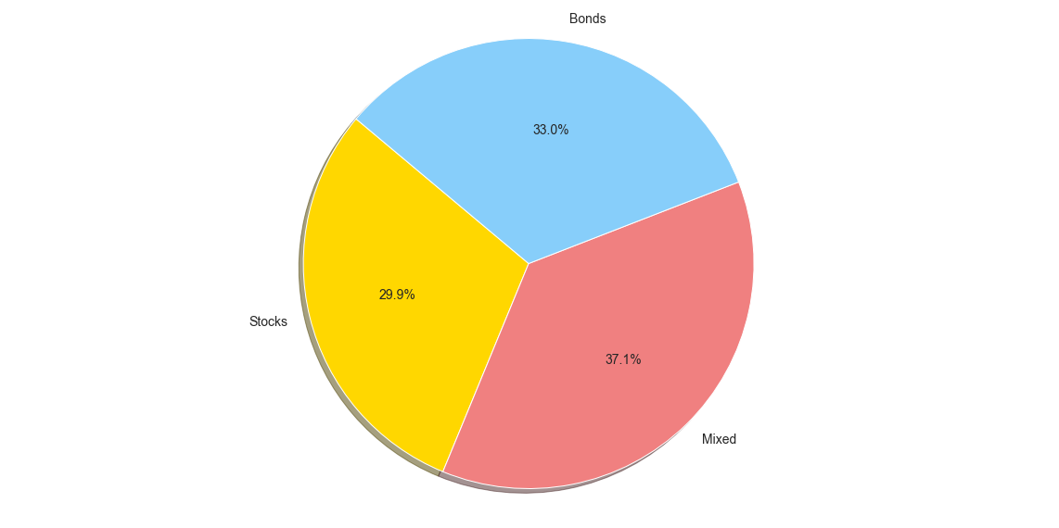
PCSTCK Chart
The following shows how many of the respondents invested primarily in bonds (0), stocks (100), or invested in a mix of both (50).

Slide 9
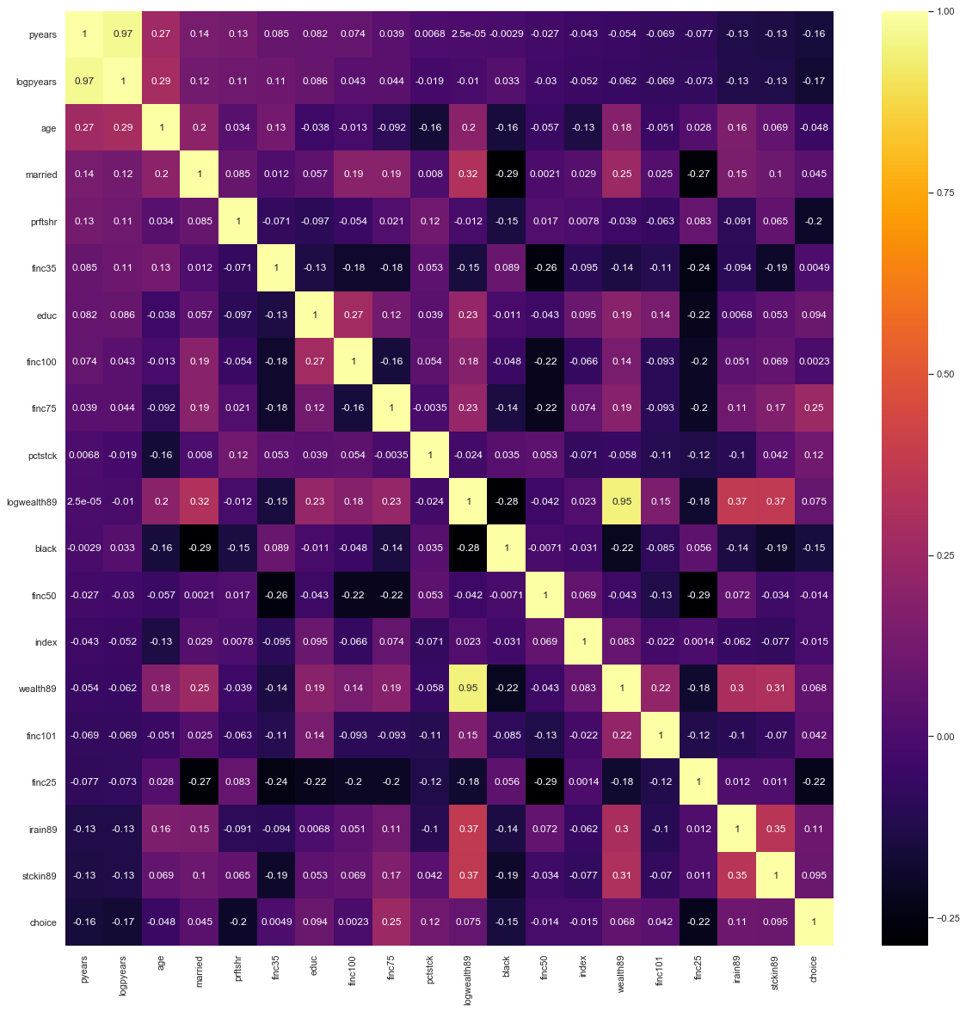
Correlation Matrix
Below is a correlation matrix of all of the variables in the dataset. The only possible problems with collinearity would obviously be between pyears and wealth89 and their log transformed counterparts. The rest are below .50, and do not cause collinearity concerns.

Slide 10
“Choice” Models
Papke’s paper focused on whether respondents had the choice to invest, so I started by creating models attempting to predict whether or not a respondent would have the choice to invest.
Types of Models
Since choice is a binary variable, I chose to do a logistic regression and a decision tree model in order to attempt to predict choice in a test set from the data. I used Python’s recursive feature elimination (RFE) and RFE with cross validation (RFECV) tool in order to get an initial list of relevant features. I then did further RFE myself in order to get logit models with the lowest AIC (since R-squared can get higher with simply more variables) and tree models with the highest accuracy score.
Feature Selection
The features selected in the logit model with the lowest AIC were “Prftshr”, “Black”, and “Educ”.
The features selected in the tree model with the highest accuracy score were “Prftshr”, “Pyears”,”Logwealth89”, and “Age”.

Slide 11
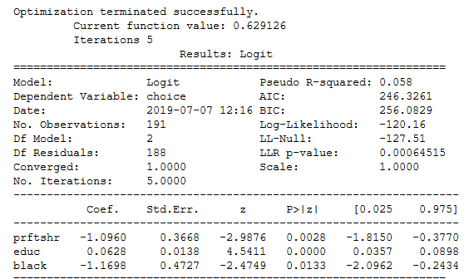
Choice Logit Model Results
Insights
PrftShr Coef: Exp(-1.0960) = .3342, which means that someone with a profit-sharing plan (PrftShr=1) is 33.42% less likely to be able to choose how to invest (choice=1).
Black Coef: Exp(-1.1698) = .3104, which means that someone who is Black (Black=1) is 33.04% less likely to be able to choose how to invest(choice=1).
Educ Coef: For every one unit increase in years of education, the log odds of having the ability to choose how to invest (choice=1) increases by 6.28%.
Statistical Significance
PrftShr is statistically significant at a .1% level (pval of .0028)
Educ is statistically significant at a .0001% level (pval of .0000..)
Black is statistically significant at a 5% level (pval of .0133)

Slide 12
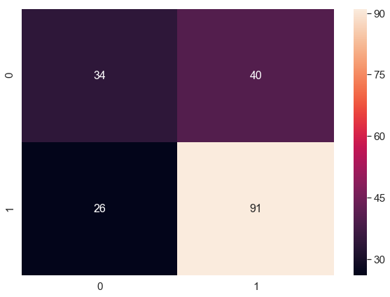
Choice Logit Model Accuracy
Confusion Matrix
Accuracy Score
According to the confusion matrix, the model is 65.44% accurate (129/191). There seems to be more false positives (Type I Errors) than false negatives in the model.

Slide 13
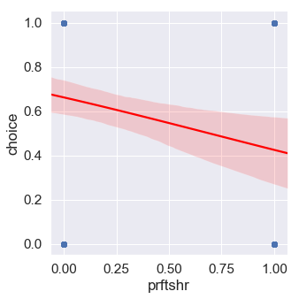
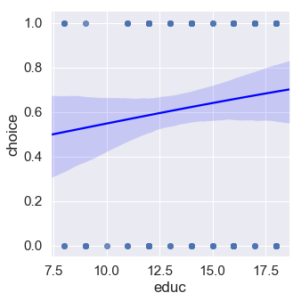
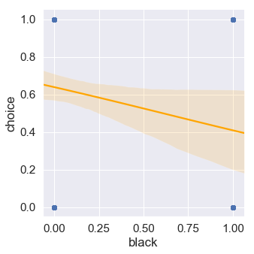
Choice Logit Model Visualizations
As log odds of prftshr increase, log odds of choice decreases.
As years of education increases, the log odds of choice increases.
As log odds of black increase, the log odds of choice decreases.

Slide 14
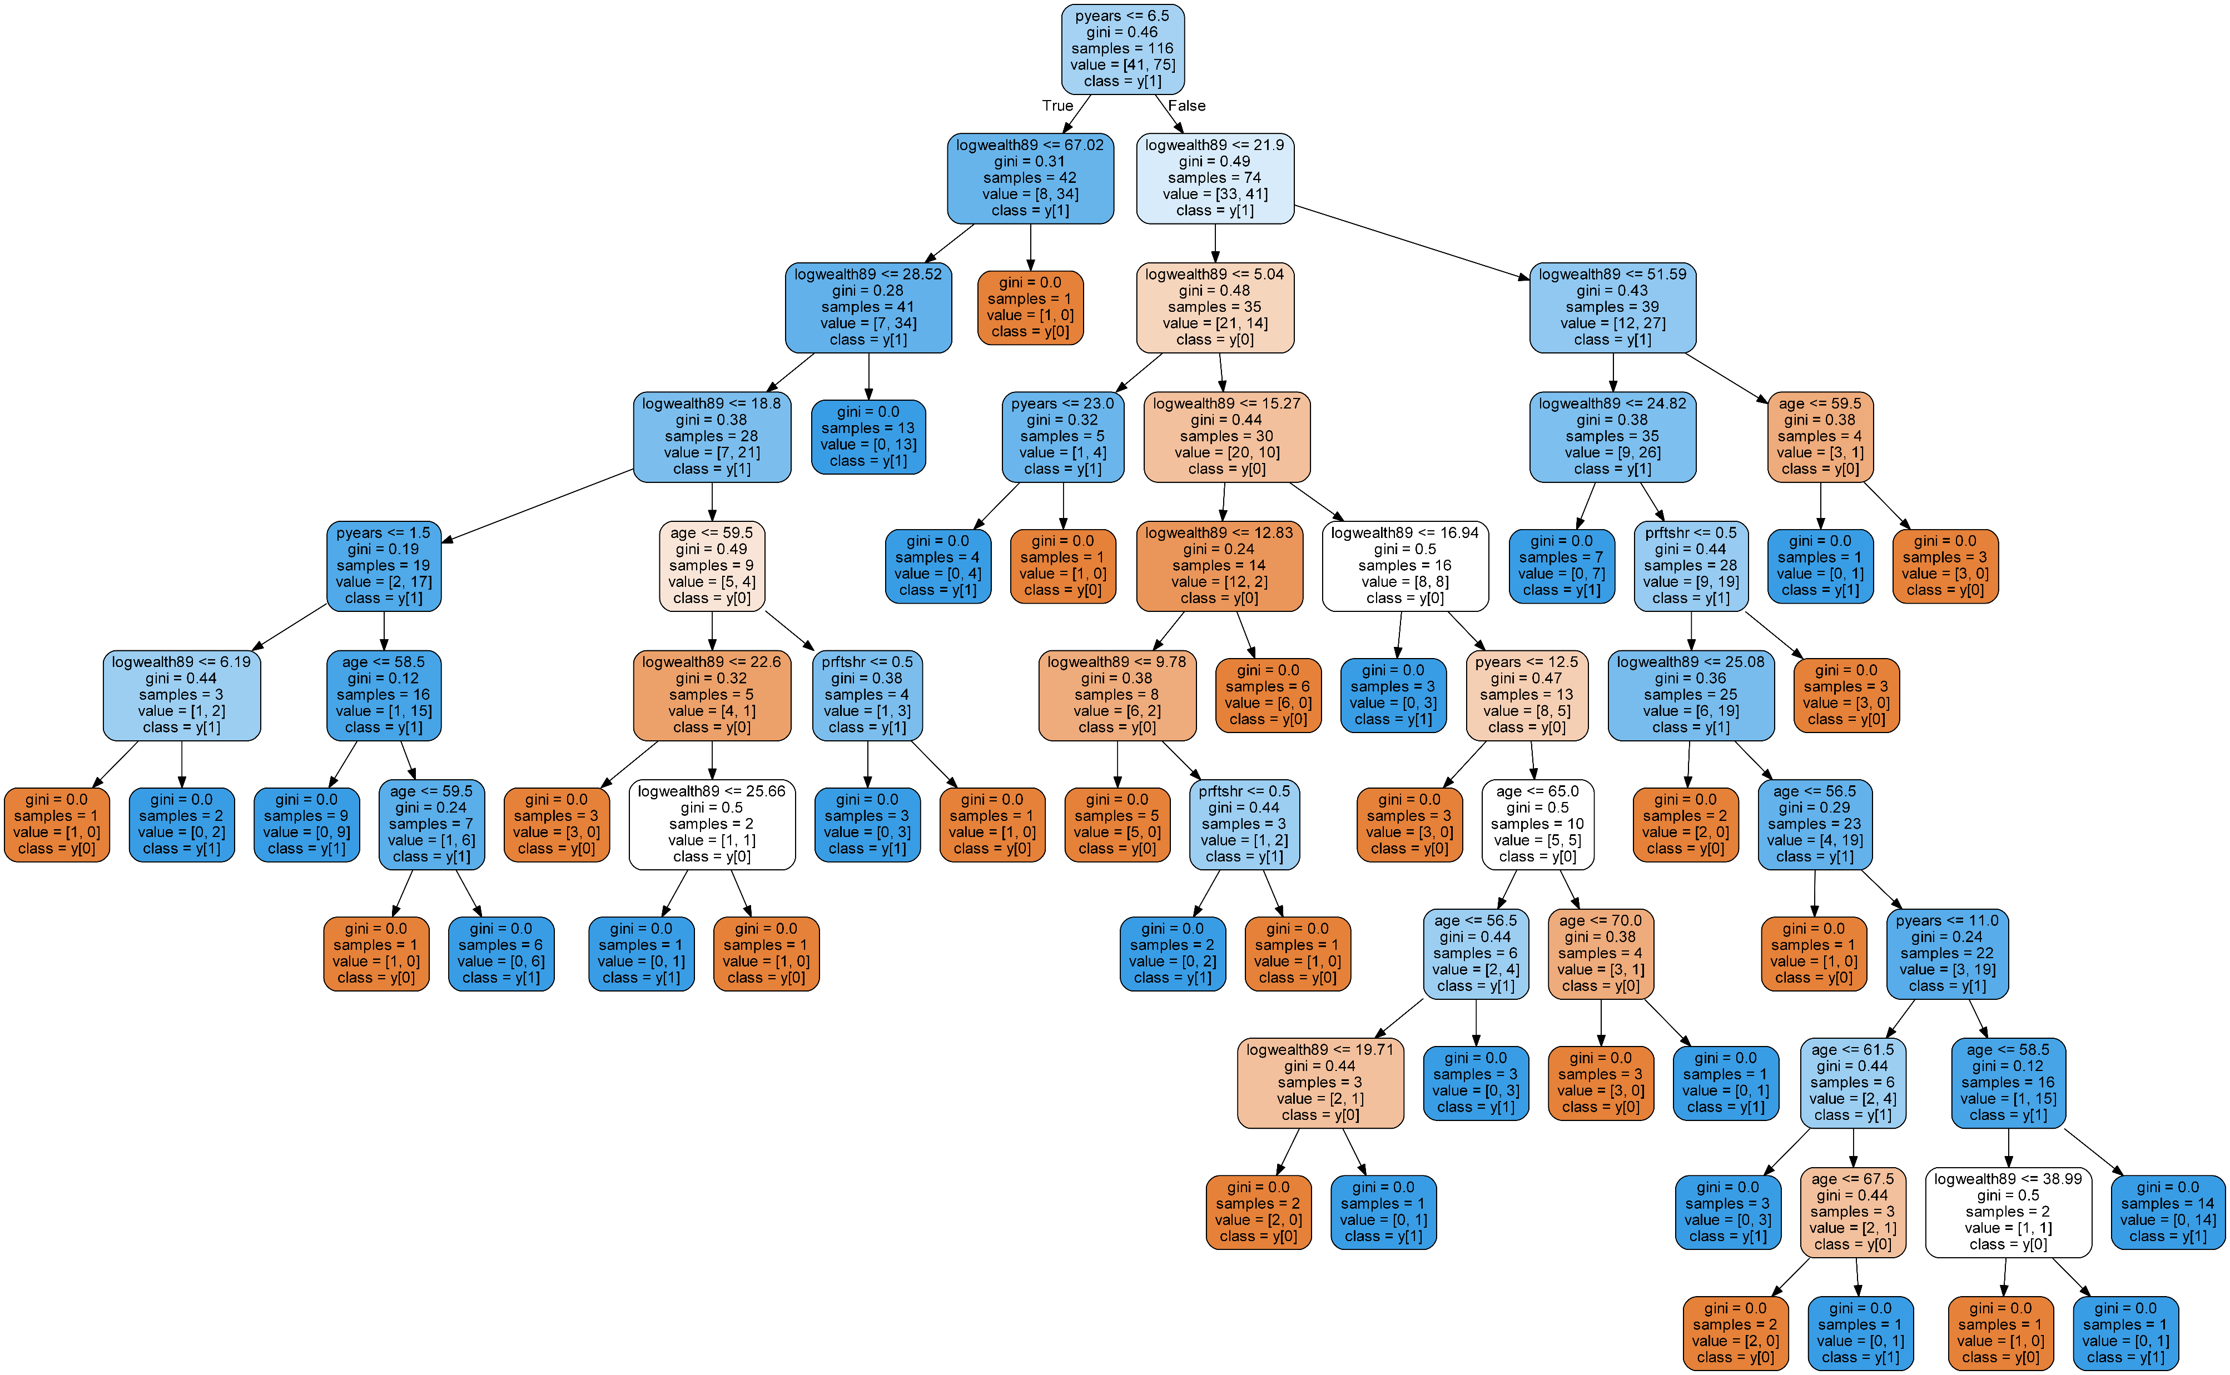
Choice Tree Model Visualization

Slide 15
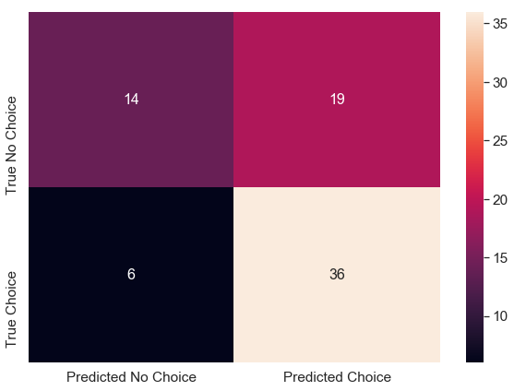
Choice Tree Model Accuracy
Confusion Matrix
Accuracy Score
According to the confusion matrix, the tree model can predict choice 66.67% of the time (50/75). There still seems to be more false positives (Type I Errors)

Slide 16
Choice Tree Model Interpretation
Insights
Pyears allows the model to most accurately create homogenous groups of elements (split between pyears <= 6.5 and pyears >= 6.5)
Logwealth89 represents the second split, splitting groups between <=67.02 and <=21.9.
Gini Index is .46 for pyears, which means that the model has a 46% chance of classifying an element wrong when predicting only based on pyears.
Feature Importance
According to the tree model, the following is the variables ranked from most to least important in predicting whether choice is 1 or 0:
Logwealth89 (.4993)
Age (.2518)
Pyears (.1369)
Prftshr (.1118)

Slide 17
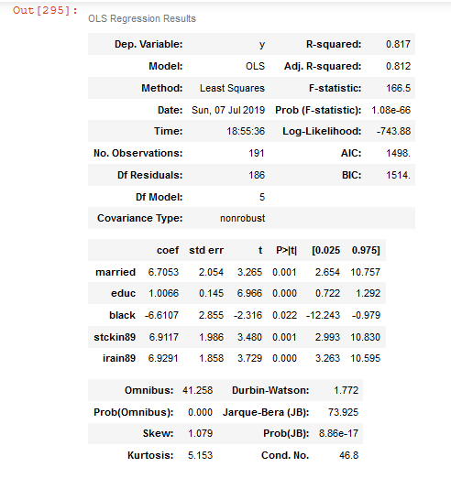
LogWealth89 MOdel
I also wanted to create a model to try and find relationships between the log of the net worths of the respondents and other variables. I first removed the family income variables as I believe those would be too closely related to the net worth of the families. Then, using backwards elimination created an Ordinary Least Squares model using the variables “married”, “educ”, ”black”,”stckin89”, and “irain89”.
Insights
The average difference between the net worth of married cases (married=1) and single cases (married=0) is $6,703 more (married is significant at .1% level)
For every additional unit of education, net worth goes up by approximately $1,066 (educ is significant at .0000.% level)
The average difference between the net worth of a black respondent (black = 1) and a non-black respondent (black = 0) is $6,610 less (black is significant at 5% level).
The average difference between the net worth of someone who owned stock in 89(stckin89 = 1) and a non-stock owner (stckin89 = 0) is $6,911 more (stckin89 was significant at .1% level).
The average difference between the net worth of someone who owned an IRA in 89(irain89 = 1) and a non-IRA owner (irain89 = 0) is $6,929 more(irain89 was significant at .0000..% level).

Slide 18
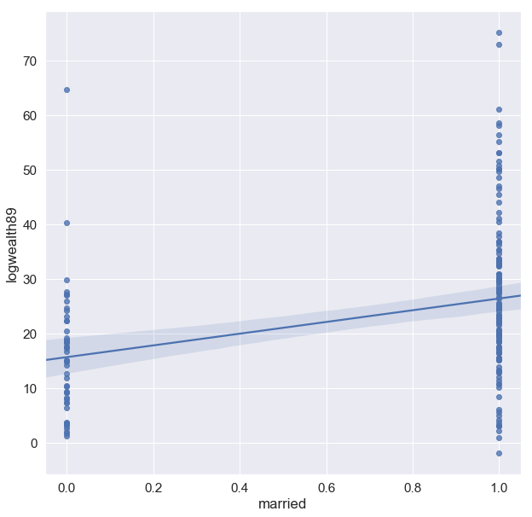
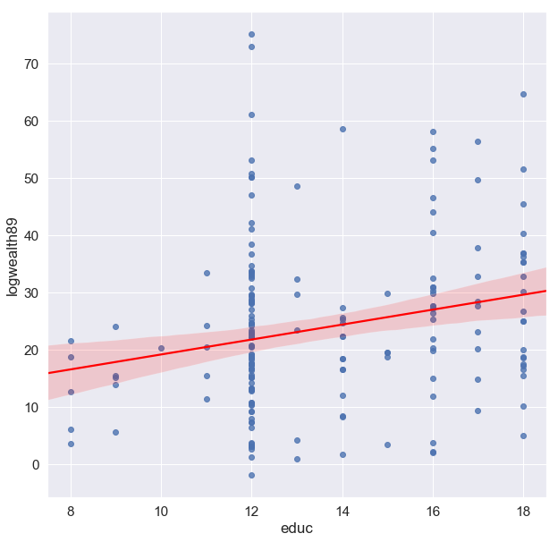
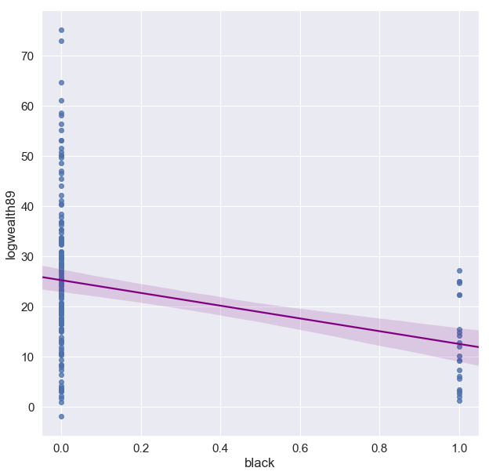
Logwealth89 Model Visualizations
If married, likely has a higher net worth than if not married.
For every additional year of educ net worth increases
If black, likely has a lower net worth than if not black.

Slide 19
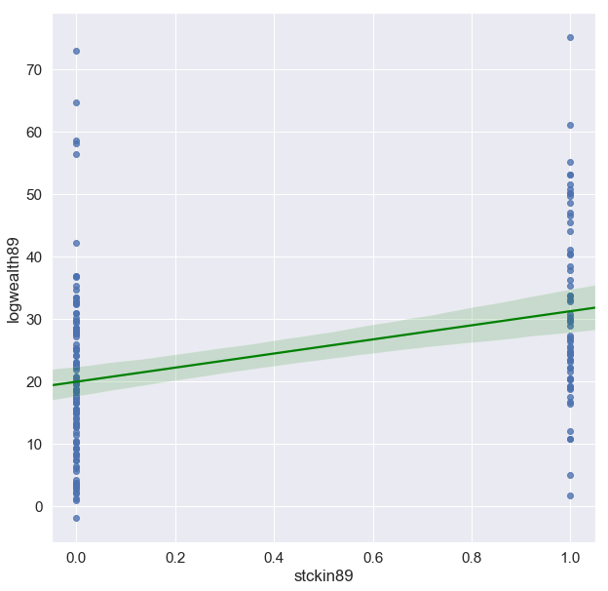
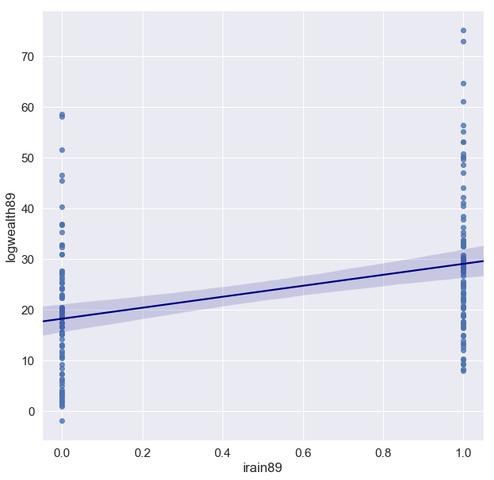
Logwealth89 Model Visualizations Continued
If owned stock in 89, likely had a higher net worth than those who didn’t own stock in 89.
If owned an IRA in 89, likely had a higher net worth than those who didn’t own an IRA in 89.

Slide 20
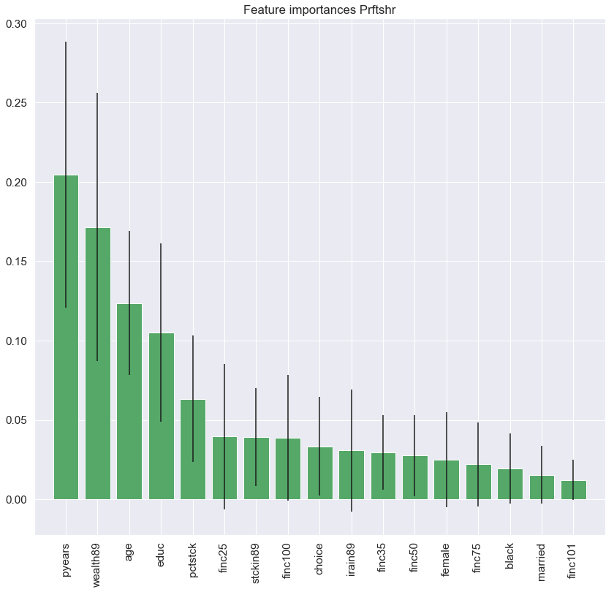
PROFIT SHARING MODEL
Next I created a model to try and predict whether a respondent had profit sharing in their pension plans. I used a random forest classifier in order to find the different feature importances of the data (visualization below). I originally chose to include the highest four features in the model, which were “logpyears”, “logwealth89”, “age” and “educ”. However, After doing backwards elimination in order to make most variables statistically significant, I was left with “age” and “logpyears”.

Slide 21
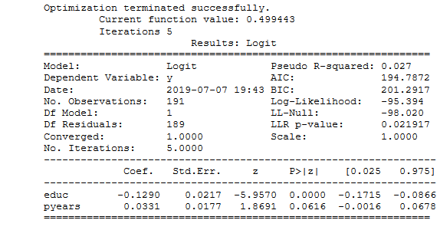
Profit Sharing Model Results
Insights
For every one unit increase in educ, the log odds for having a profit sharing plan decrease by 12.9%. Education is statistically significant at a .0000..% level (very significant).
For every one unit increase in years in the pension plan, the log odds of having a profit sharing plan increase by 3.31%. Pyears is statistically significant at only a 10% level.

Slide 22
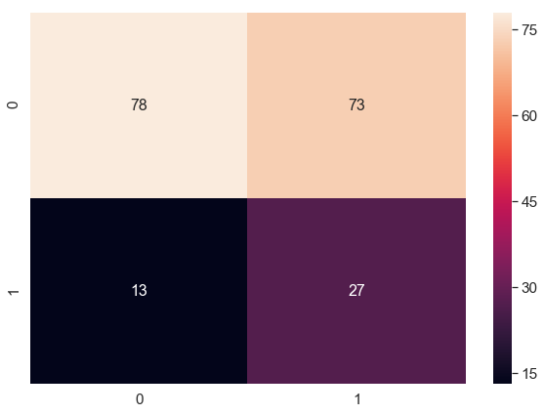
Profit Sharing Model Accuracy
Confusion Matrix
Accuracy
According to the confusion matrix, this model can predict whether someone is in a profit sharing plan with only 54% accuracy.

Slide 23
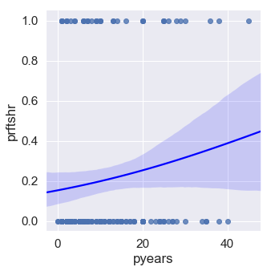
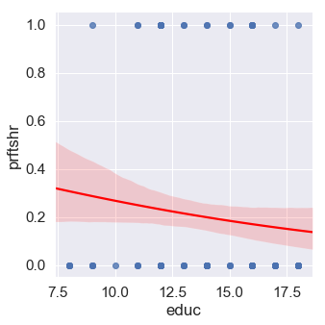
Profit Sharing Model Visualization
As pyears goes higher the log odss of prftshr go up, although the higher pyears have a wider confidence interval (likely due to outliers).
As education goes up, the log odds of having a profit share plan go down.

Slide 24
Pension Plan Years Model
Lastly, I wanted to create a model to see if there are any existing relationships between different variables and the years the respondent has been in the pension plan. I used the log transformation of pyears since there were no outliers in that variable. I used Recursive Feature Elimination with Cross Validation and then did Backward Elimination myself to get a lower AIC (since using R-squared made the model susceptible to using too many variables). The variables in this model were “prftshr”, “choice”, “female”, “finc35” and “educ”.

Slide 25
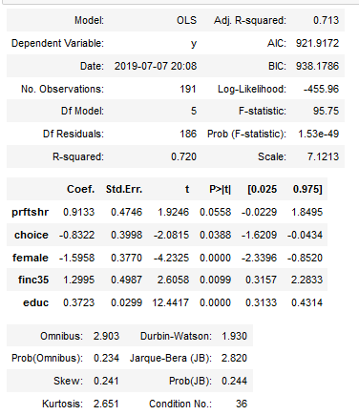
Pension Plan Years Model Results
Insights
The average difference of logyears in a pension plan when the plan is a profit-sharing plan (prftshr = 1) and a non-profit sharing plan (prftshr = 0) is .9133 more logyears in the plan. Prftshr is statistically significant at a 10% level.
The average difference of logyears in a pension plan when the plan involves choice (choice = 1) and a plan involving no choice (choice = 0) is .8322 less logyears. Choice is significant at a 5% level.
The average difference of logyears in a pension plan when female (female = 1) when compared to males (female = 0) is 1.5958 logyears. Female is significant at a .0000..% level.
The average difference of logyears in a pension plan when the respondent lists their family income as between 25k and 35k (finc35 = 1) compared to when they are in a different income bracket (finc35 = 0) is 1.2995 more logyears. Finc35 is statistically signicant at a 1% level..
For every additional year of education, the logyears in a pension plan increases by .3723 logyears. Educ is statistically significant at a .0000..% level.

Slide 26
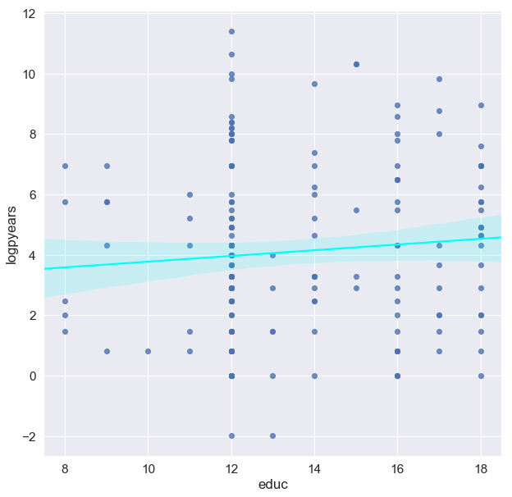
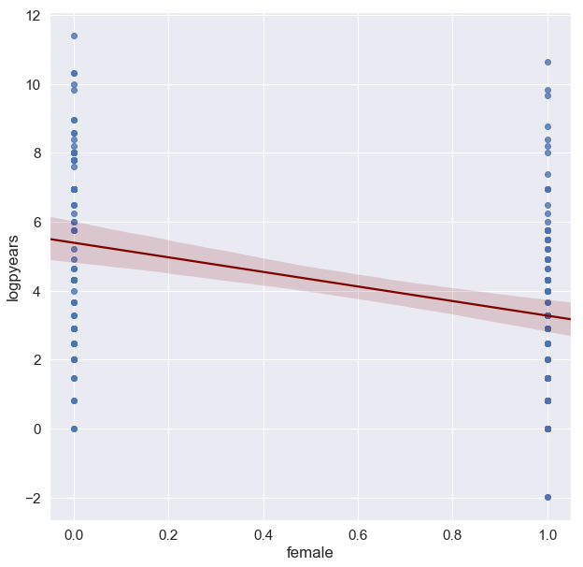
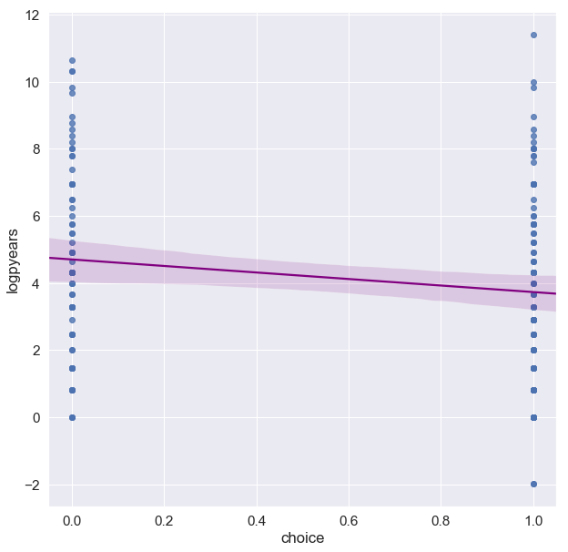
Pension Plan Years Model Visualization
If can choose to invest, likely has been in pension plan for less logyears.
As education increases the logpyears also increases.
If female, likely has been in pension plan for less logyears.

Slide 27
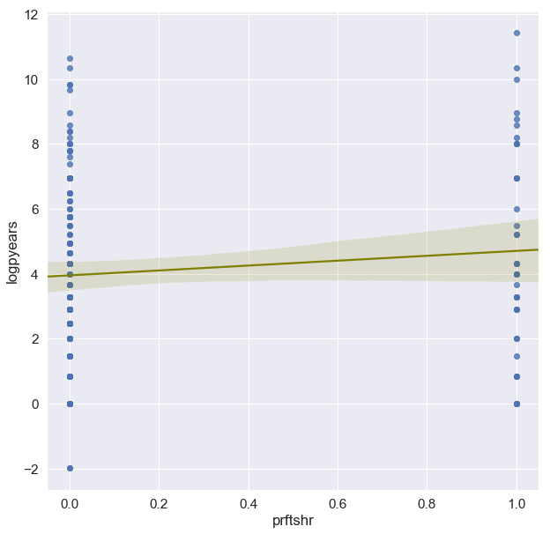
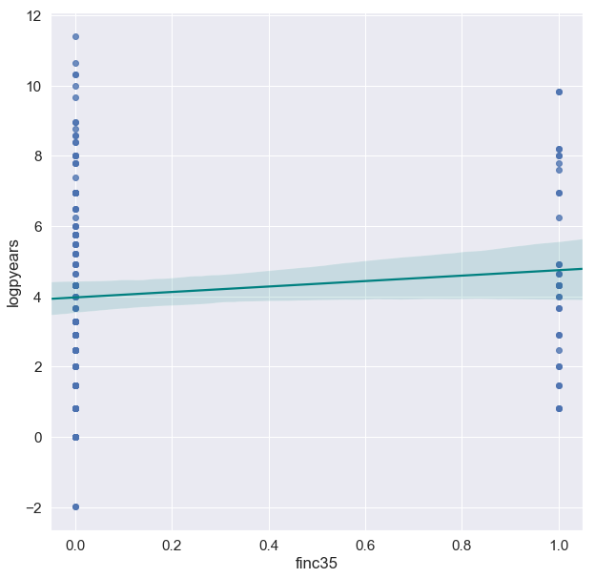
Pension Plan Years Model Visualizations Continued
If they have a profit-sharing plan, the respondent is likely to have been in the plan for more logyears.
If family income is between $25,000 and $35,000, respondent is likely to have been in the pension plan for more logyears.

