Slide 1


Big Data Project
Group 9
Adam Butcher
Anka Babu Paul Samson
Varun Banda
Monika Chintha
Siddharth Hareendran
Harshadeep Shinde
Derek Tallent

Slide 2
Project Objectives
Objective 1: Collect and process geolocation, truck route, and data relating to risky driving attributes (unsafe following, speeding, lane departures etc.)
Objective 2: Determine risk factor for each driver based on number of risky events they have recorded. Determine which drivers are at high risk of causing an event or driving dangerously (speeding, tailgating, traffic accident, etc.)
Objective 3: Create dashboards to visualize which drivers are the most risky and which locations have the most risk events occurring.

Slide 3







Project Analysis Workflow
Sourced data from Cloudera
Ingested data into Hadoop Distributed File System (HDFS)
Used Hive to load data into tables in order to prepare for risk factor analysis
Ran Pig script that joined different hive tables and determined a risk factor from geolocation and truck tables
Filtered all driver IDs with a risk factor greater than 7 using PySpark
Integrated Hive with Tableau in order to create risk factor dashboard.
Used Hive tables to perform logistic regression analysis using Python
Data Source
Data Storage
Data
Processing
Data Exploration & Analysis

Slide 4
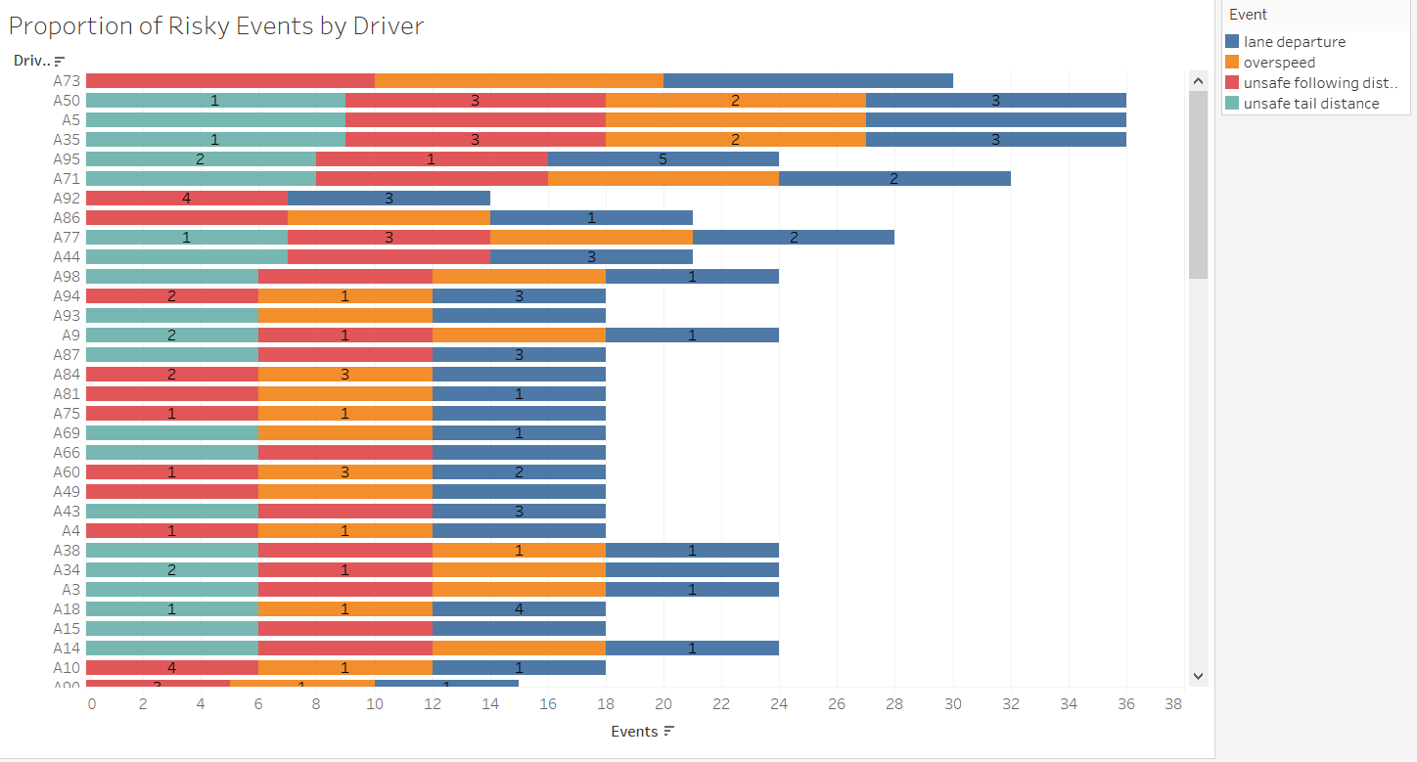
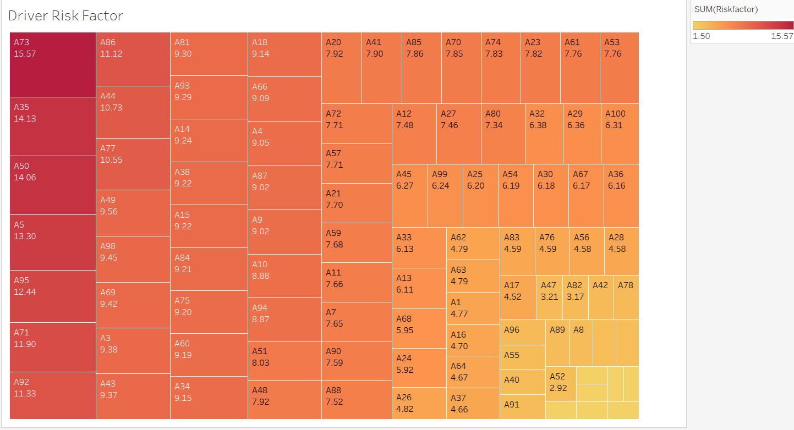
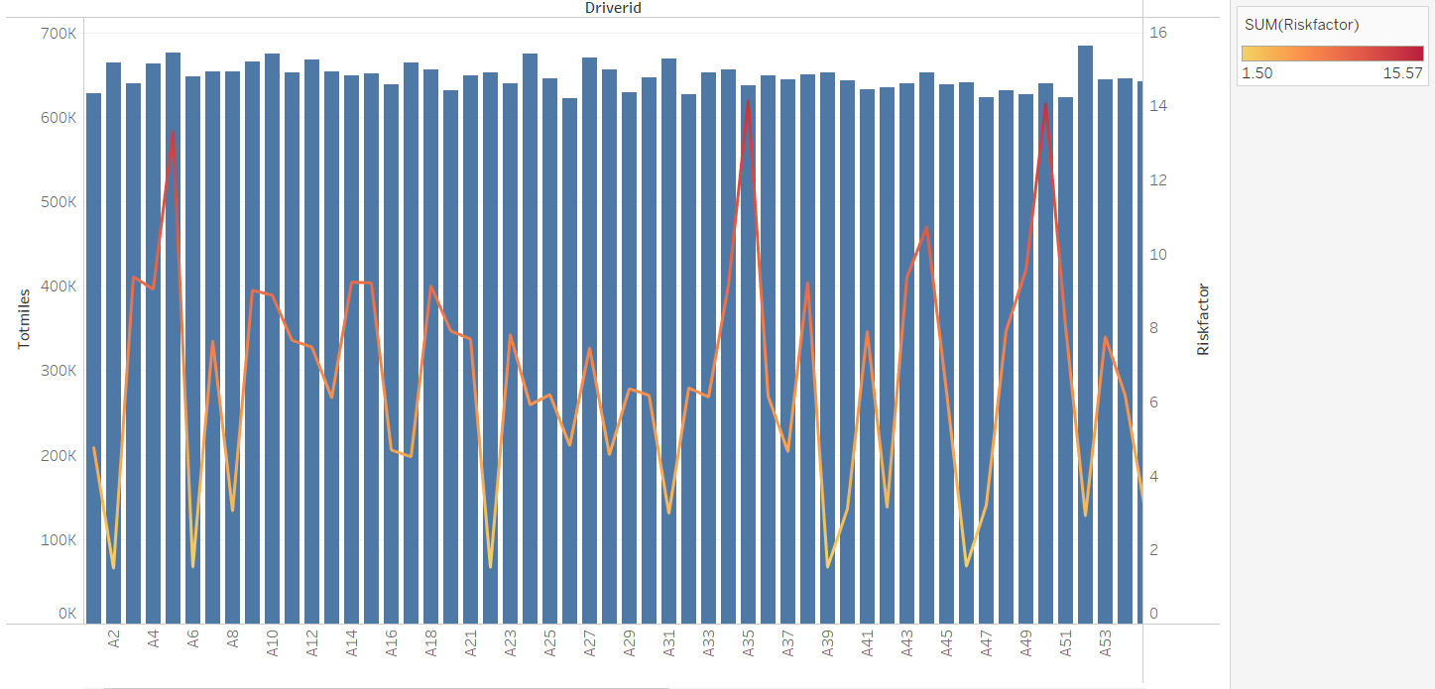
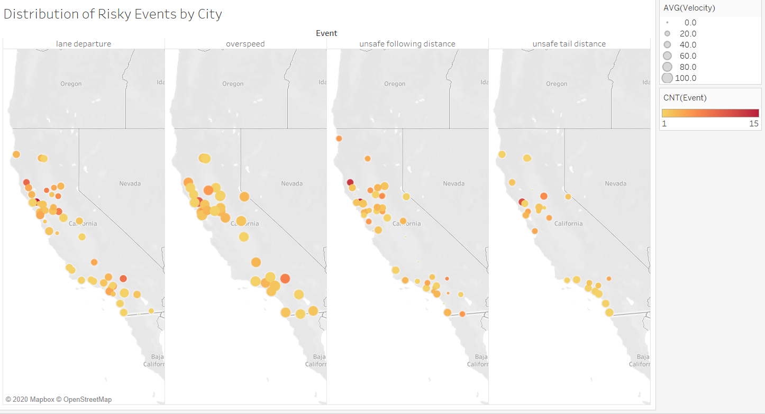
Dashboards

Slide 5
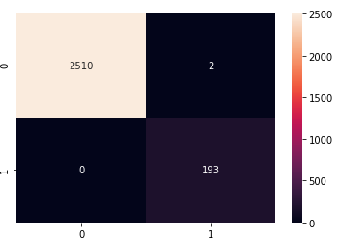
Logistic Regression
We utilized feature importance to find which events are more important in determining risk factor, the following are the events listed from most to least important:
Unsafe Following Distance
Speeding
Unsafe Tailing Distance
Lane Departure
We also created a logistic regression model to predict whether new trucks would have a riskfactor above 7 or not. Below is a confusion matrix showing the accuracy of our model (99.4%) on the data we have:

