Slide 1
Cohort_Analysis_Dashboard
File created on: 10/9/2020 1:26:50 PM

Slide 2
Data
From https://www.kaggle.com/jihyeseo/online-retail-data-set-from-uci-ml-repo
Lists transactional data between 2010-2011

Slide 3
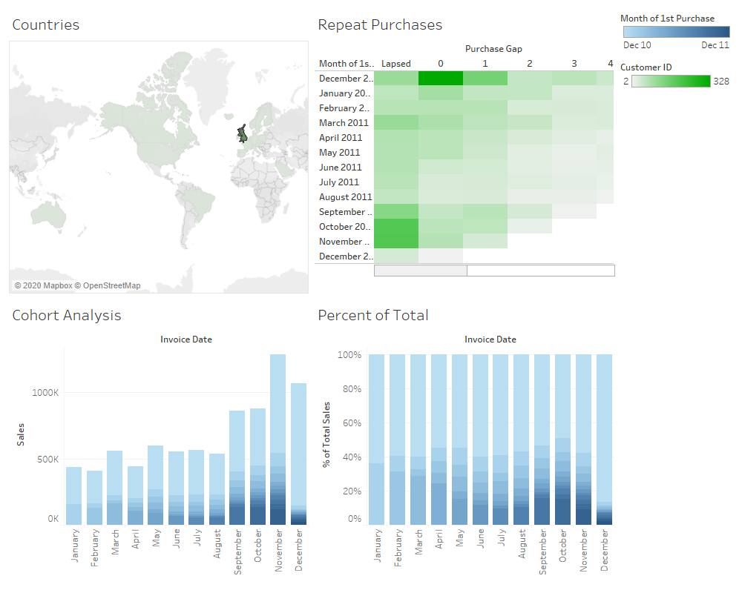

Slide 4
Calculated Fields
1st Purchase: {FIXED[Customer ID]: MIN([Invoice Date])}
2nd Purchase: {FIXED [Customer ID]:MIN([Repeat_Purchase])}
Repeat_Purchase: IIF([Invoice Date]>[1st Purchase],[Invoice Date],NULL)
Purchase Gap: DATEDIFF('month',[1st Purchase],[2nd Purchase])
Sales: [Unit Price]*[Quantity]

Slide 5
Analysis
Can click on any country to get cohorts and analysis (view above is for UK)
For each month, over 50% of sales are made up of someone whose first purchase was made in December 2010. This means that over 50% of sales each month are from repeat customers.
Panel 2: 328 of the customers whose 1st purchase was in December 2011 made another purchase before January 2011
Panel 2: 191 of the customers whose 1st purchase was in October 2011 lapsed (did not make another purchase)

