Slide 1
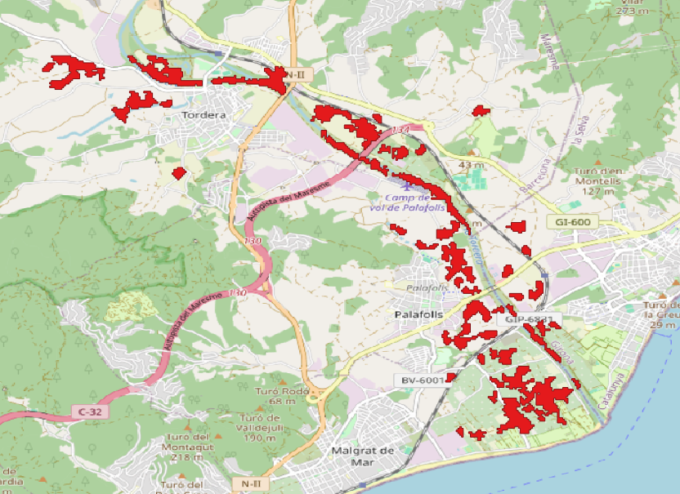
Maresme County Gloria analysis
Derek van de Ven

Slide 2
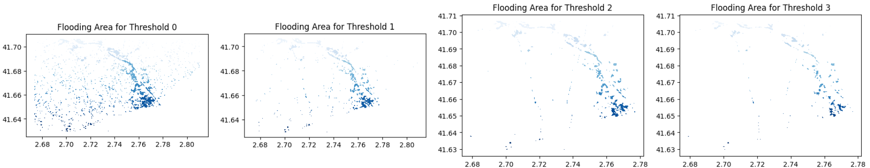
Methodology
Population and roads
For the population and roads I downloaded data from OpenStreetMap and humdata.org. Then I checked which parts spatially intersected with the mask and summed the length of road or amount of people in that pixel area. I removed tiny polygons so we wouldn't get population info from pixels far away from the river.
Coding
I started with tests to first develop the code to do the processing and then applied this code in the API and Notebook. ​
Finding suitable (satellite) data
I first wanted to investigate using visual data, but since the results were cloudy I opted for VV radar. I made composites of the radar imagery from VV before and during the flood in Google Earth Engine, and downloaded the data.
Masking flooded areas
I then masked the part that had an increase in VV reflection, without creating many extra flooding areas not near the river (see figure below)

Slide 3
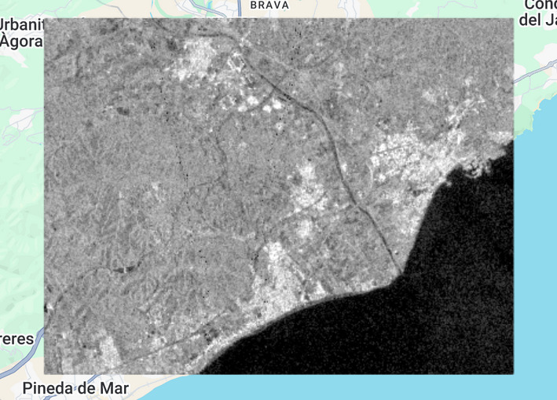
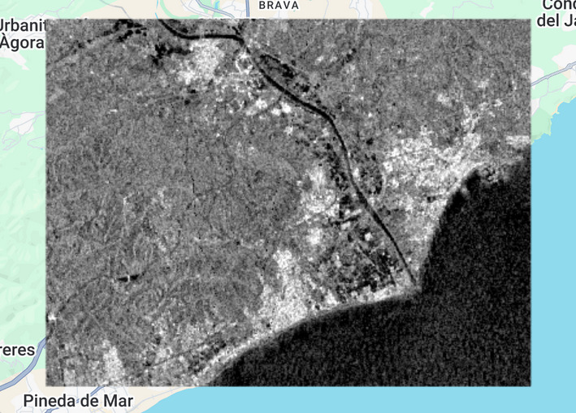
Key findings
My findings indicate the following results:
population impacted: 40951 people
road impacted: 76659m
flooding area km2: 70.0326
This is about five-and-a-half times as big as London Heathrow Airport, which seems the right size

Slide 4
API
I created the two requested api endpoints /flood_analytics and /flood_map
/flood_analytics
Pydantic for the FloodAnalyticsRequest for clarity
I use a post endpoint, since a lot of inputs are required
/flood_map
For the I simply use query parameters. I have tried to keep it simple.
A nice addition wouuld be a database, authentication, and data input automation.

Slide 5
Some niceties
I use uv for dependency management, it's really fast
I use ruff and pre-commit to make sure my code is all aligned in a nice way
I use typing to keep the code maintainable
I test the code by writing the tests first. The tests don't check the output but they check if the functionality does what it's supposed to do.

