Slide 1

von dem Team Platformer 4D Auinger, Ettinger, Litzlbauer, Pouget

Slide 2
INHALT
Game
Website
CI CD

Slide 3
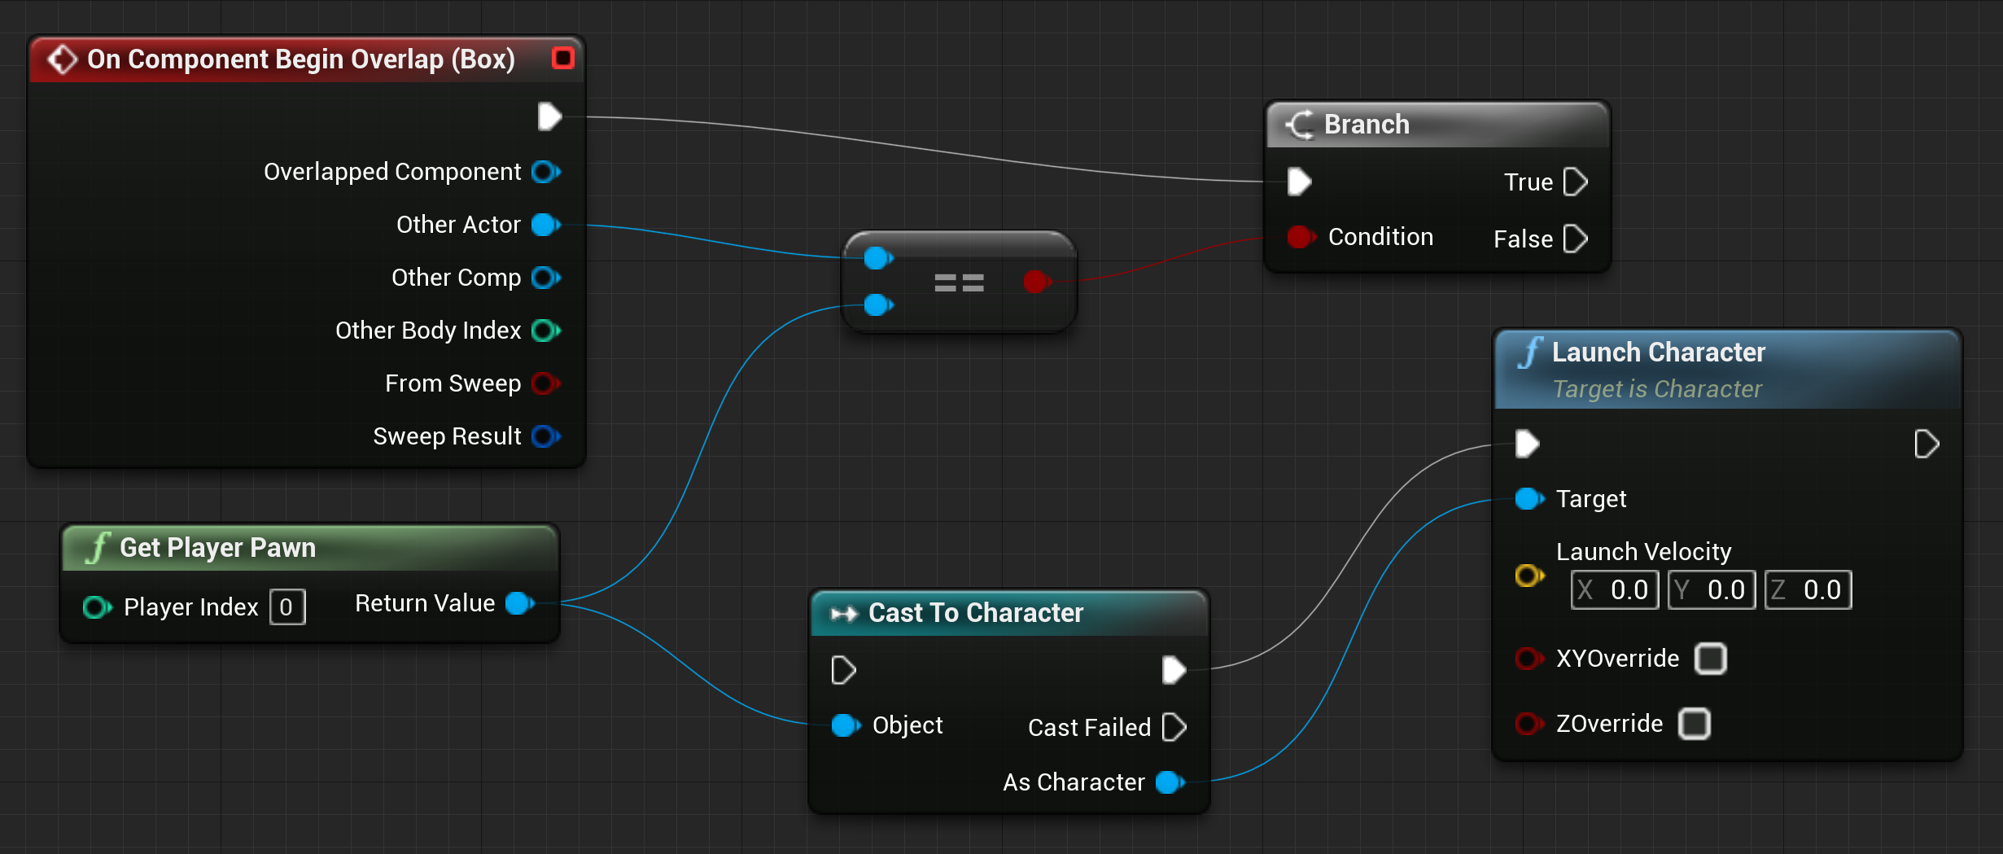
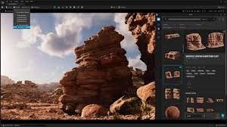
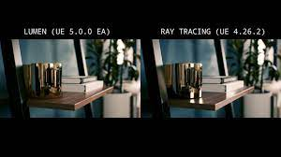
GAME – NEW TECHNOLOGIES
Blueprint
Pixel Bridge, Nanite
Lumen

Slide 4
GAME - UMGESETZT
Game
Website
CI CD

Slide 5
Unreal Engine – New Technologies
Blueprints
Lumen
Nanite
Landscape

Slide 6
Advertisement Page

Slide 7
CI CD

