Slide 1
Designing a Decision Support Web Interface for Glaucoma Diagnosis

Slide 2
1- Team
5- Timeline for future steps
4- What is done so far?
3- Did you do market analysis?
2- What is your goal/motivation for this project?

Slide 3
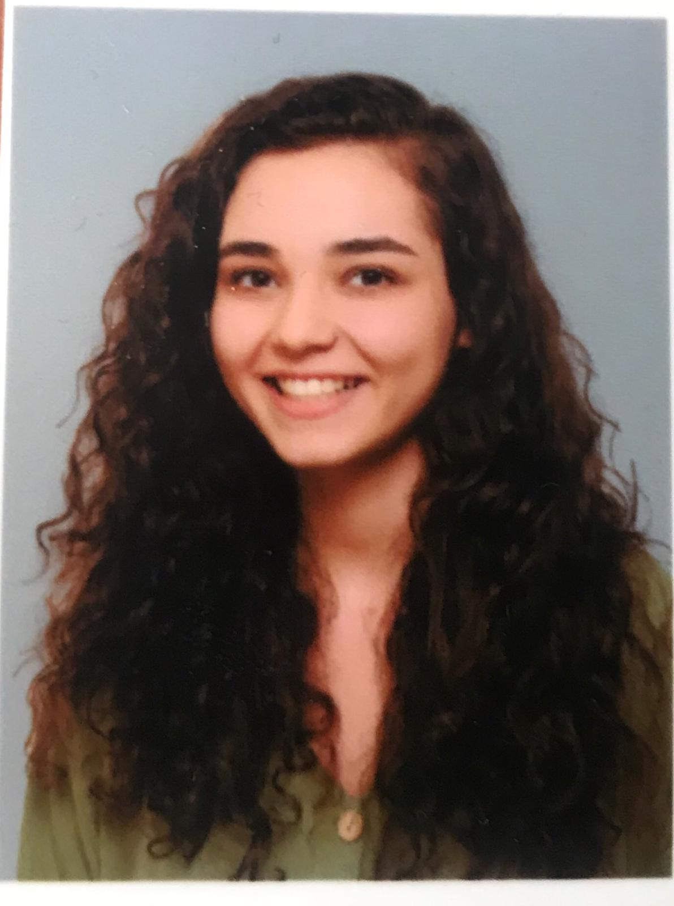
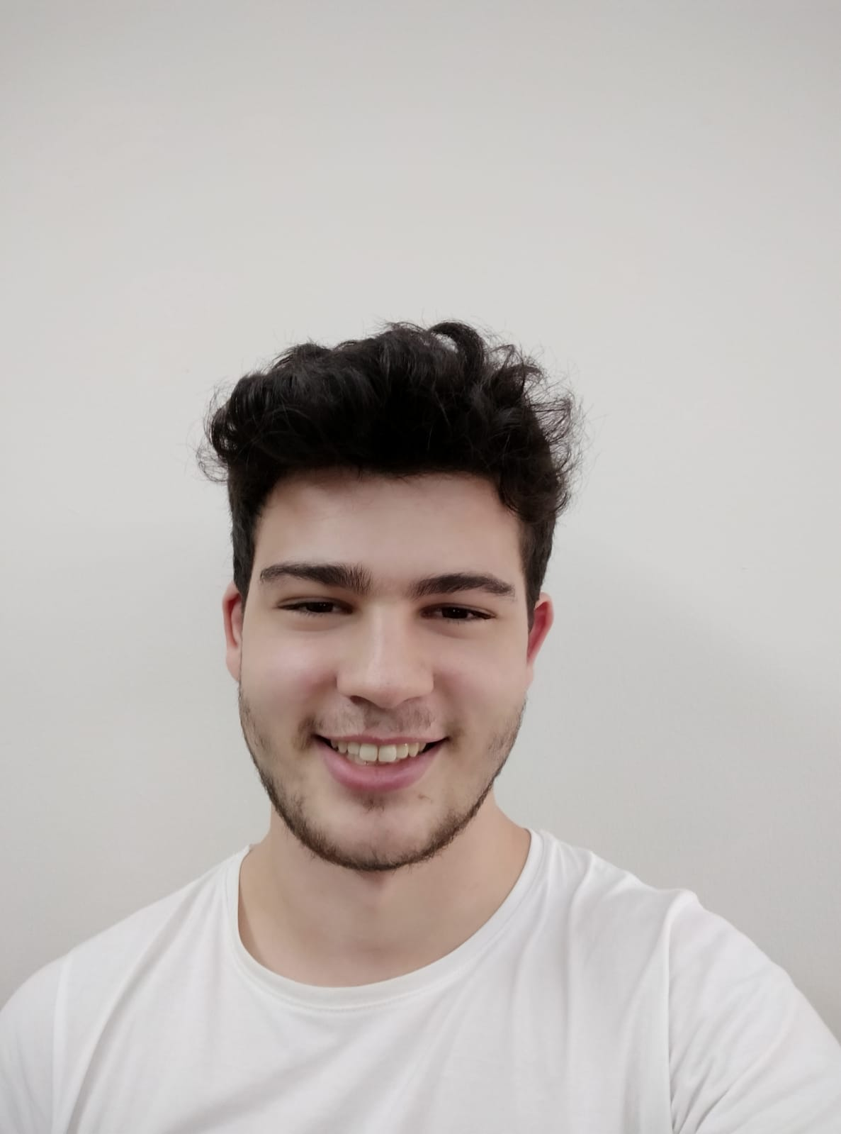
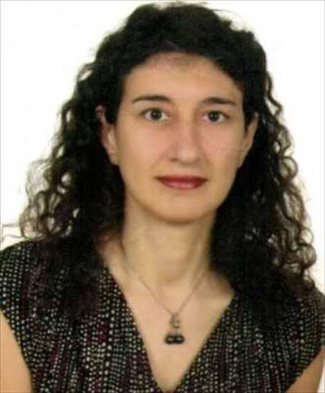
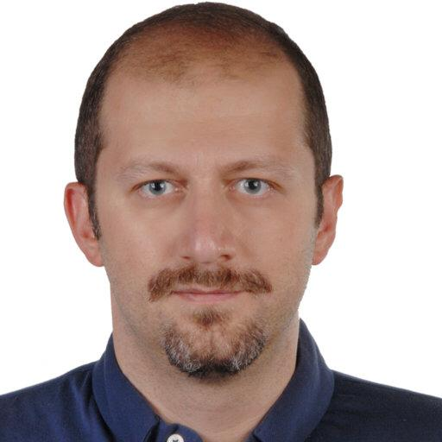
Team
Kıymet Deren Toy
MSKU Computer Science Student
4th year Student
Görkem Savran
MSKU Computer Science
4th year Student
Dr. Tuğba Süzek
MSKÜ Computer Science
Bioinformatics
Dr. Erdem Eriş
İzmir Sağlık Bilimleri Üniversitesi Göz Hastalıkları Öğretim Üyesi

Slide 4
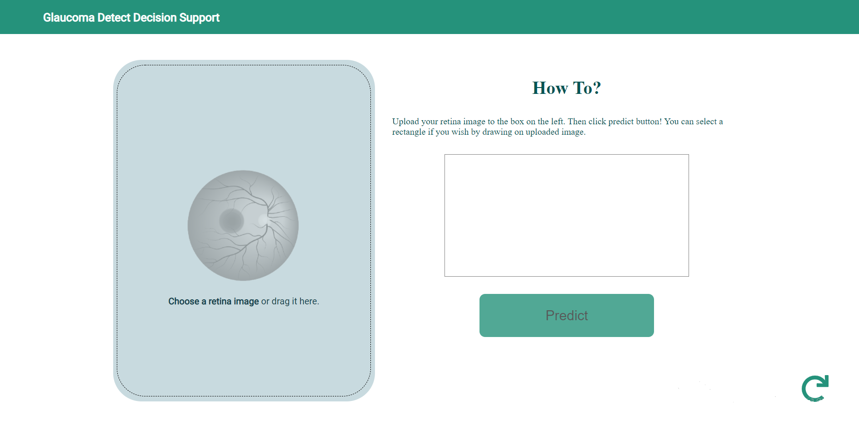
Goal/Motivation

Slide 5
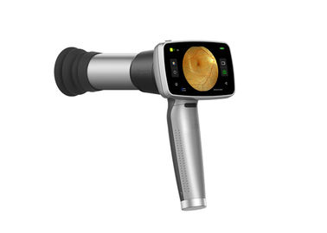
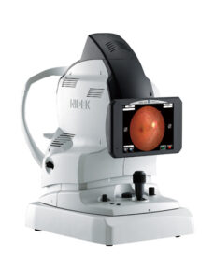
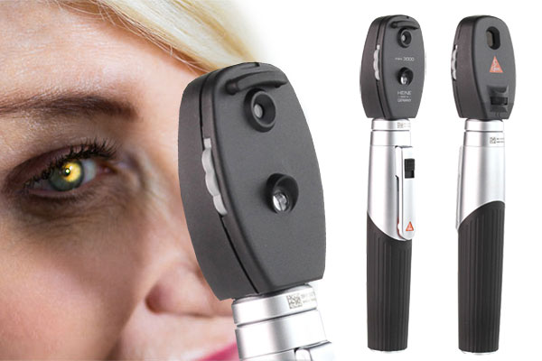
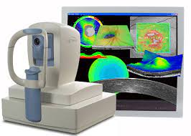
Market Analysis

Slide 6
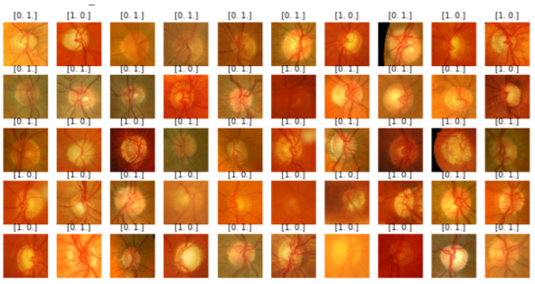
What is done so far?
Some datasets we use:
1. ORIGA-light fundus dataset
2. ACRIMADataset dataset

Slide 7
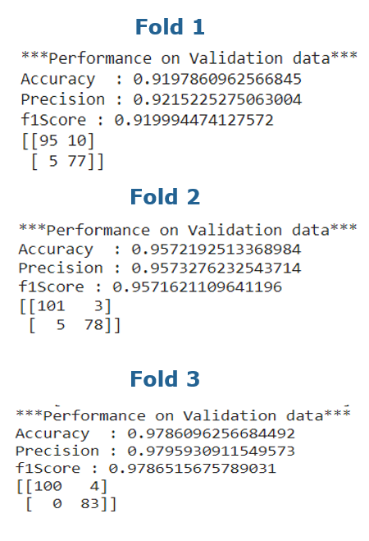
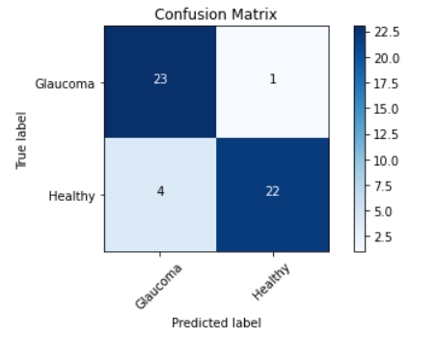
Average F1 Score :
0.9519360508901982333

Slide 8

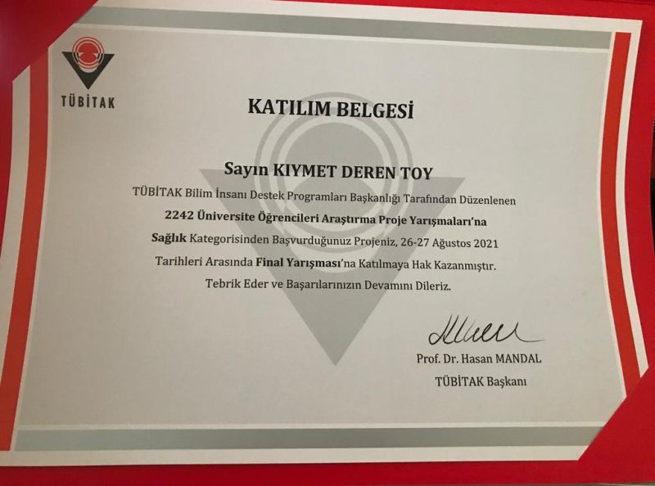
TUBITAK 2209A – TUBITAK 2242

Slide 9

Timeline for future steps

Slide 10
THANK YOU
Kıymet Deren Toy derentoy@gmail.com
Görkem Savran savran789@gmail.com

