Slide 1
Designing a Decision Support Web Interface for Glaucoma Diagnosis

Slide 2
Content
1- Team
4- Method and Process
3- Goal and Motivation
2- What is glaucoma?
5- Grants and Competitions

Slide 3
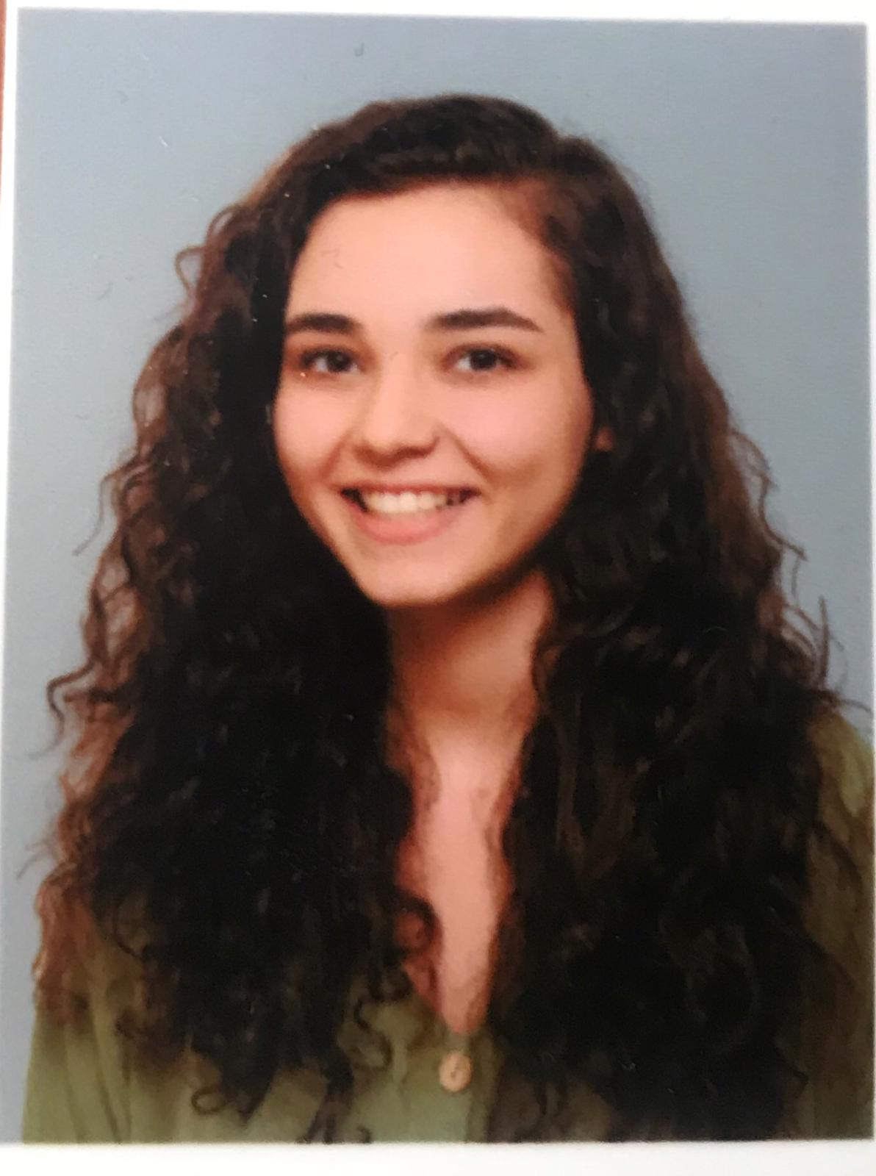
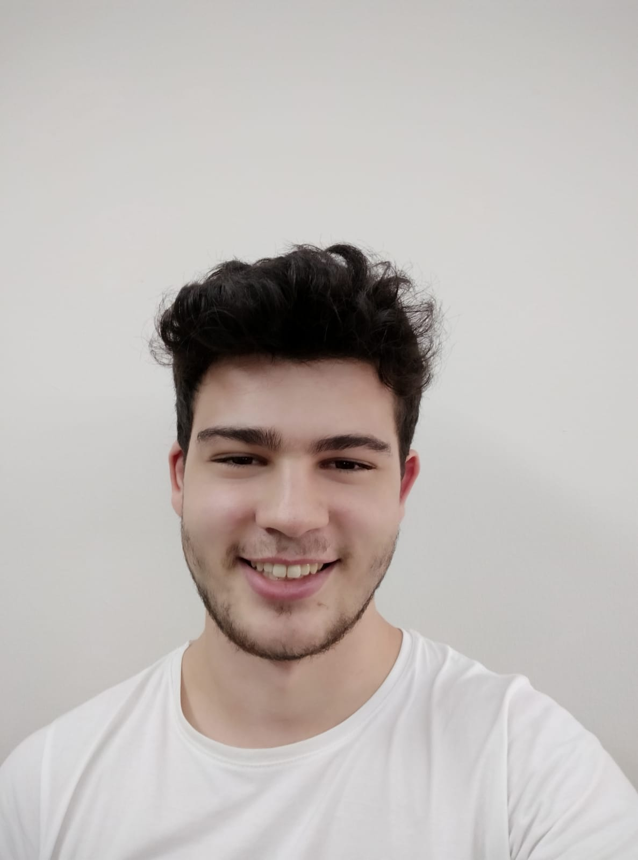
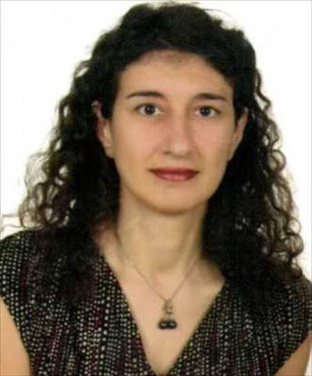
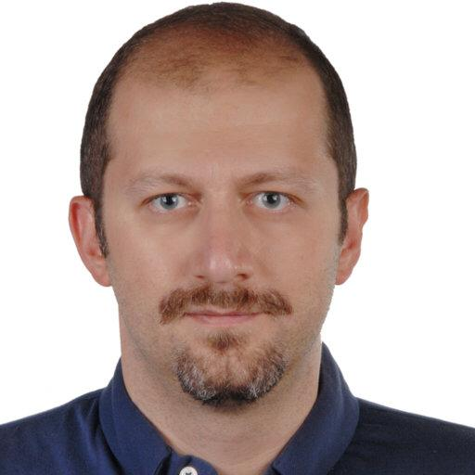
Team
Kıymet Deren Toy
MSKU Computer Science Student
4th year Student
Görkem Savran
MSKU Computer Science
4th year Student
Dr. Tuğba Süzek
MSKÜ Computer Science
Bioinformatics
Dr. Erdem Eriş
İzmir Sağlık Bilimleri Üniversitesi Göz Hastalıkları Öğretim Üyesi

Slide 4
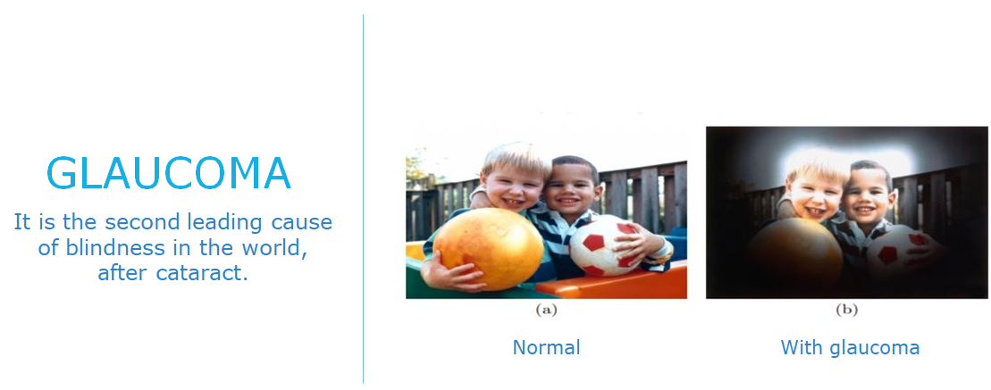

Slide 5
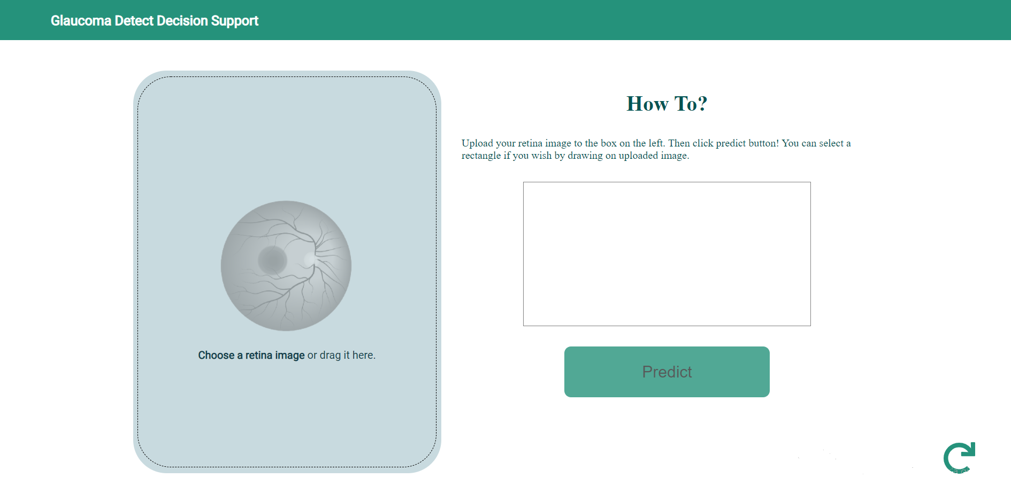
Goal/Motivation

Slide 6
Methods and Process
Data Collecting
Training AI Model
Testing AI Model
Designing the Web Interface
Publishing the Web Interface on the Internet

Slide 7
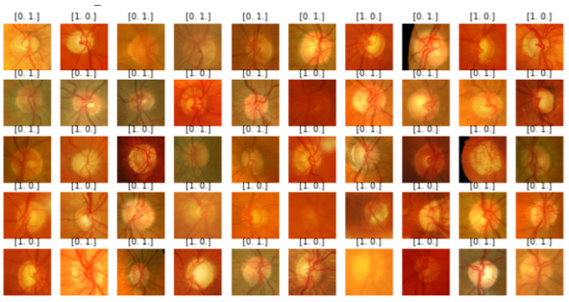
Data Collecting
Some datasets we use:
1. ORIGA-light fundus dataset
2. ACRIMADataset dataset

Slide 8


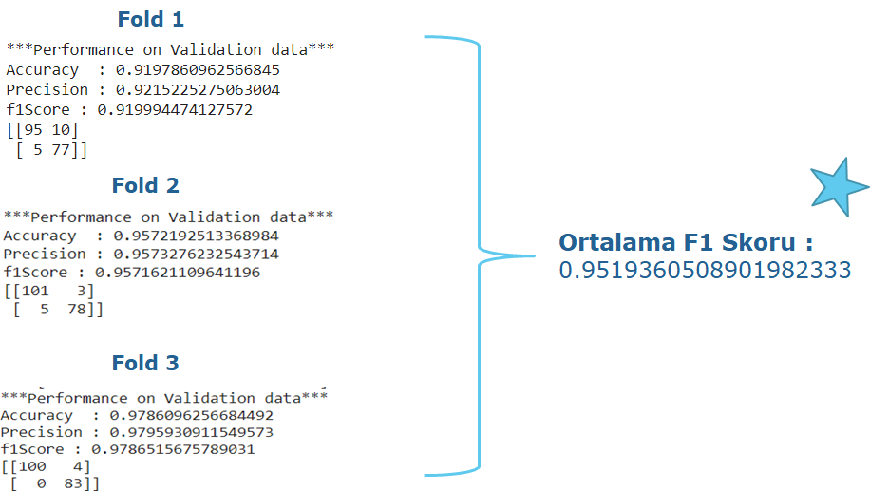
Training AI Model

Slide 9
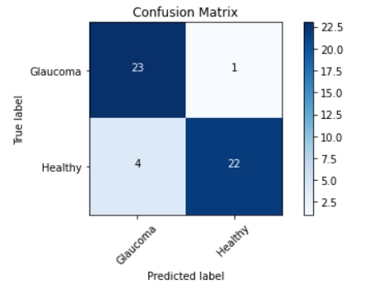
Testing AI Model

Slide 10
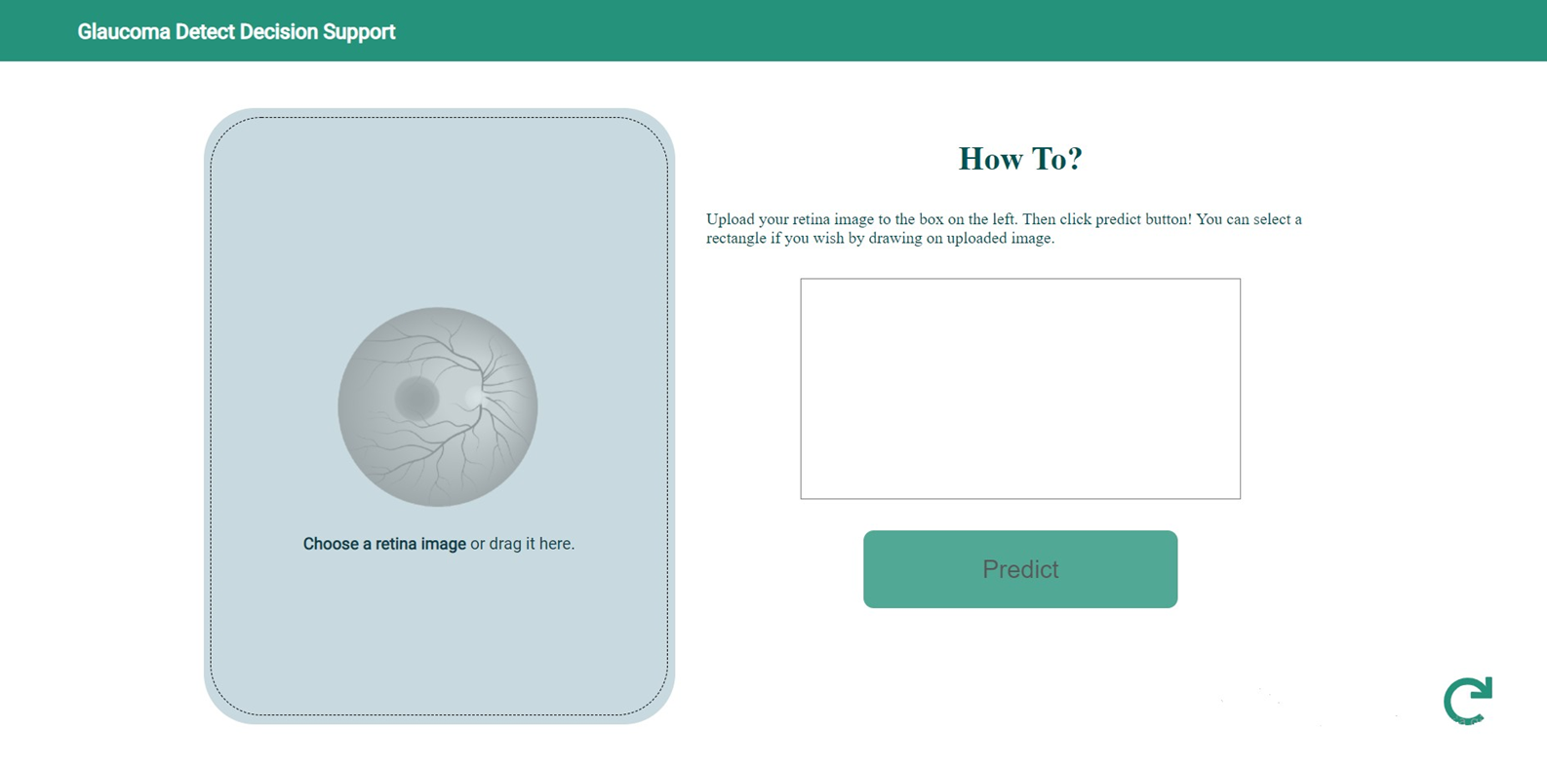
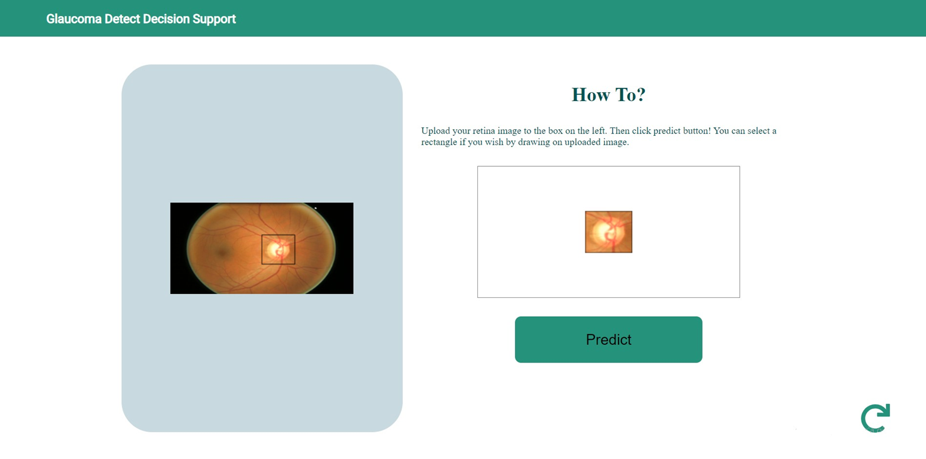

Designing Web Interface

Slide 11
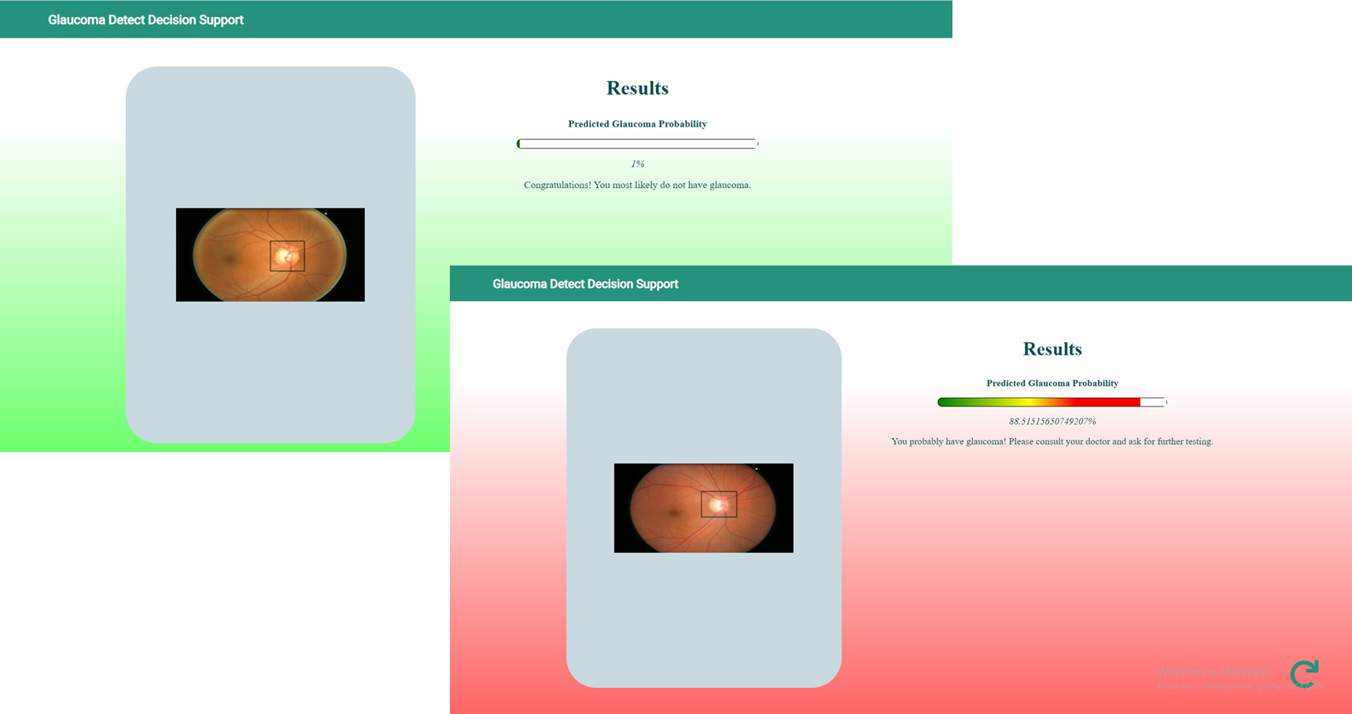

Slide 12


Publishing the Web Interface on the Internet
npm install -g firebase-tools
firebase login
firebase init
ng build --prod --aot
firebase deploy

Slide 13
Grants and Competitions

Slide 14

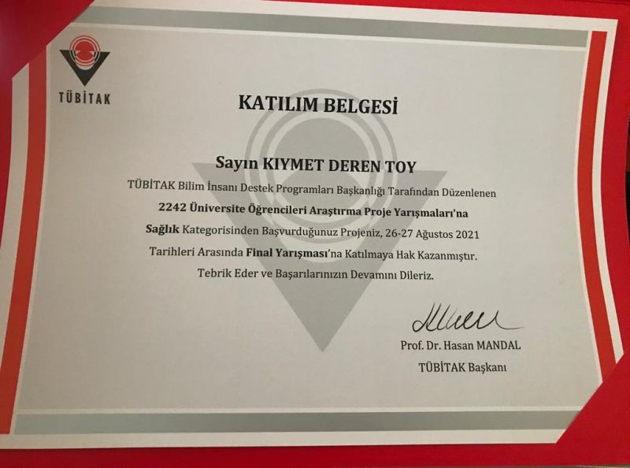
TUBITAK 2209A – TUBITAK 2242

Slide 15



Slide 16
THANK YOU
Kıymet Deren Toy derentoy@gmail.com
Görkem Savran savran789@gmail.com

