Slide 1
Score-P Control via Cmake
Eric Niklas Wolf
Proseminar Rechnerarchitektur, 30.10.2024

Slide 2
Presentation Structure
What is Score-P?
Score-P Analysis
What is CMake?
CMake Analysis
Developed CMake Modules
Localization module
Instrumentation module
Target Analysis
Performance Analysis
Conclusion and Outlook
Sources

Slide 3
What is Score-P?

Slide 4
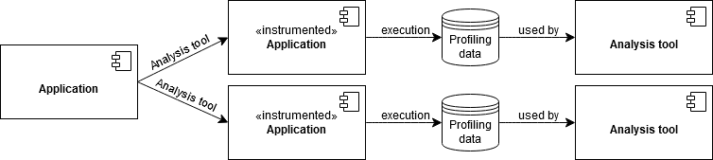
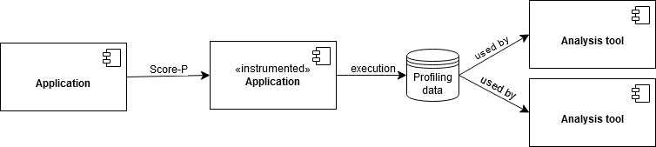
What is Score-P?
measurement infrastructure for profiling and tracing applications
allows to gather data for a number of analysis tools using open data formats
Applications only need to be instrumented once instead of for each tool

Slide 5
Score-P Analysis

Slide 6
Score-P Analysis
Instrumentation requires changes to compiler and linker command lines
provided scorep command takes command line and performs required modifications
required compiler and linker arguments are generated by the scorep-config command
scorep command has to be prefixed to all compiler and linker commands
instrumentation settings have some restrictions
some settings have to be unique within an application (threading paradigm, …)
some settings require modifications to the constructor of an executable or library
static libraries use constructor of components they are linked into
support user by inferring Score-P settings required for working application

Slide 7
What is CMake?

Slide 8
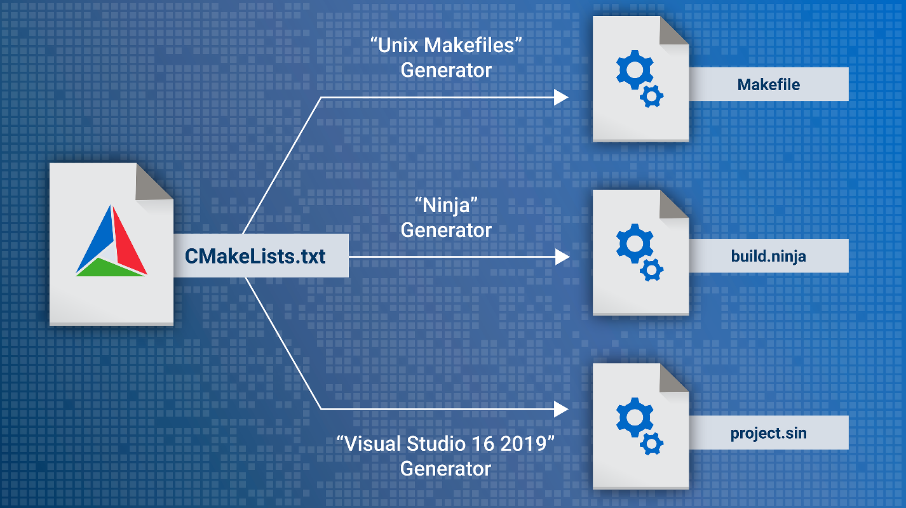
What is CMake?
widely used tool for managing and building projects
allows to define projects using a platform independent language
generates configurations for native build tools
https://cmake.org/wp-content/uploads/2023/08/Single_Source_Build.png

Slide 9
CMake Analysis

Slide 10
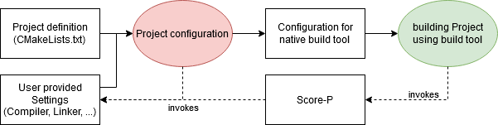
CMake Analysis (Project configuration)
before building a project it has to be configured by evaluating its definition
may call the configured compiler to extract information or compile test programs
using Score-P during project configuration may cause it to fail

Slide 11
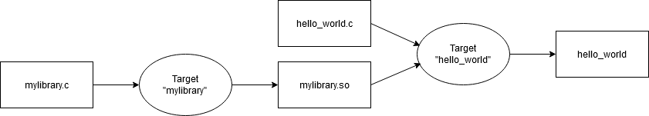
CMake Analysis (Project definition)
project definition is made out of targets with properties
represent operations to generate some outputs from some inputs
properties allow to store information for each target and affect its operation
properties may contain “generator expressions” which can’t be evaluated during configuration
access to all target properties is limited

Slide 12
CMake Analysis (external software)
code can be reused through modules
are files containing code written in the project definition language
can define functions, properties and variables
providing a module allows the user to access predefined functions
external programs are located by packages
use modules with a Find prefix to handle localization of software
alternatively special CMake files can be installed alongside the software
both approaches allow to represent capabilities using “components”
components are strings whose semantics are defined by the module used for localization
providing a Find module allows locating Score-P without changes its installation process

Slide 13
Developed CMake Modules

Slide 14
Localization module
allows to locate a Score-P installation supporting a specific set of features
components represent supported technologies (like OpenMP) or the used compiler
implements localization of Score-P in FindScoreP.cmake
Locate scorep-config (with matching capabilities)
Locate installation root of installation (using scorep-config)
Locate scorep and other commands (relative to found installation root)
create imported targets and set variables
find_package(
ScoreP "8.4" REQUIRED
COMPONENTS "COMPILER_C99_/usr/bin/gcc" "OMP_C"
)
message(INFO "scorep executable: ${SCOREP_EXECUTABLE}")

Slide 15
Instrumentation module
provides functions for instrumenting a project using Score-P
low-level interface provides complete control over Score-P settings
users have to call a function to configure a target for instrumentation
some settings can be inferred from the link dependencies of the target (OpenMP, MPI, …)
obeying restrictions of Score-P has to be done by the user
high-level interface trades control for more automation
prevents violation of Score-P restrictions
requires multiple steps:
Mark targets to be instrumented with their settings
Perform target analysis
Apply modifications (uses low-level interface internally)

Slide 16
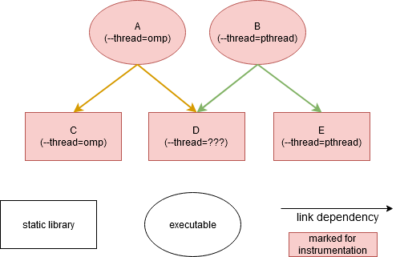
Target Analysis
creates multiple sets of targets which have to use the same values for a set of settings
setting values are merged when several different ones exist within a set
done using built-in rules and user provided priorities
sets sharing an instrumented target are merged
prevents multiple different settings from being inferred for a single target

Slide 17
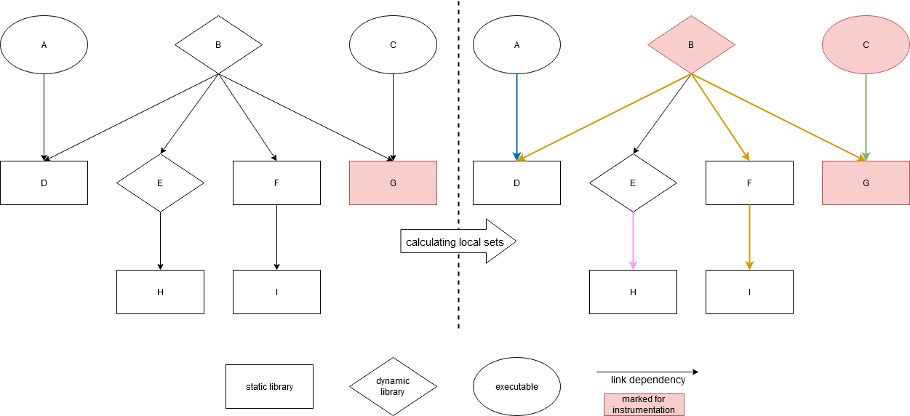
Target Analysis (local sets)
prevent conflicts when modifying a shared constructor by restricting all settings
two targets sharing a constructor are in the same local set

Slide 18
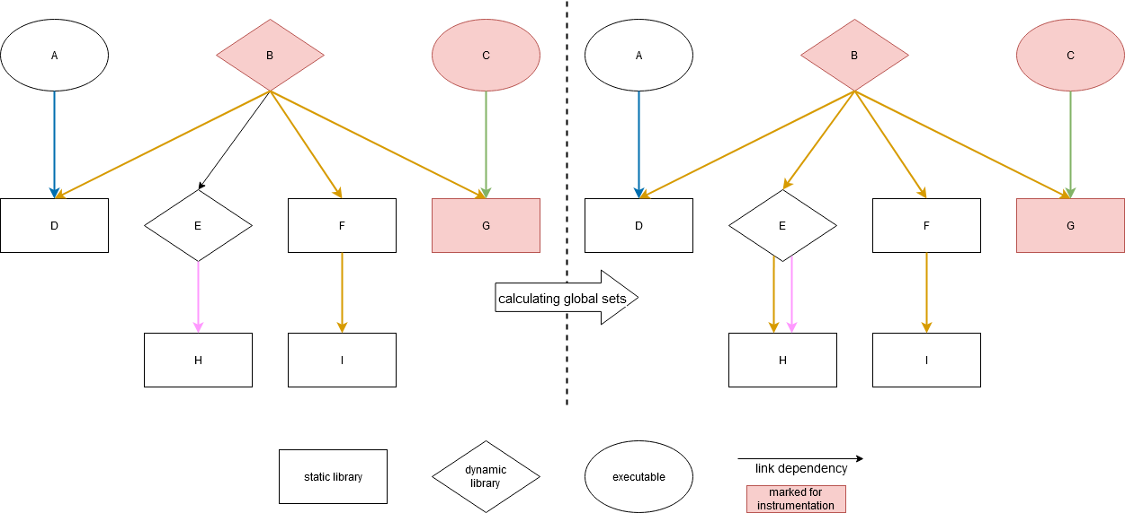
Target Analysis (global sets)
enforces threading and message passing paradigms to be unique within an application
extension of local sets which contain all transitive link dependencies

Slide 19
Performance Analysis

Slide 20
Performance Analysis
Score-P already provides wrappers to be used with CMake
deactivate instrumentation during project configuration based on environment variables
more complicated build process by configuring Score-P outside CMake
no target-level control over instrumentation
Instrumentation module allows choosing Score-P settings inside CMake
access to project options, defined targets, ….
target-level control over instrumentation
difference when instrumenting GROMACS:
export SCOREP_WRAPPER_INSTRUMENTER_FLAGS="--thread=omp:ompt --io=posix --compiler"
SCOREP_WRAPPER=off cmake -S . -B build -DGMX_BUILD_OWN_FFTW=ON -DCMAKE_CXX_COMPILER=scorep-clang++
cmake -S . -B build -DGMX_BUILD_OWN_FFTW=ON -DENABLE_SCOREP=ON

Slide 21
Performance Analysis (Runtime performance)
measured by analyzing the time required for target analysis
does not include time required by CMake for project configuration
project size represented by number of targets
target analysis scales by number of targets
one CMake target can compile and produce multiple files
target analysis not affected by number of files or source lines

Slide 22
Performance Analysis (Runtime performance)

Slide 23
Performance Analysis (Problems & Limitations)
link dependencies of a target may be specified using generator expressions
can’t be evaluated during project configuration, target analysis incomplete
some languages ignore some target properties used by the low-level interface
prevents Score-P from influencing the linking of these targets
inferring settings from link dependencies requires using well-known link dependencies
settings can still be chosen manually (for example based on CMake options)

Slide 24
Conclusion and Outlook

Slide 25
Conclusion and Outlook
the developed modules allow for a more fine-grained control of the instrumentation process
decomposition into localization module, low- and high-level interface provides flexibility
high-level interface requires some time for target analysis
can be reduced by reducing the number of instrumented targets or using the low-level interface
not using well-known link dependencies prevents settings from being inferred
well-known link dependencies are the modern approach
inferring settings manually is much easier inside CMake
languages which ignore certain properties hinder project instrumentation
can be worked around using another linker language (for example the C++ linker for CUDA)
generator expressions specifying link dependencies hinder target analysis
manual configuration or workarounds required
local set definition probably too strict
further testing of existing restrictions may increase flexibility

Slide 26
Sources

Slide 27
Sources
GitHub Repository: https://github.com/Deric-W/FindScoreP
Score-P documentation: https://perftools.pages.jsc.fz-juelich.de/cicd/scorep/tags/latest/html/index.html
CMake documentation: https://cmake.org/cmake/help/v3.20/index.html
GROMACS: https://gitlab.com/gromacs/gromacs

