Slide 1


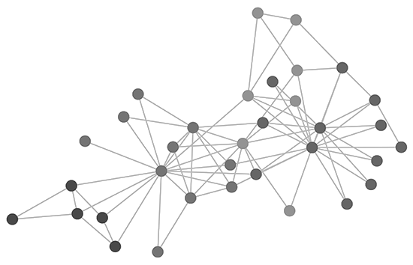
Lecture 2 – Asymptotic analysis and “BIG-o” Notation
Aigerim Aibatbek, Eldiyar Zhantileuov
aigerim.aibatbek@astanait.edu.kz, zhantileuov.eldiyar@astanait.edu.kz

Slide 2
content
Algorithm efficiency
Order of growth
Big-O notation
Complexity Classes
Constant Complexity
Linear Complexity
Logarithmic Complexity
Exponential Complexity
Literature

Slide 3
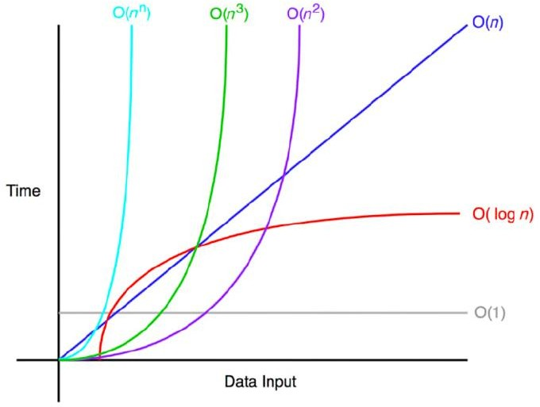

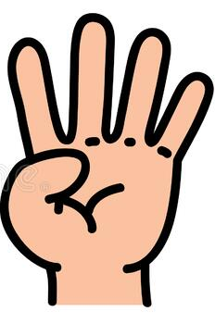
ALGORITHM EFFICIENCY
Computers are getting faster
Does the efficiency matter?
How about a very large dataset?
A program can be implemented in several ways. How to measure the efficiency?
1. Using timer
2. Count the number of operations
3. Order of growth

Slide 4
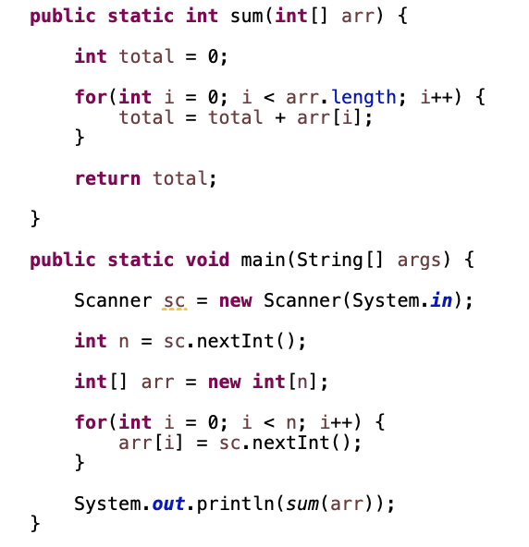
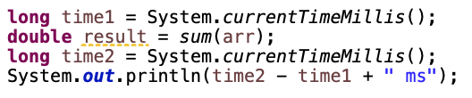



ALGORITHM EFFICIENCY : USING TIMER
Timers are inconsistent
Time varies for different inputs but cannot express a relationship between inputs and time
Can be significantly different in various cases (because of CPU, memory, GC, operating system, network, etc.)
Our first challenge is to determine how to make quantitative measurements of the running time of our program using random numbers for input
Hint: Math.random();

Slide 5

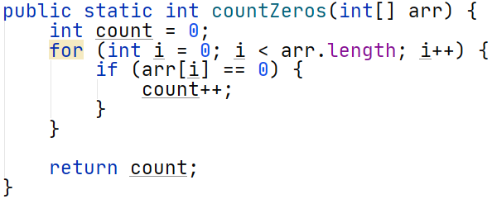
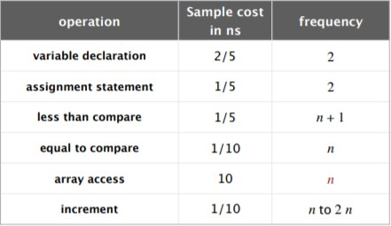
ALGORITHM EFFICIENCY : Counting Operations
Assume that any of comparison, addition, value setting and retrieving, etc. is just 1 operation.
How many of those operations do I use in my algorithm?
This could be used to give us a sense of efficiency.
2 + 2 + (n+1) + n + n + 2n and 1 more for “return” = 5n + 6 (worst case)
The worst-case scenario: all elements are zeros!

Slide 6
Order of Growth
y-axis: the runtime (ms)
x-axis: the size of the inputs
* Time complexity: Linear

Slide 7
BIG-O notation
If f(n) ~ Cg(n) for some constant C > 0, then the order of growth of f(n) is g(n)
Ignores leading coefficient
Ignores lower-order terms
Focuses on dominant terms
Examples:
1) 2𝑛³ + 5𝑛² + 0.15𝑛 + 7 ≈ 𝑛³
2) 2𝑛³ + 3^{𝑛} ≈ 3^{𝑛}
Big-O notation is a mathematical notation that describes the limiting behavior of a function when the argument tends towards a particular value or infinity.

Slide 8

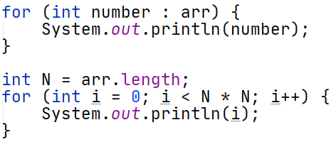

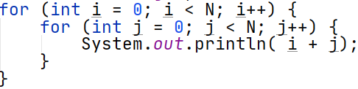




Big-O notation
Law of addition:
Used with sequential statements
Low of multiplication:
Used with nested statements/loops or recursion
𝑂(𝑛)
$$O\left(f\left(n\right)\right)+O\left(g\left(n\right)\right)=O(f\left(n\right)+g(n))$$
𝑂(𝑛²)
$O\left(n\right)+O\left(n2\right)=O\left(n +n2\right)=$ $O\left(n2\right)$
$$O\left(f\left(n\right)\right)∗O\left(g\left(n\right)\right)=O(f\left(n\right) ∗ g(n))$$
$$O\left(n\right)∗O\left(n\right)=O(n2))$$

Slide 9
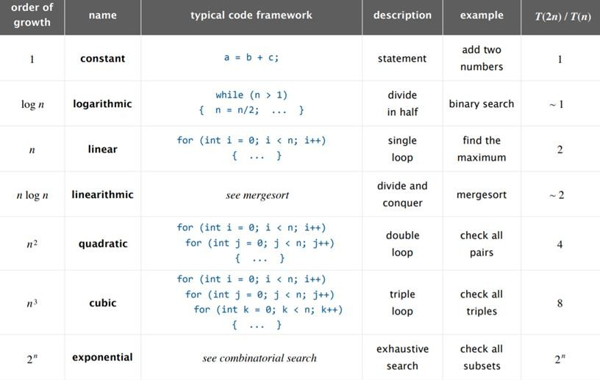
Complexity classes

Slide 10



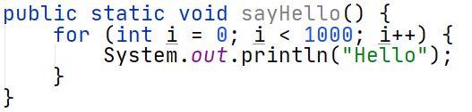
Constant Complexity
Complexity independent of inputs
No matter how many operations it performs exactly as long as it doesn`t depend on the number of inputs
Time complexity is constant
Can have loops or recursive calls, but only if number of iterations or calls independent of input size
It is still O(1) if it performs constant number of operations

Slide 11

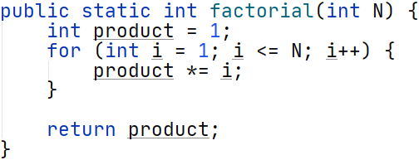

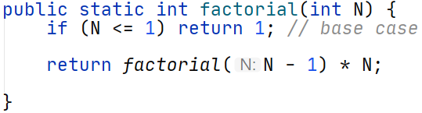
Linear Complexity
Can be in form of iterative loops or recursion
Iterative loops: depends on number of iterations Recursion: depends on number of recursive function calls

Slide 12

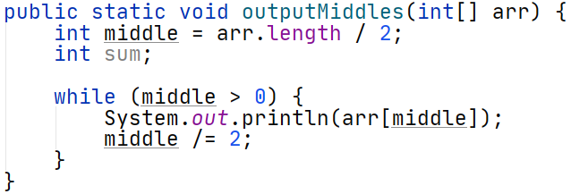

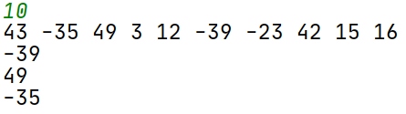

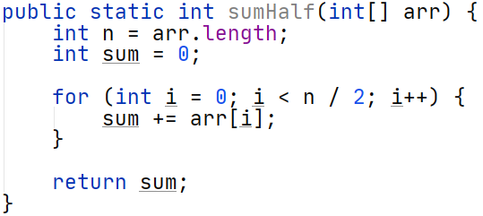


Logarithmic Complexity
Complexity grows as log of size of one of its inputs
When the number of iterations is divided to any constant K > 1 at each iteration (or halved in most cases)
How about this?
It is not decreasing at each iteration 𝑛
$O\left(\frac{n}{2}\right)=O\left(\frac{1}{2} ∗n\right)=O(n)$

Slide 13

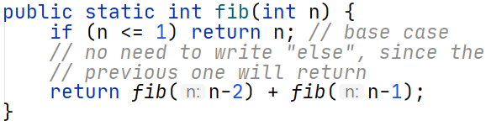
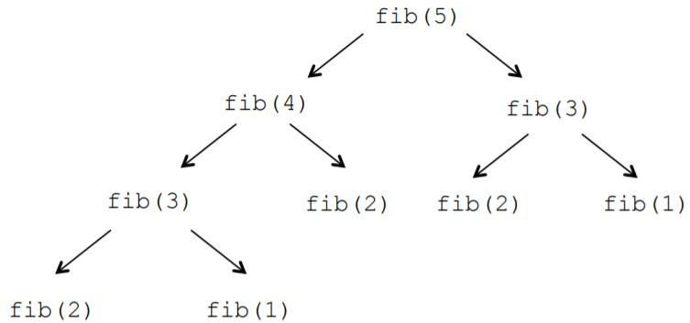
Exponential Complexity
Exponential Time complexity denotes an algorithm whose growth is increasing exponentially (doubles in most cases) with each addition to the input data set
A good example is the recursive solution for Fibonacci Complexity is 2^{𝑛}

Slide 14
Literature
Algorithms, 4th Edition, by Robert Sedgewick and Kevin Wayne, Addison-Wesley Chapter 1.4

Slide 15
Good Luck!

