Slide 1
AI Discoveries
By: Group 14 - The Net Ninjas

Slide 2
Brainstorming
Uses:
Used ChatGPT to generate ideas on how to make a magic 8-ball in a web application.
Used ChatGPT to come up with future features to consider for the web app.
Drawbacks:
Some examples didn’t apply to the product (poor context recognition)
Advice was too generic at times, it felt like it was applying typical advice to context that did not suit it
Ex: “Gamified Experience” does not really apply to Magic-8 balls

Slide 3
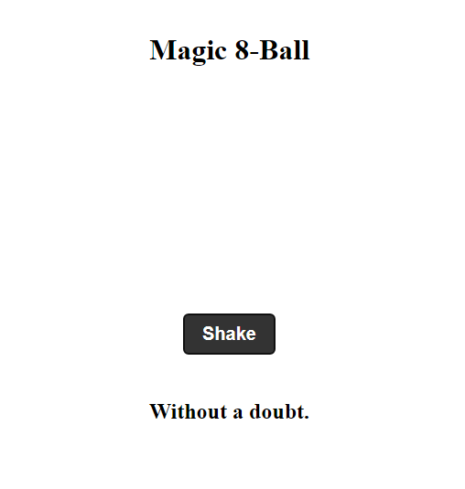
Code Generation
Uses:
Used ChatGPT
Can generate code skeletons for large projects
Can generate unit tests
Saves time for generating simple implementations
Can generate specific functions
Drawbacks:
Code is uncommented
Does not follow certain programming conventions
Does not utilize functional programming
Functions modify global variables
Utilizes dead links (does not have the rights to use these images)
The UI is very sparse

Slide 4
Generated Music/Sounds
Uses:
Used AIVA to create music
Can generate music with some preset themes
Capable of generating music with no experience required
Tested out ElevenLabs for voice generation
Drawbacks:
May sound “generic”, though is subject to opinion
Voiceovers fall into uncanny valley

Slide 5
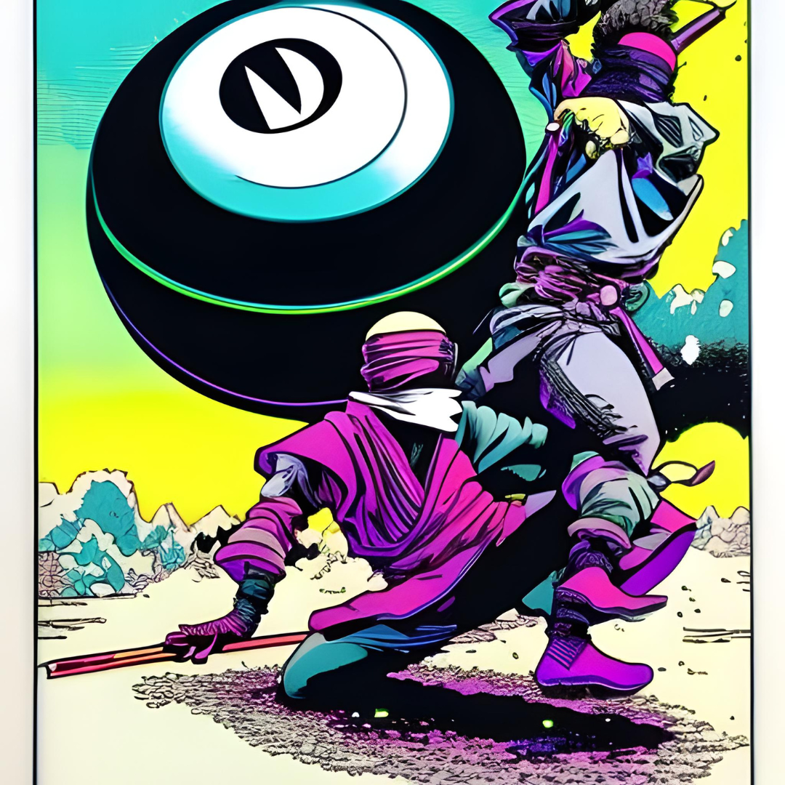
AI Images
Uses:
Used a variety of tools:
Canvas
Dream.ai
Craiyon
Midjourney didn’t work (was too busy)
Generated many assets for the 8-ball application
Assets look really good and are very quick to make
Don’t need someone very skilled at graphics to get good graphics
Allows for rapid prototyping
Drawbacks
The AI often would often not give images that we wanted
Not good at drawing letters and numbers
These are often distorted

Slide 6
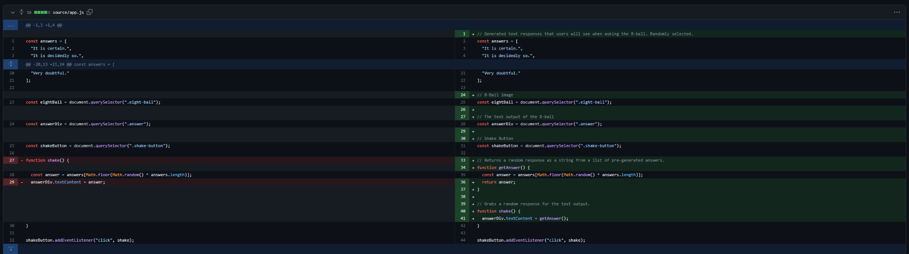
Cleaning Up Code
AI Original
After Comments
Made functions more modular and extendable.
Added simple comments/documentation.

Slide 7
Conclusions
The various AI used is capable of generating creative works without the user having the skills necessary to do so.
However, without such skills, the user will not have the ability to “correct” the AI’s generated works.

