Slide 1
Tech assignment – protein interaction probing
Tiejun Wei
https://github.com/DerienFe/InstaD_pro_abc

Slide 2


Intro
Task:
Probe the interface of Prot_A and Prot_B/Prot_C.
To provide insight how to redesign Prot_A such that it abrogate binding with Prot_B while maintain binding affinity for Prot_C.
Practical use: Redesign the antibody such that
Antibody Target
Antibody ADE target

Slide 3
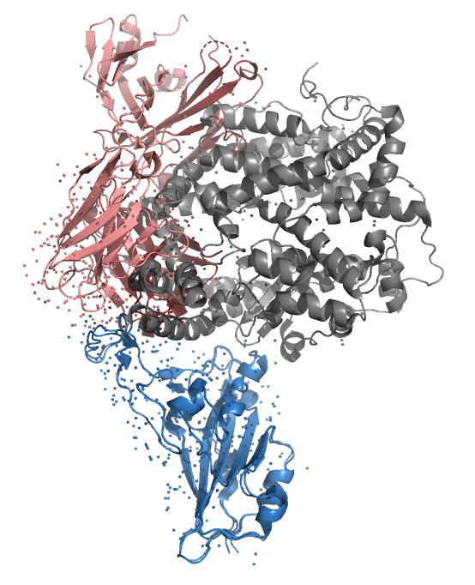
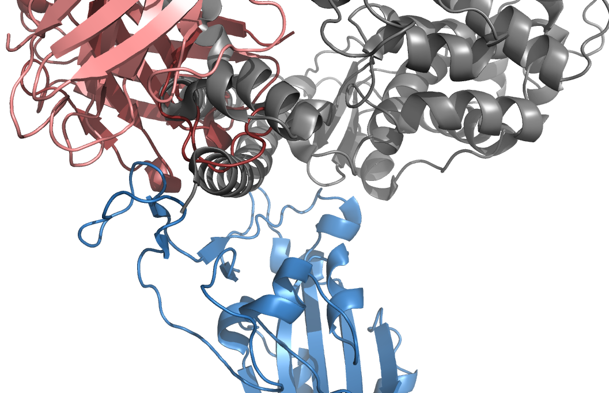
Intro: example structure overview
pro_a: S1 spike protein (blue)
pro_b: Ab P5A 3C8 (THSC20.HVTR26) (red)
pro_c: ACE2 (grey)
https://www.rcsb.org/structure/6m0j
https://www.rcsb.org/structure/7Z0X

Slide 4
Analytical pipeline overview: functionality
Input: [pro_a, pro_b, pro_c]
Output:
Binding free energy on pair A-B, A-C;
FEP on selected CV space.
Dependency:
Python with conda
Gromacs/AMBER/OpenMM as MD engine
Shell (execution and/or cluster submission)

Slide 5
Analytical pipeline overview: pipeline structure
Phase 1: Preparation of structure
Search for binding pattern (skipped since we have bounded structures)
Water/Ion/Protonation state (skipped, H++ server down)
MD simulation system construction using tleap
Generation of classic MD run files (GROMACS)
Generation of complex file for MMPBSA (gmx_MMGBSA in conda)
Phase 2: MD simulations
Consists of minimization/NVT/NPT and production run
Phase 3: post-MD analysis
MD simulation validation and visualization
MMGBSA calculations
Analysis on per-residue decomposition
Select a CV and run metadynamics

Slide 6
File/repo
Please refer to the Github repo:
https://github.com/DerienFe/InstaD_pro_abc
The main.sh also provides a markdown file:
https://github.com/DerienFe/InstaD_pro_abc/blob/main/main.md

Slide 7
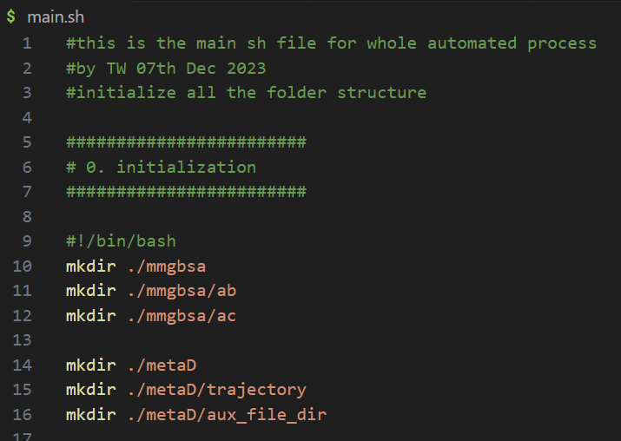
Analytical pipeline: implementation (1)
Phase 1
Automation of

Slide 8
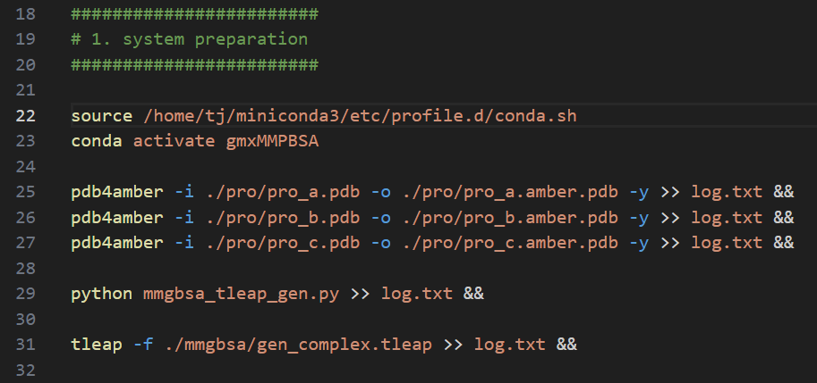
Analytical pipeline: implementation (2)
Phase 1
Automation of pdb pre-processing for AMBER.
Automated tleap generation -> construction of complex structure
Execution of tleap.

Slide 9
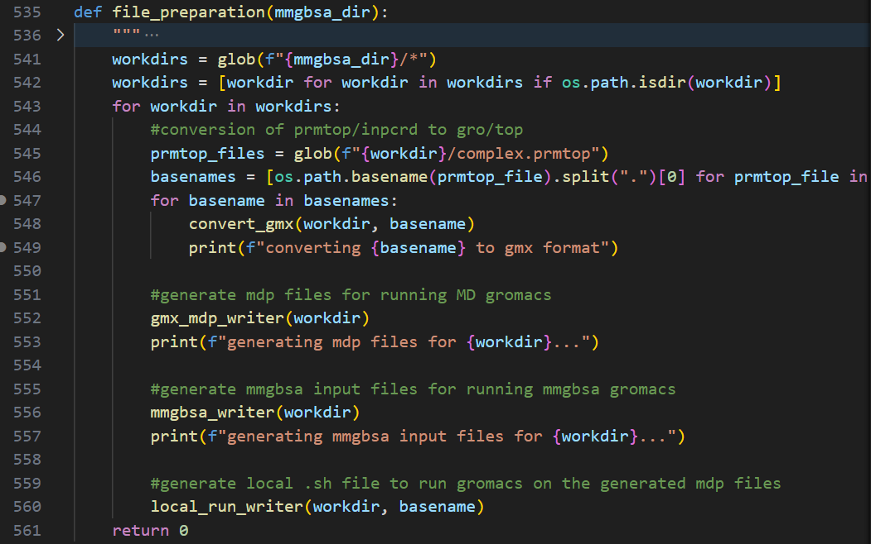
Analytical pipeline: implementation (3)
Phase 1
File_preparation.py contains follows:
For each working directory under mmgbsa:
Generate .gro and .top file using parmed
Generate .mdp file for GROMACS MD runs
Write the MMGBSA script given the calculation type (qm/pb/gb)
Write the local run script that consecutively commence the commands.

Slide 10
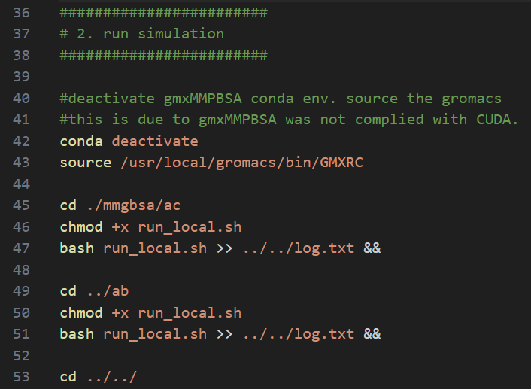
Analytical pipeline: implementation (5)
Phase 2
Initialize the correct environment /path
Navigate to each directory and consecutively commence the MD simulations:
Minimization
NVT
NPT
Production

Slide 11
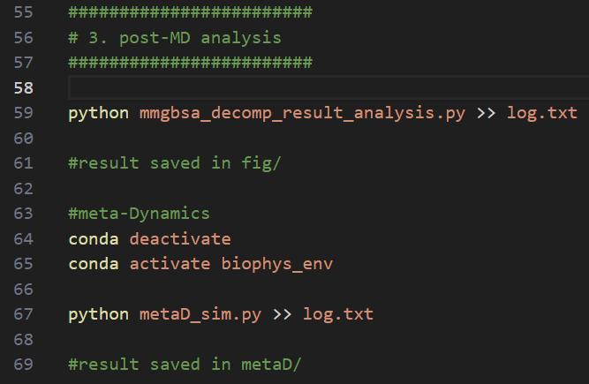
Analytical pipeline: implementation (6)
Phase 3
Initialize the correct environment/path
Perform mmgbsa per-residue decomposition
Automated analysis for mmgbsa result.
Given the residue index, perform the 1D distance based metadynamics.

Slide 12
Analytical pipeline summary
Advantage:
Full automation
Good agreement with literature
Direct evidence which residue contributes the binding.
Provided insight into protein (antibody) redesign.
Disadvantage:
Messy starting structure (Ion, water in pocket kept)
No protonation check (H++ server down)
Residue index hard coded to fix lost chainid info AMBER/GROMCAS
CV space too large and meta-dynamics very expensive.

Slide 13
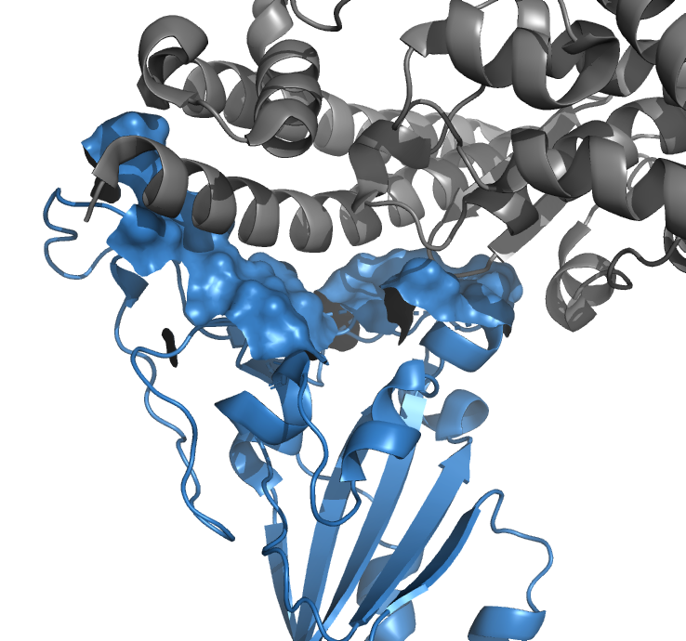
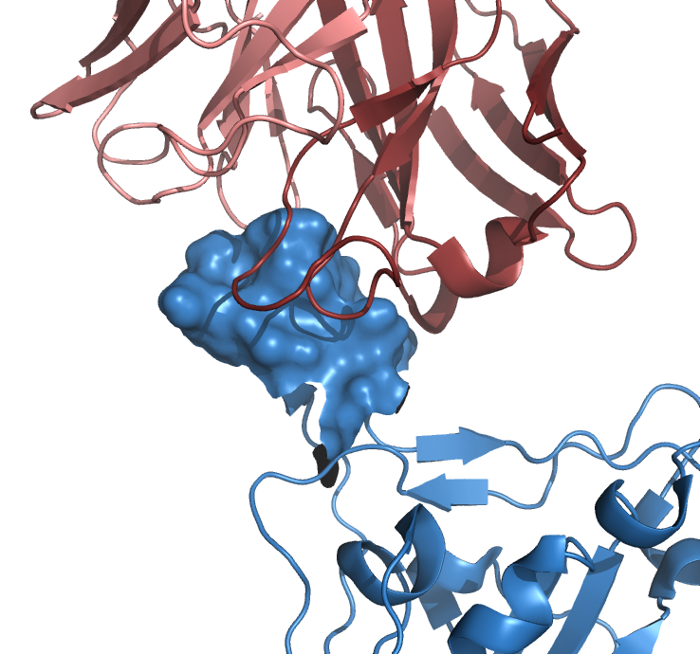
Interface review:
Key binding res on pro_a to pro_c (left):
[417, 446, 449, 453, 455, 456, 475, 486, 487, 489, 493, 496, 498, 500, 501, 502, 505]
Key binding res on pro_a to pro_b (right):
[484, 478, 486, 487]
Binding of S1 spike protein(blue) with ACE2(grey). contacting residue on S1 protein are shown in blue surface.
Binding of S1 spike protein(blue) with antibody THSC20.HVTR26 (red). contacting residue on S1 protein are shown in blue surface.
https://www.nature.com/articles/s41586-020-2180-5

Slide 14
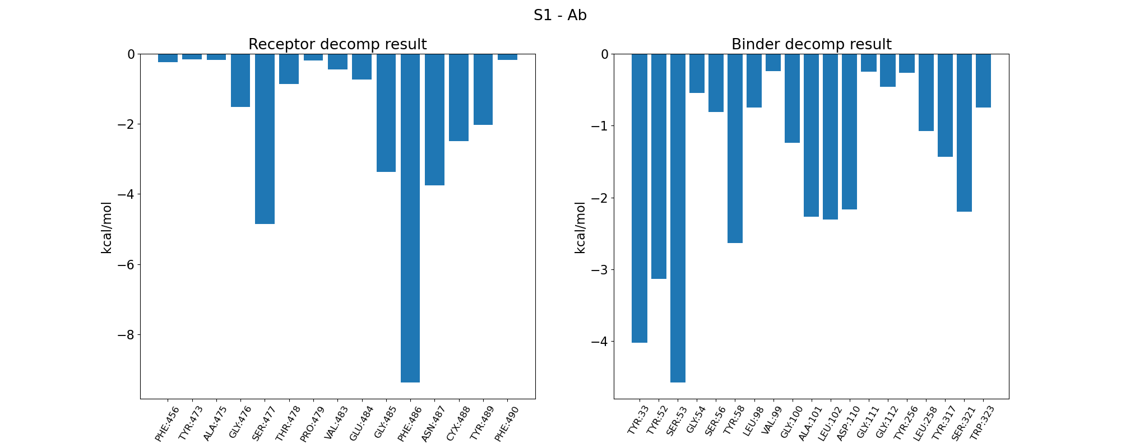
MMGBSA per-residue decomposition S1-Ab
Suggest the residue 486 on S1 protein contribute the most (~-9 kcal/mol), while the Ab has several key residues Tyr 33, Tyr52 and Ser53 etc..

Slide 15
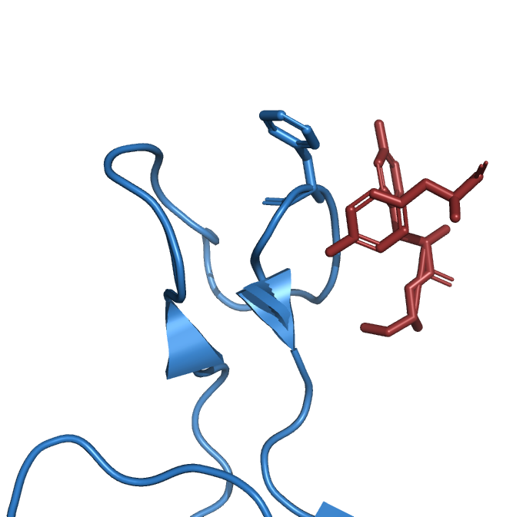
MMGBSA per-residue decomposition S1-Ab visualization
Phe486
Tyr52
Good agreement with the literature.
Close contact:
between the Phe486 on S1 protein (blue)
with Tyr52, Tyr33 and Ser53 on
Antibody P5A3C8 (THSC20.HVTR26) (red)
Tyr33
Ser53

Slide 16
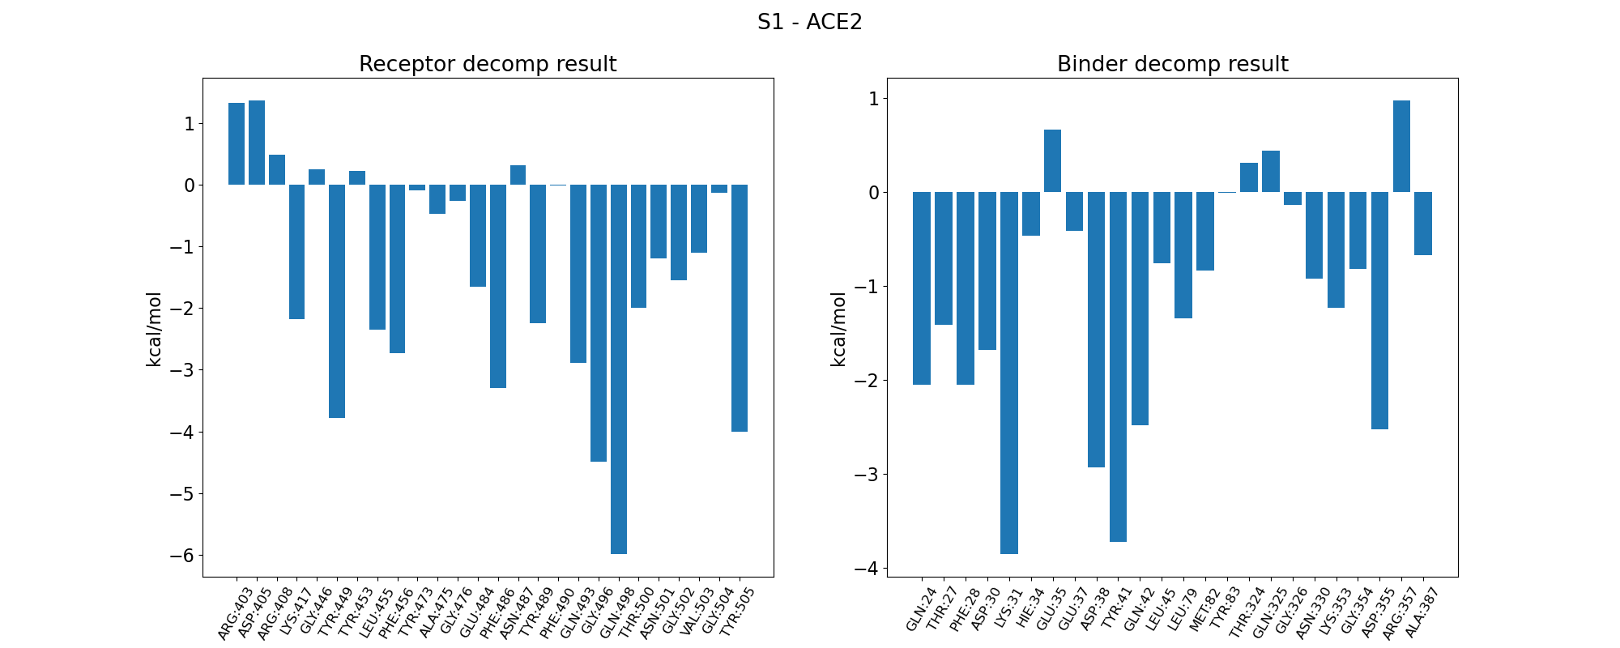
MMGBSA per-residue decomposition S1-ACE2
Phe486 contribute ~-3.4 kcal/mol, less than S1-Ab scenario. While the Gln498 contributes the most ~-5.9 kcal/mol.
On the other hand, ACE has 3 residues contribute the most: Lys31 (~-3.8 kcal/mol), Asp41 (~-2.9 kcal/mol) Tyr38 ( ~-3.7 kcal/mol).

Slide 17
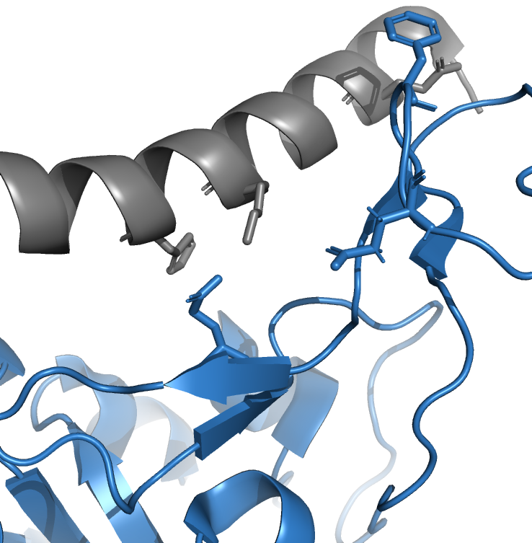
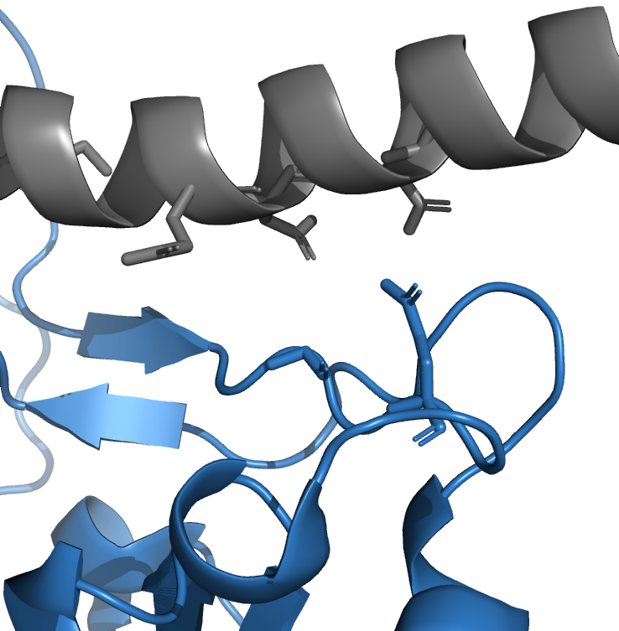
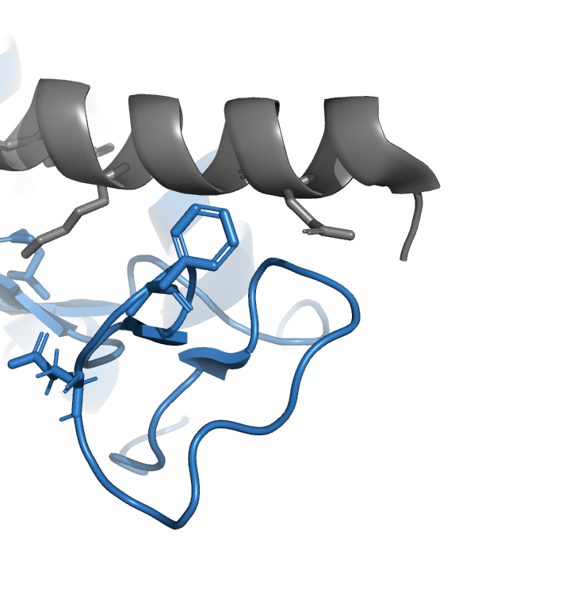
MMGBSA per-residue decomposition S1-ACE2: visualization
Lys31
Asp38
His34
Gln493
Gln42
Glu37
Gln498
Gly496
Phe486
Gln24

Slide 18
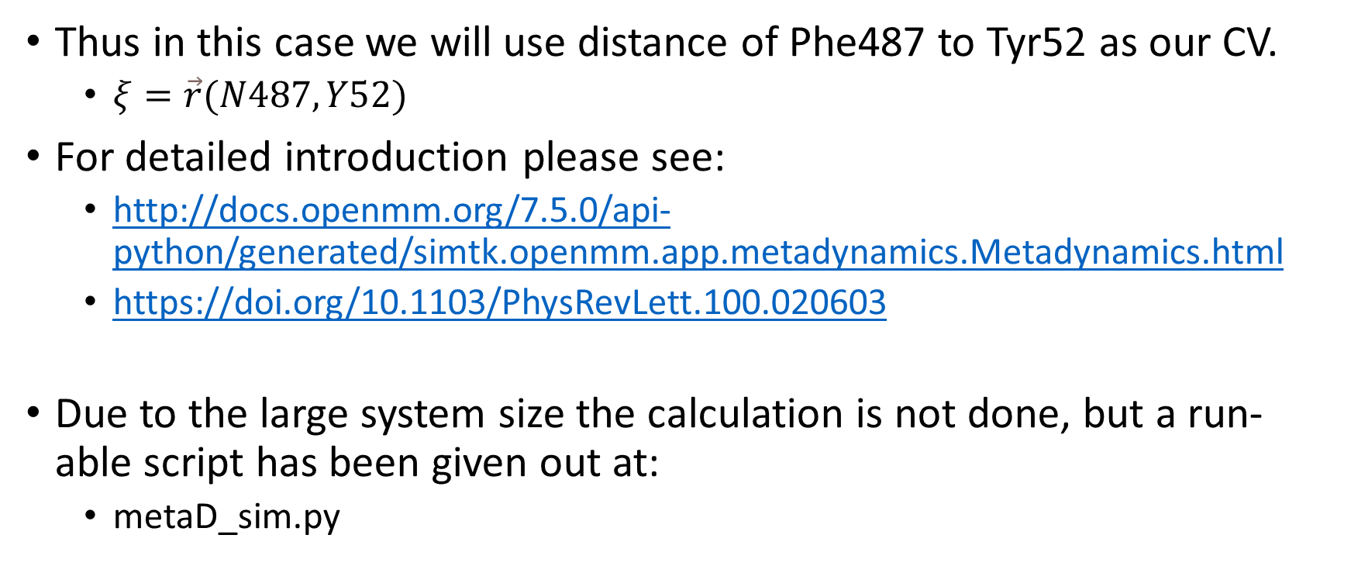
Meta-Dynamics and other Enhanced Sampling techniques
Thus in this case we will use distance of Phe487 to Tyr52 as our CV.
$ξ=\vec{r}(N487, Y52)$
For detailed introduction please see:
http://docs.openmm.org/7.5.0/api-python/generated/simtk.openmm.app.metadynamics.Metadynamics.html
https://doi.org/10.1103/PhysRevLett.100.020603
Due to the large system size the calculation is not done, but a run-able script has been given out at:
metaD_sim.py

Slide 19
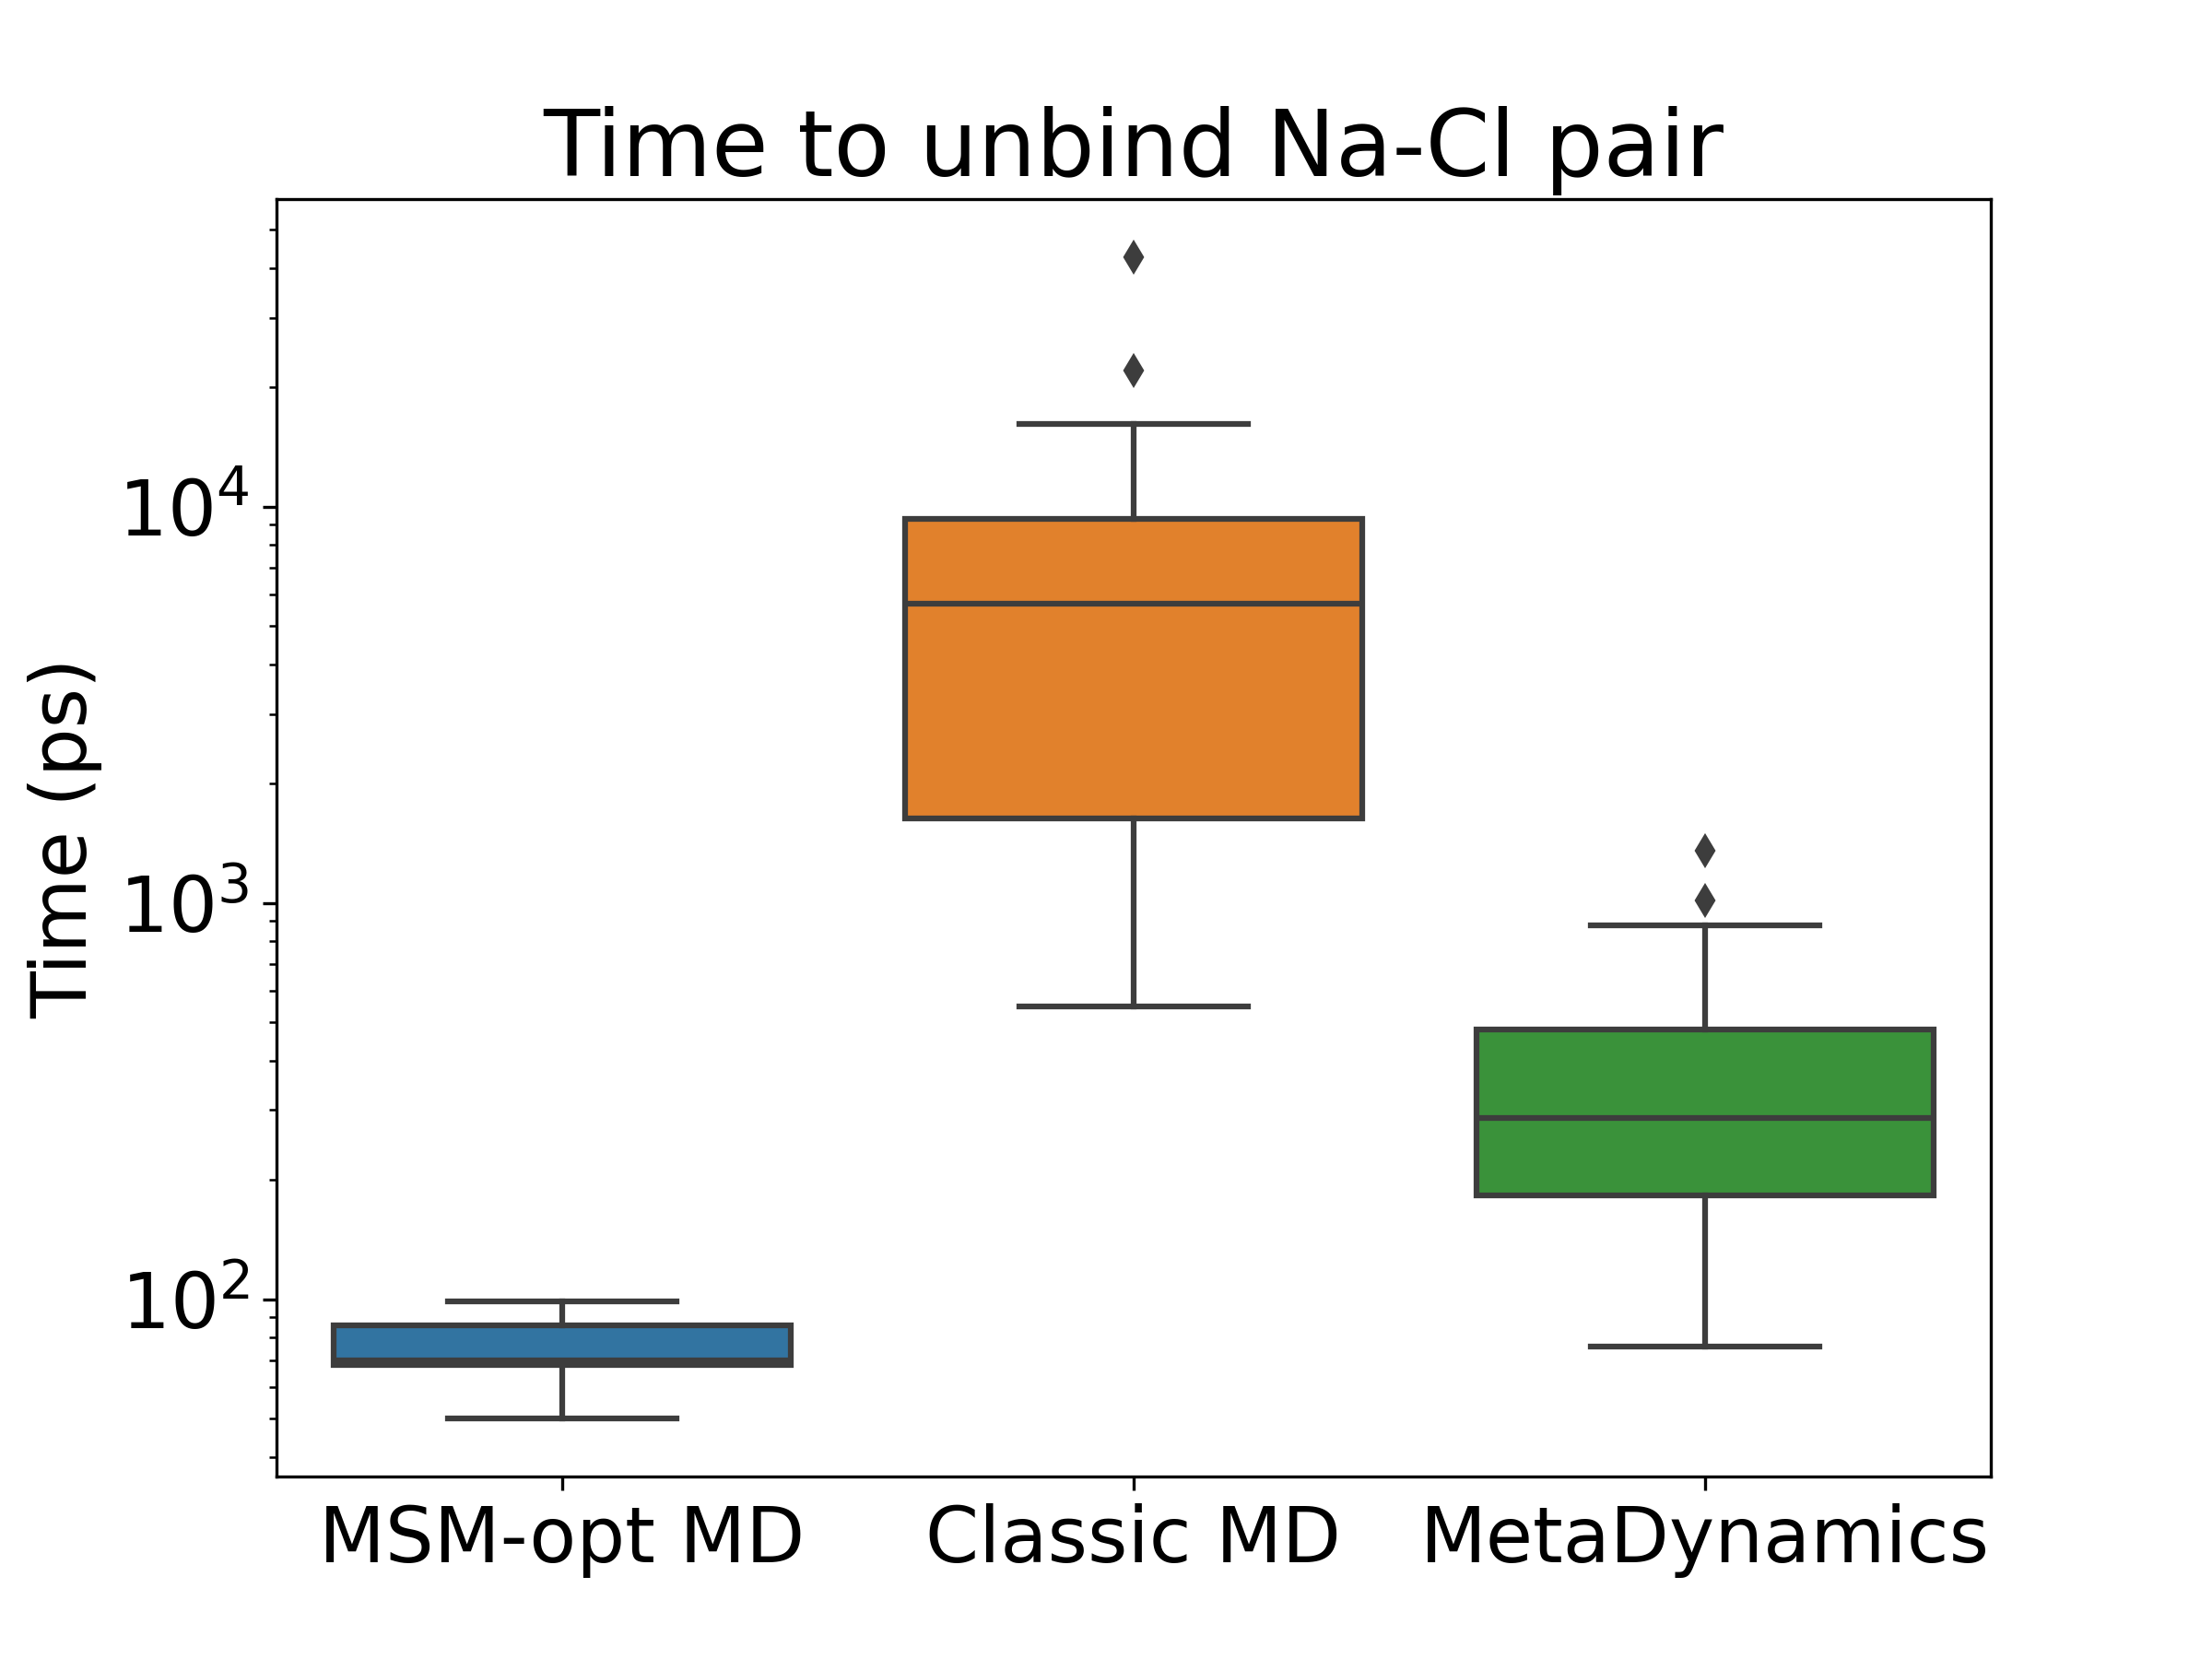
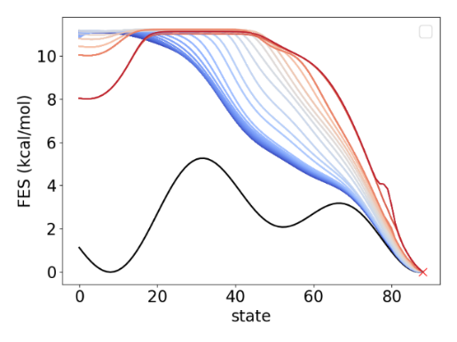
A bit more on ES…
I’ve been working on a MSM optimized biasing technique that sample the target state at least magnitudes faster than meta-dynamics…
Figure 1 Left: Illustration of adaptive MSM guided bias generation, color lines (blue to red): the biased free energy surface, black solid line: the original FES. Right: preliminary benchmark result on time needed for Na⁺-Cl⁻ ion pair separation task.

