Slide 1
Tech assignment – protein interaction probing
Tiejun Wei

Slide 2
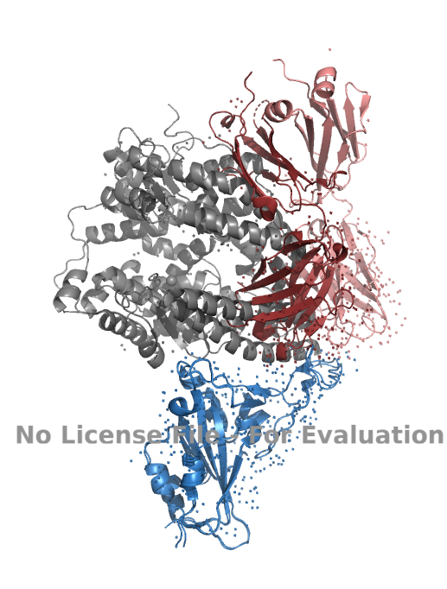
intro

Slide 3
CV selection

Slide 4
Energetic metrics

