Slide 1
Tech assignment – protein interaction probing
Tiejun Wei

Slide 2
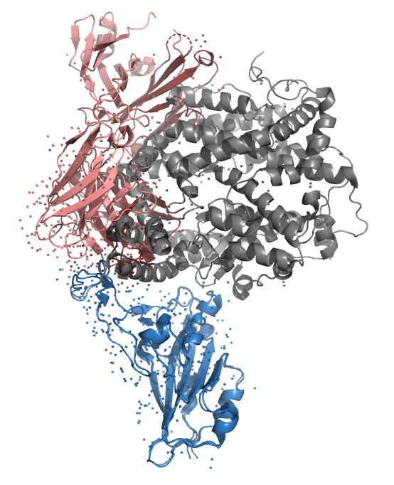
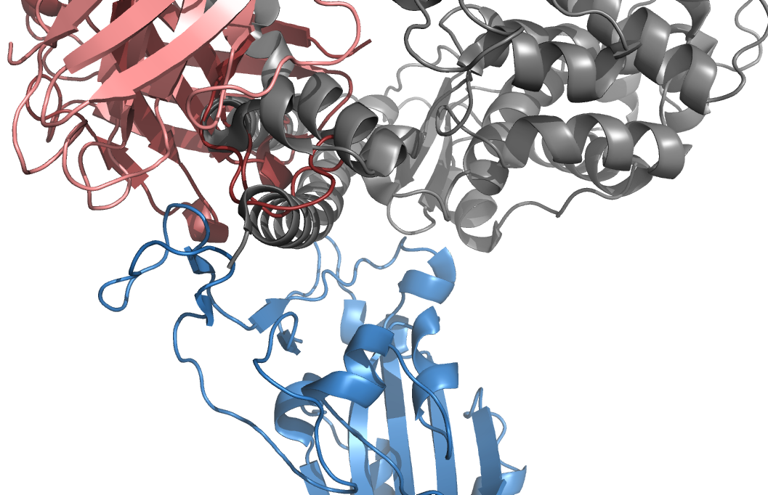
intro
pro_a: S1 spike protein (blue)
pro_b: Ab P5A 3C8 (red)
pro_c: ACE2 (grey)
https://www.rcsb.org/structure/6m0j
https://www.rcsb.org/structure/7Z0X

Slide 3
Analytical pipeline overview
Input: [pro_a, pro_b, pro_c]
Output:
Binding free energy on pair A-B, A-C;
FEP on selected CV space.
Dependency:
Python with conda
Gromacs/AMBER/OpenMM as MD engine
Shell (for cluster submission)

Slide 4
Analytical pipeline
Phase 1: Preparation of structure
Search for binding pattern (skipped since we have structures)
Water/Ion/Protonation state
Generation of classic MD run files (GROMACS)
Generation of complex file for MMPBSA (gmx_MMGBSA in conda)
Phase 2: MD simulations with post-MD analysis
Run MD on GROMACS
Run MMPBSA
Analysis on per-residue decomposition
Select a CV and run metaD

Slide 5
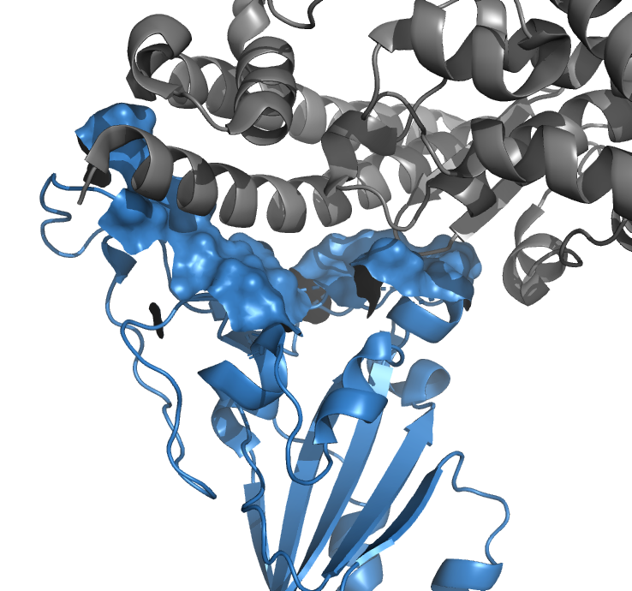
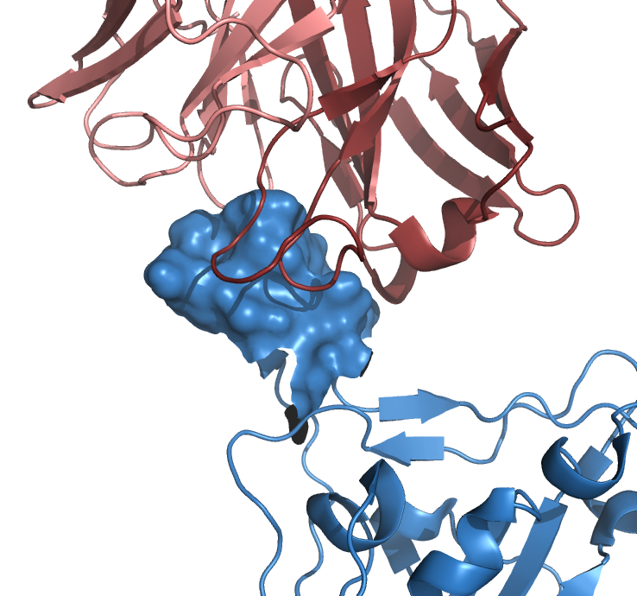
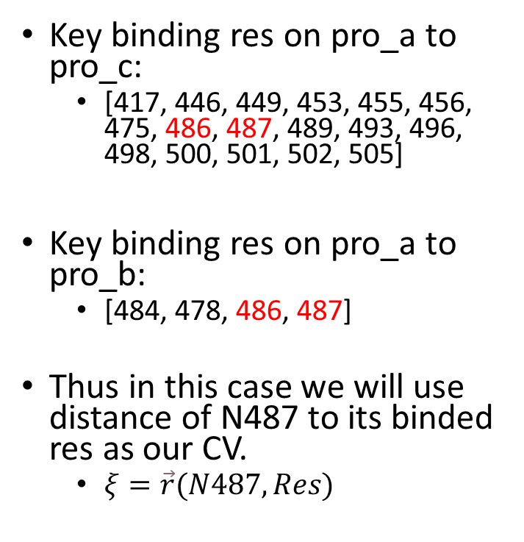
CV selection
Key binding res on pro_a to pro_c:
[417, 446, 449, 453, 455, 456, 475, 486, 487, 489, 493, 496, 498, 500, 501, 502, 505]
Key binding res on pro_a to pro_b:
[484, 478, 486, 487]
Thus in this case we will use distance of N487 to its binded res as our CV.
$ξ=\vec{r}(N487, Res)$
Binding of S1 spike protein(blue) with ACE2(grey). contacting residue on S1 protein are shown in blue surface.
Binding of S1 spike protein(blue) with antibody THSC20.HVTR26 (red). contacting residue on S1 protein are shown in blue surface.
https://www.nature.com/articles/s41586-020-2180-5

Slide 6
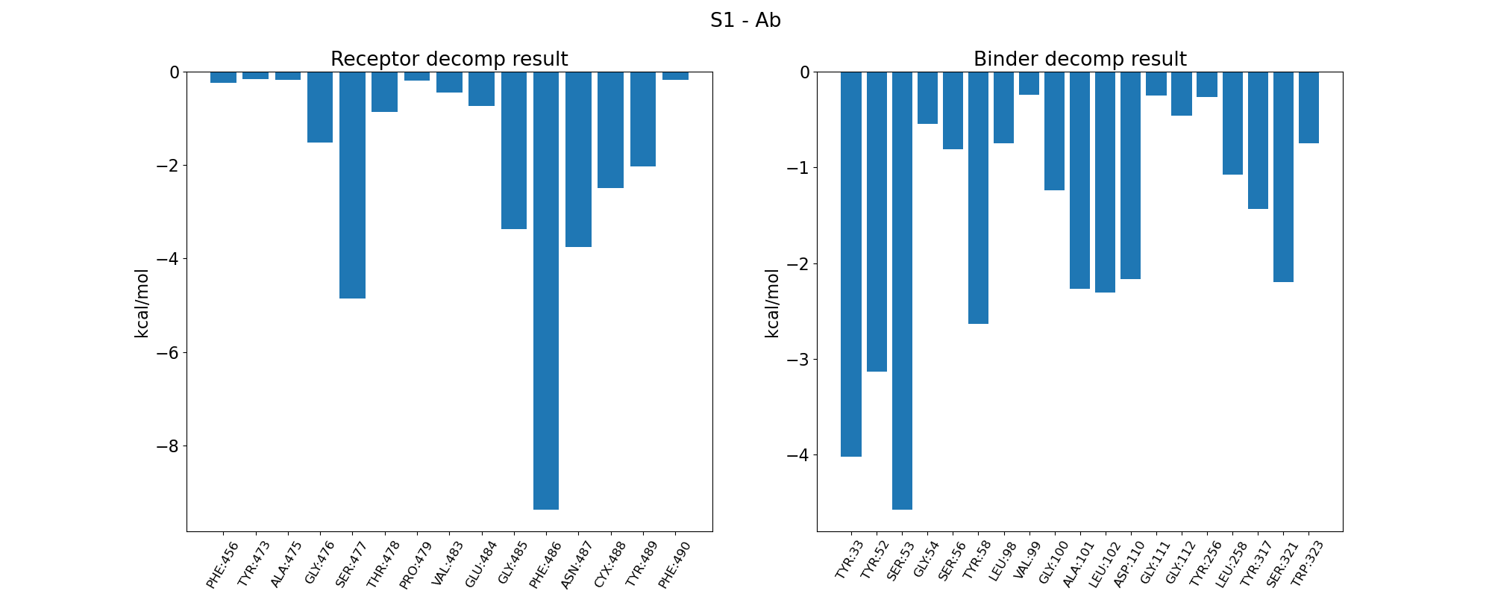
MMGBSA per-residue decomposition S1-Ab
Suggest the residue 486 on S1 protein contribute the most (~-9 kcal/mol), while the Ab has several key residues Tyr 33, Tyr52 and Ser53 etc..

Slide 7
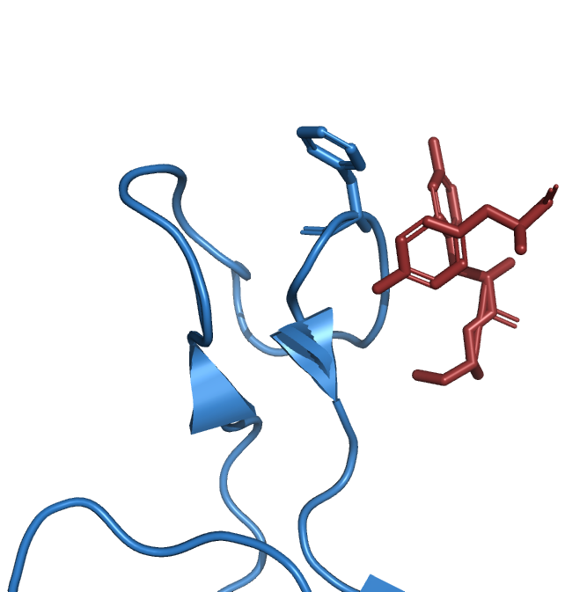
MMGBSA per-residue decomposition S1-Ab visualization
Phe486
Tyr52
Good agreement with the literature.
Close contact:
between the Phe486 on S1 protein (blue)
with Tyr52, Tyr33 and Ser53 on
Antibody P5A3C8 (THSC20.HVTR26) (red)
Tyr33
Ser53

Slide 8
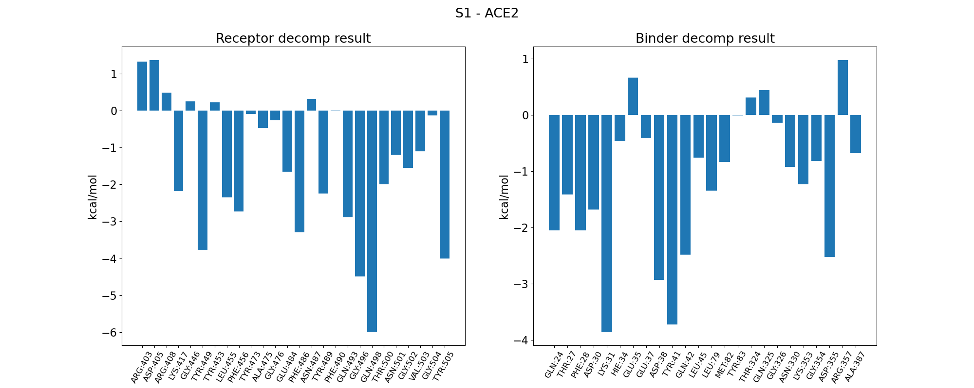
MMGBSA per-residue decomposition S1-ACE2
Phe486 contribute ~-3.4 kcal/mol, less than S1-Ab scenario. While the Gln498 contributes the most ~-5.9 kcal/mol.
On the other hand, ACE has 3 residues contribute the most: Lys31 (~-3.8 kcal/mol), Asp41 (~-2.9 kcal/mol) Tyr38 ( ~-3.7 kcal/mol).

Slide 9
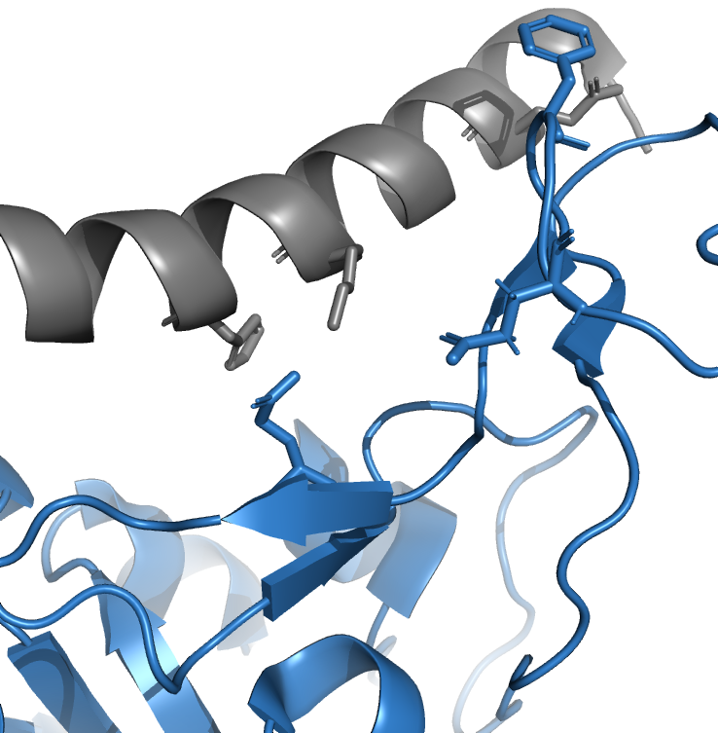
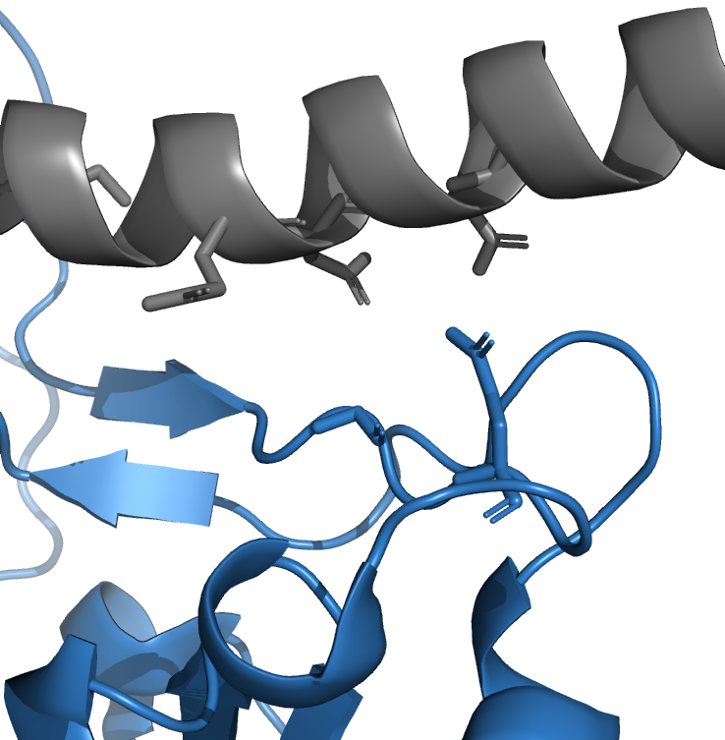
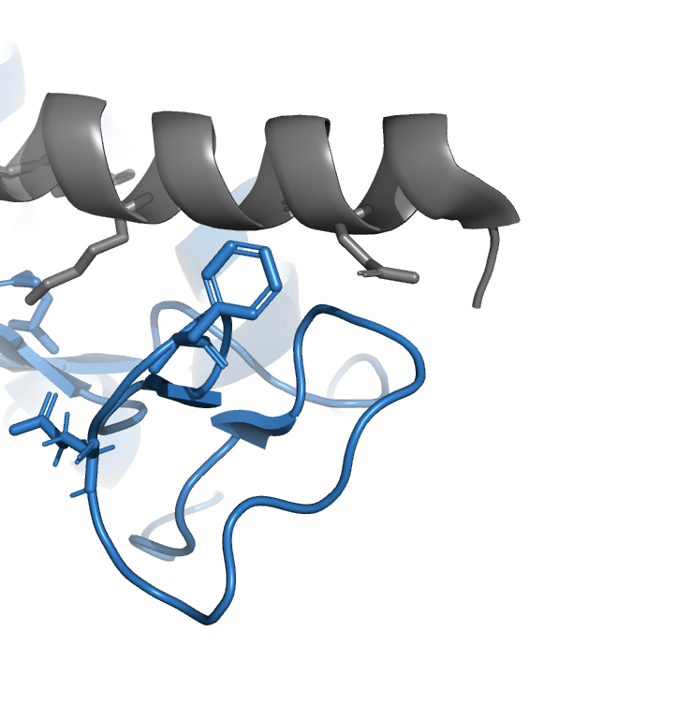
MMGBSA per-residue decomposition S1-ACE2
Lys31
Asp38
His34
Gln42
Glu37
Gln493
Gln498
Gly496
Phe486
Gln24

Slide 10
MetaDynamics and other Enhanced Sampling techniques

Slide 11
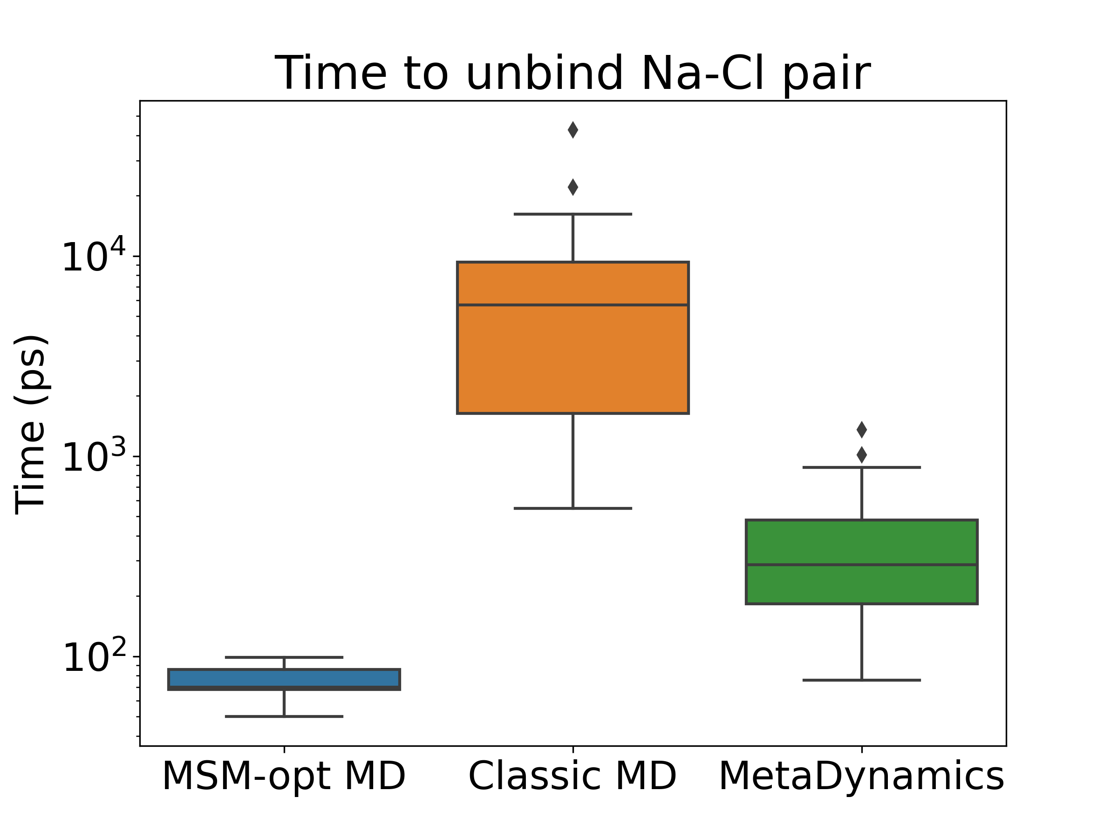
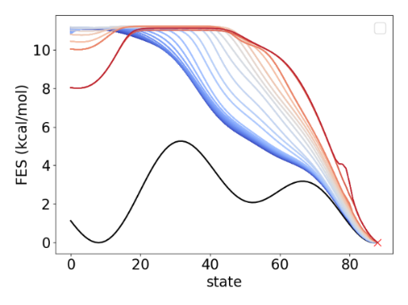
A bit more on ES…
Figure 1 Left: Illustration of adaptive MSM guided bias generation, color lines (blue to red): the biased free energy surface, black solid line: the original FES. Right: preliminary benchmark result on time needed for Na⁺-Cl⁻ ion pair separation task.

