Slide 1
1D

Slide 2
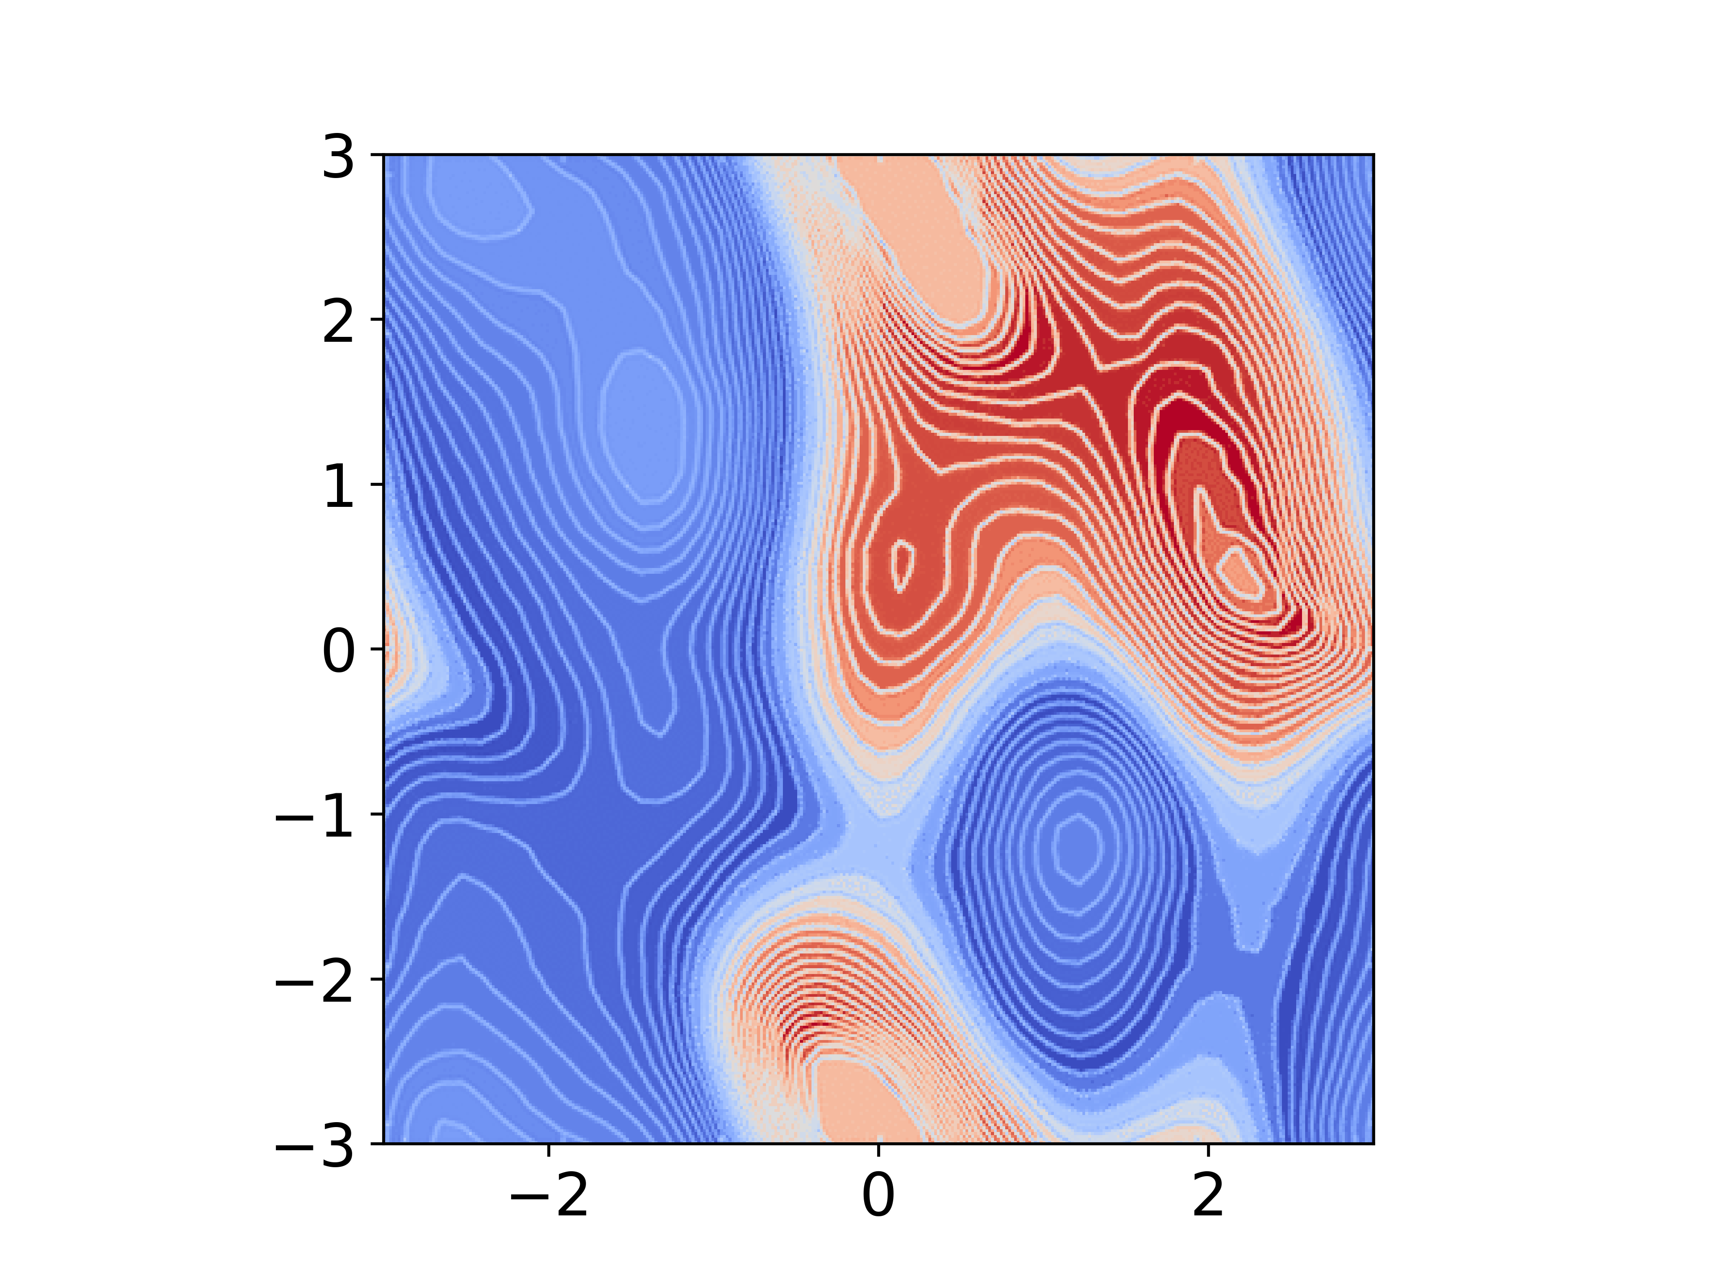
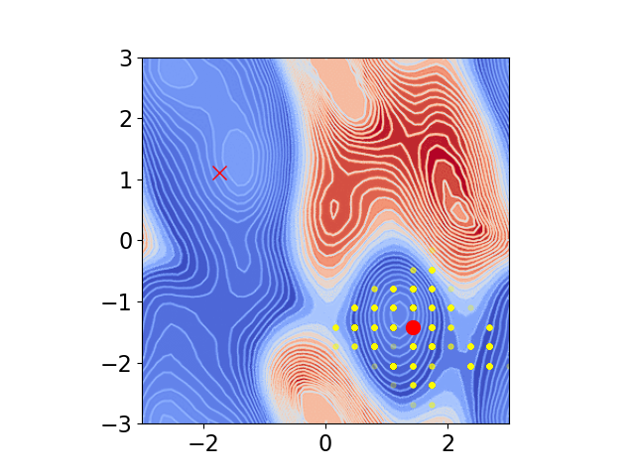
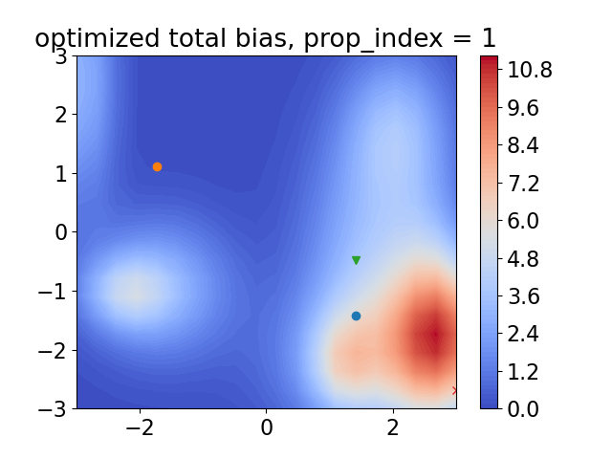
2D
Unbiased fes
traj1
Generated bias

Slide 3
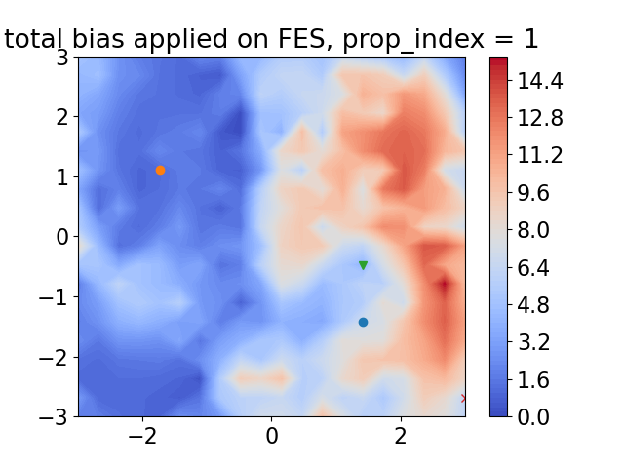

2D
Applied bias on prop 1
Traj2 (reached target)

