Slide 1

Global meeting about MRI
dMRI to quantify stroke rehabilitation
- Report on advancment-
Lovat Louis

Slide 2

Master thesis subject
Research and development of a predictive model based on dMRI, capable of predicting the motor evaluation of stroke patients after rehabilitation.

Slide 3

What is already done
Preprocessing of data using Elikopy
Denoising
Eddy currents and magnetic inhomogeneities correction
Visually check of the results + quality report of elikopy
Computing some metrics
DTI
DIAMOND
Microstructure Fingerprinting (still to be done)

Slide 4
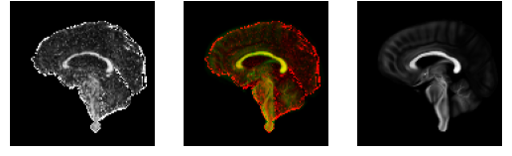
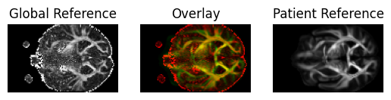
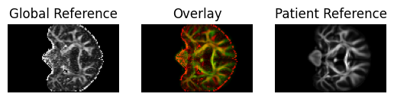
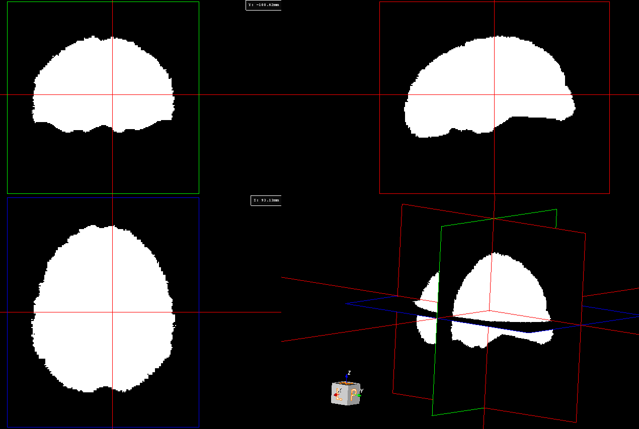
Patient Comparison Atlas
What is already done
Registration
Rigid & Diffeomorphic
Based on an atlas
Creation of a mask common to all patients
Objective : Beeing able to compare all patients

Slide 5
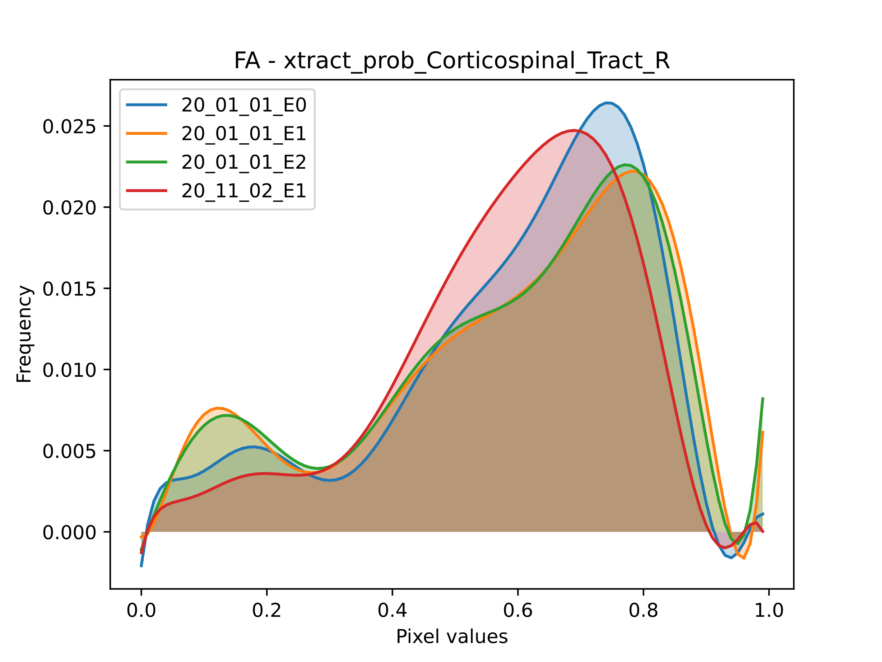
What is already done
Deffining ROI from the atlas
Brain functions and anatomy
Surface analysis of metrics in those ROI
Only for DTI metrics at the moment
Analysing repartition (histogram) of voxel values in the specific area

Slide 6

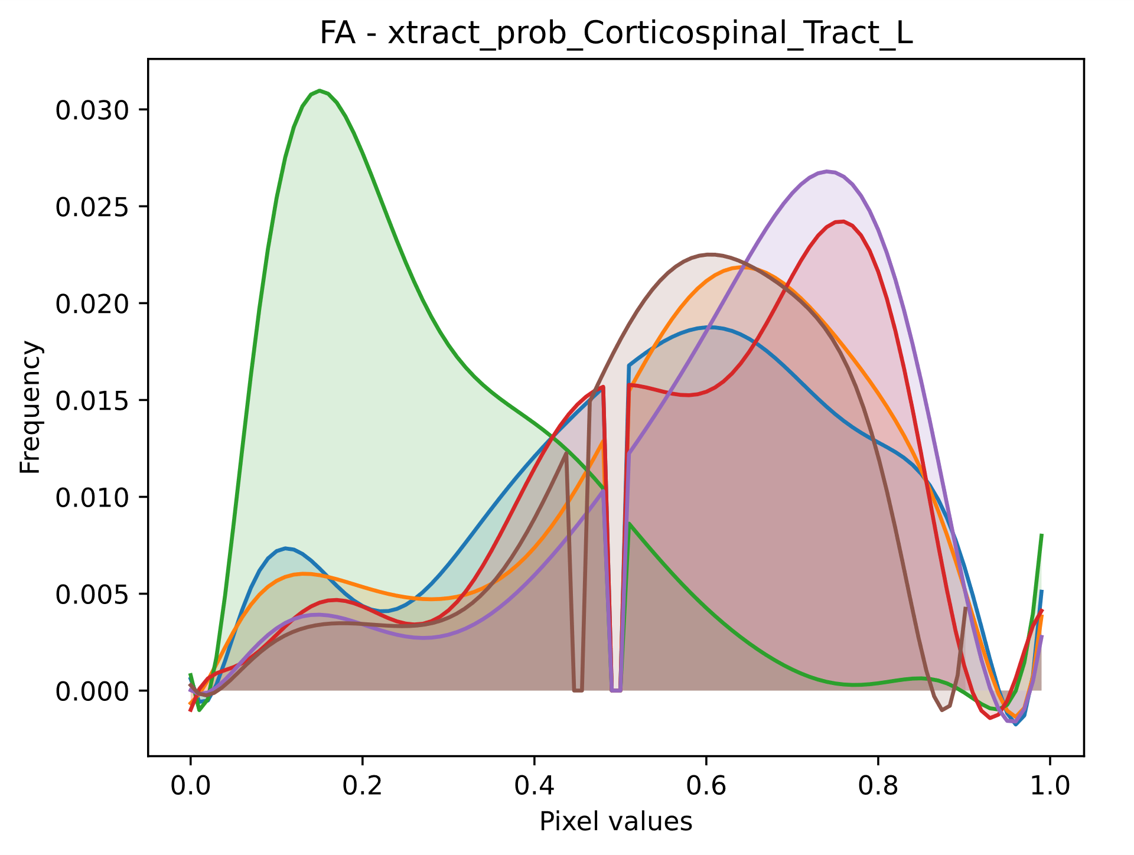
What remains
In depth analysis of metrics
Extend to DIAMOND and MF metrics
Bugs ? → Visual investigations of nifti files
Sum of gaussians approximation ?
(Dimensionality reduction of
feature space)
Looking for other analysis methods
Model creation and training

Slide 7
Thank You

