Slide 1
Django Site Deployment
EPAM DevOps Training
KhAI Winter 2019-2020.
Bogdan Shchogolev

Slide 2
Agenda
Goals
Tools required
Project structure
Implementation

Slide 3
Goals
Setup cloud infrastructure
Automatically configure workers via Ansible
Configure Docker containers
Implement feedback via Telegram

Slide 4








Tools
IaC:
Terraform
Ansible
VCS:
Git
CI:
Jenkins
Cloud Provider:
Amazon Web Service
SCM:
GitHub
Containerization:
Docker
Docker-compose

Slide 5






Project Structure

Slide 6
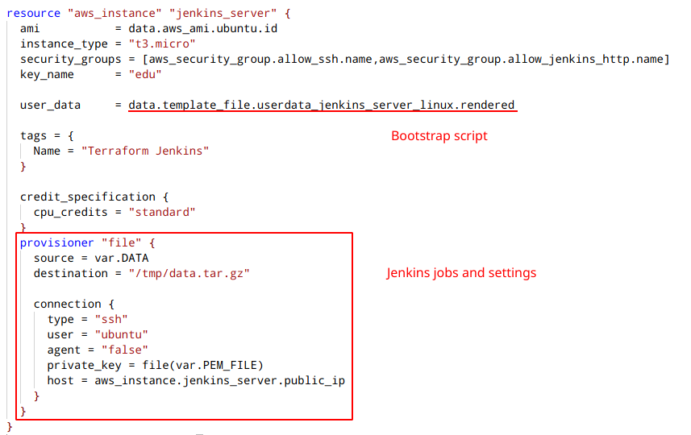

Step 1
Setup infrastructure via Terraform
Jenkins server:

Slide 7
Step 1
Jenkins server user data contains bash script
that does following:
Installs Jenkins and Ansible on instance
Installs all required Jenkins plugins
Imports jobs and settings
Creates template configuration file for Ansible

Slide 8
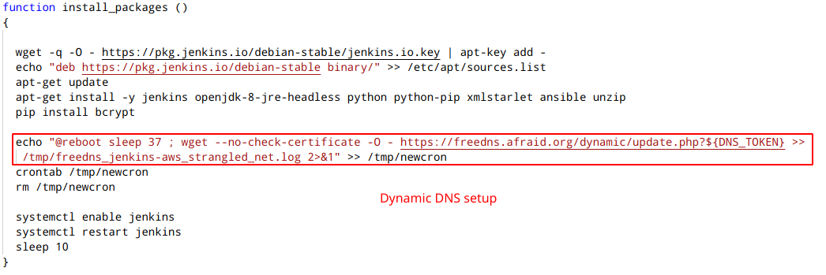
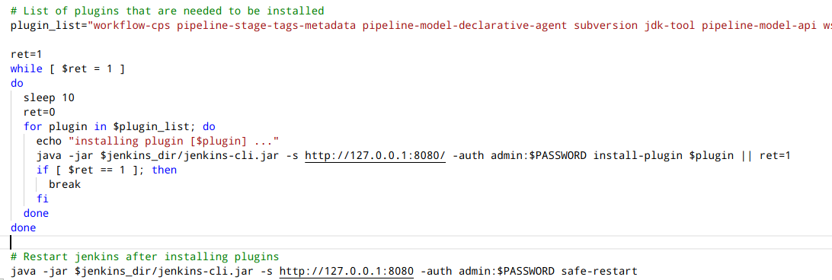
Step 1

Slide 9
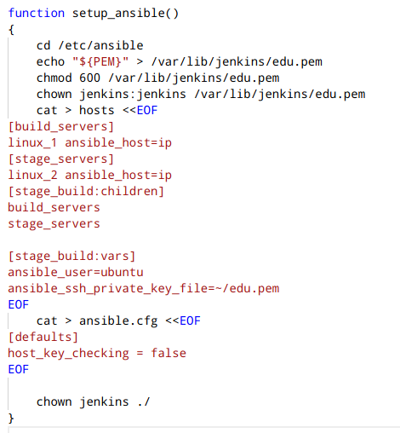
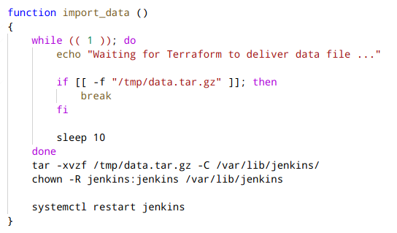
Step 1

Slide 10
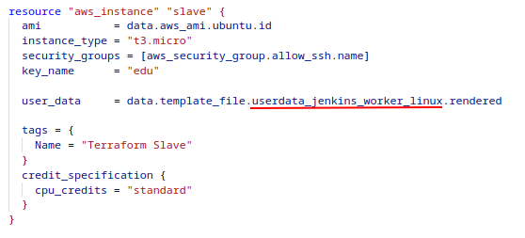
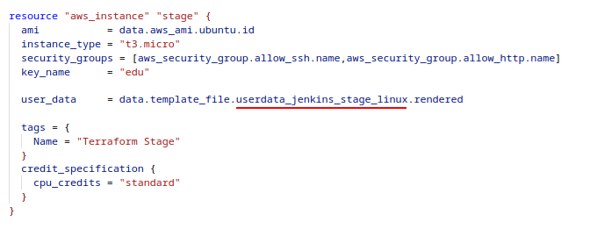
Step 1
Build Slave:
Stage Slave:

Slide 11
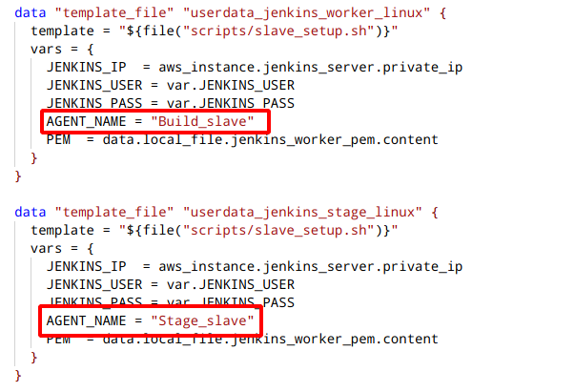
Step 1
Both slaves have the same user data. The only difference is in AGENT_NAME variable:

Slide 12
Step 1
Slaves bootstrap script:
Installs Java and Python
Retrieves jenkins-cli form Jenkins master server
Generates XML file with agent config
Adds it's instance as a slave on Jenkins master

Slide 13

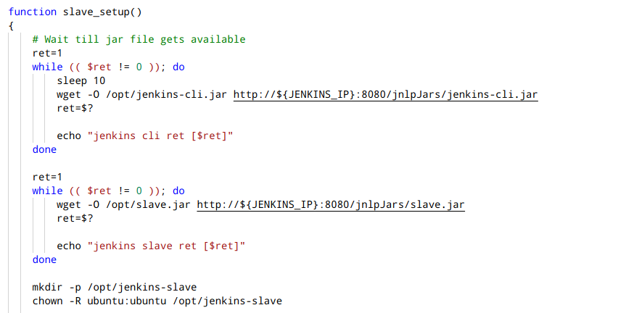
Step 1

Slide 14
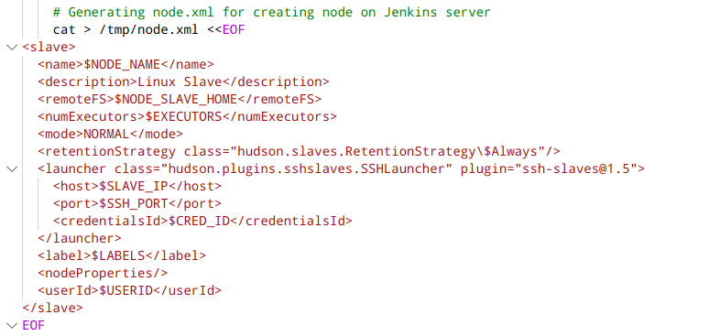
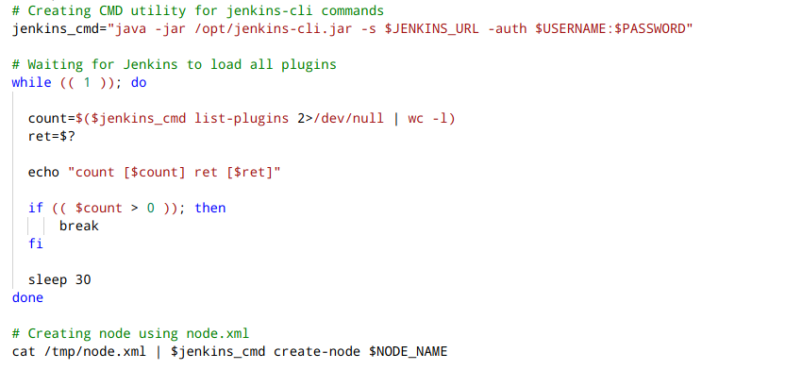
Step 1

Slide 15

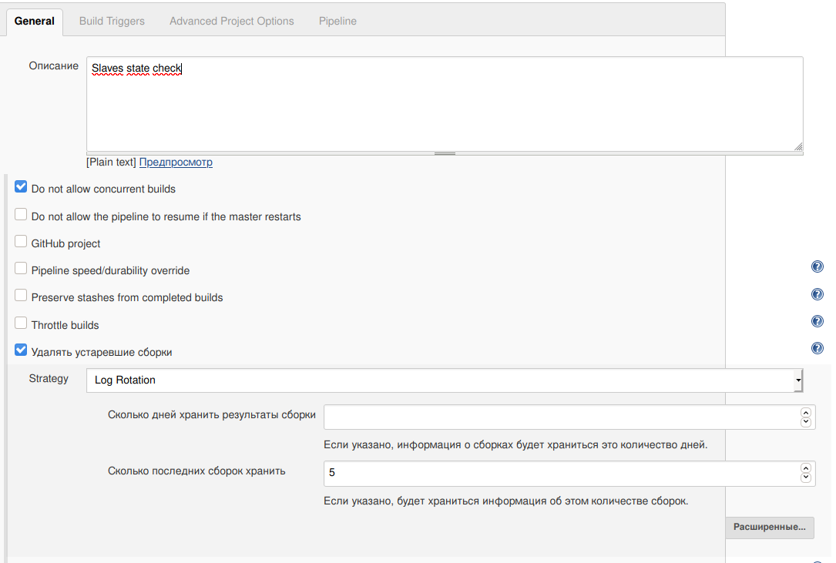
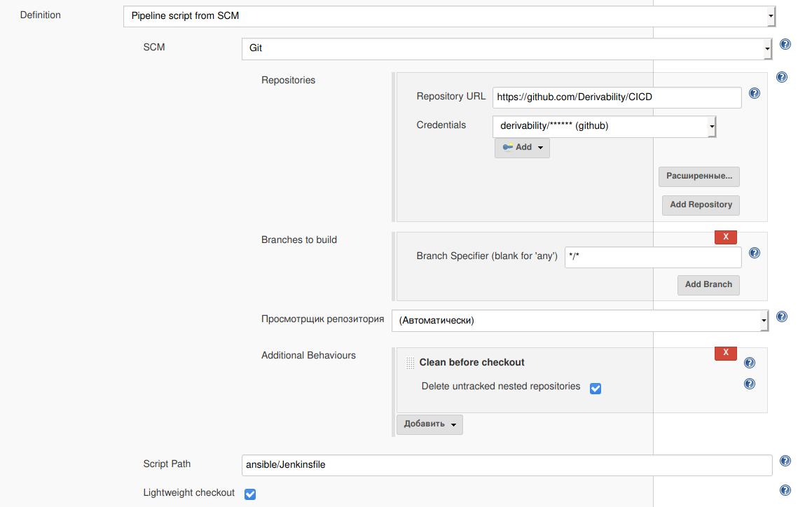
Step 2
Check imported jobs
Ansible job config:

Slide 16
Step 2
Ansible job stages:
Update configuration — get slaves ip from Jenkins
Run 2 playbooks
Trigger main job
OR
Send notification if job failed

Slide 17
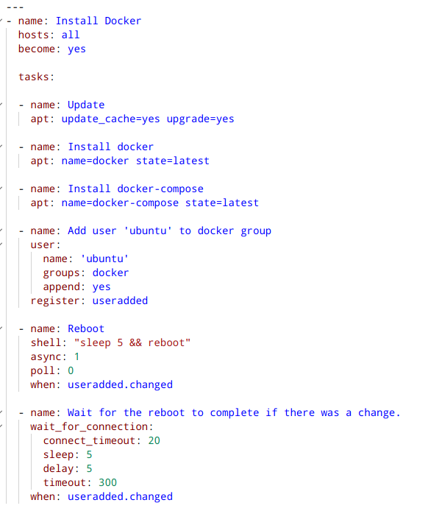
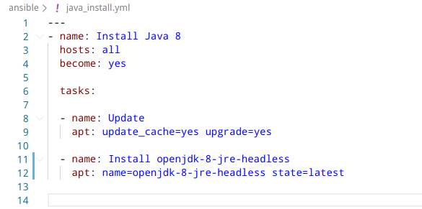

Step 2
Ansible playbooks

Slide 18
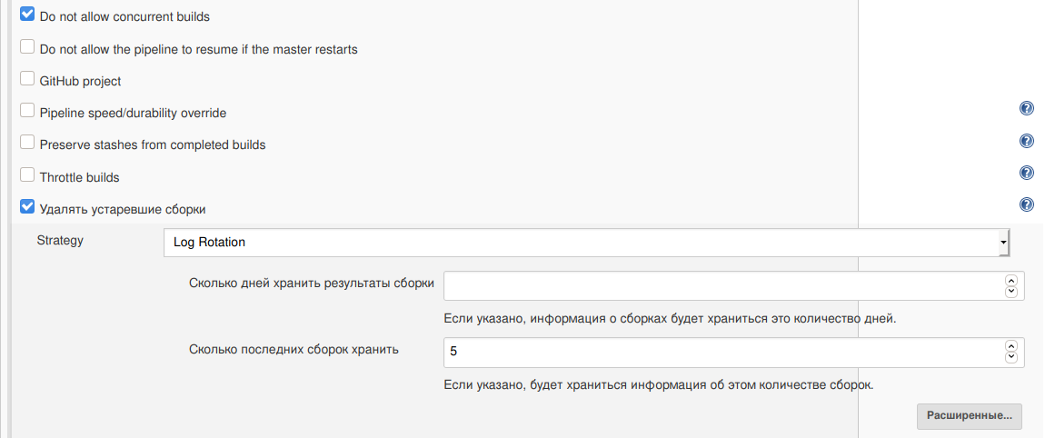
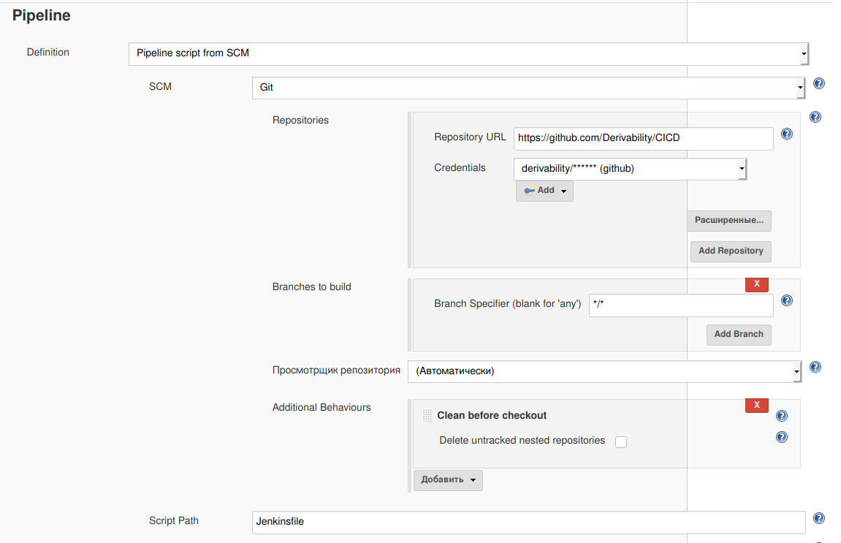
Step 2
Main job config

Slide 19
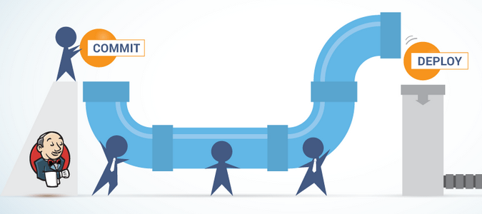
Step 2
Main job pipeline stages:
Build — build docker images
Test — run django unit tests inside container
Stage — deploy new version to staging server
Post — send results via telegram bot

Slide 20

Docker review
Docker configuration:
Two containers: «db» and «web»
«web» has access to «db» via record in /etc/hosts
«db» stores data on created volume «pgdata»
«web» is accessible from outside via 80 port

Slide 21
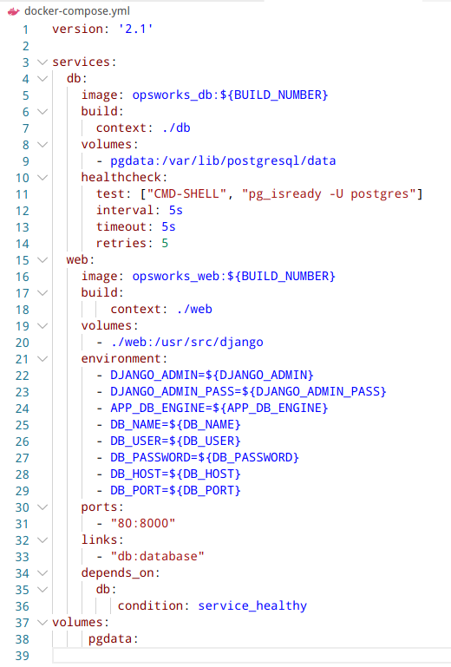
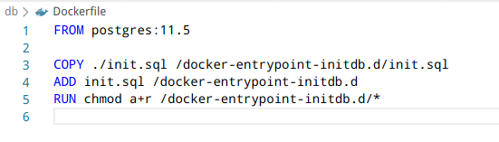
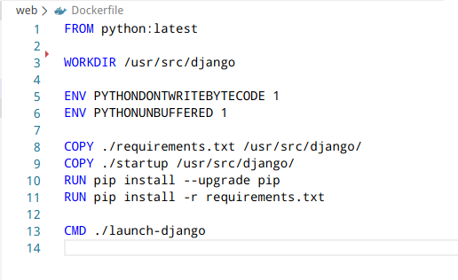
Step 2
Docker and Docker-compose files

Slide 22
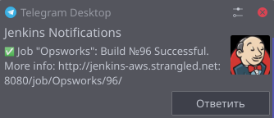
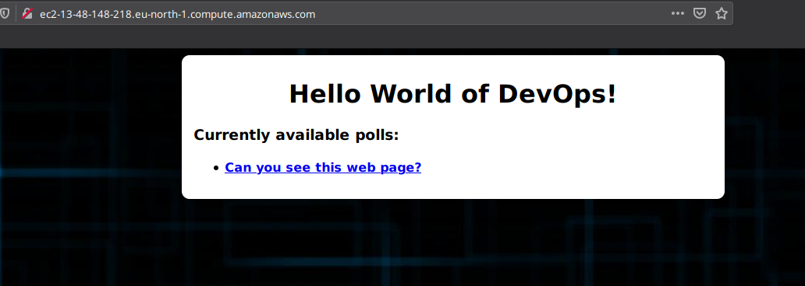
Step 3
Commit some code to GitHub and wait

Slide 23
Thanks for attention!

