Slide 1
Employee Data Analysis using Excel
STUDENT NAME: Derlin Rebekah Rani.S
REGISTER NO: 122201086/unm295derlinrebekahrani.s
DEPARTMENT: B.COM Corporate secretaryship
COLLEGE: Apollo Arts and Science College

Slide 2
PROJECT TITLE
Employee Performance Analysis using Excel

Slide 3


AGENDA
Problem Statement
Project Overview
End Users
Our Solution and Proposition
Dataset Description
Modelling Approach
Results and Discussion
Conclusion
3/21/2024 Annual Review

Slide 4

PROBLEM STATEMENT
The organization faces challenges in effectively evaluating employee performance due to a lack of structured data analysis.
To address this, there is a need to implement an Excel-based performance analysis system that consolidates and examines various performance metrics.
This system will enable the organization to objectively assess employee productivity, attendance, and work quality, providing insights for more informed decision-making regarding promotions, training, and development.
The goal is to leverage Excel’s capabilities to streamline performance evaluations and enhance overall workforce management.

Slide 5

PROJECT OVERVIEW
The project focuses on developing an Excel-based system for analyzing employee performance. It aims to systematically collect and organize performance data, including metrics such as productivity, attendance, and quality of work. By utilizing Excel’s analytical tools, the project will calculate key performance indicators, identify trends, and visualize the data through charts and graphs. The ultimate goal is to generate a comprehensive report that provides actionable insights and supports informed decision-making in human resources, enhancing overall employee management and development.

Slide 6
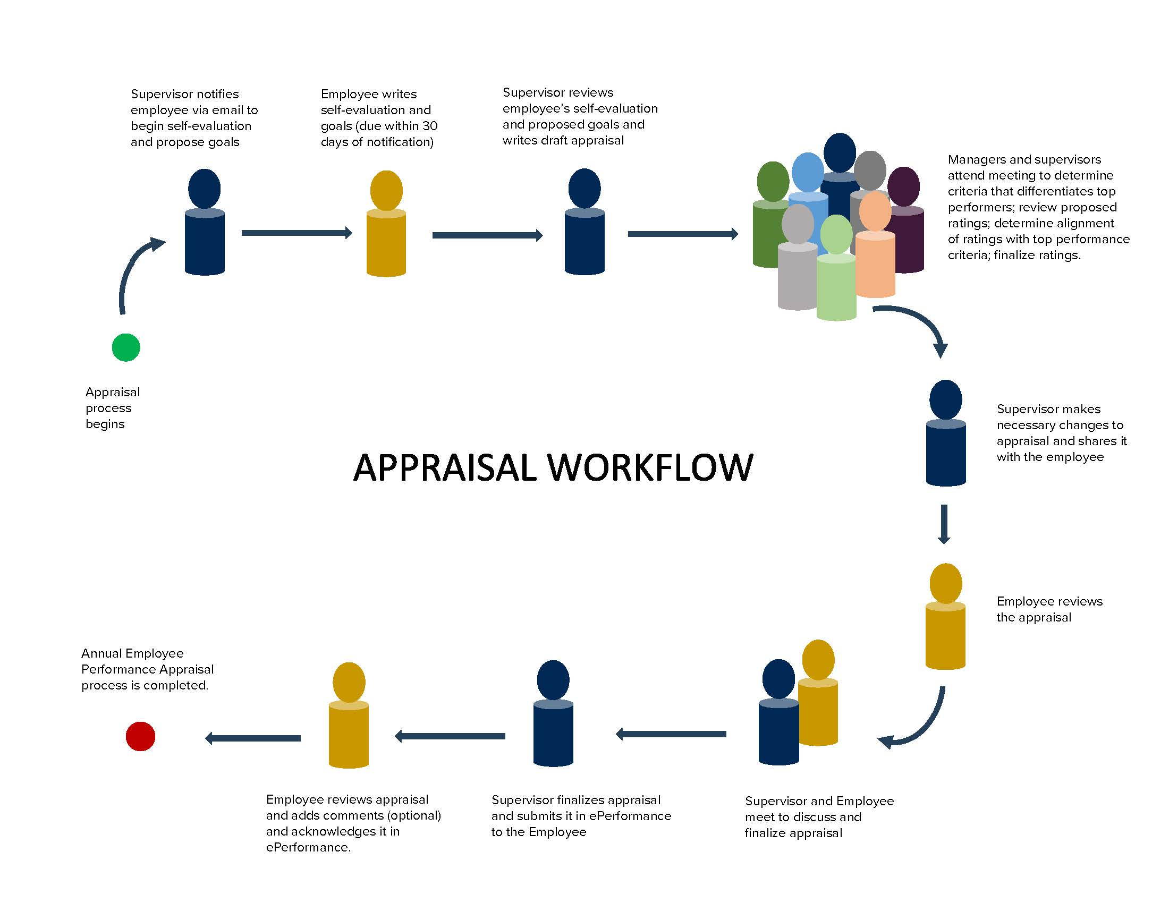

WHO ARE THE END USERS?

Slide 7

OUR SOLUTION AND ITS VALUE PROPOSITION
Highlighting - Features
Conditional Formatting – Missing
Filter – Remove
Formula - Performance
Pivot Table – Summary
Graph – Data visualization

Slide 8
Dataset Description
Employee Dataset – Edunet Foundations
26 – Features
9 – Features
Employee ID – Numerical data
Name – Text format
Employee Type – Text format (Full time/contract/Part time)
Performance level – Text format (Very High/ High /Medium/ Low)
Gender – Male/Female
Employee Rating – Numerical data (1 to 5)
Performance Score – Text (Exceeds/Fully meet/Need Improvement)
Employee Classification Type – Text Format(Full time, Part time , Temporary)
Business Unit - Text

Slide 9

THE "WOW" IN OUR SOLUTION
Formula =IFS(z8>=5,”Very High”,z8>=4,”High”,Z8>=3,”Medium”,True,”Low”)
3/21/2024 Annual Review
9

Slide 10
MODELLING
Data Collection:
Employee data were collected from Edunet Foundations.
Feature Selection:
The employee dataset originally had 26 features.
We selected 9 important features, including Login ID, First Name, Business Unit, Employee Status, Employee Type, Performance Level, Employee Rating, Gender, and Performance Score.
10

Slide 11
MODELLING
Data Cleaning:
Highlighting Blank Columns:
Use conditional formatting to highlight blank cells.
Navigate to Conditional Formatting > Highlight Cell Rules > More Rules (a new formatting dialog box will open).
Select Format only cells with and choose the Blanks option.
Click on Format > Fill > Select Red color and then click OK.
11

Slide 12
MODELLING
Data Cleaning:
2.Filtering and Removing Blank Columns:
To filter and remove blank columns, select the "Exit Date" column.
Go to Sort & Filter > Filter.
The filter icon will appear on the Exit Date column. Click on it to filter out blank cells.
The blank rows will then be removed from the dataset.
12

Slide 13
MODELLING
Performance Level:
Identify the performance level using the following formula: =IFS(Z8>=5, "Very High", Z8>=4, "High", Z8>=3, "Medium", TRUE, "Low")
Visualization:
Create a Pivot Table:
Go to Insert > Pivot Table.
Select the table and range, and choose to create the Pivot Table in a new worksheet.
The Pivot Table will be created.
13

Slide 14
MODELLING
Set up the Pivot Table:
Select Business Unit for Rows.
Select Performance Level for Columns.
Use Gender as a filter.
Add First Name as the value.
Create a Chart:
Go to Insert > Recommended Charts.
The chart will be created automatically.
Name the chart as "Employee Performance Analysis".
14

Slide 15
RESULTS
15

Slide 16
conclusion
The chart indicates that most employees are categorized as having “Medium” performance levels, reflecting an overall average performance across the business units. However, there are significant differences among units, with some reporting higher proportions of “Low” and “Very High” performers. This suggests that specific strategies may be necessary to address these performance discrepancies and improve consistency across all units.

