Slide 1
Using Deep learning to decode the stock market
A brief overview into how we can use deep learning techniques can be used for stock analysis

Slide 2
What will be covered
Company Profile
Why should we use LSTMs for stock analysis?
Role of Keras/Deep learning and LSTM
Dataset description
Some initial insights
Analysis of the trend of the stock
Data Pre-processing steps
Techniques used to build the model
Model accuracy
Results obtained
Limitations of the model and other things to consider

Slide 3

Company profile-Alphabet (Google)
We are going to be analysing stocks of Google's parent company Alphabet. Here is a brief about the company:
Alphabet Inc., born in 2015 from a restructuring of Google
It has become a dominant force in the global technology landscape.
Headquartered in California, the company boasts a staggering market capitalization of $1.44 trillion, solidifying its position as a tech behemoth.
Alphabet's reach extends far beyond its core internet businesses, encompassing a diverse portfolio that includes software, hardware, and cutting-edge ventures
In 2022, Alphabet's revenue reached an impressive $270 billion, propelled by its main advertising business and the burgeoning Google search engine.

Slide 4
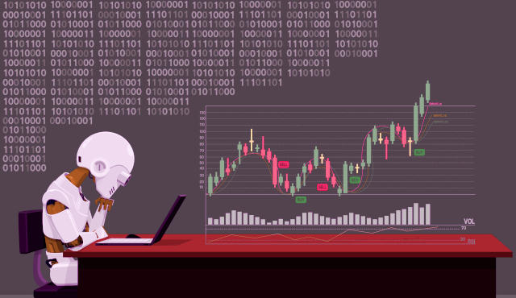
Usage of LSTM and Keras deep learning
LSTM, powered by Keras, adeptly recognizes and leverages sequential patterns in historical stock data for precise predictions.
LSTM's strength lies in capturing long-term dependencies, crucial for understanding the evolving trends in financial markets.
Deep learning library Keras offers an easy-to-use interface, enabling users to make informed decisions based on LSTM's deep learning insights.
LSTM's adaptability to market volatility, combined with Keras' efficiency, enhances the model's resilience in predicting stock prices.
The synergy of LSTM and Keras facilitates the development of models capable of providing real-time predictions, aiding timely investment decisions.

Slide 5
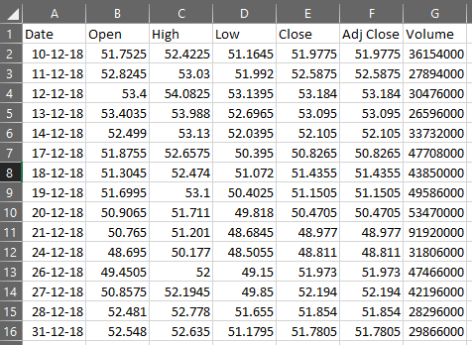
Description of the dataset
This dataset has been obtained from Yahoo finance.
It is in a csv format and has around 1200 entries which contains the stock information of Alphabet Inc (5 years) from December 2018 to December 2023.
The dataset contains the following fields: Date, Open, High, Low, Close, Volume. A snippet of the dataset has been attached.

Slide 6
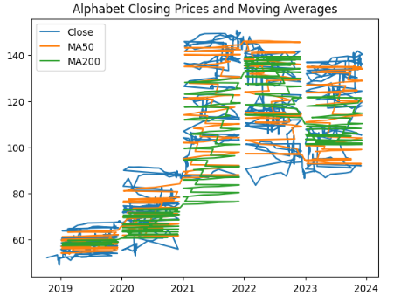
Insights gathered
The graph shows the closing prices and moving averages for Alphabet Inc. stock from December 2018 to December 2023. The closing price is the price at which the stock closed at the end of each trading day. The moving averages are calculated by averaging the closing prices over a certain period of time. The most common moving averages are the 50-day and 200-day moving averages.The graph of the 50 and 200 day moving average has a general upward trend which means the stock prices are closing at a higher price than before which means a bullish trend.Overall, the graph suggests that Alphabet Inc. stock is in a strong uptrend. The stock is likely to continue to rise in the near future.

Slide 7

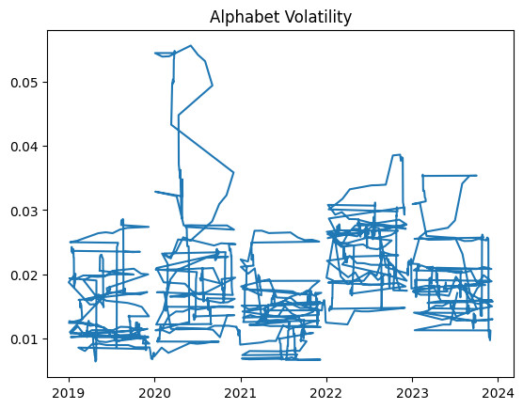
Analysis of the stock trend
While the negative ADF statistic suggests the possibility of non-stationarity in the time series, the p-value exceeding the 5% significance level prevents us from drawing a definitive conclusion. This ambiguity necessitates further analysis to conclusively determine the stationarity of the data.
The graph suggests that the volatility of Alphabet Inc. stock has been increasing in recent months. This is something that investors should be aware of before making any investment decisions.

Slide 8
Data Preprocessing steps
The following steps were taken to prepare the dataset for analysis:
The dataset was checked for null values in the beginning.
Only the necessary columns were kept for the analysis.
The stock data is scaled using the Min-Max Scaling method from sklearn.preprocessing (MinMaxScaler). Scaling is necessary as it converts all variables into a single scale.
The fit_transform method is applied to scale the entire DataFrame (scaled_data), normalizing the values between 0 and 1.
Then the dataset is divided into X(independent variables) and Y(dependent variable) and split into training and testing sets.

Slide 9
Techniques used to build the model
The creation of the model is broken up in the following steps:
Model Architecture:A Sequential model is created. An LSTM layer with 128 units is added, and the input shape is specified based on the shape of the training data.A Dense layer with 1 unit is added, presumably for regression output.
Compilation: The model is compiled using Mean Squared Error (MSE) as the loss function and the Adam optimizer.
Training:The model is trained on the training data (X_train and y_train) for 100 epochs.
Prediction:The trained model is used to make predictions on the test set (X_test), resulting in the array y_pred.
Reshaping Prediction:y_pred is then reshaped to a 1D array.

Slide 10
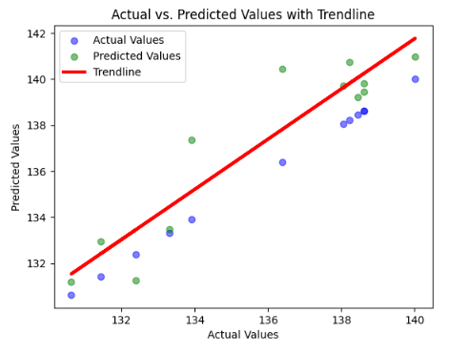
Accuracy of the model
Here are a few points to consider regarding the accuracy of the model:
The Mean Squared Error value of 3.737603401851672 represents the average squared difference between the predicted and actual values.
This means that on average, the predictions deviate from the actual values by approximately 2.5% of the possible range (between 50 and 150).
While the relative error might seem small, the magnitude of the error in absolute terms is between 1.25 and 3.75.
The Mean Absolute Error value is 1.56 which means that on average, the squared difference between predicted and actual values is relatively small, which means good predictive accuracy.
The model has a R squared value of 0.6235 which means approximately 62.35% of the variance in the target variable is explained by the model.

Slide 11
Model Limitations and other considerations
We have a few points to consider and think about:
This model won't work for companies with volatile stock and will only work with large and stable corporations.
AI Models can be prone to bias as datasets can tend to have data of people from one group more or less in quantity.
A lot of training data is needed to train such models hence there can be concerns over privacy issues and other such matters when obtaining the data.
Using AI can lead to more efficiency in the financial sectors but it could lead to a lot of job losses, thus negatively affecting the economy.
AI can also be used to spread fake news which means stock manipulation would increase.

Slide 12
Final Remarks
The LSTM model's performance in predicting stock prices is commendable, with a Mean Squared Error (MSE) of 3.74 indicating a relatively small average deviation from actual values.
The Mean Absolute Error (MAE) further reinforces the model's accuracy, suggesting effective capture of underlying trends.
The R-squared value of 0.6235 signifies a substantial explanation of variance, although there is room for improvement.
Insightful analysis of relative and absolute errors underscores the nuanced evaluation, recognizing both the modest percentage deviation and the notable absolute error range.
Although the model demonstrates competency in capturing patterns, a lot of ongoing refinement is needed through alternative architectures and feature exploration would do great to enhance its precision.

