Slide 1
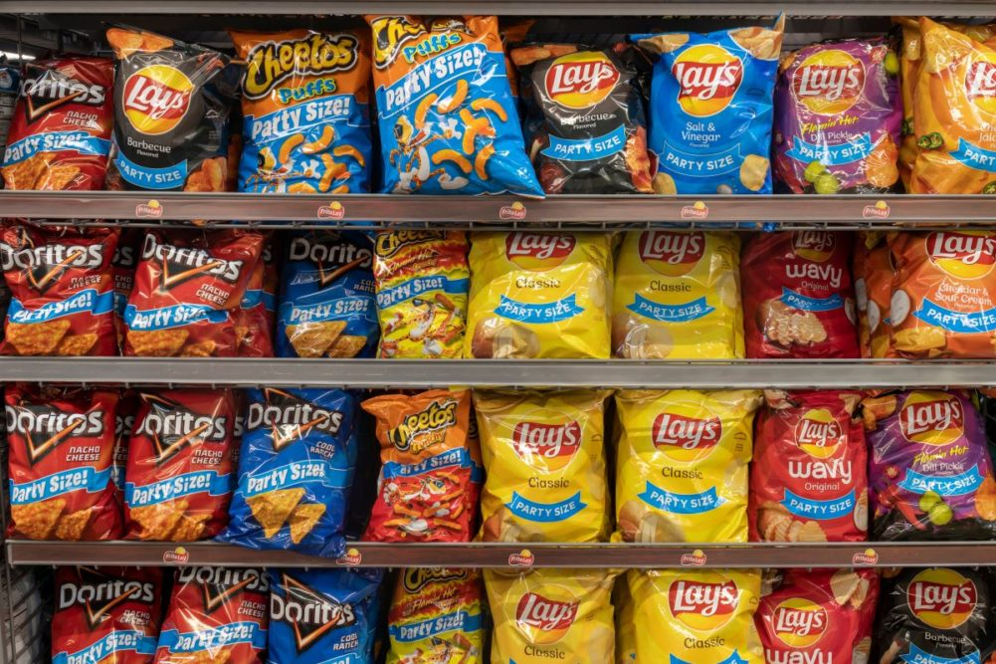

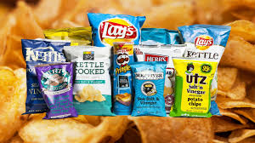
Category review: Potato Chips
June 2020
Prepared by: Ishan Dutta
Data Analyst, Quantium

Slide 2
Notes:
To view Privacy video explaining how important data privacy is to Quantium, please click here: https://www.youtube.com/watch?v=Zq1QDAkoRzU
or here Q:\Company Reference\Brand & Design\Brand videos\Q Privacy.mp4
At Quantium, we believe that data is the behavioural footprint of humanity and that it has to be treated with the utmost care and responsibility.
Histories, attitudes, indeed lives are stored within it in ways that aren’t always apparent – and that’s what makes its potential so powerful.
To work with it responsibly, sensitively, we set ourselves the highest data privacy protection and governance standards.
We have spent 17 years perfecting privacy-by-design and secure-by-design principles. Central to this is not holding any personally identifiable information about people –
we neither receive it, and put the necessary protections in place to be unable to decipher it.
Every aspect of handling data is safeguarded: from its de-identification, to its encryption – data security is paramount and of the highest grade.
We pride ourselves on gaining the trust of iconic organisations around the world through years of securely working with their data,
and in turn the trust that builds with their stakeholders.

Slide 3
Executive summary
01
Task 1:Customer Segment Analysis
In the first task, the objective was to analyse customer segments based on their purchase behaviour. This involved observing consumption patterns across various segments, identifying key trends and differences in purchasing habits, and understanding how these segments interact with the product offerings. To understand the differences between these segments hypothesis tests were performed.
02
Task 2: Trial-Control Analysis
In this task our job was to find the appropriate control stores for the selected trial stores based on the similarity of metrics. Also we had another objective which was to observe the performance difference if any between the trial and control stores during the observation window. For this we chose two metrics: Revenue generated and New customers acquired.

Slide 4
01: Customer Segment Analysis
Procedures followed: To obtain meaningful insights, a systematic approach was adopted. Two datasets provided by the client were first merged to create a consolidated dataset. Irrelevant columns and duplicates were removed to ensure data integrity. Outliers, which are extreme values, were addressed by replacing them with median values to maintain robustness. The dataset then underwent proper formatting and sanity checks to ensure it was suitable for analysis. Additional features such as brand name and product size (the size of the chips packet) were created through feature engineering to allow for a more in-depth analysis. This comprehensive data preparation ensured that the subsequent analysis would be accurate and insightful.

Slide 5
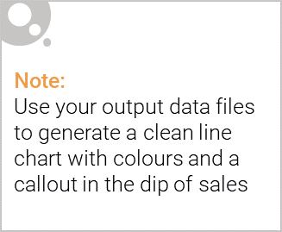
Key Insights Obtained
There were almost 2.7 lakh records in the dataset.
An average order had 2 packets each with a size of 165 gram were ordered which gave us a revenue of 8 dollars!
The best order had 15 packets in which each were around 210 grams and it generated a revenue of 15 dollars.
The least order had a single packed which was 125 grams and gave us just 1.5 dollars!

Slide 6
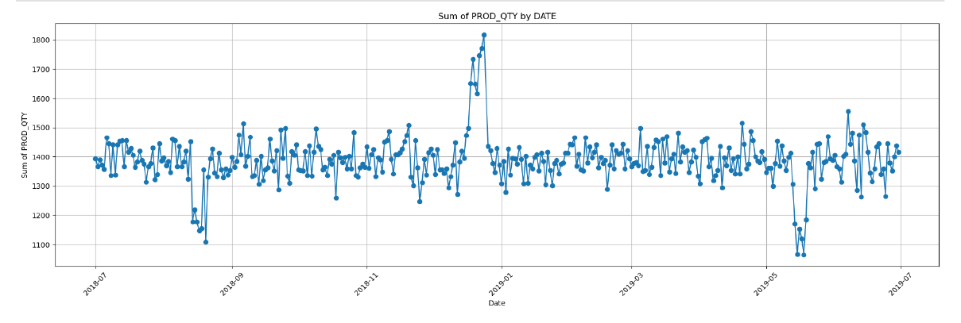
Amount of products ordered by Quantity
In this graph we can see that more products are ordered during the Holiday season which is in December and less products are ordered in the Humid month of June. So its imperative to stock up more during the Holiday season and less during June. Also special packets need to be created in order to make sure the chips are able to retain their crispness more during the humid season.

Slide 7
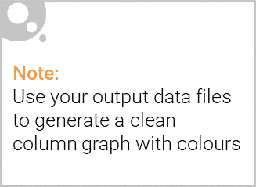
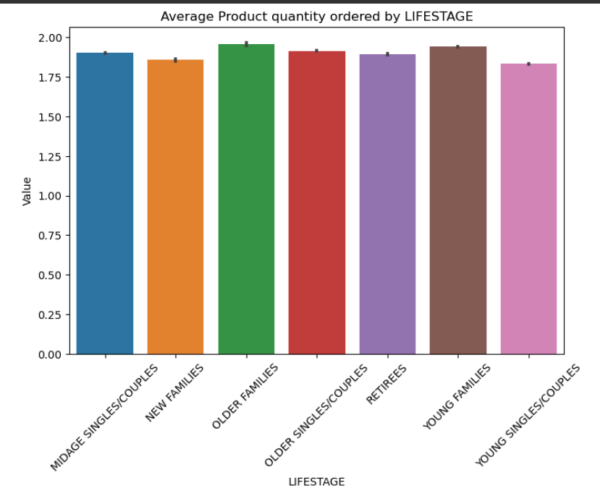
Which age group orders the most products?
As We can observe that the older and young families are the groups that order the most products.. This might be that both groups are likely to have children, leading to higher demand for various products. To target these groups, offer loyalty programs and familiar products for older families, and promotions or bundles for young families. Also in the store website, if someone searches toys or kids stuff , offers for chips bundles could be displayed to them!

Slide 8
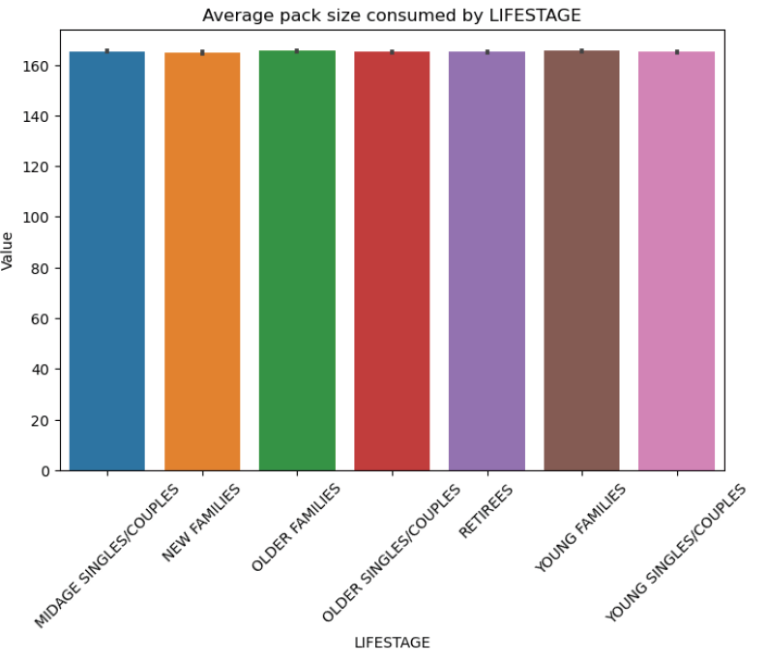
Which age group orders the biggest packs?
As we can observe that the pack size appears almost the same among all the groups. We can see that older families and young families love to consume bigger packs which again confirms the fact that they have kids and in fact our real target market is kids. So small toys should be included in the chips packet and the packets should be made enticing for the kids.

Slide 9
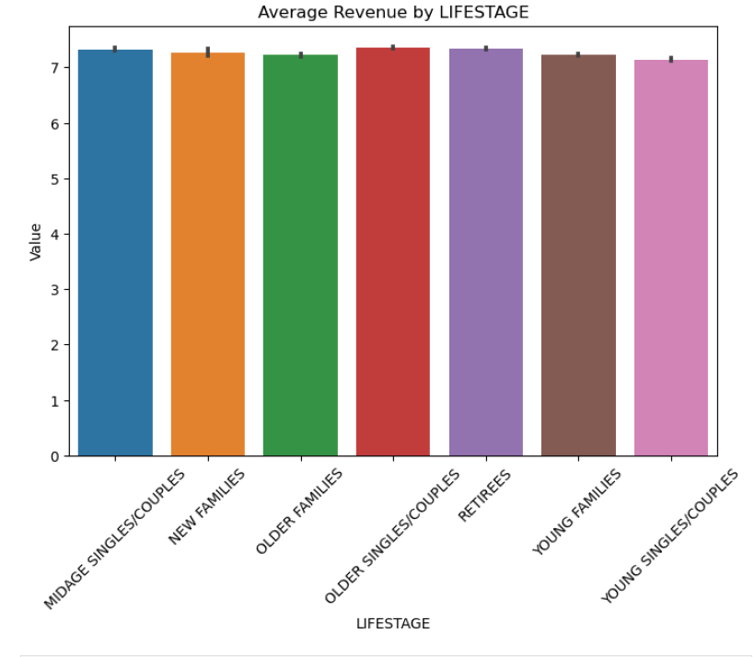
Which age group brings the most revenue?
As we can observe that the older couples/singers and retirees segment bring the most revenue. If we combine the previous slides and the fact that the sales take place most during the holiday season, we can conclude that we need to come out with more gift hampers and combine them with toys in order to boost sales from these segments.

Slide 10
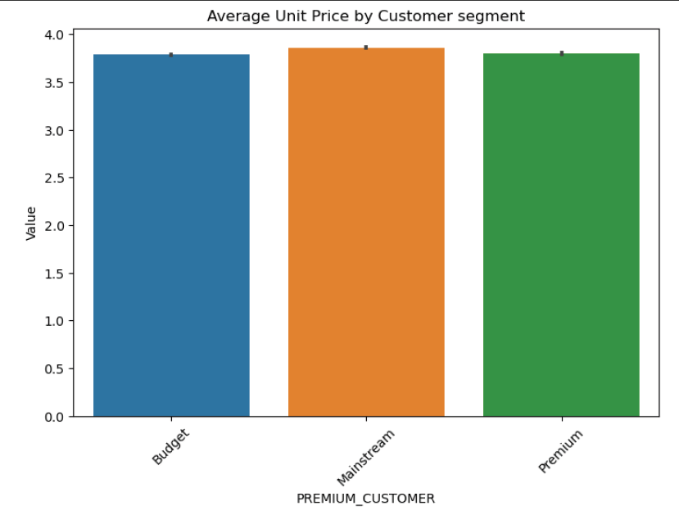
Price sensitivity across customer types
We can clearly see that customers are price sensitive. Mainstream customers purchase the most expensive packs, while Budget customers tend to go for the cheapest packs. Premium customers go for something in between. To better cater to these segments, consider offering targeted promotions: discounts or value packs for Budget customers, exclusive deals or loyalty rewards for Premium customers, and new product launches or premium options for Mainstream customers.

Slide 11
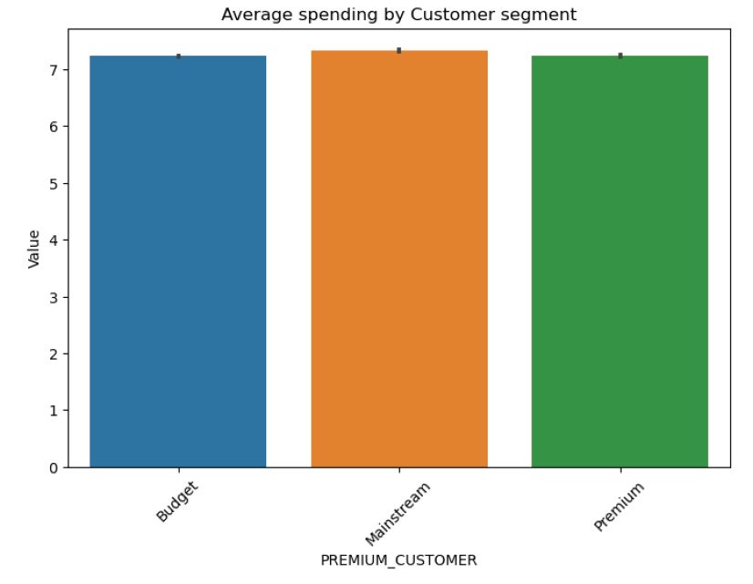
Which customer segment spends the most on average?
Mainstream customers are the ones that bring in the most revenue, while ironically, Premium and Budget customers spend almost the same amount. This suggests that a bit of rework is needed in classifying customers into categories. It's essential to refine these segments based on spending habits, preferences, and purchasing power. Implementing more detailed customer profiling and personalized marketing strategies could help better target each group. For instance, consider offering tailored loyalty programs for Mainstream customers to retain their high spending, while introducing more appealing options for Premium and Budget customers to encourage higher spending.

Slide 12
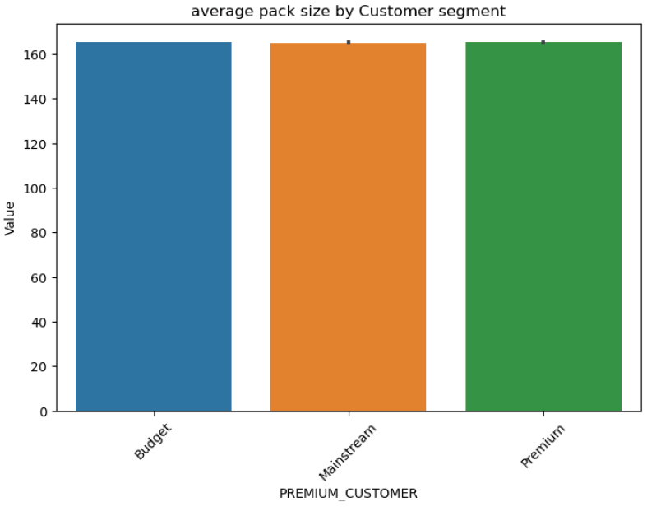
Which segment prefers it big?
The Premium and Budget segments suggest a preference for larger pack sizes, indicating they value getting more for their money. To cater to this preference, consider offering bundled deals or larger pack sizes at discounted rates for these segments. This could enhance their perceived value for money and increase their purchase frequency.

Slide 13
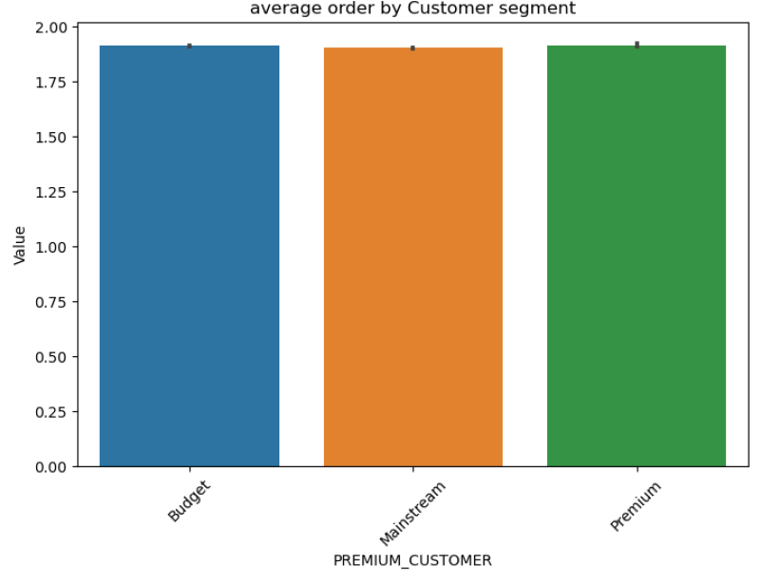
Which segment buys more at a time?
The Premium and Budget segments suggest a preference for placing bulk orders and are almost at par with each other. To capitalize on this behaviour, consider offering bulk purchase incentives or loyalty programs for these segments. Additionally, providing special discounts on bulk orders could further encourage this buying. pattern

Slide 14
02
Trial store performance
In this segment of the project, the stores: 77, 86 and 88 were designated as trial stores. These stores had some confidential special measures taken with the aim of improving the two key metrics namely: customers acquired on a monthly basis and gross sales generated. For this purpose only one dataset was required and this time no outlier removals were performed to get a clearer picture. A few additional metrics like the amount of transactions per customer, average price per packet etc were created for better analysis. The time period before February 2019 was selected as pre-trial period which is the time before the trials were performed. The months of February to April were selected as the trial period. For the trial stores, control stores were selected on the basis of similarity score. Since correlation score wasn’t significant, magnitude score was used to calculate the similarity score. For store 77 :control store was 233, for store 86: control store was 155 and for store 88: the control store was 237. Pre-trial and during trial observation was made for the two metrics we have selected to ascertain if improvements were there in the trial stores. Control stores and Other stores have been added for comparison.

Slide 15
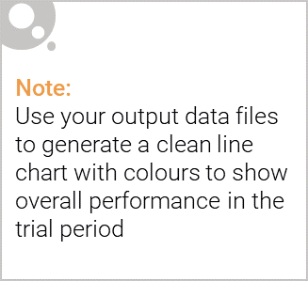
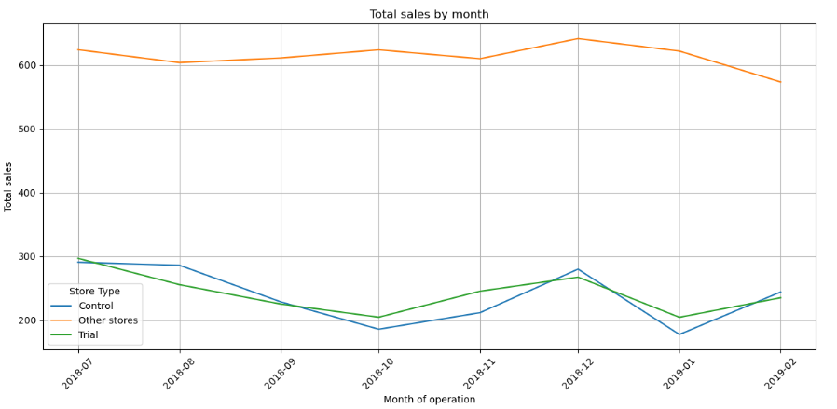
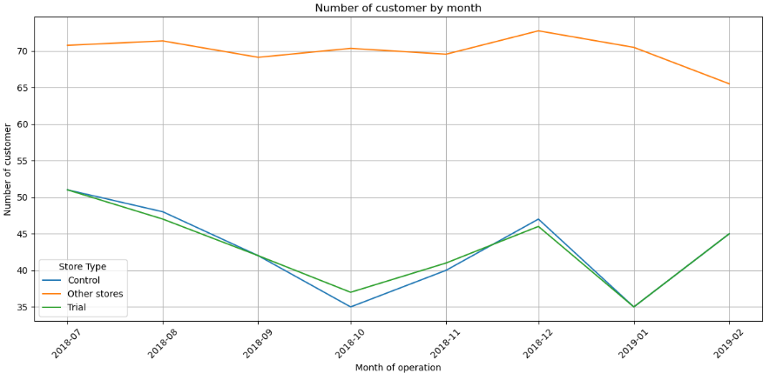
Pre Trial observation for trial store 77 and control store 233
Amount of sales by month
Customers acquired by month
In this case we can observe that other stores are good at acquiring more customers and generating more revenue than the trial and control stores. In the pre-trial period we can see that trial and control stores almost have the same level of performance.

Slide 16
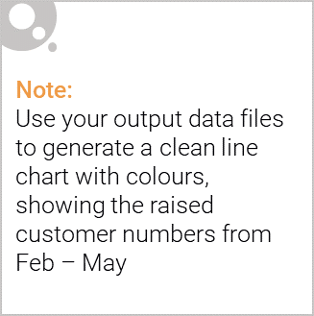
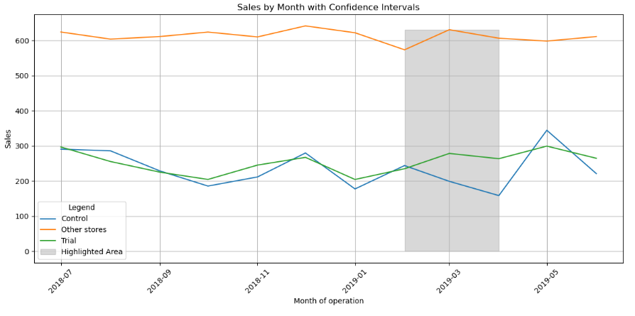
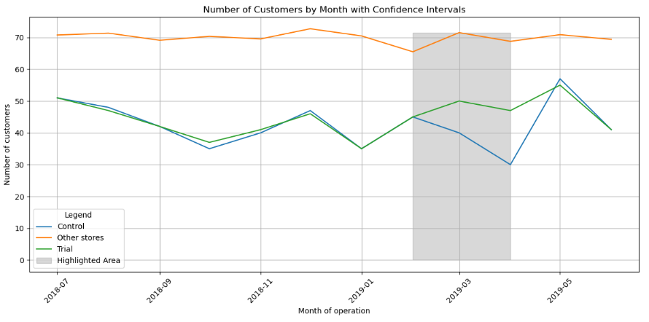
During Trial observation for trial store 77 and control store 233
Amount of sales by month
Customers acquired by month
Although the trial and control stores don’t perform as well as other stores in both these metrics, but we can see that in the trial period that is highlighted in grey that the trial store performs significantly better than the control store, which shows that the trial measures worked well for the trial stores.

Slide 17
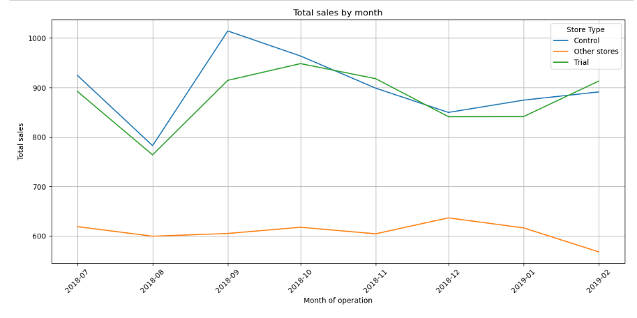
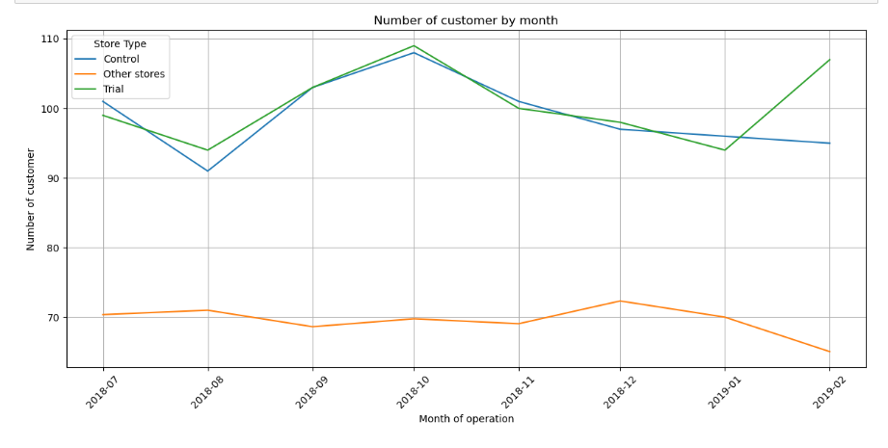
Pre Trial observation for trial store 86 and control store 155
Amount of sales by month
Customers acquired by month
In this trial and control pair we observe that they perform better than other stores in both regards. However, we observe in case of sales control stores perform the best while in customer acquisition we see that Trial stores perform slightly better than control stores in the pre-trial period. Other stores lag far behind in both these aspects.

Slide 18
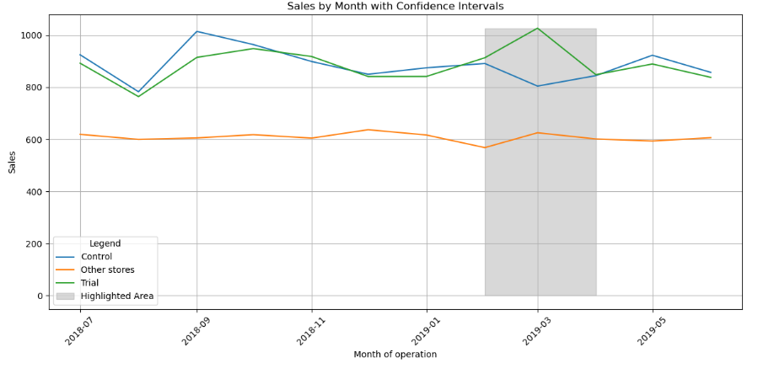
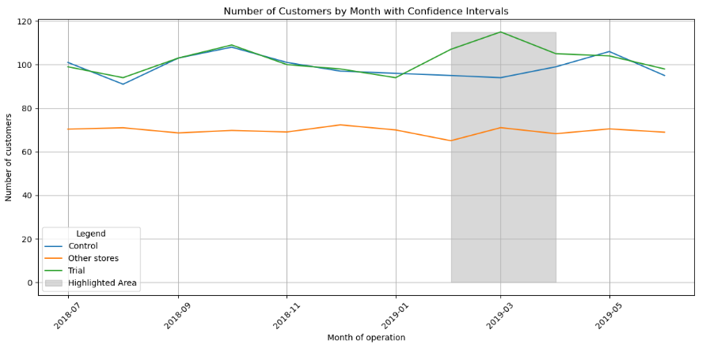
During Trial observation for trial store 86 and control store 155
Amount of sales by month
Customers acquired by month
We can see that in both aspects , the trial stores outperform other stores and control stores. This clearly shows that trial stores not only perform well but they perform well by a great margin in both aspects which clearly shows that the measures taken in store 86 work really well.

Slide 19
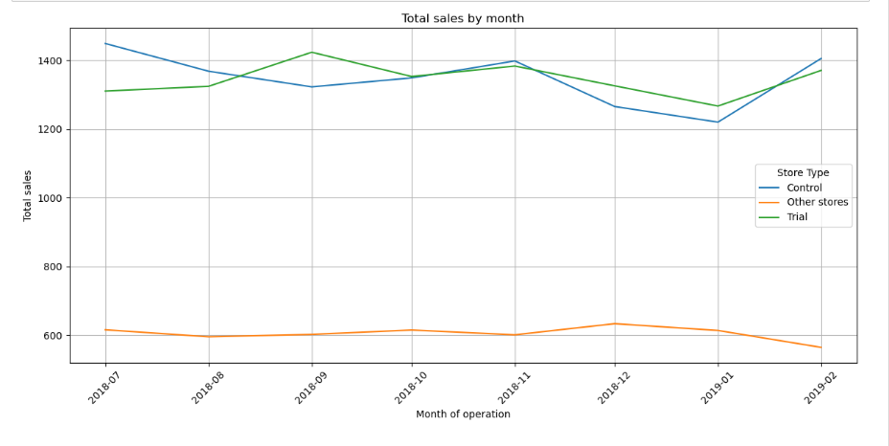
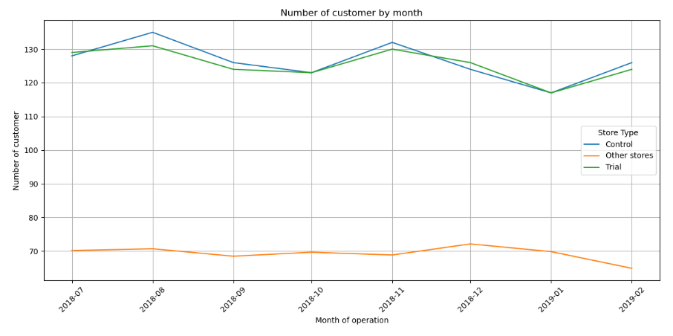
Pre Trial observation for trial store 88 and control store 237
Amount of sales by month
Customers acquired by month
This trial and control pair outperform other stores as well. In the first case of sales, we see that Trial stores mostly performs the best than control stores and far better than the other stores. While in the second case of customer acquisition, Trial and Control stores perform almost the same but still better than other stores before the observation period.

Slide 20
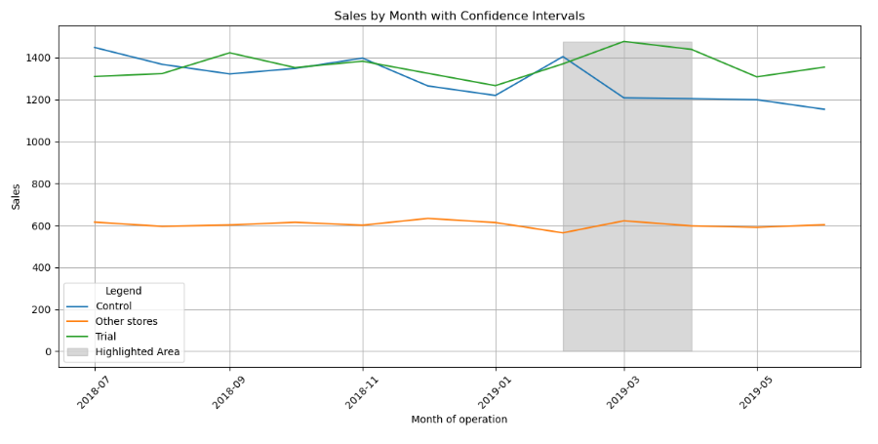
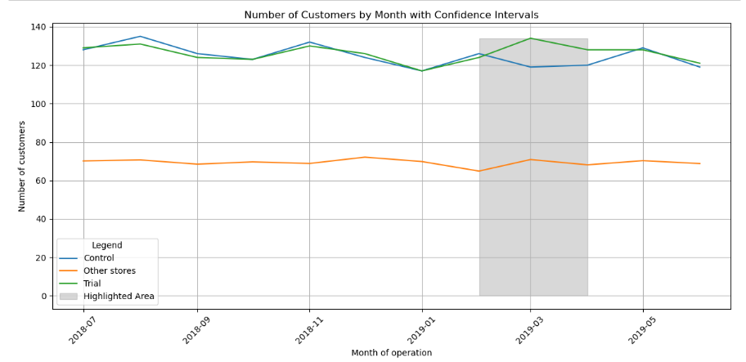
During Trial observation for trial store 88 and control store 237
Amount of sales by month
Customers acquired by month
In the shaded observation period, we can see that the trial stores outperform the control stores by a decent margin and other stores by a huge margin in both aspects. However in customer acquisition the margin reduces between the trial and control stores. Overall, the trial stores perform well in the observation period showing that the measures really worked well.

Slide 21
Final words
We can conclude that the trial measures worked really well for the three stores. However, Trial Store 77 stands out as it is the only one performing below expectations compared to other trial stores. This discrepancy suggests that the strategies implemented may need to be reevaluated or adjusted for this specific location. Factors such as local market conditions, customer preferences, and competitive landscape might be influencing its performance. Further analysis is recommended to identify and address the specific challenges faced by Trial Store 77 to ensure consistent success across all trial stores.

