Slide 1


Social-Buzz Insights

Slide 2


Today's agenda
Problem
The Analytics team
Process
Insights
Summary

Slide 3


Problem
The client wants to know the insights about their social media app social buzz and has provided us datasets for the purpose. Our goal is to analyse the user behaviour to gather insights and give them advice about the same.

Slide 4
The Analytics team
The Chief of Data Science of Accenture Mae Mulligan assigned this task to me the data analyst, Ishan Dutta. It’s a solo endeavour by the one man army.

Slide 5

Insights
The insights have been gathered about user behaviour ,sentiment and activities based on time of day. General trends like amount of content posted on a daily basis and a monthly basis have been analysed. Also sentiment score has been calculated on basis of category types and time of day to understand what the users like. Analysis of reaction types, emojis etc has been conducted as well.

Slide 6
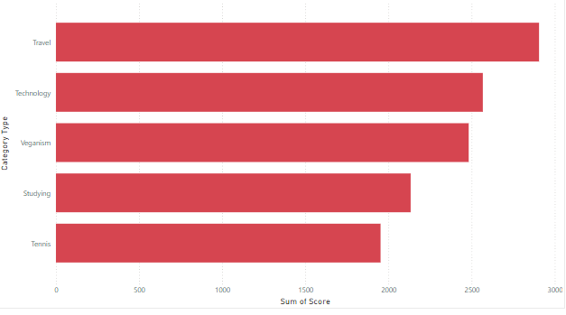
Top 5 categories by sentiment score
The top 5 categories which are trending among the users as we can ascertain from above are: Travel, Technology, veganism, studying and tennis. These topics are current centre of interest for the users.

Slide 7
Overview
There are almost 1000 posts generated by the customer that we are using for this data analysis. As of now this app has 16 distinct type of reactions and 16 distinct type of categories. The app categorizes posts into three different categories: positive , neutral and negative and allots the score accordingly. As of now the app supports 4 types of media: photo, GIF, video and audio format.

Slide 8
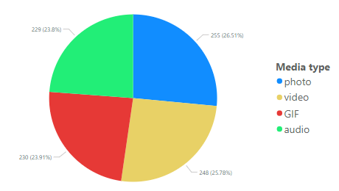
What type of media do the users use more
As we can infer from the pie chart, it appears that all the media types have almost the same level of usage among users and there is not much difference. But on closer inspection we get to know that photos and videos shared by the users the most.

Slide 9
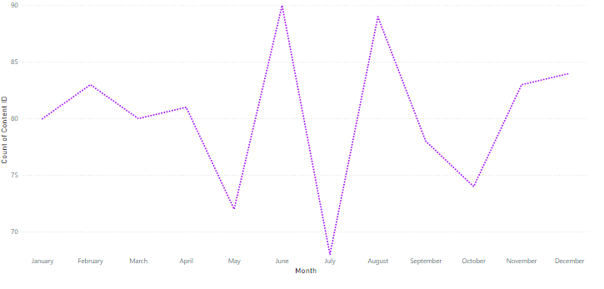
User activity by month
The user activity has normal ups and downs from January to April but we can observe a huge fall in user activity in the month of May followed by a very steep rise in the month of June. We again see a sharp fall in July which is followed by a huge spike in August to a sharp decline in the months of September to October. Finally in the final months of November and December there is a gradual rise of user activity.

Slide 10
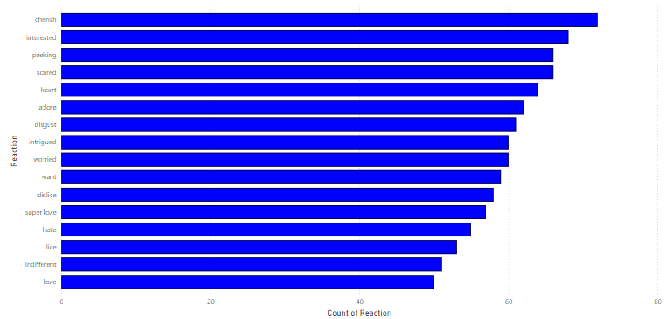
Most popular Emoji reactions
Analysing the emojis can be a great way to gauge the user’s perceptions and hence a psychoanalyst can explain it better. Cherish, interested and peeking are the most popular emojis suggesting the users are curious and hence we can advertise products and services on our social media pages.

Slide 11
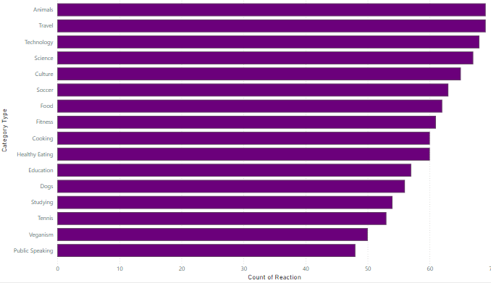
Which topic attracts the most reactions?
The topics that has the most amount of user engagement is animals, travel, technology, science and culture. Also topics like public speaking and veganism don’t have most reactions.

Slide 12
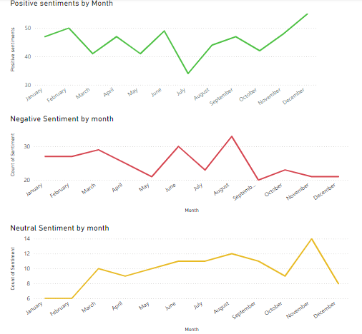
Sentiment analysis by Month
The winter months in general have the most positive sentiments among users and the least amount of negative sentiments. While the months of summer and autumn have substantial amount of neutral sentiments. These sentiments spike the most in November and take a sharp dip in December. The most amount of negative sentiments are observed in June and August. There is sharp rise and fall in negative sentiments. Users in a generally positive and neutral mood are more receptive to ad campaigns.

Slide 13
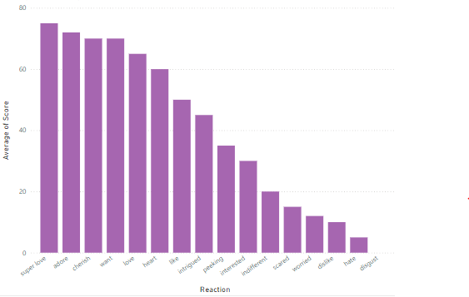
Understanding score by reactions
As we can infer from the graph that the positive reactions like super love, adore, cherish etc have the highest average scores while the negative reactions like dislike, hate and disgust have the lowest sentiment scores.

Slide 14
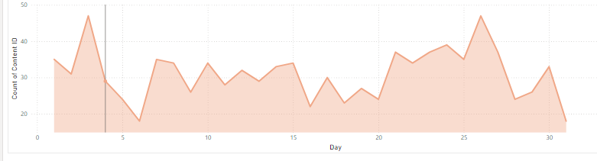
Overall Trend of user activity
The overall trend suggests that the user activity has gone down in general in the application which is a cause for worry for the stakeholders and efforts must be taken to the increase user engagement.

Slide 15
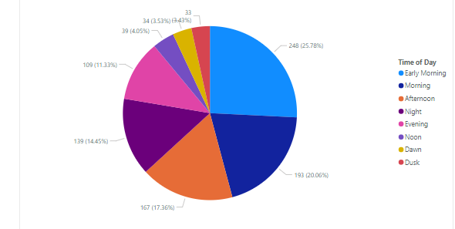
What time of the day sees the most user activity?
The period in which users are the most active is in the early morning hours which is between 12 AM to 5 AM. This time is suitable for targeted advertising according to their tastes. The next best time appears to be the morning hours which is from 6 AM to 12 PM.

Slide 16
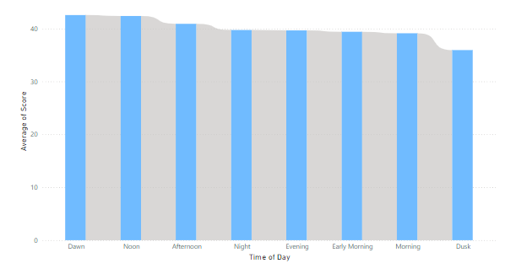
At what period of time the users are more jolly?
The user appear to be in a good mood during the hours of dawn which is between the time of 5 AM to 7 AM. The dusk hour which is the hour between 8 to 9 PM can be considered the time where the users aren’t in a good frame of mind and hence things that make them feel better should appear on their feed around this time.

Slide 17
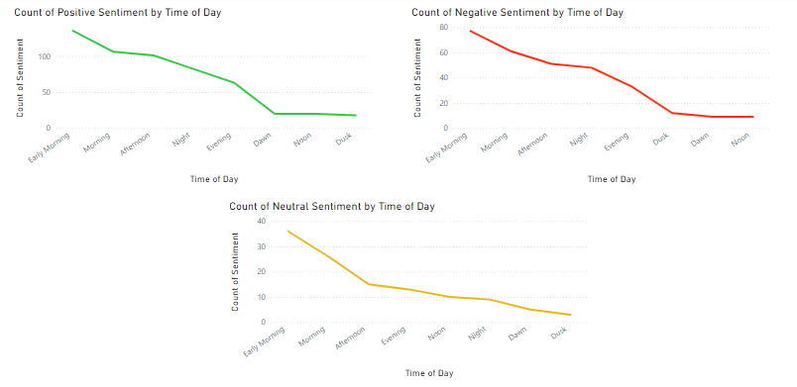
User sentiment based on hour of day
The sentiment of users doesn’t depend on the time of day at all as we can infer from this analysis.

Slide 18

From what we observed from these datasets, that this app has a good and active user base with varied interests. The app needs to learn to monetize its users to generate revenue which can be beneficial to its investors and its IPO. The app needs to pay attention to the falling user activity and must work to retain its user base.
Summary

Slide 19
Thank you!

