Slide 1
Final Year Project 2021 Higher Diploma in Computer Science Dermot Sheerin - 20086620

Slide 2

Chat Generator Test Harness with Automated Deployment using a Jenkins pipeline
Dermot Sheerin
National Diploma Electronic Engineering
Higher Diploma Computer Science

Slide 3
Agenda
Chat Generator Test Harness Overview
Project Demo
Problems Encountered
Future Work
Questions

Slide 4
What is this project about exactly?
A test framework team has been tasked with identifying a chat generator tool capable of simulating customer chat interactions with Contact Center (CC) agents. The project I have selected is to develop a test generator capable of simulating up to 20k customer chat interactions. The generator will first establish a session with the CC via several API calls and if successful will wait for an agent to answer their interaction. Once the agent answers, the generator will send a chat message and wait for the agent's response. This cycle will continue for a predefined number of loops (specified by the tester) before terminating the interaction.
A React UI will be responsible for setting the test parameters, starting/stopping each test run, and providing live test statistics and resource usage of the chat generator
To complete the test environment, a Continuous Integration /Continuous Deployment (CI/CD) pipeline (Jenkins) will automate the build and deployment of the chat generator and React applications into docker containers, each time a change is pushed to a GitHub repository

Slide 5
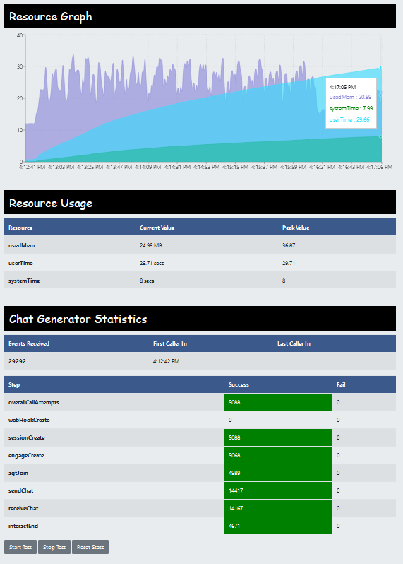
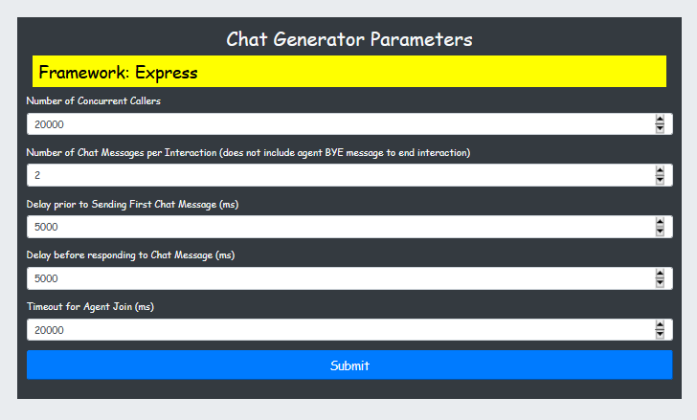
Front End – React JS
Configure test parameters for test run
View Realtime Resource usage of chat generator (Used Memory and CPU time)
Chat interaction flow statistics

Slide 6
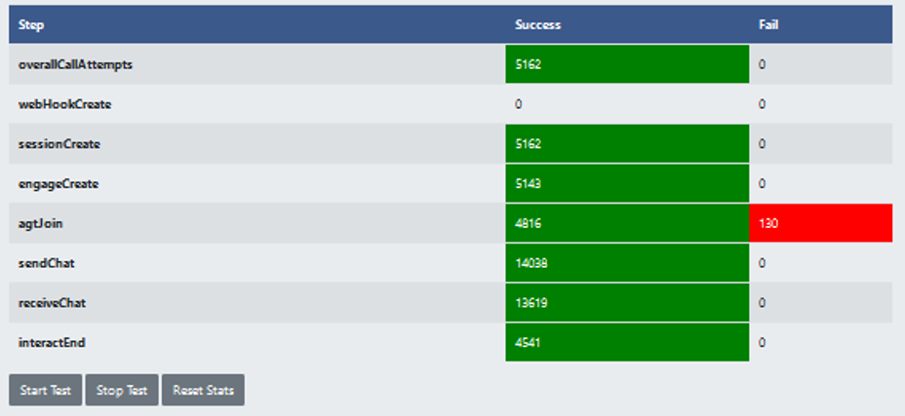
Backend Chat Flow - NodeJS
Session create API Call
Engagement create API call
Verify an Agent answers
Exchange Chat interactions
Terminate interaction

Slide 7
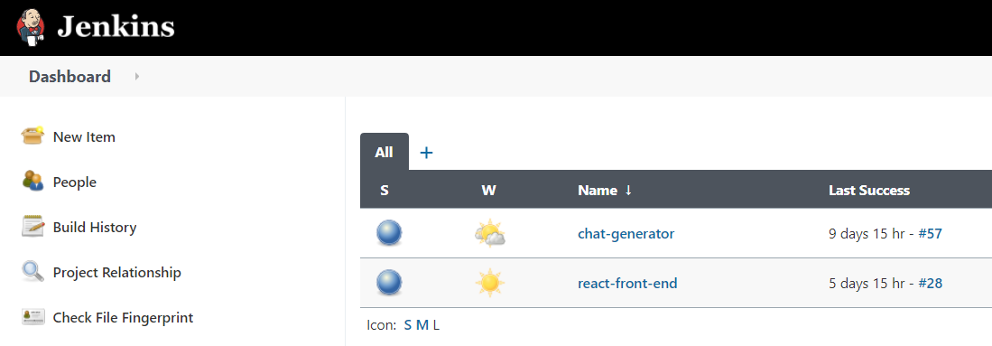
Automated Deployment on Docker (CI/CD Pipeline)
Jenkins Server running inside a Docker container to manage the build and deployment of the Front and Backend applications throughout the development cycle
Chat Generator Pipeline
Front End UI Pipeline
Each time a change is pushed to the applications repo, an automated build and deployment of the application will take place. Once complete, the application along with the new changes will be running in a Docker container

Slide 8
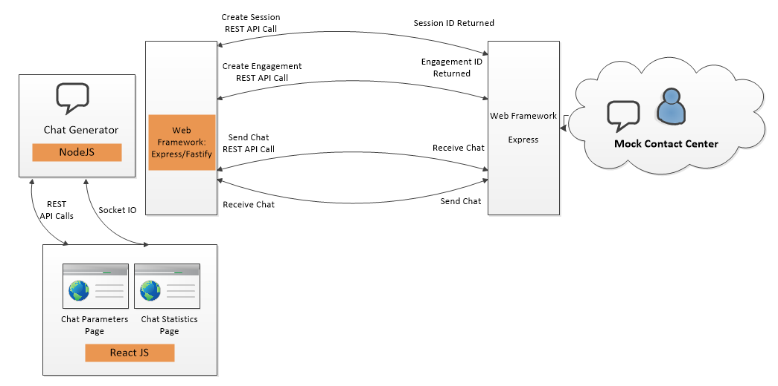
Environment Overview
High Level Overview of Contact Center Chat Generator Environment

Slide 9
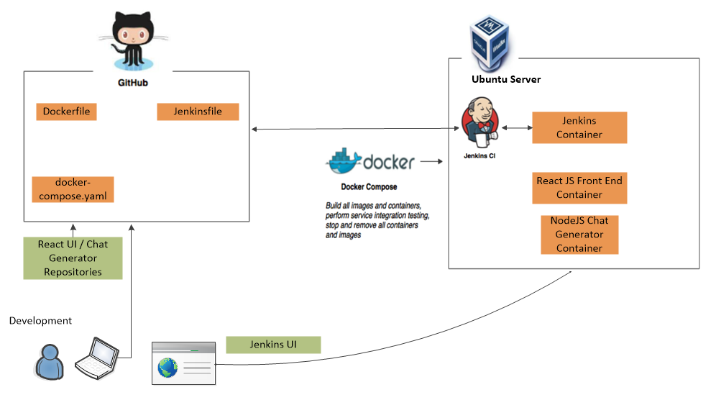
CI/CD Development Test Harness Overview

Slide 10
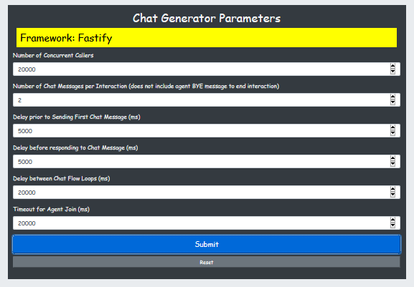
20k Test - Express V’s Fastify Web Framework Test
The chat generator is a modular design, effectively allowing different technologies to be swapped in or out at relative ease.
An example of this is discussed in the report where I assess the performance of Express Web Framework versus Fastify Web Framework for a 20k chat run
The test uncovered an issue with my Fastify implementation that caused high memory usage of the chat generator. The Realtime UI resource usage graph captured this information allowing me to track down the root cause - The chat generator was failing to release memory caused by too many open network sockets.

Slide 11
Live Demo

Slide 12
Problems Encountered
Optimizing Realtime Chat Statistics Display. Initially I was using a custom React Hook to fetch the statistics every 5 seconds. Solution: Socket IO - WebSockets allow for a higher amount of efficiency compared to REST because they do not require the HTTP request/response overhead for each message sent and received.
High Memory Usage during Fastify Implementation Test Run. Resource graph displayed an unexpected rise in memory for the chat generator caused by too many open network connections. Reply status code method did not work, causing the above network and memory consumption issue. Solution: use Reply send method instead.
Jenkins Build Trigger (GitHub webhook trigger for GITScm polling V Poll SCM trigger) Due to network constraints between the SUT and Github when using the webhook callback, I opted to use Poll SCM instead of Github webhook to trigger the pipeline build.

Slide 13
Future Work
Add additional REST APIs to chat generator as Contact Center functionality evolves
Migrate Mock CC Server from isolated network to docker container and take ownership of this code base for future enhancements
Move chat generator and Mock CC to cloud serverless functions
Move application deployment from containers running on Docker to a microservice running on Kubernetes
Investigate other technologies that would help improve the benchmark results e.g., introduce Load Balancer, multi-threading to back-end

Slide 14

Project Demonstration Video
https://vimeo.com/549611226/8f1a0c597f

Slide 15
Questions ?

Slide 16
Thank You

