Slide 1
COS30082 – Applied Machine Learning:
Bird Species Classification
Deron Yijia FOO (102780757)
Notes:
Good day everyone. I’m Deron Foo. In this project, I developed a fine-grained bird species classifier using the CUB-200 dataset. The focus of my approach was not just achieving high accuracy, but ensuring strong generalisation through advanced training and anti-overfitting strategies. I’ll walk through my experimental journey from CNN to Resnet50, to EfficientNetV2-L, the model design, training setup, results, and finally my Hugging Face demo.

Slide 2
Project Overview
01
02
03
04
Task
Dataset
Fine-grained image classification
CUB-200 (200 North American bird species)
Goal
Tools
Build robust classifier with limited data
PyTorch, SAM, EMA, ArcFace, Hugging Face
Notes:
This project focuses on fine-grained classification differentiating between 200 visually similar bird species. The CUB-200 dataset is challenging due to small sample size and high inter-class similarity. So, the main challenge was achieving generalisation with limited data. My final chosen and proposed solution include using PyTorch with transfer learning on EfficientNetV2-L and several anti-overfitting strategies including SAM, EMA, and ArcFace. Finally, the trained model was deployed on Hugging Face as a live web app.”

Slide 3
01
Data Augmentation & Preprocessing
Controlled, realism-preserving augmentations
Random crop, flip, rotation, mild colour jitter
Purpose: increase diversity, retain fine details
Normalisation: ImageNet mean/std
Seed fixation for reproductivity
Notes:
Because the dataset was relatively small and fine-grained, the augmentation strategy was crucial. I used naturalistic transformations namely random cropping, flipping, slight rotation, and gentle color jitter to improve robustness without distorting subtle features like feather textures or wing patterns. All images were normalised using ImageNet statistics, and random seeds were fixed to ensure reproducibility across runs.”

Slide 4
Experimental Progression
1) Baseline CNN (from scratch):
47% accuracy > overfitting
3) EfficientNetV2_L
(transfer + advanced strategies):
88.1% accuracy
2) ResNet50 (transfer learning):
68.8% accuracy
Key lesson:
Model capacity +
regularisation balance
Notes:
I began with a simple CNN trained from scratch it learned basic patterns but quickly overfitted, achieving only around 42% accuracy. Next, I moved to a pretrained ResNet50, which improved to nearly 69%, confirming the value of transfer learning. However, ResNet50 was heavy and unstable on limited data. That motivated me to adopt EfficientNetV2-L, a more balanced architecture optimised for both efficiency and regularisation. This shift, combined with my custom training strategy, led to over 88% accuracy.

Slide 5
Model Architecture
Backbone: EfficientNetV2-L (pretrained on ImageNet)
Custom classifer head:
Linear layer + Dropout + BatchNorm
Embedding for ArcFace margin
Progressive layer unfreezing
Notes:
The model architecture builds on EfficientNetV2-L’s scalable design. I replaced its final classification layer with a custom head including dropout, batch normalisation, and a learnable embedding layer for ArcFace. Initially, only this head was trained while the backbone remained frozen. Then I progressively unfroze deeper layers, allowing controlled adaptation to the bird dataset without catastrophic forgetting.

Slide 6
Core Concepts
EfficientNetV2: compound scaling > better efficiency
Transfer learning: reuse low/mid-level features
Fine-grained classification: subtle inter-class differences
Goal: Stable, generalisable representations
Notes:
EfficientNetV2’s main strength is compound scaling, it balances depth, width, and resolution for better efficiency. Transfer learning helps reuse low- and mid-level image features like edges and textures, so the model only needs to learn species-level refinements. For fine-grained tasks like birds, this stability and feature reuse are critical to avoid overfitting while retaining discriminative detail.

Slide 7
Training Strategy
Optimiser
EMA
Hybrid Loss
Sharpness-Aware Minimisation (SAM)
Stabilises weight update
ArcFace + Label Smoothing CE
Learning rate
Differential LR
Cosine annealing + warmup
For backbone vs head
Notes:
My training scheme integrates several modern strategies. SAM pushes the model toward flatter minima, producing weights that generalise better. Exponential Moving Average maintains a smoothed copy of weights to stabilise validation performance. The loss combined Label-Smoothed Cross-Entropy reducing overconfidence with ArcFace, which enforces angular separation between classes, improving discriminability. Learning rates were tuned differently for the backbone and head, and decayed gradually using cosine annealing with warm-up to ensure smooth convergence.

Slide 8
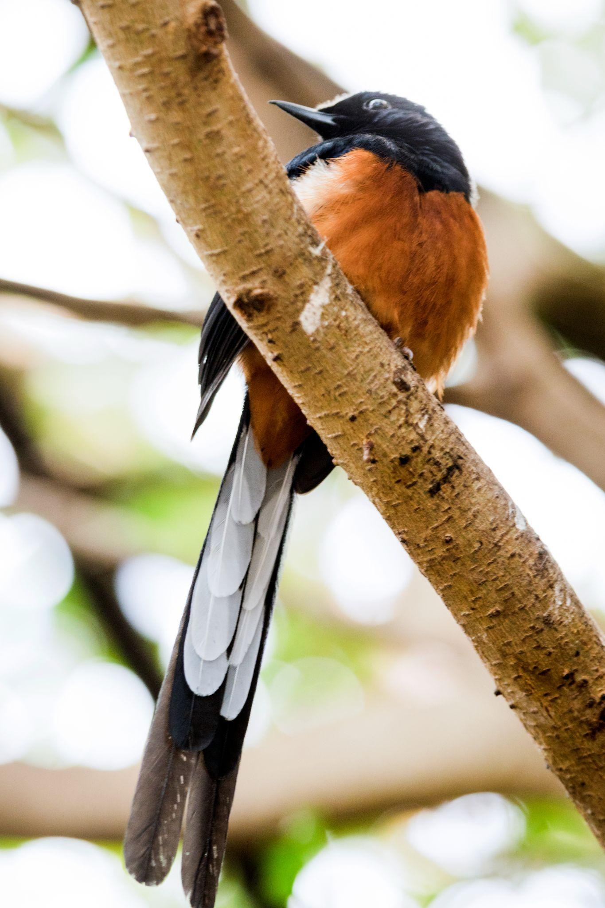
Anti-Overfitting Mechanisms
Dropout & batch normalisation in classifier
Progressive unfreezing (ULMFiT-inspired)
Early stopping based on validation loss
Structural + optimisation-based regularisation synergy
Notes:
To further control overfitting, I applied structural and optimisation-based regularisation. Dropout and batch normalisation enforced feature diversity. Progressive unfreezing, inspired by ULMFiT, slowly exposed deeper layers to training, this prevented the backbone from over-adapting too early. Finally, early stopping monitored validation loss to halt training before any performance degradation. Together, these formed a multi-layered defence against overfitting.

Slide 9
Results & Analysis
Model Phase | Train Acc | Val Acc | Key Insight
Head Only | 85.9% | 85.9% | Stable foundation
Fine-tuning | 94.5% | 87.2% | Good generalisation
Final | - | 88.1% | Top-5: 97.8%
Weighted: F1: 87.99%, Avg Per-Class: 87.89%
Consistent precision-recall balance
Notes:
The training progressed in two major phases: head training and fine-tuning. During head-only training, both training and validation accuracy converged around 85.9%, confirming stable learning. After fine-tuning, validation improved to 87.2%, with minimal overfitting. The final model achieved 88.1% Top-1 and 97.8% Top-5 accuracy. The small precision–recall gap indicates balanced performance across all 200 species, exactly what fine-grained classification needs.”

Slide 10
Code & Demonstration
Colab Notebook (Source Code)
HuggingFace Space (Web App)
Predict bird species from uploaded image
Real-time inference with EfficientNetV2-L
Notes:
All code and experiments were implemented in PyTorch via Google Colab. The trained model was then exported and deployed to Hugging Face Spaces. The web app allows users to upload an image of any bird and instantly receive predictions with confidence scores. This demonstrates not just model performance, but also how it can be deployed for real-world inference.”

Slide 11
Conclusion
EfficientNetV2-L + SAM + EMA + ArcFace → 88.1%
Demonstrated strong generalisation & stability
End-to-end ML pipeline: from experiment to deployment
Notes:
To summarise, this project delivered a stable and high-performing fine-grained image classifier using EfficientNetV2-L with modern optimisation and anti-overfitting methods. Through careful augmentation, layered fine-tuning, and loss design, the model achieved 88.1% accuracy demonstrating strong generalisation despite limited data. It’s also fully deployed on Hugging Face for public testing.

