Slide 1
COS30082 Applied Machine Learning
Bird Species Classification (CUB-200)
Prepared by: Deron Yijia FOO (102780757)
Prepared for: Ts Dr Lee Sue Han
Notes:
A very good morning to Dr. Lee. I’m Deron Foo, and this is my journey of developing a bird species classifier catering to the Caltech–UCSD Birds 200 dataset. Let’s begin.

Slide 2
Project Overview
01
02
03
04
Objective
Challenge
Generalised fine-grained image classification for 200 bird species
Limited data and high visual similarity between species → overfitting
Solution
Implementation
Transfer learning (EfficientNet) + anti-overfitting mechanisms
(SAM, EMA, ArcFace etc.)
Developed in PyTorch,
Deployed as HuggingFace
web application
Notes:
This project focuses on fine-grained image classification specifically, differentiating between 200 morphologically similar bird species. The CUB-200 dataset is especially challenging because of its small sample size and high inter-class similarity, which make overfitting a serious issue.
So, the key challenge here was achieving strong generalisation despite limited data.
To address this, I adopted transfer learning using EfficientNetV2-L, and enhanced it with several modern anti-overfitting techniques
For instance, (Sharpness-Aware Minimisation) SAM to seek flatter minima and more stable convergence, (Exponential Moving Average) EMA for weight smoothing, and ArcFace for discriminative feature embeddings.
The entire model was developed in PyTorch and finally deployed on Hugging Face as an interactive live web application.

Slide 3
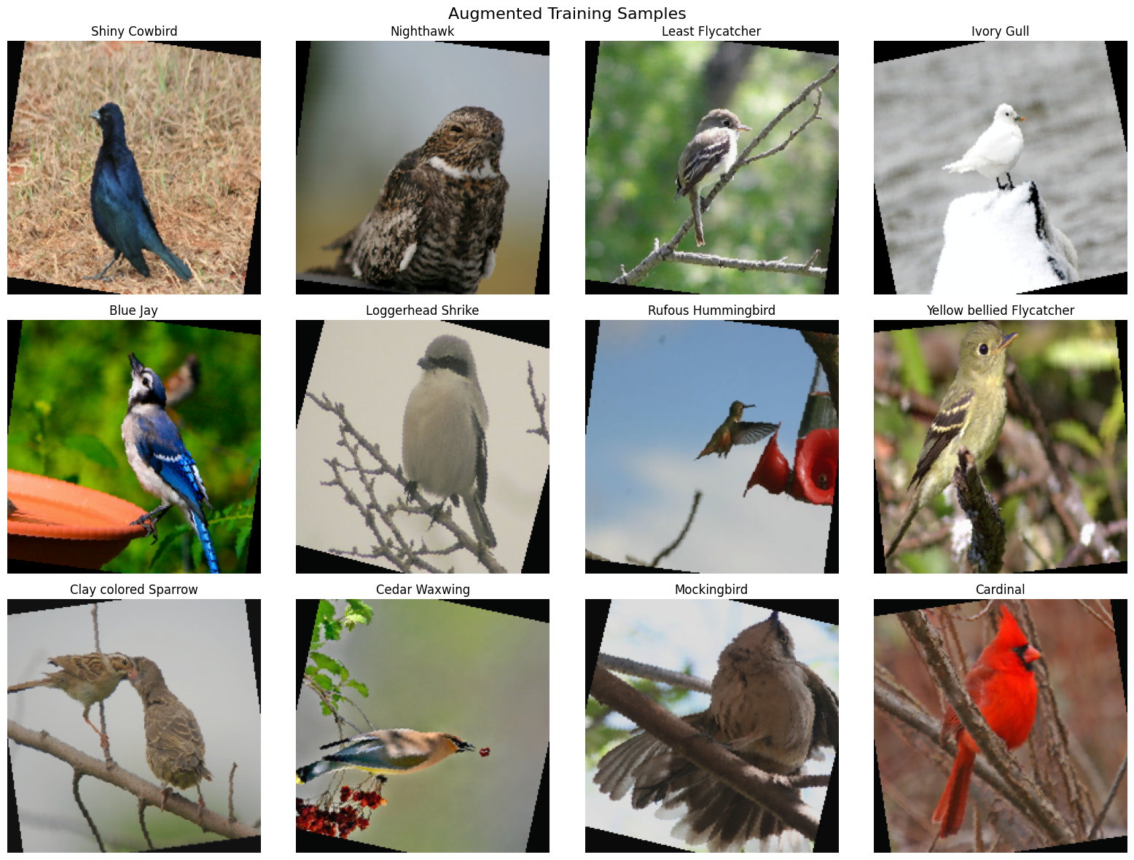
01
Data Preprocessing & Augmentation
Controlled, realism-preserving augmentations:
Random crop, horizontal flip, mild rotation, conservative colour jitter (❌cutout/hue shift)
Purpose: increase diversity, retain fine details
Normalisation: ImageNet mean/std
Seed fixation (42) for reproductivity
Resized 256x256 -> Cropped 224x224
Notes:
Since the dataset is both small and fine-grained, augmentation plays a key role in improving generalisation.
The pipeline starts [click] by resizing images to 256×256, then randomly cropping to 224×224, this introduces minor viewpoint variation while maintaining a consistent input size.
I also applied horizontal flips, ±15° mild rotations, and a 15% colour jitter to simulate realistic changes in orientation and environmental lighting.
These transformations were intentionally conservative: that is strong enough to add variety, but not so strong that they distort key patterns like feather texture or colour gradients.
Finally, all images were normalised with ImageNet statistics for compatibility with the pretrained Resnet/EfficientNet backbone, and random seeds were fixed to ensure reproducibility.

Slide 4
Experimental Progression
1) Baseline CNN (from scratch):
≈ Acc 42% (overfitted)
3) EfficientNetV2-L
(transfer + advanced strategies):
≈ Acc 88%
Balanced efficiency and regularisation;
strong fine-grained generalisation
2) ResNet50 (transfer learning):
≈ Acc 69% (overfitted)
heavy and prone to instability
Notes:
My journey started with a simple CNN trained from scratch, it learned basic textures but quickly overfitted, plateauing around 42% accuracy.
Then I moved to a pretrained ResNet50, which confirmed the value of transfer learning, improving performance to about 69%. However, it was computationally heavy and unstable on limited data, showing that bigger isn’t always better.
Finally, I adopted EfficientNetV2-L, which provides a stronger balance between capacity and regularisation. With advanved anti-overfitting strategies, it achieved 88% accuracy with robust generalisation.
The key takeaway therefore is model scaling with purpose works better than straight-off starting big.

Slide 5
Model Architecture
Backbone - EfficientNetV2-L (Pretrained on ImageNet)
Custom classifer head:
GlobalAveragePooling → Linear(embedding) →
BatchNorm → Dropout → Linear(200 classes)
Linear layer + Dropout + BatchNorm
Embedding for ArcFace margin
Progressive Fine-Tuning:
Train head → Gradual Unfreeze → Full fine-tune
Notes:
The core of my model is EfficientNetV2-L, chosen for its compound-scaling design as it balances model capacity and computational cost by optimising depth, width, and resolution altogether. Because it’s pretrained on ImageNet, it already captures rich visual hierarchies from basic edges to complex textures which transfer well to bird imagery.
I then replaced the original 1000-class layer with a custom classifier head consisting of a linear embedding, BatchNorm, Dropout, and a final 200-class output. The embedding layer feeds into ArcFace, enforcing angular margins so that bird species form tighter clusters and larger inter-class separation in feature space.
Moving on, training followed with a progressive unfreezing schedule: starting with the head only, then gradually unlocking deeper layers for fine-tuning. This approach allowed the network to adapt to the bird dataset without losing its pretrained general features avoiding catastrophic forgetting.
Altogether, this structure combines EfficientNetV2-L’s efficient representation power with a discriminative, stability-focused classifier design.

Slide 6
Core Concepts
EfficientNetV2-L: compound scaling → achieves high accuracy with fewer parameters
Transfer learning: reuse low/mid-level features → speeds up convergence
Fine-grained classification: subtle inter-class differences → sensitivity without overfitting
Overall Goal: stable, generalisable representations → balance precision and robustness
Notes:
To summarise the core concepts behind my approach:
EfficientNetV2-L uses compound scaling, it balances model depth, width, and input resolution to deliver strong accuracy with better computational efficiency.
Through transfer learning, the model reuses low- and mid-level features such as edges, textures, and colour gradients, so it only needs to learn the fine species-specific refinements.
In fine-grained classification tasks like bird identification, these subtle differences are critical, and feature reuse helps prevent overfitting while maintaining discriminative power.
Altogether, the aim is to build stable and generalisable feature representations, precise enough to distinguish 200 bird species, yet robust under limited data.

Slide 7
Training Strategy
Optimiser
EMA
Hybrid Loss
Sharpness-Aware Minimisation (SAM)
Searches for flatter minima in the loss landscape
Exponential Moving Average maintains a smoothed copy of weights over time
Label Smoothing Cross-Entropy (CE) prevents overconfidence and memorisation + ArcFace enforces class separation on hypersphere
Learning Rate
Differential LR
Warmup + cosine annealing decay for
gradual, stable convergence
Smaller for pretrained backbone, larger for classifier head
Notes:
To reiterate, my training pipeline integrates several modern optimisation and regularisation techniques designed to enhance stability and generalisation.
First, I used Sharpness-Aware Minimisation, or SAM, which doesn’t just minimise loss directly, it searches for flatter minima in the loss landscape. This makes the weights less sensitive to small perturbations, leading to better test performance.
Alongside that, an Exponential Moving Average (EMA) of the weights was maintained during training. This smoothed out noisy gradient updates and gave more consistent validation performance.
The loss function was a hybrid of Label-Smoothed Cross-Entropy, which discourages overconfidence, and ArcFace, which introduces an angular margin between classes. ArcFace forces embeddings of the same species to cluster tightly while pushing different species further apart, ideal for fine-grained classification.
Finally, the learning rate schedule combined a warm-up phase followed by cosine annealing decay for smooth convergence. I also applied differential learning rates that is smaller LR for the pretrained backbone and larger for the newly added classifier head ensuring efficient adaptation without destabilising pretrained features.
Put everything together, this training scheme worked cohesively to produce a stable, well-generalised model even with limited data.

Slide 8

Anti-Overfitting Mechanisms
Dropout & batch normalisation in classifier
Progressive unfreezing - gradually unlocks deeper layers from the backbone
Early stopping based on validation loss
Structural + optimisation-based (SAM, EMA, Label Smoothing) regularisation synergy
Notes:
To clarify once more how I manage overfitting, I combined both structural and optimisation-based regularisation.
Within the classifier head, Dropout randomly deactivates neurons to prevent co-adaptation, while Batch Normalisation keeps activations stable and supports smoother gradients.
I also implemented progressive unfreezing, where deeper layers of EfficientNetV2 were gradually made trainable. This allowed controlled adaptation, preserving the backbone’s general features early on while fine-tuning the later layers once the classifier had stabilised.
Early stopping monitored validation loss, halting training before any degradation in generalisation could occur.
To sum up, these mechanisms when combined with SAM, EMA, and Label Smoothing, formed a multi-layered defence against overfitting, both structurally and algorithmically.

Slide 9
Results & Analysis
Model Phase | Train Acc (%) | Val Acc (%) | Key Insight
Head Only Training | 85.9 | 85.9 | Stable foundation
Progressivefine-tuning | 94.5 | 87.2 | Improved Adaptation
Final (SWA + EMA) | - | 88.1 | Weight averaging
Weighted F1-Score: 87.99%,
Average Per-Class Accuracy: 87.89%
Precision–Recall balance:
Consistent across 200 species
Notes:
Now let’s take a look at the results of the training and analyse a bit.
During the head-only training phase, both training and validation accuracy stabilised around 85.%, confirming that the pretrained backbone provided a strong and transferable feature base.
After progressive fine-tuning, where deeper layers were gradually unfrozen, the validation accuracy improved to about 87.2%, showing effective adaptation with minimal overfitting.
In the final stage, I merged SWA and EMA weight averages to further smooth optimisation noise, which slightly boosted generalisation giving 88.1% Top-1 and 97.8% Top-5 accuracy.
The small gap between precision and recall, along with an average per-class accuracy of 87.9%, indicates consistently balanced predictions across all 200 bird species, exactly what fine-grained classification requires.

Slide 10
Code & Demonstration
Colab Notebook (Source Code)
HuggingFace Space (Web App)
Github Repository
Notes:
Before concluding, here are the URLs to the key resources for my project.
I’ll now switch over to Colab to briefly walk through the main training codes.

