Slide 1
Journey of code
Architecture of frontend deployment

Slide 2
Name Pattern
Environment
Usage
name new project
Development
name new page
full compile
Test
fast compile
sync path
Production
page url path

Slide 3
Name Pattern 1.0
NAME | project | compile command | src folder | CDN folder
wap | invest | build:wap | apps/wap | /static/wap
mall | p2p | build:mall | apps/mall | /static/wap
command pattern | npm run gulp [project name]:[compile type]:[page name]:[action]
example production | npm run gulp mall:pack:home:revision
example dev | npm run gulp mall:home:watch

Slide 4
Name Pattern 2.0
NAME | project | compile command | src folder | CDN folder
invest | invest | build:wap | apps/wap/invest | /static/wap
p2p | p2p | build:wap | apps/wap/p2p | /static/wap
wap | wap | build:wap | apps/wap | /static/wap
loan | loan | build:loan | apps/loan | /static/loan
activity | activity | build:activity | apps/activity | /static/activity
command pattern | npm run gulp [project name]:[compile type]:[page name]:[action]
example production | npm run gulp loan:pack:p2p:revision
example dev | npm run gulp loan:p2p:watch

Slide 5
Name Pattern 3.0
NAME | cluster | project | compile command | src folder | CDN folder
invest | wap | invest | build:wap | apps/wap/invest | /static/wap/invest
p2p | wap | p2p | build:wap | apps/wap/p2p | /static/wap/p2p
activity | activity |  | build:activity | apps/activity | /static/activity
manager | jrgc | manager | build:jrgc:manager | apps/jrgc/manager | /static/jrgc/manager
insurance | jrgc | insurance | build:jrgc:insurance | apps/jrgc/insurance | /static/jrgc/insurance
cash |  | cash | build:cash | apps/cash | /static/cash
command pattern | npm run gulp [cluster name]:[project name]:[action]
example production | npm run gulp jrgc:manager:pack
example dev | npm start manager

Slide 6
Compare Name patterns
简单
易用
better
规范
扩展性
易用
good

Slide 7
Deployed by who?
Coding
write locally
with debug
Gitlab
synchronous
event trigger
Jenkins
event driven
auto build

Slide 8


When will be triggered?
push
merge
commit
trigger a event
anything changed in
Gitlab
trigger a event
(AKA webhook)
Jenkins

Slide 9

Who is listening the event?
triggered by Gitlab
triggered by hand
Jenkins
start a Pipeline
compile source code
publish production code

Slide 10
What Jenkins do when triggered?
generate command
check diff
compile
publish
DONE
fetch special branch
nothing change
check diff
finished
fetch special branch
DONE

Slide 11
How Jenkins handle A trigger?
Gitlab triggered a push event from THE repo
then
Jenkins start all jobs connected with THE repo
Event: we change some code of project: activity
Wap
fetch master branch
check diff
Activity
fetch master branch
check diff
Manager
fetch master branch
check diff
no diff finished
generate command
no diff finished
Cash
fetch master branch
check diff
no diff finished
compile
publish

Slide 12






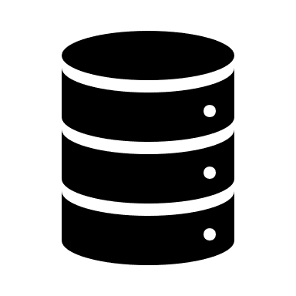




Overall
Gitlab repo
published
fast compile
git push
Jenkins
trigger
all compile task
compile success
synchronous
typing typing typing
check diff
debug
typing typing typing
full compile
commit
fix fix fix
no change
compile fail
Internal net

Slide 13








