Slide 2
Chapter Topics
Chapter 10 discusses the following main topics:
  What Is Inheritance?
  Calling the Superclass Constructor
  Overriding Superclass Methods
  Protected Members
  Chains of Inheritance
  The Object Class
  Polymorphism
  Abstract Classes and Abstract Methods
  Interfaces
  Anonymous Classes
  Functional Interfaces and Lambda Expressions
10-<number>

Slide 3
Data types
So far you have been using data types such as char, int and double.
These are simple data types that hold a single piece of information.
But what if we want a variable to hold more than one related piece of information?
Think for example of a book—a book might have a title, an author, an ISBN number and a price

Slide 4
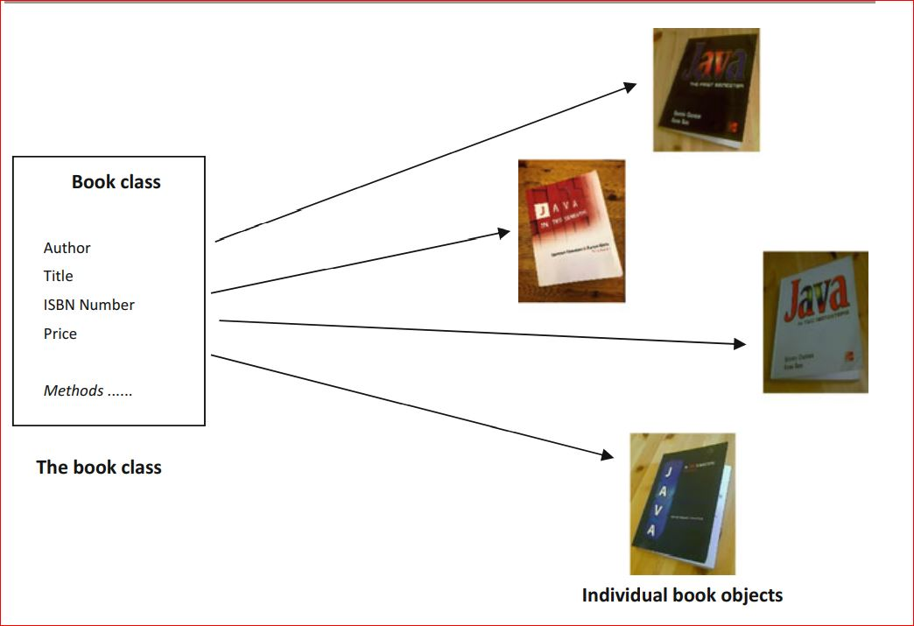

Slide 5
Data types
Student might have a name, an enrolment number and marks for various subjects
Types such as char and int ?
Can these be used
Why ? Yes or No
What about arrays ? Why not use them
Earlier languages such as C and Pascal use structure and record.
Notes:
can hold a single piece of information only, and would therefore be completely inadequate for holding all the necessary information about a book or a student

Slide 6
Object Oriented Languages
Object-oriented languages such as Java and C++ came to
They enabled us not only to create types that stored many pieces of data, but also to define within these types the methods by which we could process that data

Slide 7
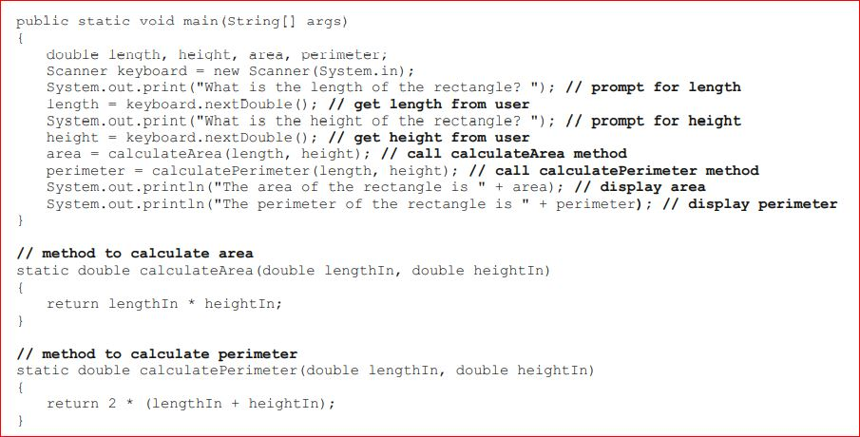
Rectangle class

Slide 8
Rectangle class
Can you see how useful it might be if, each time we wrote a program dealing with rectangles, instead of having to declare several variables and write methods to calculate the area and perimeter of a rectangle, we could just use a rectangle ‘type’ to create a single variable, and then use its pre-written methods
In fact you wouldn’t even have to know how these calculations were performed

Slide 9
Classes
This is exactly what an object-oriented language like Java allows us to do.
This is exactly what an object-oriented language like Java allows us to do.
You can see that there are two aspects to a class:
the data that it holds;
the tasks it can perform.

Slide 10
Objects
In order to use the methods of a class you need to create an object of that class.
To understand the difference between classes and objects, you can think of a class as a blueprint, or template, from which objects are generated, whereas an object refers to an individual instance of that class.

Slide 11
Objects
For example, imagine a system that is used by a bookshop. The shop will contain many hundreds of books—but we do not need to define a book hundreds of times.
We would define a book once (in a class) and then generate as many objects as we want from this blueprint, each one representing an individual book.

Slide 12
What is Inheritance?
Generalization vs. Specialization
Real-life objects are typically specialized versions of other more general objects.
The term “insect” describes a very general type of creature with numerous characteristics.
Grasshoppers and bumblebees are insects
  They share the general characteristics of an insect.
  However, they have special characteristics of their own.
    grasshoppers have a jumping ability, and
    bumblebees have a stinger.
Grasshoppers and bumblebees are specialized versions of an insect.
10-<number>

Slide 13
Inheritance
Insect
Contains those attributes and methods that are shared by all insects.
BumbleBee
Grasshopper
Contains those attributes and methods that specific to a Bumble Bee.
Contains those attributes and methods that are specific to a Grasshopper.
10-<number>

Slide 14
The “is a” Relationship
The relationship between a superclass and an inherited class is called an “is a” relationship.
  A grasshopper “is a” insect.
  A poodle “is a” dog.
  A car “is a” vehicle.
A specialized object has:
  all of the characteristics of the general object, plus
  additional characteristics that make it special.
In object-oriented programming, inheritance is used to create an “is a” relationship among classes.
10-<number>

Slide 15
The “is a” Relationship
We can extend the capabilities of a class.
Inheritance involves a superclass and a subclass.
  The superclass is the general class and
  the subclass is the specialized class.
The subclass is based on, or extended from, the superclass.
  Superclasses are also called base classes, and
  subclasses are also called derived classes.
The relationship of classes can be thought of as parent classes and child classes.
10-<number>

Slide 16
Inheritance
The subclass inherits fields and methods from the superclass without any of them being rewritten.
New fields and methods may be added to the subclass.
The Java keyword, extends, is used on the class header to define the subclass.
  public class FinalExam extends GradedActivity
10-<number>

Slide 17
The GradedActivity Example
GradedActivity
Contains those attributes and methods that are shared by all graded activities.
- score : double
+ setScore(s : double) : void
+ getScore() : double
+ getGrade() : char
Contains those attributes and methods that are specific to the FinalExam class.
Inherits all non-private attributes and methods from the GradedActivity class.
FinaExam
- numQuestions : int
- pointsEach : double
- numMissed : int
Example:
  GradedActivity.java,
  GradeDemo.java,
  FinalExam.java,
  FinalExamDemo.java
+ FinalExam(questions : int,
missed : int)
+ getPointsEach() : double
+ getNumMissed() : int
10-<number>

Slide 18
Inheritance, Fields and Methods
Members of the superclass that are marked private:
  are not inherited by the subclass,
  exist in memory when the object of the subclass is created
  may only be accessed from the subclass by public methods of the superclass.
Members of the superclass that are marked public:
  are inherited by the subclass, and
  may be directly accessed from the subclass.
10-<number>

Slide 19
Inheritance, Fields and Methods
When an instance of the subclass is created, the non-private methods of the superclass are available through the subclass object.
  FinalExam exam = new FinalExam();
  exam.setScore(85.0);
  System.out.println("Score = "
  + exam.getScore());
Non-private methods and fields of the superclass are available in the subclass.
  setScore(newScore);
10-<number>

Slide 20
Inheritance and Constructors
Constructors are not inherited.
When a subclass is instantiated, the superclass default constructor is executed first.
Example:
  SuperClass1.java
  SubClass1.java
  ConstructorDemo1.java
10-<number>

Slide 21
The Superclass’s Constructor
The super keyword refers to an object’s superclass.
The superclass constructor can be explicitly called from the subclass by using the super keyword.
Example:
  SuperClass2.java, SubClass2.java, ConstructorDemo2.java
  Rectangle.java, Cube.java, CubeDemo.java
10-<number>

Slide 22
Calling The Superclass Constructor
If a parameterized constructor is defined in the superclass,
  the superclass must provide a no-arg constructor, or
    subclasses must provide a constructor, and
    subclasses must call a superclass constructor.
Calls to a superclass constructor must be the first java statement in the subclass constructors.
10-<number>

Slide 23
Overriding Superclass Methods
A subclass may have a method with the same signature as a superclass method.
The subclass method overrides the superclass method.
This is known as method overriding.
Example:
  GradedActivity.java, CurvedActivity.java, CurvedActivityDemo.java
10-<number>

Slide 24
Overriding Superclass Methods
GradedActivity
- score : double
+ setScore(s : double) : void
+ getScore() : double
+ getGrade() : char
This method is a more specialized version of the setScore method in the superclass, GradedActivity.
CurvedActivity
- rawScore : double
- percentage : double
+ CurvedActivity
(percent : double)
+ setScore(s : double) : void
+ getRawScore() : double
+ getPercentage() : double
10-<number>

Slide 25
Overriding Superclass Methods
Recall that a method’s signature consists of:
  the method’s name
  the data types method’s parameters in the order that they appear.
A subclass method that overrides a superclass method must have the same signature as the superclass method.
An object of the subclass invokes the subclass’s version of the method, not the superclass’s.
The @Override annotation should be used just before the subclass method declaration.
  This causes the compiler to display a error message if the method fails to correctly override a method in the superclass.
10-<number>

Slide 26
Overriding Superclass Methods
An subclass method can call the overridden superclass method via the super keyword.
  super.setScore(rawScore * percentage);
There is a distinction between overloading a method and overriding a method.
Overloading is when a method has the same name as one or more other methods, but with a different signature.
When a method overrides another method, however, they both have the same signature.
10-<number>

Slide 27
Overriding Superclass Methods
Both overloading and overriding can take place in an inheritance relationship.
Overriding can only take place in an inheritance relationship.
Example:
  SuperClass3.java,
  SubClass3.java,
  ShowValueDemo.java
10-<number>

Slide 28
Preventing a Method from Being Overridden
The final modifier will prevent the overriding of a superclass method in a subclass.
  public final void message()
If a subclass attempts to override a final method, the compiler generates an error.
This ensures that a particular superclass method is used by subclasses rather than a modified version of it.
10-<number>

Slide 29
Protected Members
Protected members of class:
  may be accessed by methods in a subclass, and
  by methods in the same package as the class.
Java provides a third access specification, protected.
A protected member’s access is somewhere between private and public.
Example:
  GradedActivity2.java
  FinalExam2.java
  ProtectedDemo.java
10-<number>

Slide 30
Protected Members
Using protected instead of private makes some tasks easier.
However, any class that is derived from the class, or is in the same package, has unrestricted access to the protected member.
It is always better to make all fields private and then provide public methods for accessing those fields.
If no access specifier for a class member is provided, the class member is given package access by default.
Any method in the same package may access the member.
10-<number>

Slide 31
Access Specifiers
Access Modifier | Accessible to a subclass inside the same package? | Accessible to all other classes inside the same package?
default (no modifier) | Yes | Yes
Public | Yes | Yes
Protected | Yes | Yes
Private | No | No
Access Modifier | Accessible to a subclass outside the package? | Accessible to all other classes outside the package?
default (no modifier) | No | No
Public | Yes | Yes
Protected | Yes | No
Private | No | No
10-<number>

Slide 32
Chains of Inheritance
A superclass can also be derived from another class.
Object
Example:
GradedActivity.java
PassFailActivity.java
PassFailExam.java
PassFailExamDemo.java
GradedActivity
PassFailActivity
PassFailExam
10-<number>

Slide 33
Chains of Inheritance
Classes often are depicted graphically in a class hierarchy.
A class hierarchy shows the inheritance relationships between classes.
GradedActivity
FinalExam
PassFailActivity
PassFailExam
10-<number>

Slide 34
The Object Class
All Java classes are directly or indirectly derived from a class named Object.
Object is in the java.lang package.
Any class that does not specify the extends keyword is automatically derived from the Object class.
  public class MyClass
  {
    // This class is derived from Object.
  }
Ultimately, every class is derived from the Object class.
10-<number>

Slide 35
The Object Class
Because every class is directly or indirectly derived from the Object class:
  every class inherits the Object class’s members.
    example: toString and equals.
In the Object class, the toString method returns a string containing the object’s class name and a hash of its memory address.
The equals method accepts the address of an object as its argument and returns true if it is the same as the calling object’s address.
Example: ObjectMethods.java
10-<number>

Slide 36
Polymorphism
A reference variable can reference objects of classes that are derived from the variable’s class.
  GradedActivity exam;
We can use the exam variable to reference a GradedActivity object.
  exam = new GradedActivity();
The GradedActivity class is also used as the superclass for the FinalExam class.
An object of the FinalExam class is a GradedActivity object.
10-<number>

Slide 37
Polymorphism
A GradedActivity variable can be used to reference a FinalExam object.
  GradedActivity exam = new FinalExam(50, 7);
This statement creates a FinalExam object and stores the object’s address in the exam variable.
This is an example of polymorphism.
The term polymorphism means the ability to take many forms.
In Java, a reference variable is polymorphic because it can reference objects of types different from its own, as long as those types are subclasses of its type.
10-<number>

Slide 38
Polymorphism
Other legal polymorphic references:
  GradedActivity exam1 = new FinalExam(50, 7);
  GradedActivity exam2 = new PassFailActivity(70);
  GradedActivity exam3 = new PassFailExam(100, 10, 70);
The GradedActivity class has three methods: setScore, getScore, and getGrade.
A GradedActivity variable can be used to call only those three methods.
  GradedActivity exam = new PassFailExam(100, 10, 70);
  System.out.println(exam.getScore()); // This works.
  System.out.println(exam.getGrade()); // This works.
  System.out.println(exam.getPointsEach()); // ERROR!
10-<number>

Slide 39
Polymorphism and Dynamic Binding
If the object of the subclass has overridden a method in the superclass:
  If the variable makes a call to that method the subclass’s version of the method will be run.
  GradedActivity exam = new PassFailActivity(60);
  exam.setScore(70);
  System.out.println(exam.getGrade());
Java performs dynamic binding or late binding when a variable contains a polymorphic reference.
The Java Virtual Machine determines at runtime which method to call, depending on the type of object that the variable references.
10-<number>

Slide 40
Polymorphism
It is the object’s type, rather than the reference type, that determines which method is called.
Example:
  Polymorphic.java
You cannot assign a superclass object to a subclass reference variable.
10-<number>

Slide 41
Abstract Classes
An abstract class cannot be instantiated, but other classes are derived from it.
An Abstract class serves as a superclass for other classes.
The abstract class represents the generic or abstract form of all the classes that are derived from it.
A class becomes abstract when you place the abstract key word in the class definition.
  public abstract class ClassName
10-<number>

Slide 42
Abstract Methods
An abstract method has no body and must be overridden in a subclass.
An abstract method is a method that appears in a superclass, but expects to be overridden in a subclass.
An abstract method has only a header and no body.
  AccessSpecifier abstract ReturnType MethodName(ParameterList);
Example:
  Student.java, CompSciStudent.java, CompSciStudentDemo.java
10-<number>

Slide 43
Abstract Methods
Notice that the key word abstract appears in the header, and that the header ends with a semicolon.
  public abstract void setValue(int value);
Any class that contains an abstract method is automatically abstract.
If a subclass fails to override an abstract method, a compiler error will result.
Abstract methods are used to ensure that a subclass implements the method.
10-<number>

Slide 44
Interfaces
An interface is similar to an abstract class that has all abstract methods.
  It cannot be instantiated, and
  all of the methods listed in an interface must be written elsewhere.
The purpose of an interface is to specify behavior for other classes.
It is often said that an interface is like a “contract,” and when a class implements an interface it must adhere to the contract.
An interface looks similar to a class, except:
  the keyword interface is used instead of the keyword class, and
  the methods that are specified in an interface have no bodies, only headers that are terminated by semicolons.
10-<number>

Slide 45
Interfaces
The general format of an interface definition:
  public interface InterfaceName
  {
  (Method headers...)
  }
All methods specified by an interface are public by default.
A class can implement one or more interfaces.
10-<number>

Slide 46
Interfaces
If a class implements an interface, it uses the implements keyword in the class header.
  public class FinalExam3 extends GradedActivity implements Relatable
Example:
  GradedActivity.java
  Relatable.java
  FinalExam3.java
  InterfaceDemo.java
10-<number>

Slide 47
Fields in Interfaces
An interface can contain field declarations:
  all fields in an interface are treated as final and static.
Because they automatically become final, you must provide an initialization value.
  public interface Doable
  {
  int FIELD1 = 1, FIELD2 = 2;
  (Method headers...)
  }
In this interface, FIELD1 and FIELD2 are final static int variables.
Any class that implements this interface has access to these variables.
10-<number>

Slide 48
Implementing Multiple Interfaces
A class can be derived from only one superclass.
Java allows a class to implement multiple interfaces.
When a class implements multiple interfaces, it must provide the methods specified by all of them.
To specify multiple interfaces in a class definition, simply list the names of the interfaces, separated by commas, after the implements key word.
  public class MyClass implements Interface1,
  Interface2,
  Interface3
10-<number>

Slide 49
Interfaces in UML
GradedActivity
A dashed line with an arrow indicates implementation of an interface.
FinalExam3
Relatable
10-<number>

Slide 50
Polymorphism with Interfaces
Java allows you to create reference variables of an interface type.
An interface reference variable can reference any object that implements that interface, regardless of its class type.
This is another example of polymorphism.
Example:
  RetailItem.java
  CompactDisc.java
  DvdMovie.java
  PolymorphicInterfaceDemo.java
10-<number>

Slide 51
Polymorphism with Interfaces
In the example code, two RetailItem reference variables, item1 and item2, are declared.
The item1 variable references a CompactDisc object and the item2 variable references a DvdMovie object.
When a class implements an interface, an inheritance relationship known as interface inheritance is established.
  a CompactDisc object is a RetailItem, and
  a DvdMovie object is a RetailItem.
10-<number>

Slide 52
Polymorphism with Interfaces
A reference to an interface can point to any class that implements that interface.
You cannot create an instance of an interface.
  RetailItem item = new RetailItem(); // ERROR!
When an interface variable references an object:
  only the methods declared in the interface are available,
  explicit type casting is required to access the other methods of an object referenced by an interface reference.
10-<number>

Slide 53
Default Methods
Beginning in Java 8, interfaces may have default methods.
A default method is an interface method that has a body.
You can add new methods to an existing interface without causing errors in the classes that already implement the interface.
Example:
  Displayable.java
  Person.java
  InterfaceDemoDefaultMethod.java

Slide 54
Anonymous Inner Classes
An inner class is a class that is defined inside another class.
An anonymous inner class is an inner class that has no name.
An anonymous inner class must implement an interface, or extend another class.
Useful when you need a class that is simple, and to be instantiated only once in your code.
Example:
  IntCalculator.java
  AnonymousClassDemo.java

Slide 55
Functional Interfaces and Lambda Expressions
A functional interface is an interface that has one abstract method.
A lambda expression can be used to create an object that implements the interface, and overrides its abstract method.
In Java 8, these features work together to simplify code, particularly in situations where you might use anonymous inner classes.
Example:
  LambdaDemo.java
  LambdaDemo2.java

