Slide 1

PandemicPulse Mini Project 3 Derrick T USN : 21BTRCL036

Slide 2
Introduction
PandemicPulse
This project involves analyzing the global spread of COVID-19 using the dataset provided.
Dataset Link : https://raw.githubusercontent.com/datasets/covid-19/main/data/countries-aggregated.csv
Amidst the global challenges posed by COVID-19, understanding its impact through data-driven analysis is crucial.
This presentation delves into the trends, impacts, and responses to COVID-19 across regions and demographics.
Exploring the evolving dynamics of confirmed cases, mortality rates, and healthcare responses provides insights into navigating this unprecedented health crisis."

Slide 3
Approach
Analysis and Arriving at Conclusions
Load and Pre-process the Dataset
Data Exploration and Cleaning
Visualize Global Trends
Country-Specific Analysis
Comparative Analysis
Correlation Analysis

Slide 4
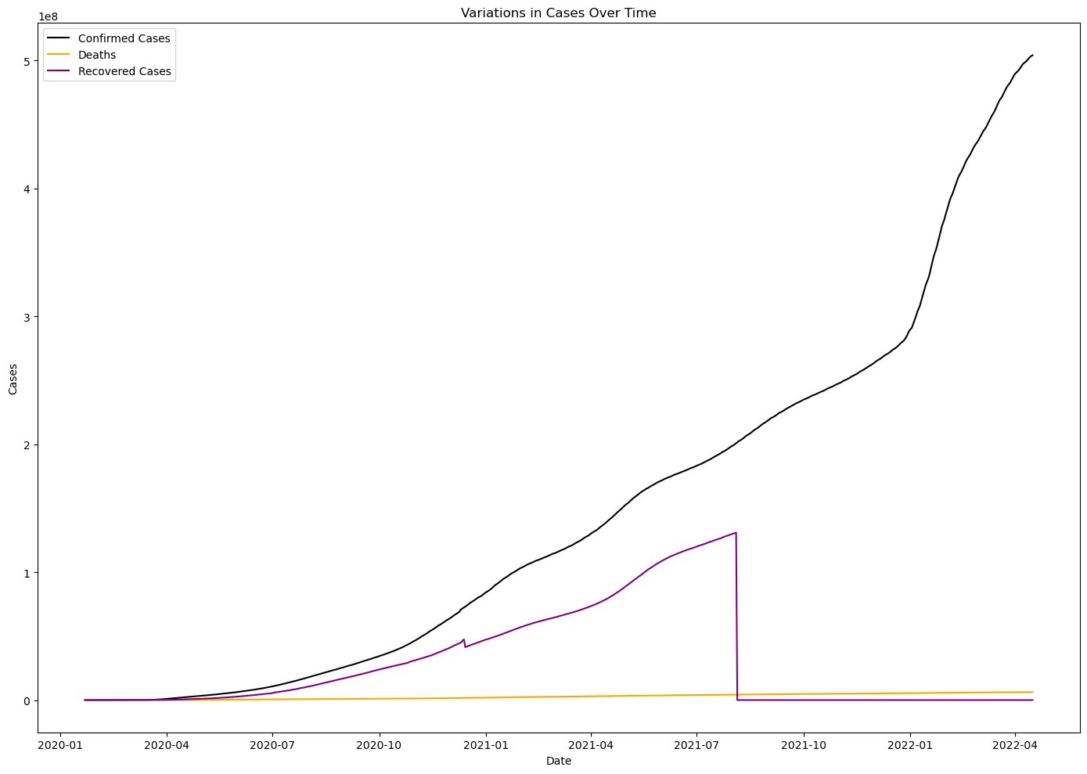
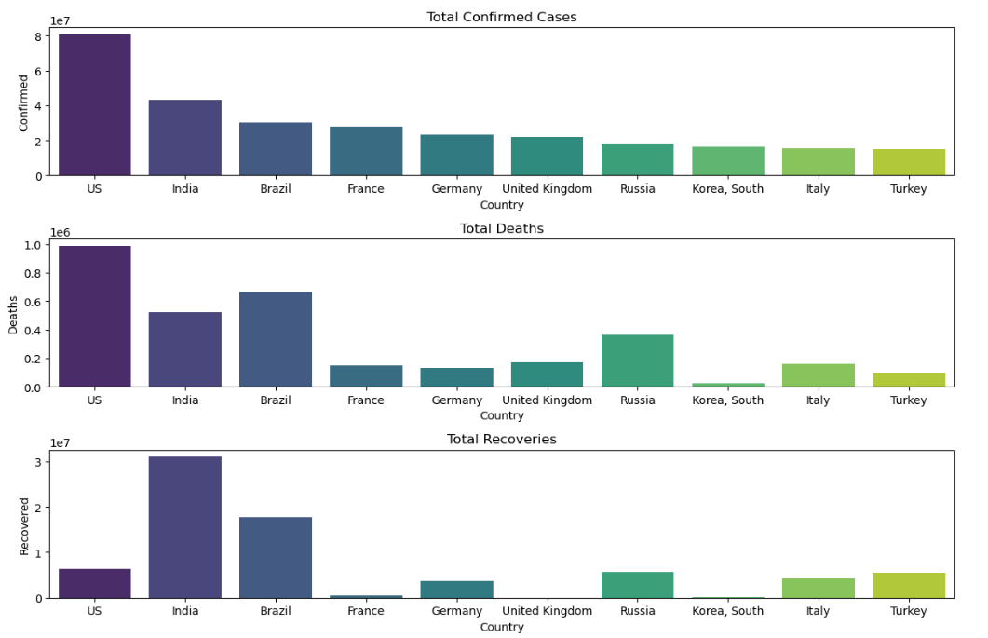
Insights
Trends and variations over time globally

Slide 5
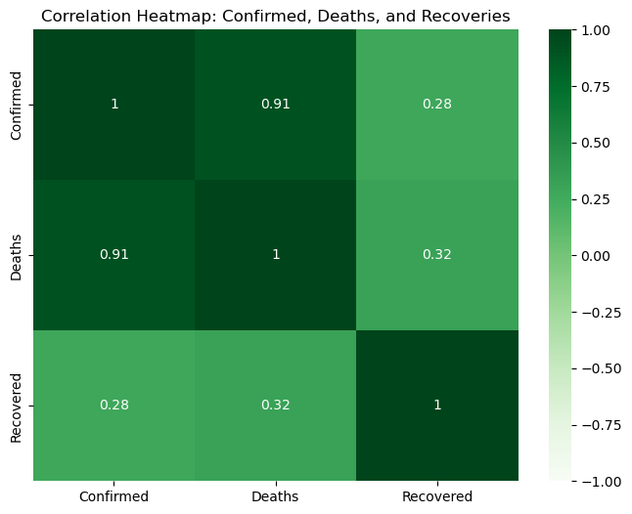
Correlation Analysis
Recovered Cases, Confirmed Cases, Deaths

Slide 6
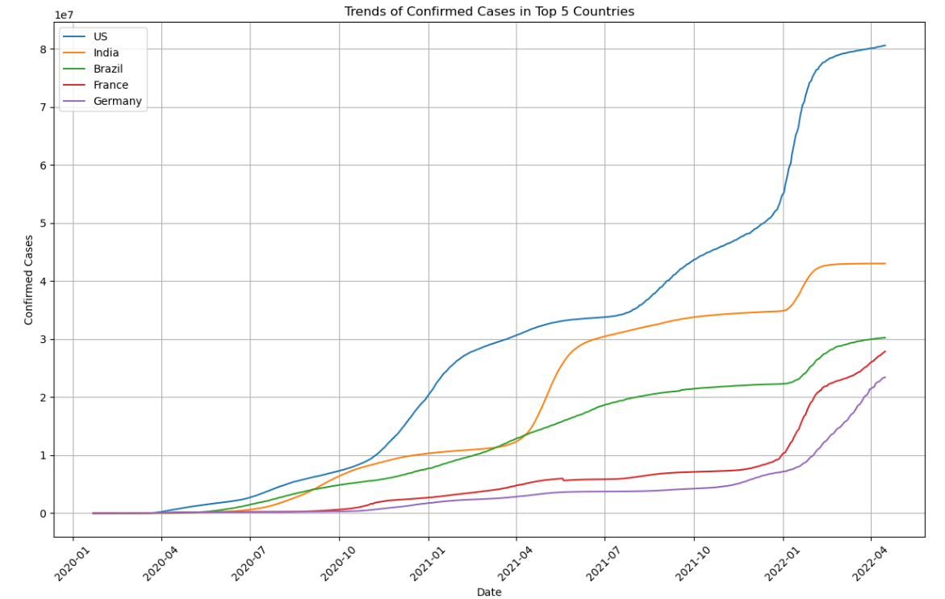
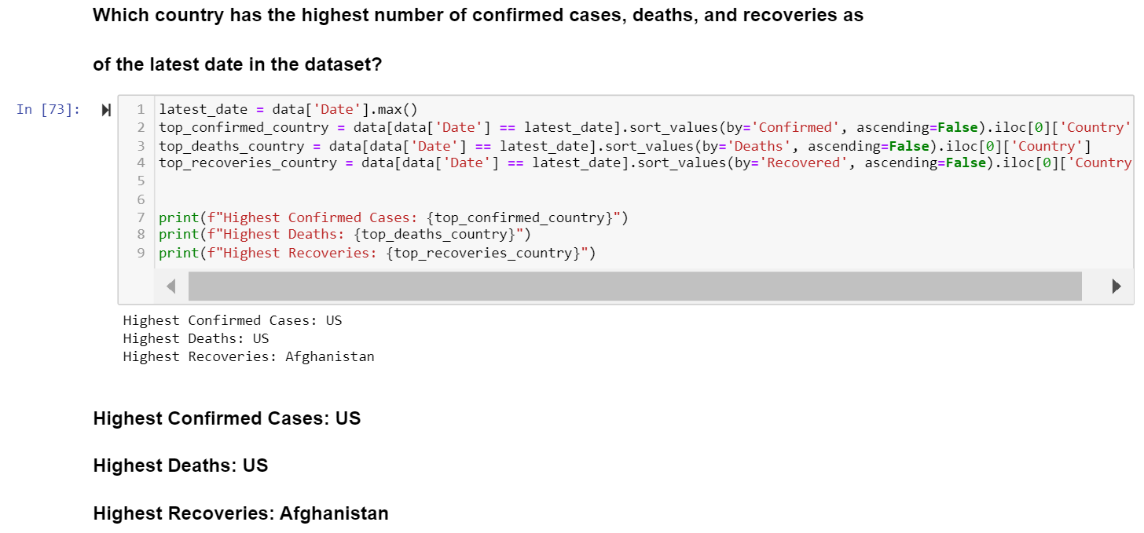
Highest number of confirmed cases , recovered and deaths:

