Slide 1

By: Patrick Moran
Gerard Naughton
Andrei Petruk
Supervisor: Daniel Cregg
Notes:
1. Cover Slide: title of project, names of student(s) and supervisor(2).
2. Introduction: set the context for the project.
3. Objectives: list the set of planned outcomes.
4. Architecture/Technologies: planned technical solution.
5. Project Plan: work units and deliverables to ensure completion of project for April deadline (software + documentation).

Slide 2
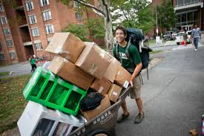
Introduction
Student Accommodation App
Helping Students find Accomodation and Roommates
Allowing Letters to advertise properties
Created by Students for Students
Notes:
2. Introduction: set the context for the project

Slide 3

Objectives
Users can sign in to the app with a username and password or with their Facebook/Twitter
Upload information about available accommodations
Search for specified house or location
Message Board
Notes:
3. Objectives: list the set of planned outcomes.

Slide 4

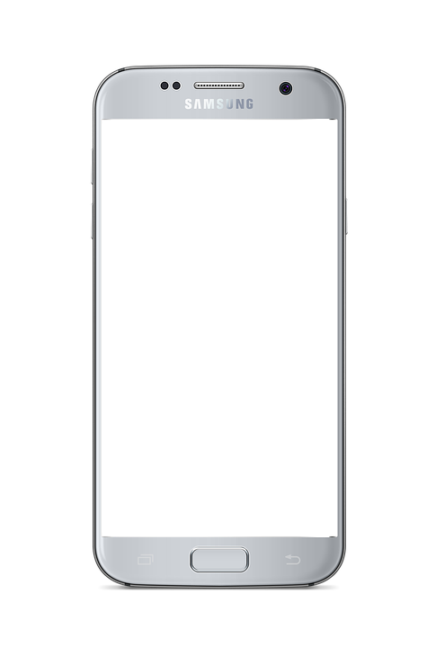





Architecture/Technologies
Logic Tier
Presentation Tier
Data Tier

Slide 5

GitHub Agile Weekly meetings
Project Plan
09/2017
6/11/2017
12/2017
Read me
Hosting
03/2018
Submission
04/2018
Viva Voce Examination
Seminar Presentation
Github set up
Functional framework
Testing
16/04/2018
Report / Dissertation
Architecture Research

