Slide 1

By: Patrick Moran
Gerard Naughton
Andrei Petruk
Supervisor: Daniel Cregg
Notes:
This is a small presentation of my 4th final year project called Digs.
As you can see from the logo related to accommodations.
This is a group project and I work on it with another two great students Patrick and Gerard and Daniel Creagg

Slide 2
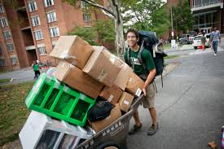
Introduction
Student Accommodation App
Helping Students find Accommodation and Roommates
Allowing Letters to advertise properties
Created by Students for Students
Notes:
You probably aware of the current situation on accommodation market and the difficulties students face when looking for a room in Galway. For this reason, we come up with the idea to create digs Student Accommodation App.
Helping Students find Accommodation and Roommates
Allowing Letters to advertise properties
Created by Students for Students

Slide 3

Objectives
Users can sign in to the app with a username and password or with their Facebook/Twitter
Upload information about available accommodations
Search for specified house or location
Message Board
Notes:
As well, we would like to implement functionality for users to interact with each other using the Message Board.

Slide 4

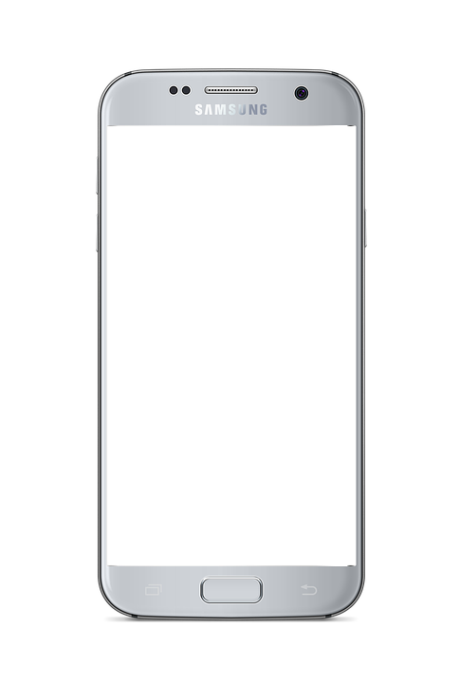



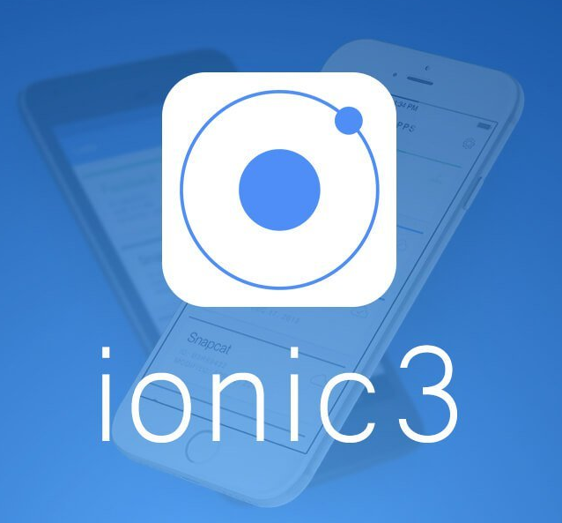

Architecture/Technologies
Logic Tier
Presentation Tier
Data Tier
Notes:
This is three-tier architecture used in our project. There is a lot of serverless solutions available these days but the three-tier architecture was required to showcase our abilities. The logic tier presented by NodeJS wich responsible for the connection between Ionic Interface and Mongo database.

Slide 5
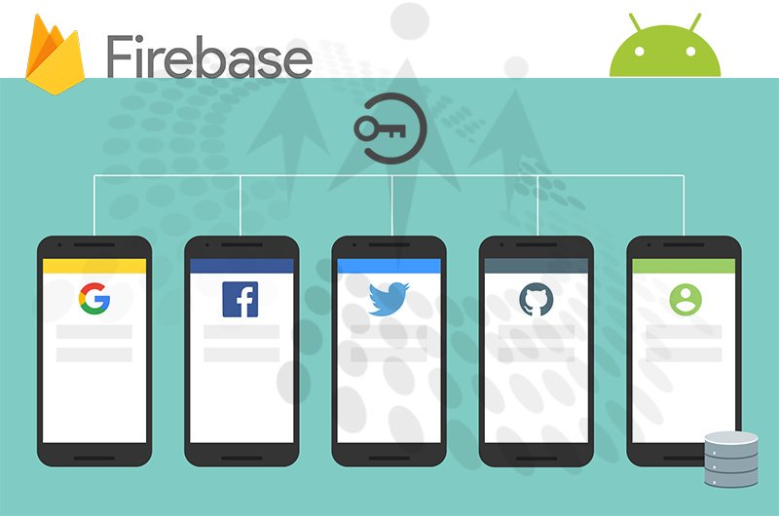
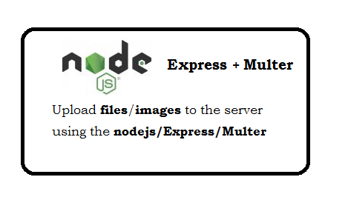
Architecture/Technologies
Login Functionality
Multer plugin
Notes:
Multer plugin used for uploading and store files in MangoDB.

Slide 6
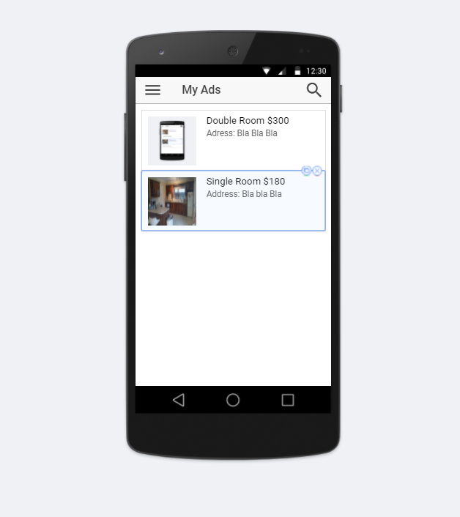
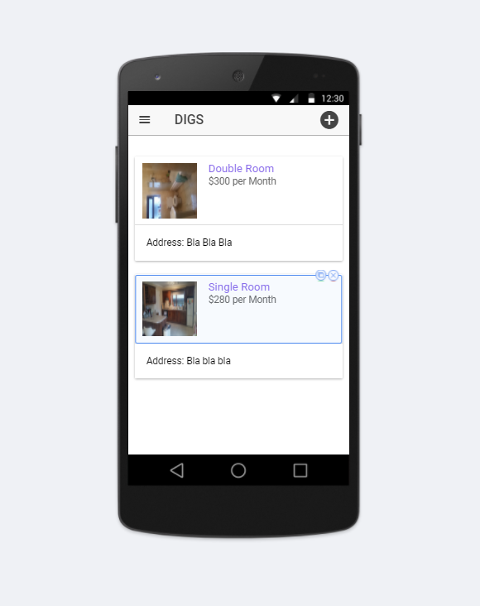
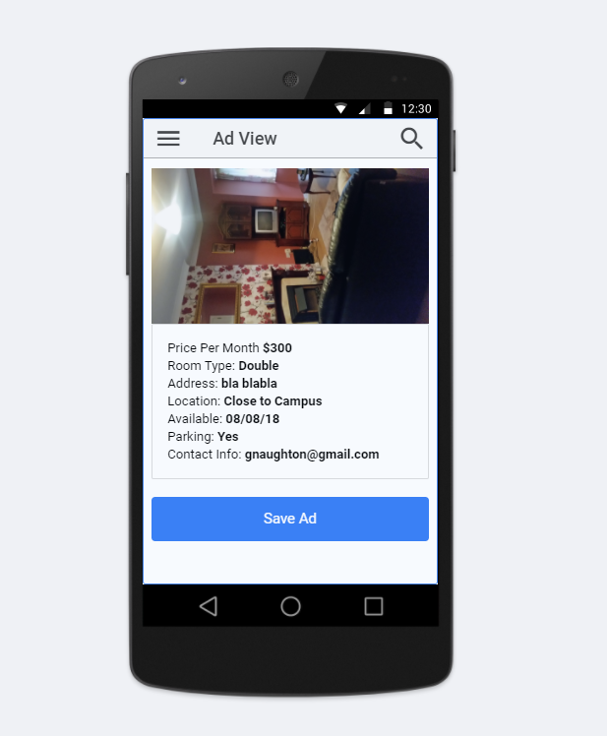
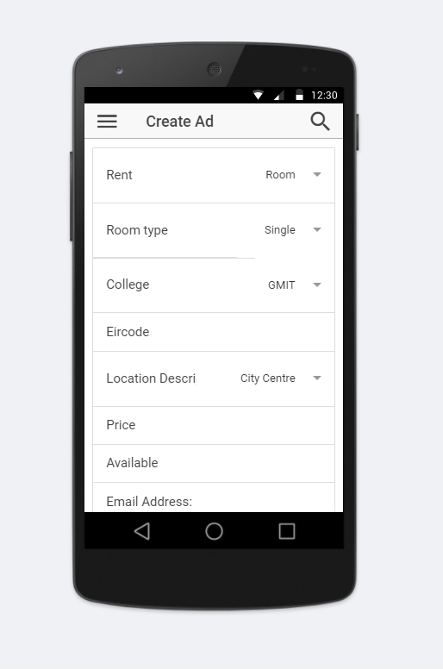
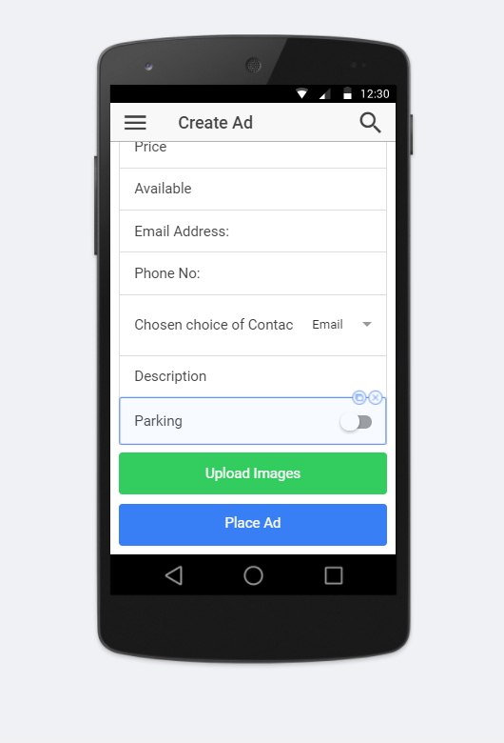
Design
My Ads
List of properties
Create add
Create add
Ad View
Notes:
We create this screenshots using ionic creator, before starting development to have clear idea of what we need.

Slide 7

GitHub Agile Weekly meetings
Project Plan
GitHub Wiki
09/2017
6/11/2017
12/2017
Read me
Hosting
03/2018
Submission
04/2018
Viva Voce Examination
Seminar Presentation
Github set up
Functional framework
Testing
16/04/2018
Report / Dissertation
Architecture Research
https://github.com/gerardnaughton7/4th-Year-Final-Year-Project
Notes:
We use the Agile methodology and having weekly meetings where we discuss our progress and plans.

Slide 8
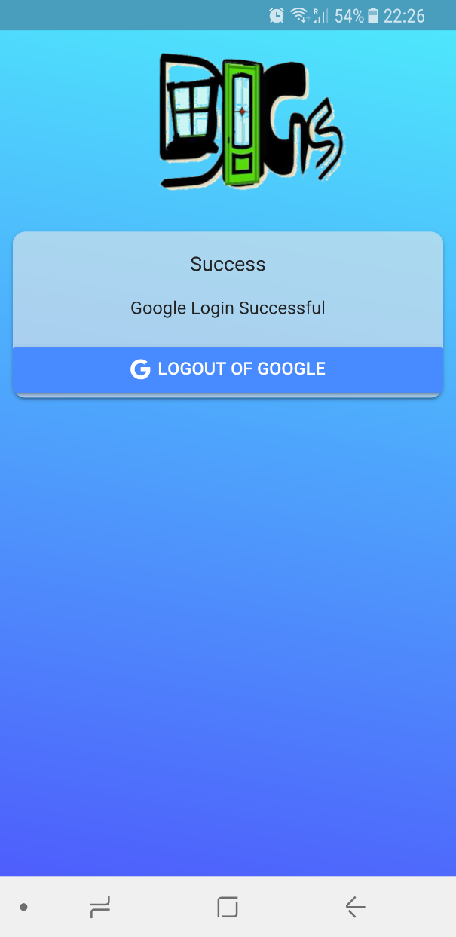
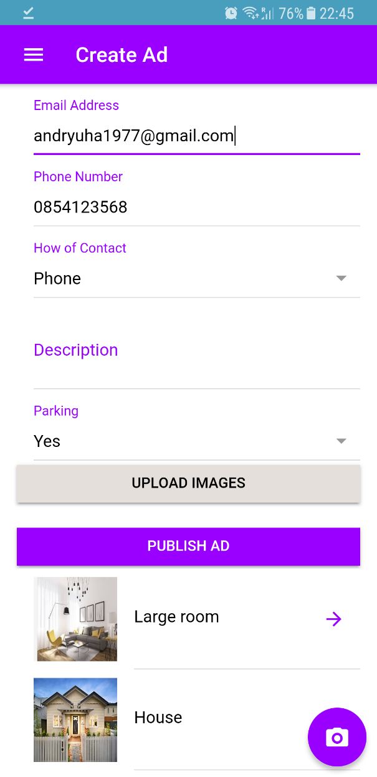
Where are we now ?
Set up and running Amazon server
Deployed back-end
Working image storing functionality
Front-end prototype

Slide 9


