Slide 1
NLP Week 2
Language Modeling
Spelling Correction

Slide 2
Spelling Correction Review
“Noisy Channel” model
relies on the observed error word itself
Bayesian model
P(actual | observed) ~ P(observed | actual) * P(actual)
Language Model
calculates probability of actual word given other words in sentence
uses n-grams, other context clues
Real spellcheckers use a combination of both

Slide 3
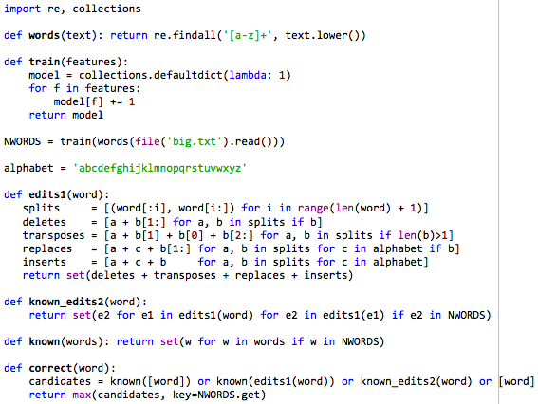
25-Line Autocorrect by Peter Norvig

Slide 4
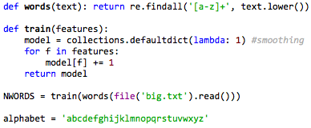
The Setup
tokenizer regular expression
default value for unknown word = 1
the alphabet
creates NWORDS dictionary

Slide 5
NWORDS
A dictionary of words found in the training text
training text is a collection of literary works
key = word
value = count
default value (for unknown words) = 1
In [7]: NWORDS['the']
Out[7]: 80031
In [8]: NWORDS['elephant']
Out[8]: 4
In [9]: NWORDS['asdfasdf']
Out[9]: 1

Slide 6
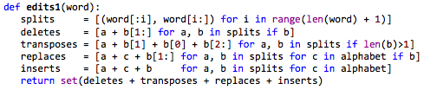
edits1(word) Function
returns set of all possible combinations of letters of edit distance 1 from the input word
using Damerau-Levenshtein edit distance (includes transposes)
counts each possible transform operation equally
returns all possible words, not just real words

Slide 7
edits1(words) Examples
In[11]: edits1('hello’)
Out[11]: ['iello', 'hellto', 'khello', 'hellmo', 'hyllo', 'helslo', 'hjllo', 'helvlo', 'hellro', 'helklo’, … ]
284 total combinations
In[12]: edits1('world’)
Out[12]: ['zworld', 'wuorld', 'wored', 'worjd', 'wqorld', 'woxrld', 'worlvd', 'worldz', 'wrold', 'wnorld’, … ]
286 total combinations

Slide 8
known(words) Function
given a set of words, returns only those that are found in the training text
In [17]: known({'teh', 'the', 'then', 'hte’})
Out[17]: {'the', 'then'}

Slide 9
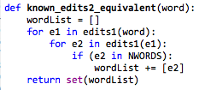
known_edits2(word) Function
returns all known words with edit distance 2 from the given word
equivalent code:

Slide 10
known_edits2(word) Example
In[21]: known_edits2('whisjer')
Out[21]: {'whiskers', 'whiskey', 'whisper', 'whispers', 'whiter', 'whither', 'wiser'}

Slide 11

correct(word) Function
Returns single best guess correction for a word
Returns the first of these sets with a valid result:
the word itself (if known)
a known word of edit distance 1 from the input
if more than one, returns that with the highest count in the training text
a known word of edit distance 2 from the input
if more than one, returns that with the highest count in the training text
the word itself, even if not known
This algorithm is party probabilistic, partly heuristic

Slide 12
correct(word) Examples
In[23]: correct('teh')
Out[23]: 'the’
In[24]: correct('whisjer')
Out[24]: 'whisper’
In[25]: correct('tej')
Out[25]: 'ten’
‘ten’ at 1 edit distance chosen over more frequent ‘the’ at 2 edit distance

Slide 13
Things this code doesn’t do
Correct known words used incorrectly
Account for proximity of keys on a keyboard
Account for sentence context
Use word or letter pronunciation in the error model

Slide 14
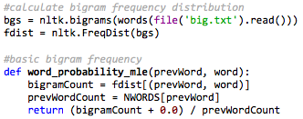
Adding Bigram Context
P(word | prevWord) = P(word & prevWord) / P(prevWord)

Slide 15

Adding Bigram Context
no change
conditional bigram frequency
creates a new one-argument
function for the max key

Slide 16
bigramCorrect() examples
In[144]: bigramCorrect('as', 'ij')
Out[144]: 'if’
In[145]: bigramCorrect('then', 'ij')
Out[145]: 'i’
In[146]: bigramCorrect('asdfasdf', 'elephatn')
Out[146]: 'elephant’
In[147]: bigramCorrect('then', 'asdfasdf')
Out[147]: 'asdfasdf'

